Slide 1
7-4.3
The Great Depression

Slide 5
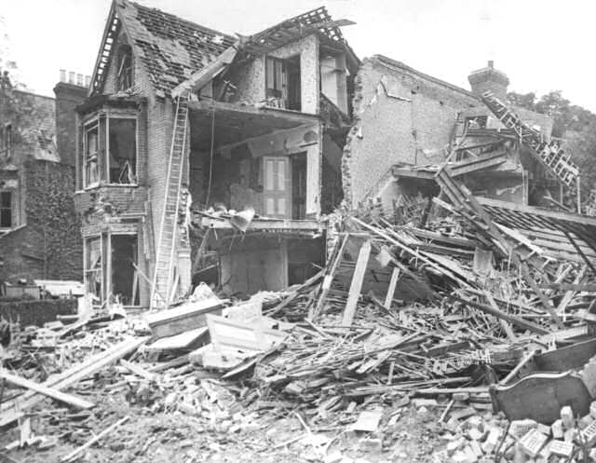
What was the Great Depression?
The Great Depression was an international collapse of the economy. The damages caused by World War I and the heavy monetary penalties imposed on Germany by the Treaty of Versailles, left Europe with some very serious economic problems. The reparations did not cover the expense of the Allied Countries to rebuild.

Slide 6
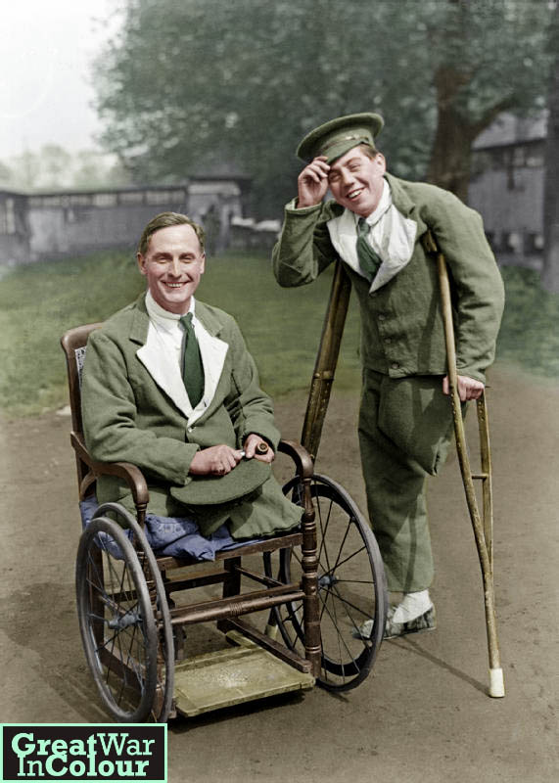
Why did unemployment rise?
Nations also experienced the transition of soldiers returning from the war looking for work or replacing workers who held their jobs during wartime. Wartime spending had stretched many nations financially, but employment had been high during the war. After the war unemployment skyrocketed.

Slide 7
Why was Germany’s Great Depression the worst?
Germany experienced the depression the worst because of the high reparations and the loss of some of its prime industrial land and resources. This hurt trade and production across Western Europe.
In 1923, France further sabotaged Germany’s ability to recover by seizing the Ruhr Valley (Germany’s main industrial region). Germany’s response was to begin printing money that had no economic support, causing hyperinflation and the devaluing of money across the continent.

Slide 8
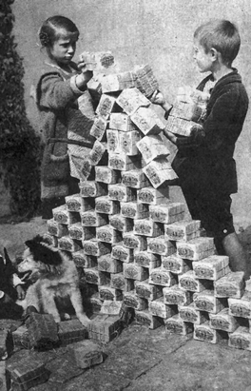
Hyperinflation in Germany
December 1918 | 0.5
December 1921 | 4
December 1922 | 163
January 1923 | 250
March 1923 | 463
June 1923 | 1,465
July 1923 | 3,465
August 1923 | 69,000
September 1923 | 1,512,000
October 1923 | 1,743,000,000
November 1923 | 201,000,000,000
The price of bread in Germany during hyperinflation

Slide 9
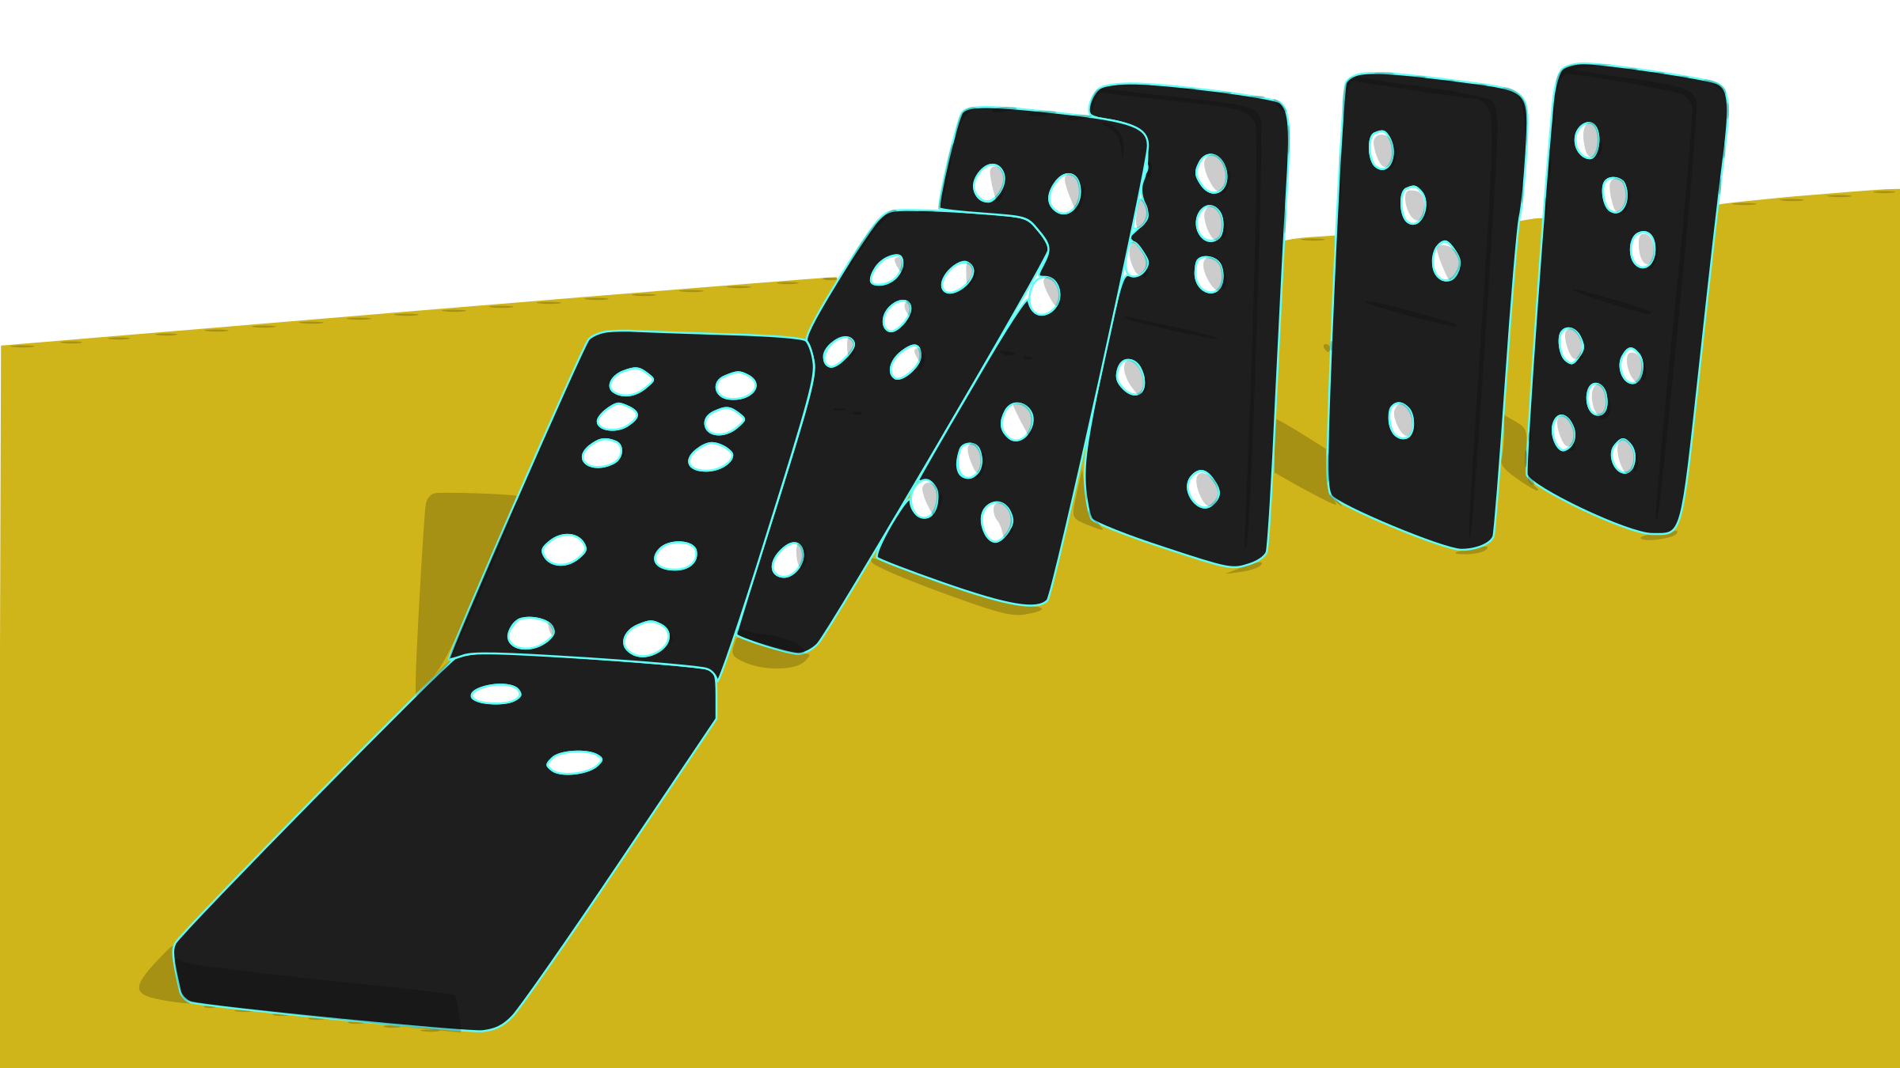
How did this affect the economy?
Because of all these financial difficulties and the necessity to rebuild, European nations were not buying and investing in foreign goods, including goods from the United States.

Slide 10
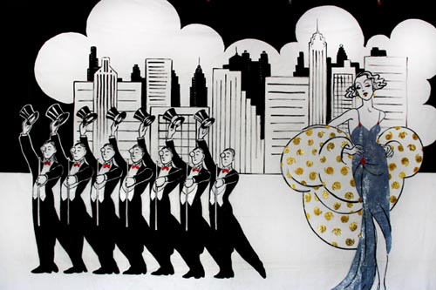
Roaring Twenties
Despite economic problems in Europe, the U.S. experienced an artificial boom in the 1920s. American companies continued producing goods at the high volume they had achieved during wartime to which they were accustomed expecting the trade to continue.

Slide 11
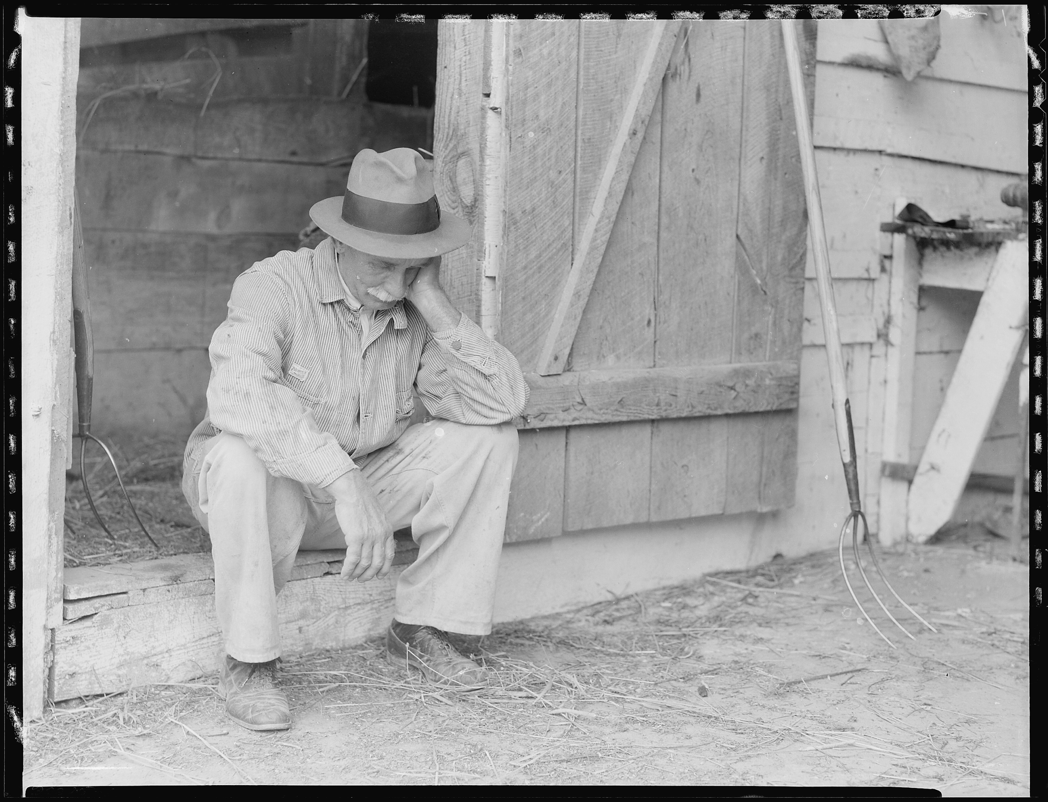
What happened with the farmers?
American farmers, who had fed the Allied armies and the people of Europe during the war, no longer had the European market and were in a depression throughout the 1920s. The wages of industrial workers remained low.

Slide 12
Dust Bowl

Slide 13
Stock Market

Slide 14
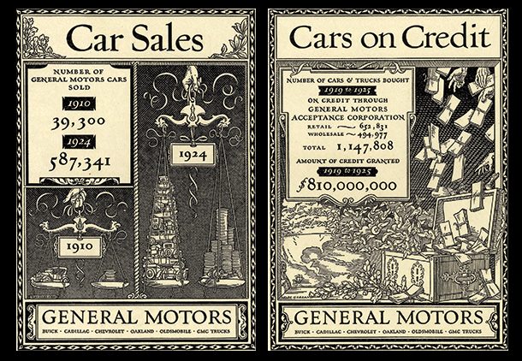
How did Americans buy goods?
For a while, American consumers were able to buy goods on an installment plan (or credit), but by the end of the 1920s most were reaching the extent of their buying power.

Slide 16
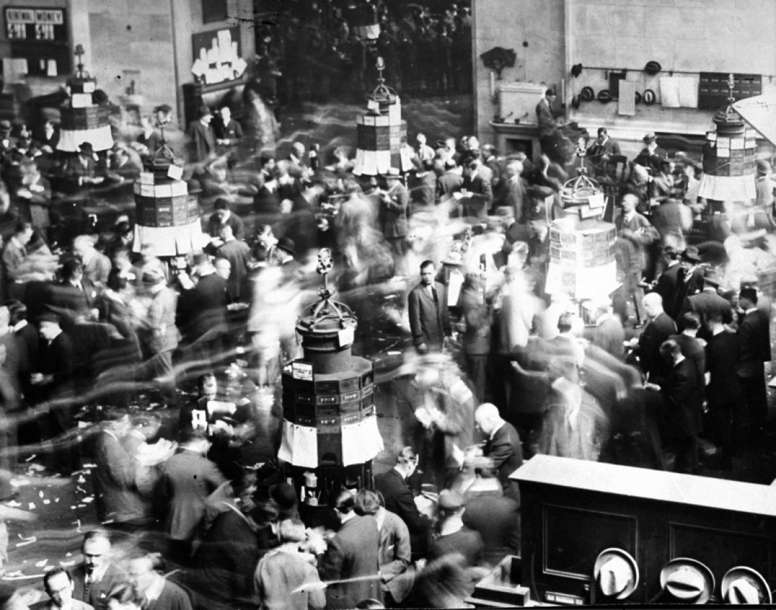
How did Americans buy stocks?
Many Americans during the 1920s also increasingly bought stock in U.S. companies. These stocks were often bought on credit (on margin), but the investments were risky because they relied on further business growth.

Slide 17
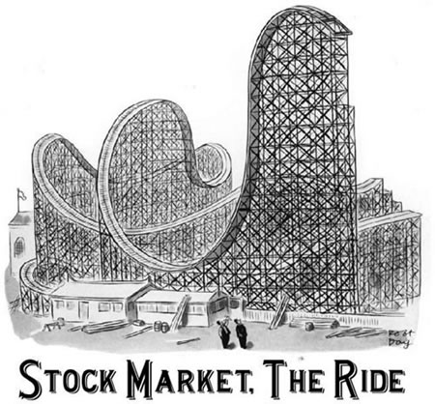
What was the effect of buying ‘on margin’?
The increase in buying stock on margin led to stock values rising quickly, making it appear as though money was there to be easily made and enticing even more investors.

Slide 18
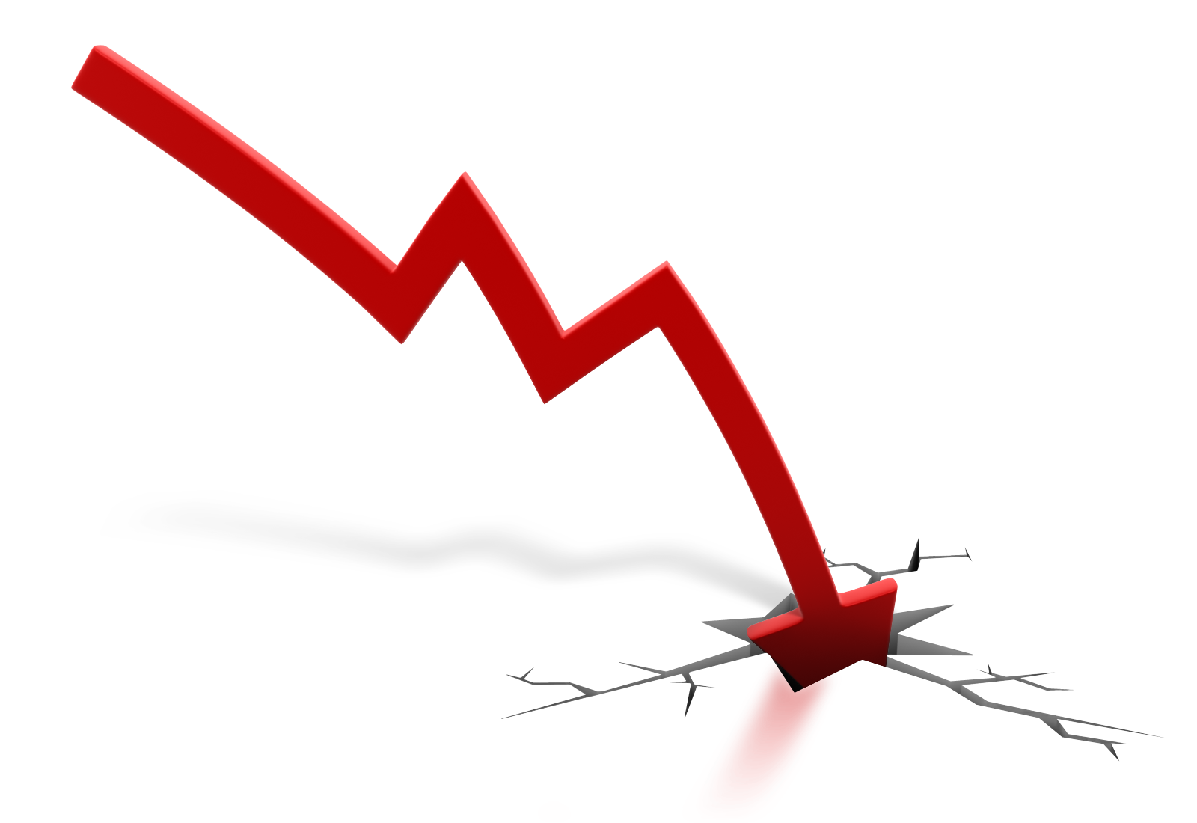
What was the effect of investors selling?
As people stopped buying, companies started to experience surpluses of goods. Investors began to try to sell off their stock and stock prices quickly declined. Creditors began demanding payments for the stocks bought on margin, but the investors didn’t have the money. Investors intensified the selling off of stocks and emptied their bank accounts to pay off debts. All of these events led to the Stock Market Crash.

Slide 19
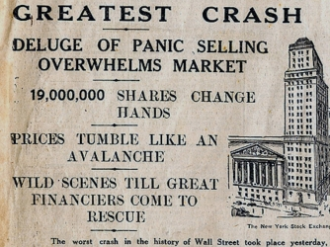
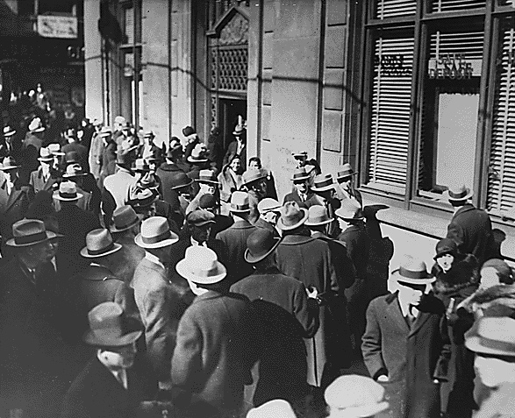
Black Tuesday
On October 29, 1929, known as Black Tuesday, the Stock Market crashed. Companies were forced to lay off workers and unemployment rose (this led to less spending and even more surplus). More people went to the banks to withdraw all their money, but the banks had loaned out much of the money. When so many people were making “runs on the banks” the savings were wiped out. To try to recover their loans, banks demanded full payment and so people lost their homes or other collateral.

Slide 21
Yee Haw Game!

Slide 22
Effects of the Great Depression

Slide 23
Bread Lines

Slide 25
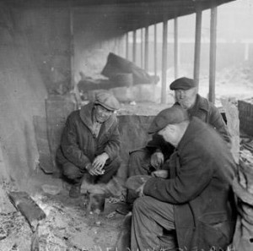
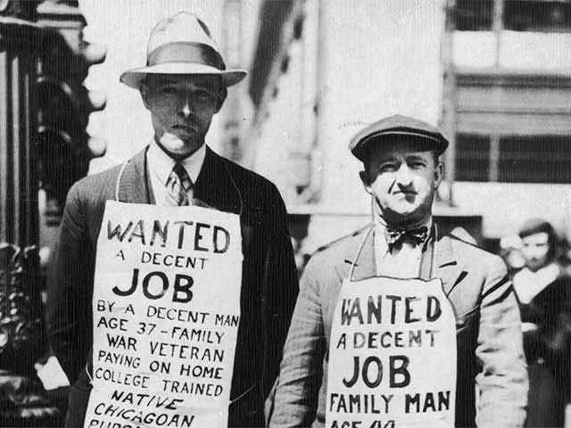
What was the effect of the depression?
Unemployment and homelessness continued to increase, banks and businesses closed, and the economic depression of the U.S. made the worldwide depression worse.

Slide 26
How did the US collapse effect Europe?
The U.S. had been serving as a creditor of European nations and therefore the European economy was linked heavily to the United States. Many nations trying to rebuild after WWI borrowed money from the U.S. to do so, especially Germany who had to make reparations as well as rebuild. As the U.S. economy worsened, U.S. creditors began to call in their loans to European nations. They also stopped making investments to other markets in Africa, Asia and South America, so those countries suffered too.

Slide 27
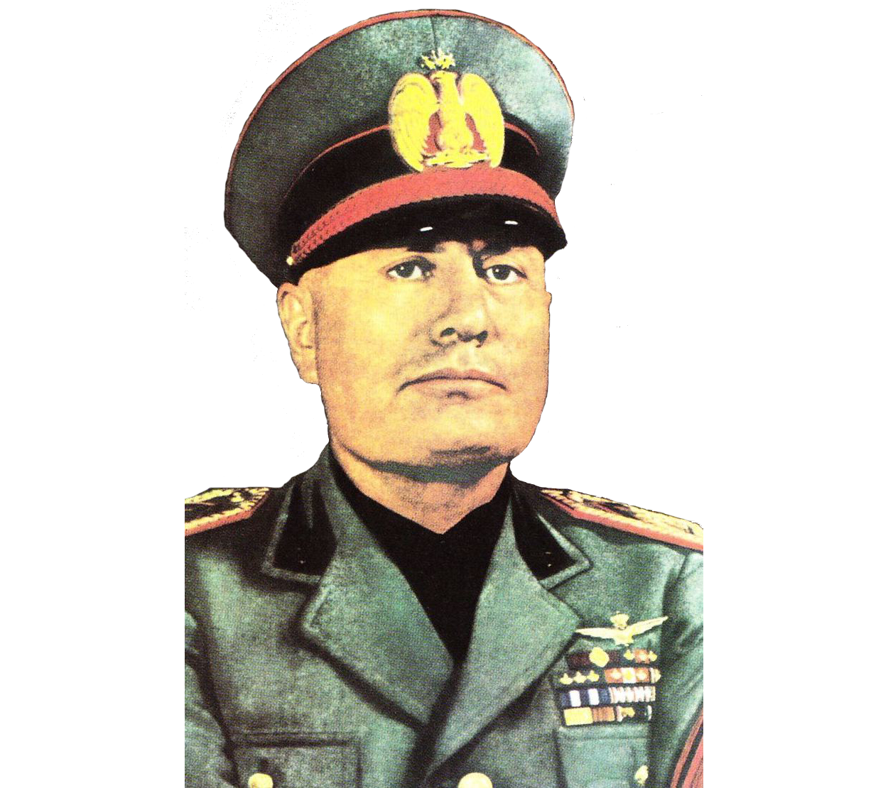
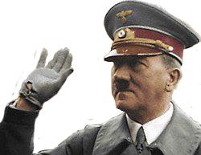
What resulted from the poor economy?
The poor economy gave rise to totalitarian governments. The reaction of most nations was to return to the policy of isolationism and focus on solving their own economic problems.

Slide 28
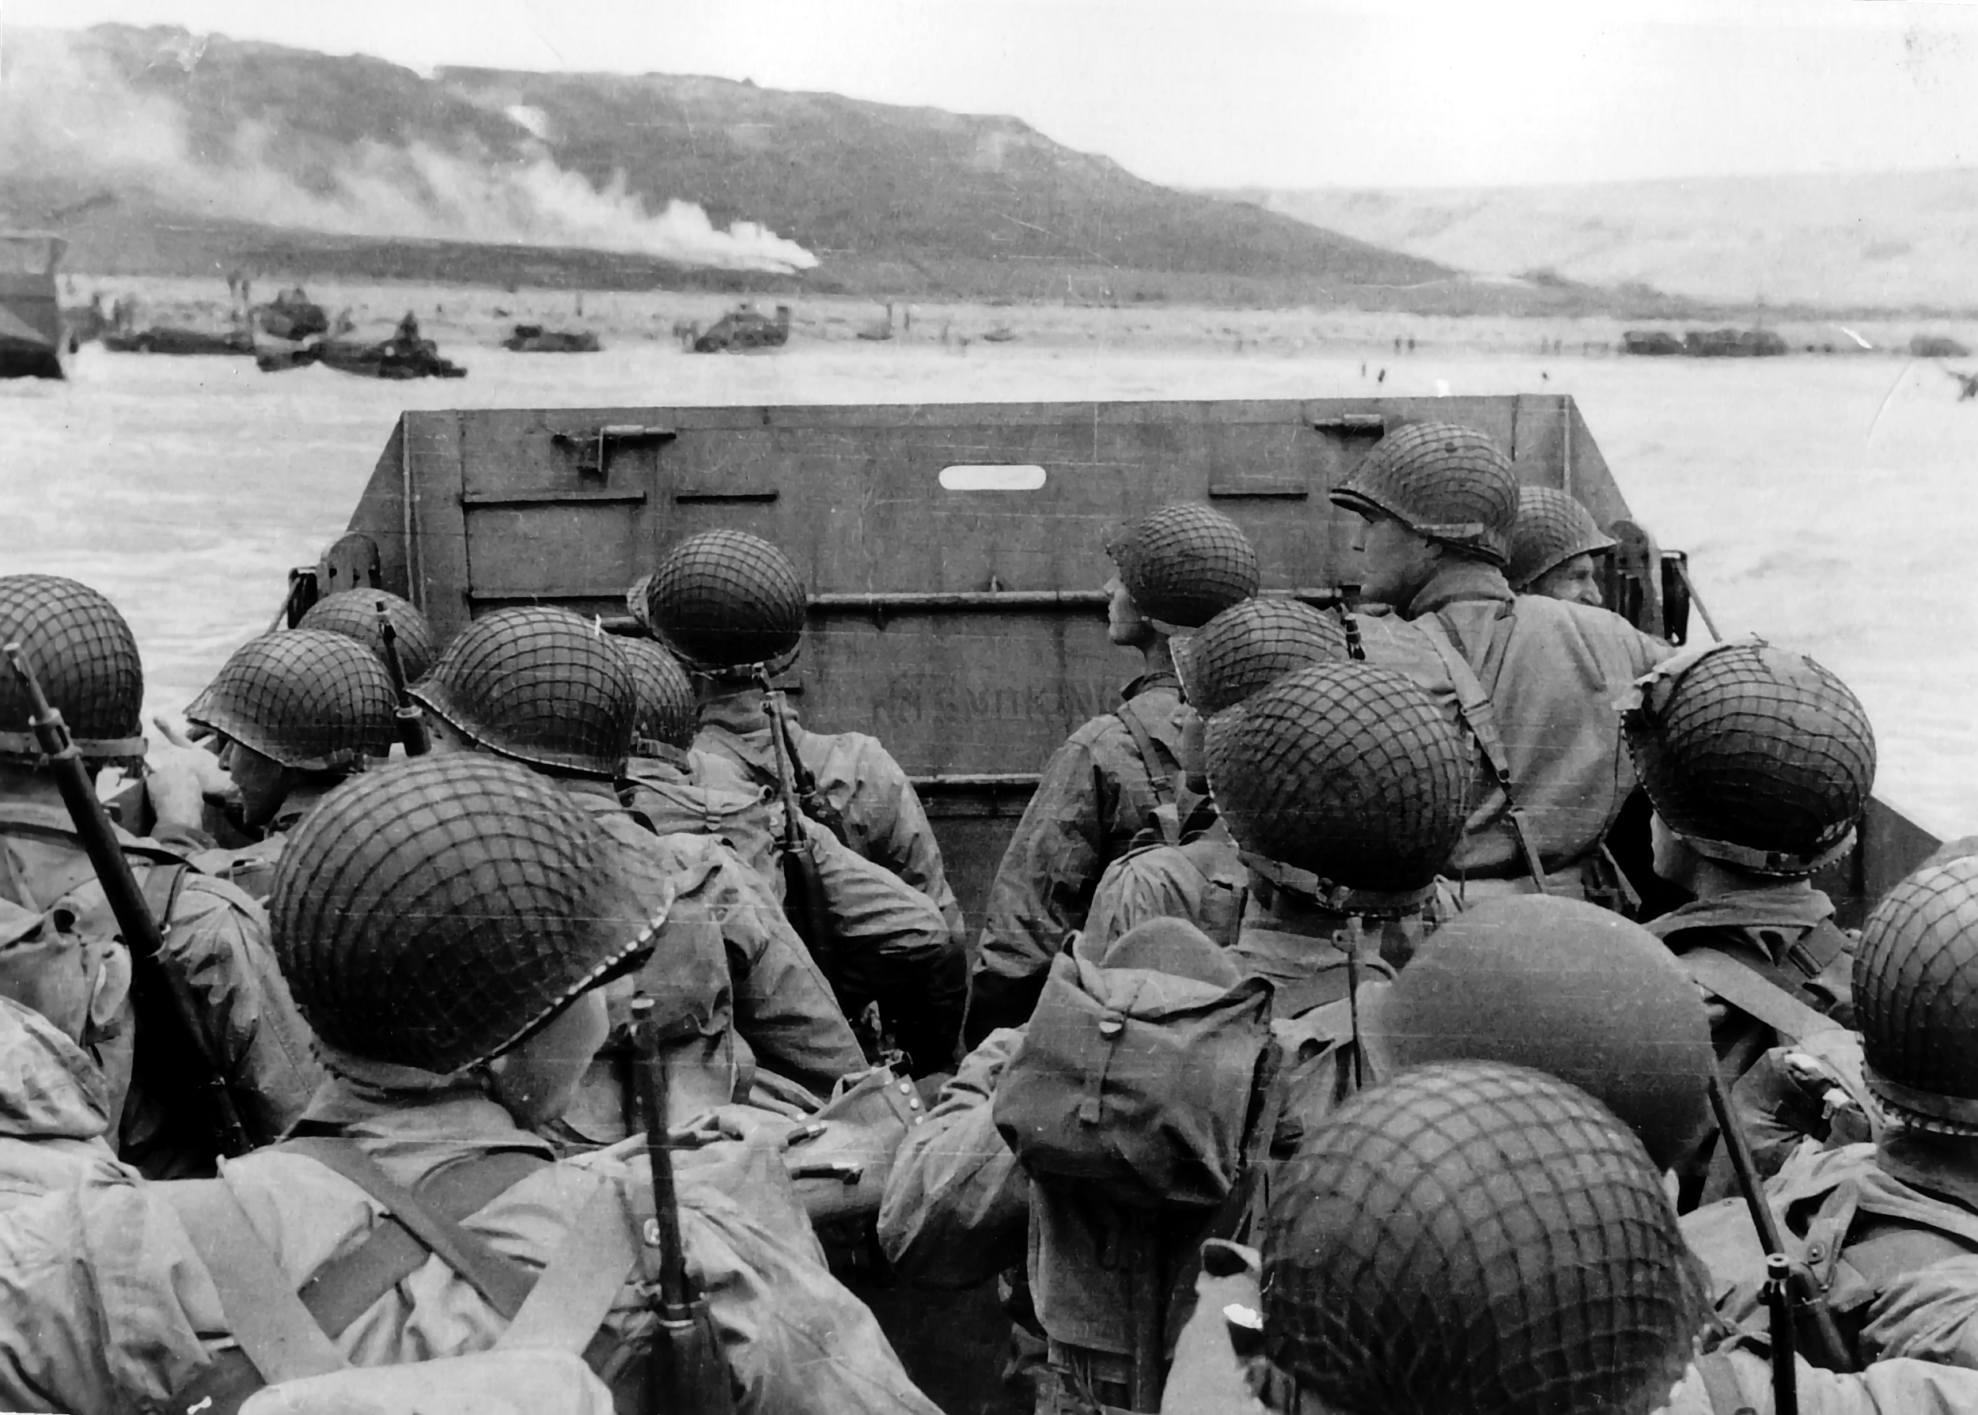
How did nations respond?
In democratic nations, the governments worked to improve the economy through passing laws, but the nations that turned to totalitarianism used imperialism to gain raw materials and markets to help stimulate the economy. World War II was on the horizon.

Slide 29
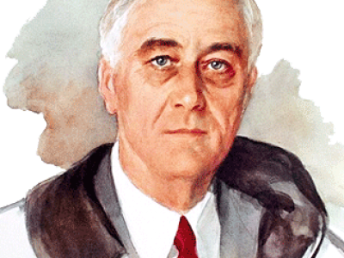
The New Deal
The U.S. responded by electing Franklin Delano Roosevelt (FDR) president over Herbert Hoover in 1932. FDR proposed and Congress approved a series of programs that he called the “New Deal.”

Slide 30
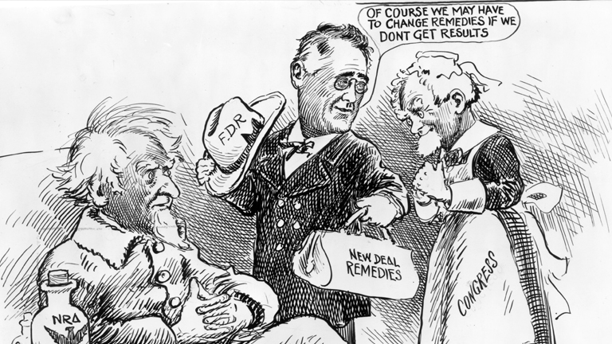
What was the New Deal?
The New Deal focused on relief and reform in the form of public works programs. These programs were designed to increase employment and regulate the stock market, banks, and business and agricultural production.

Slide 31
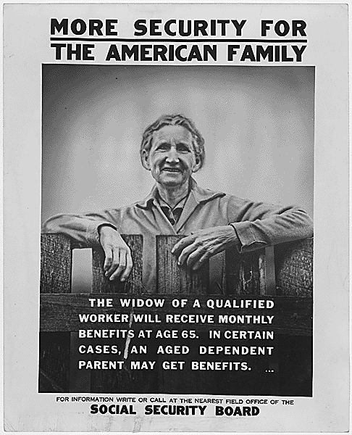
How did the New Deal change the economy?
The New Deal greatly enhanced the national government’s role in the economy and in the lives of individuals. For the first time in U.S. history, direct relief provided by the government was a significant component to everyday life.

Slide 32
Fireside Chats

Slide 33
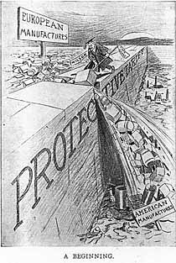
How did Britain respond?
Great Britain on the other hand, enacted protectionist policies (designed to protect domestic industries and services from foreign competition) such as dropping the gold standard and increased government ownership and management of key industries. Britain also raised taxes to loan money to new businesses in the hope of creating employment.

Slide 34
How did Germany respond?
In Germany, the depression provided the opportunity for radical groups to participate in the political process (usual for democratic nations in times of hardship). This gave rise to the Nazi Party in Germany.
Hitler was able to take advantage of economic anxiety, political discontent, and the parliamentary structure of the German government to become the German chancellor in 1933. He then eliminated political opponents, consolidated power, and established total control over Germany. He renounced the Treaty of Versailles and gained popularity of the people.

Slide 35
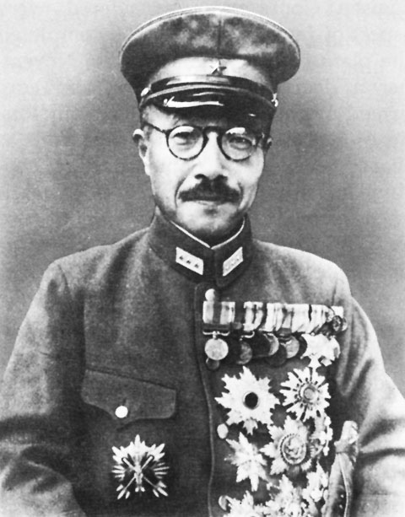
How did Italy and Japan respond?
In Italy, the economic depression allowed Benito Mussolini to gain similar control over Italy. Japan also turned to a totalitarian government. Germany, Italy, and Japan used the economic depression to justify the takeover of other nations in order to help improve their own economies.

