Slide 1
Totalitarian
Governments
7-4.4

Slide 2
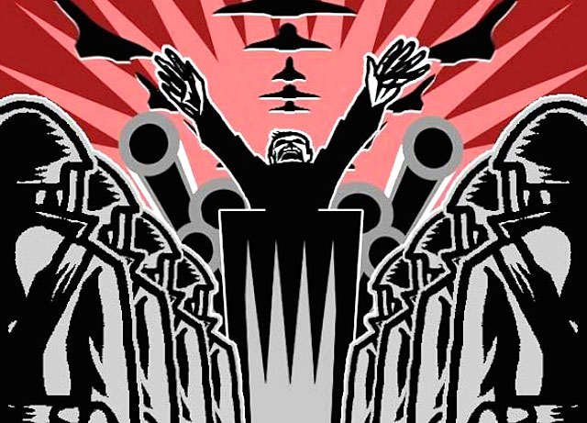
Soviet Union

Slide 3
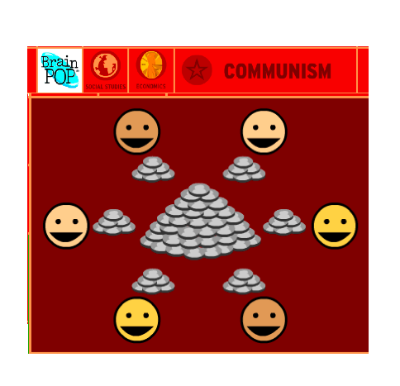
Lesson Set: Soviet Union
Watch the Brain Pop video to understand the system the Soviets instituted in Russia in 1917.
Click play to get the video.

Slide 4
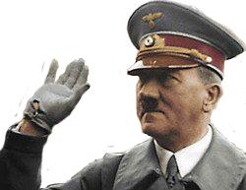
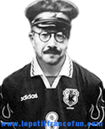
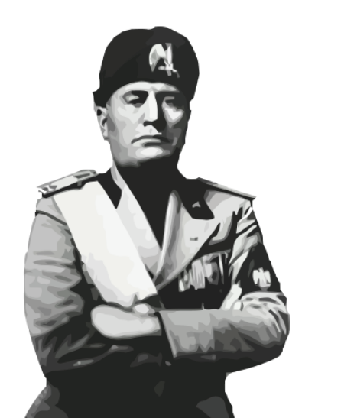
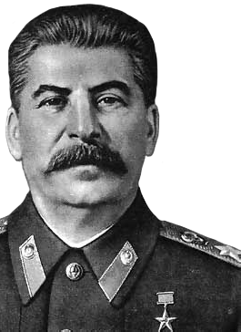
What led to Totalitarian Govts?
Problems in Germany, Italy, Japan, and the Soviet Union after World War I led to the establishment of totalitarian governments (government that has absolute power over citizens).

Slide 5
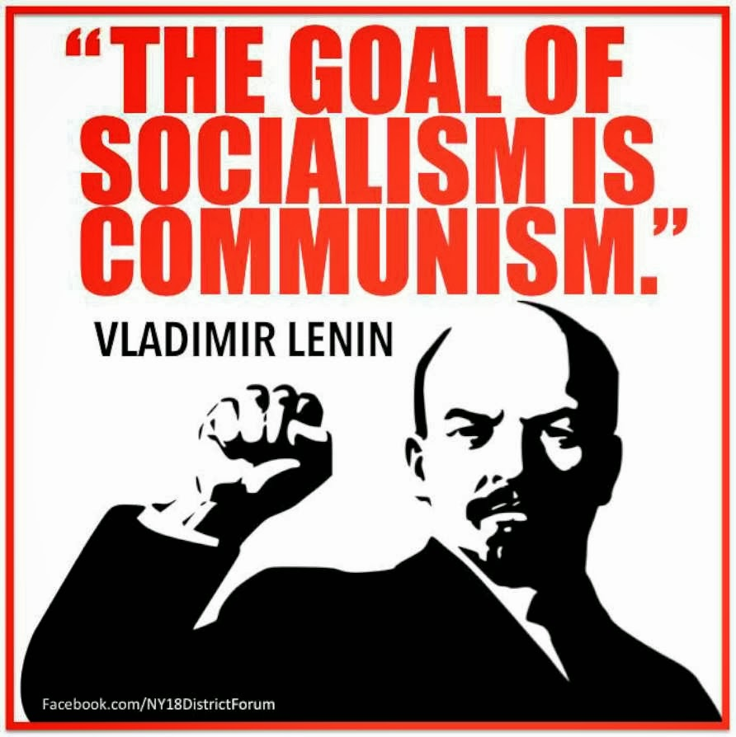
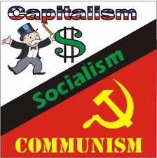
What were the main ideologies of the USSR?
Socialism and Communism were the main ideologies of the Soviet Union.

Slide 6
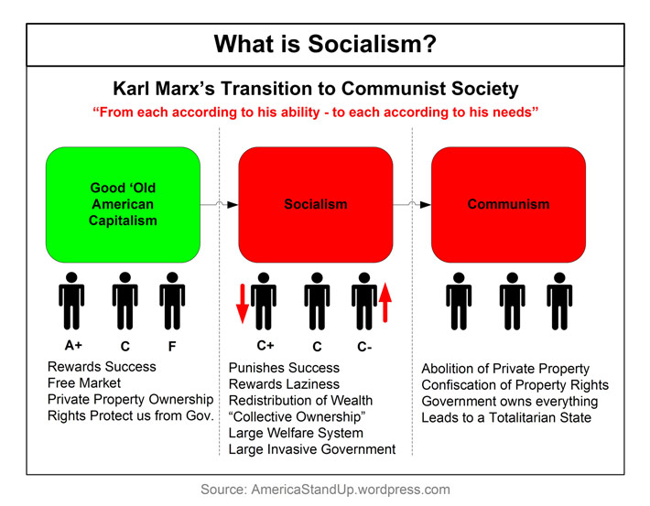
Example of Socialism & Communism:

Slide 7
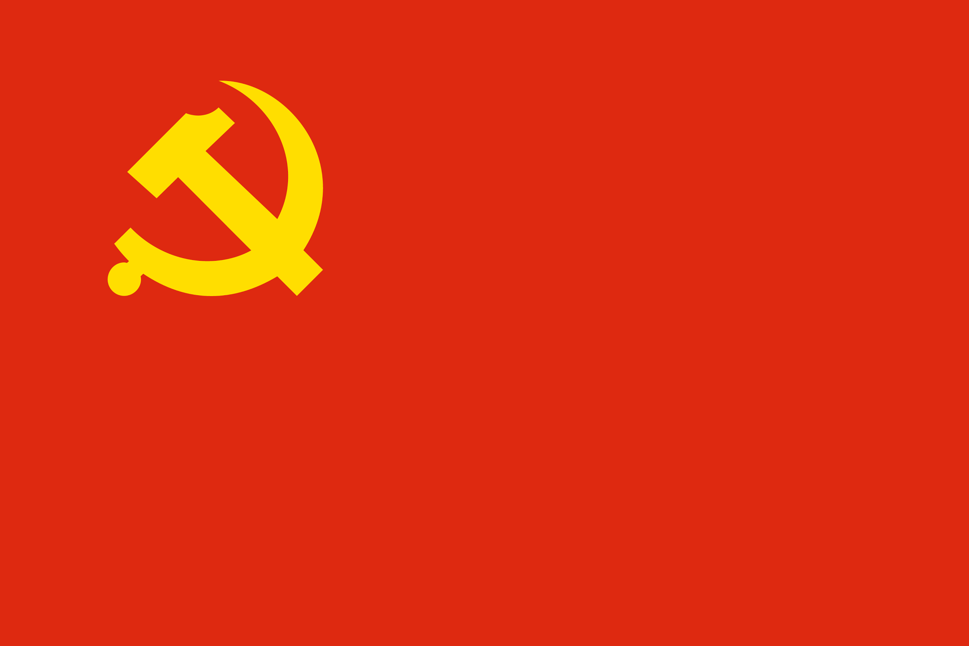
Communism Ideology:
Decrease the wealth and power of industrial capitalists
Industry, production, and business controlled by the whole society
Empower the proletariat (working class)
Soviet Union:
Land is arranged in communes
Ends Religion
Wealth is evenly distributed to citizens
Collectivization or owning property as a group becomes the focus
Competition and private property is abolished
Notes:
This slide’s format is very different than the format in their guided notest (it is done to show the centralization of communism). The following slide mirrors their guided notes, if they struggle to copy from this slide.

Slide 8
In case you didn’t get that last slide...
Communism
· Empower the proletariat (working class)
· Decrease the wealth and power of industrial capitalists
· Industry, production, and business controlled by the whole society
· Wealth is evenly distributed to citizens
· Competition and private property is abolished
· Collectivization or owning property as a group becomes the focus
· Land is arranged in communes
· Ends religion

Slide 9
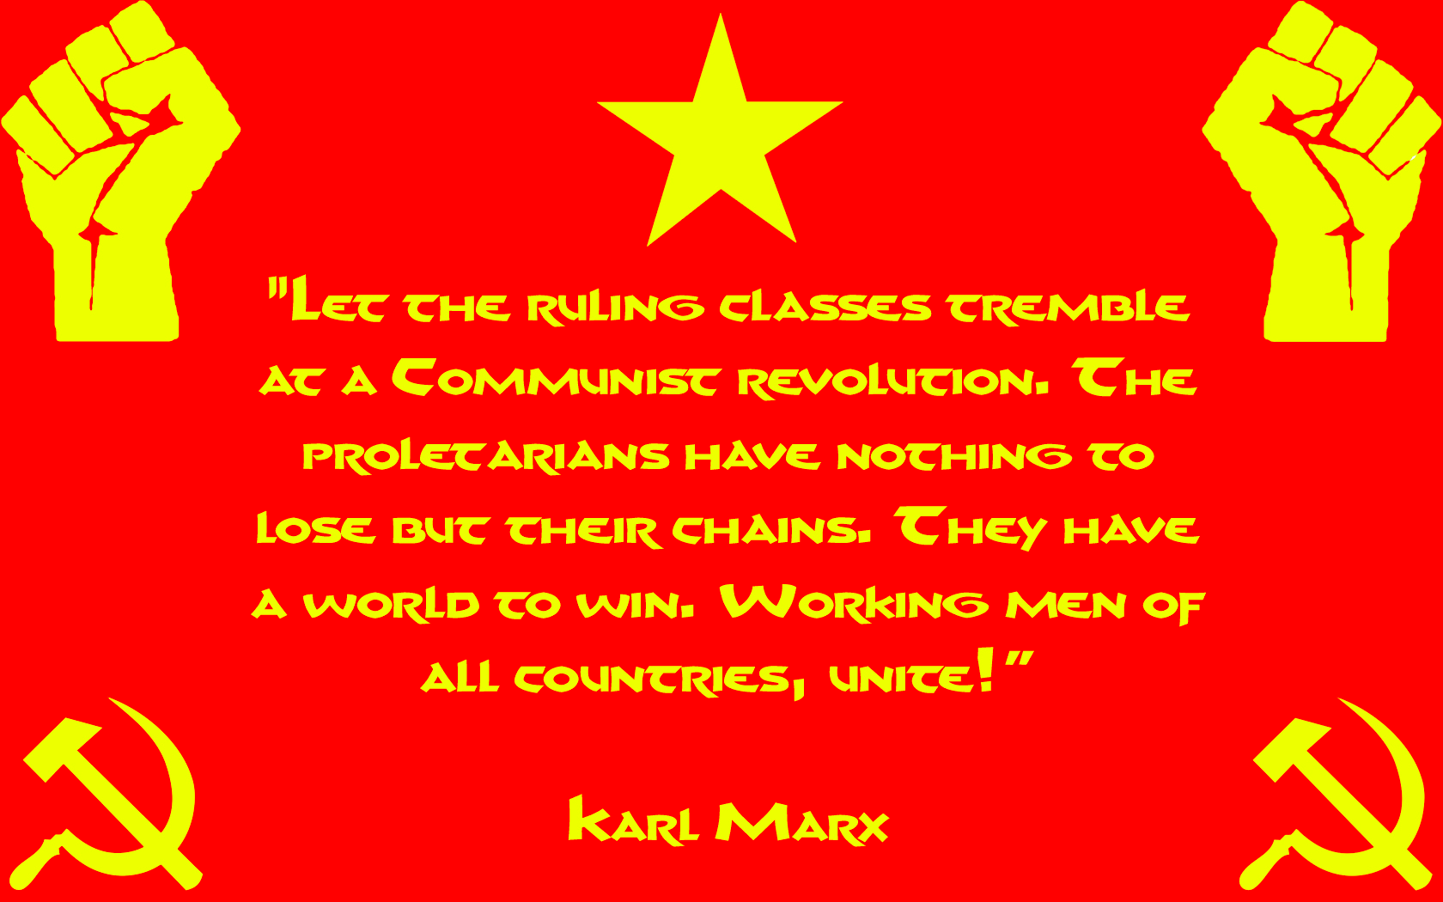
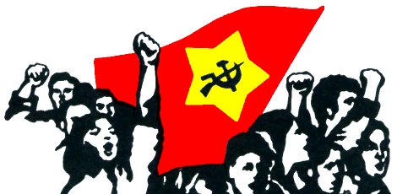
How did they switch to Communism?
For these changes to take place, communism calls for the overthrow of democratic and capitalist ideas by the working class and the institution of a government that oversees the establishment of these ideas.

Slide 10
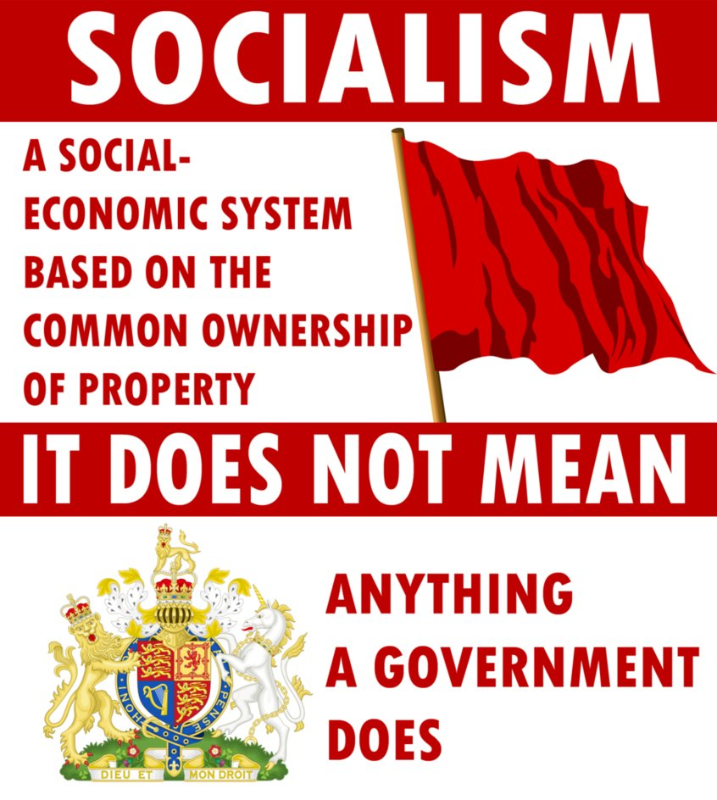
What is Socialism?
Socialism is based on the economic principles of Communism and not on the ideas of violent revolution. Therefore, the primary focus of socialist is creating an economic system where the working classes could share in the wealth generated by industry, and society (represented by the government) would control the means of production

Slide 11
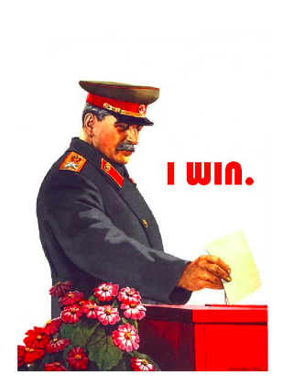
Who is Joseph Stalin?
Joseph Stalin used these ideas to strengthen his rule. He became leader of the Soviet Union in 1928 after having been General Secretary of the Communist Party. After Lenin’s death in 1922, Stalin gained support of his fellow Communist members and exiled Leon Trotsky, his biggest rival.

Slide 12
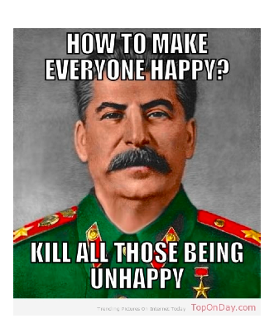
How did he establish his power?
He created a totalitarian state and made the country an industrial power. He had a secret police force monitor everything said and written, censored all sources of information, and used propaganda to maintain his power.

Slide 13
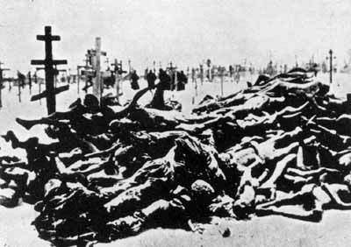
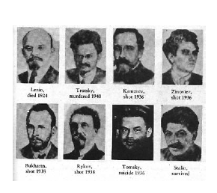
What did he do in the USSR?
During the Great Purge, Stalin terrorized members of his own Communist Party whom he thought were a threat to his power. He persecuted religions and implemented a command economy. He ordered several Five-Year Plans, which focused on heavy industrialization. Industrial production increased dramatically, but there were shortages of light, consumer goods.

Slide 14
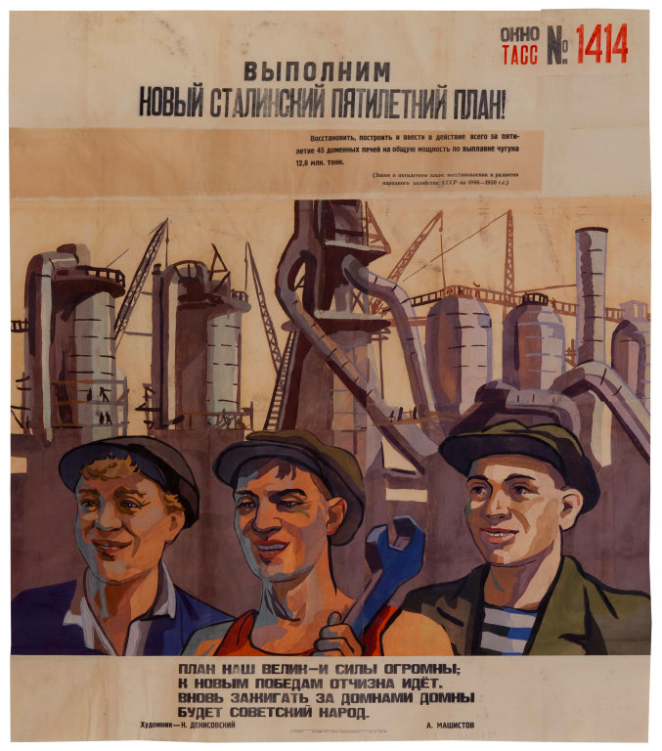
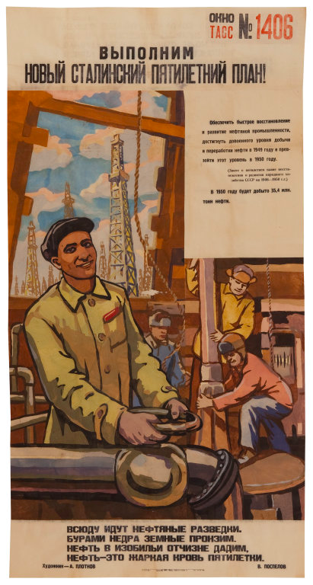
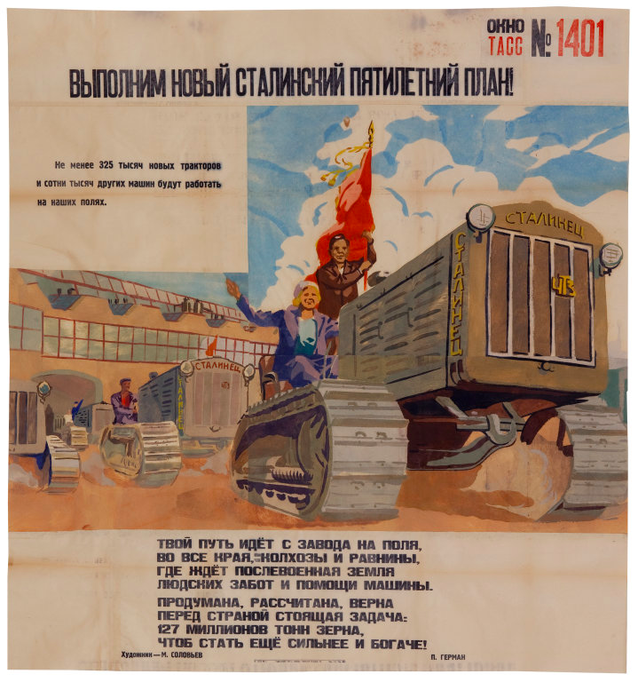
Five Year Plan Propaganda Posters
“Let Us Fulfill Stalin’s Five Year Plans”
Notes:
First Poster Text: Within the next five years we must restore, build and place on line 45 blast furnaces with a total capacity for smelting 12.8 million tons of iron.
(The law concerning the five-year plan for the recovery and development of the economy of the USSR in 1946-1950)
Our plan is great and our powers huge;
The fatherland goes to new victories.
Again the Soviet people will kindle
Blast furnace after blast furnace.
Second Poster Text: We must achieve the rapid recovery and development of the oil industry, return to pre-war levels in the extraction and refining of oil by 1949 and surpass these levels in 1950.
(The law concerning the five-year plan for the recovery and development of the economy of the USSR in 1946-1950)
In 1950, 35.4 million tons of oil will be extracted.
Oil probes are going everywhere.
The earth's depths are being pierced.
We will give the fatherland abundant oil.
Oil is the hot blood of the five-year plan.
Third Poster Text:
At least 235,000 new tractors and hundreds of thousands of other machines will work in our fields.
[The tractor’s nameplate reads: “The Stalinist”]
Your path goes from the factory to the fields,
To all regions, collective farms and plains
Where the postwar land awaits
Human care and the help of machines.
The task before our country
Is well-considered, calculated and true:
127 million tons of grain
In order to become even stronger and richer.
More Information Can be found at: http://www.artic.edu/aic/collections/exhibitions/TASS/artwork/206164

Slide 15
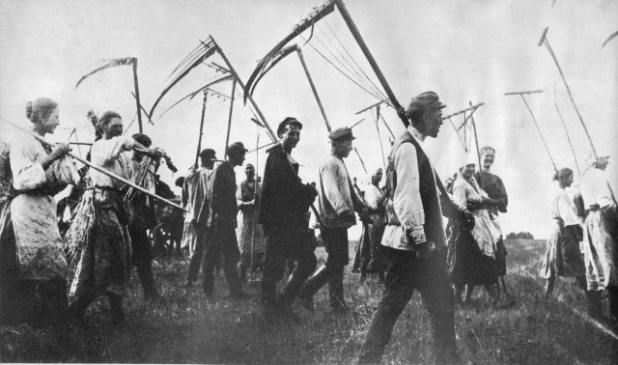
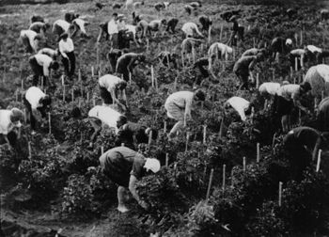
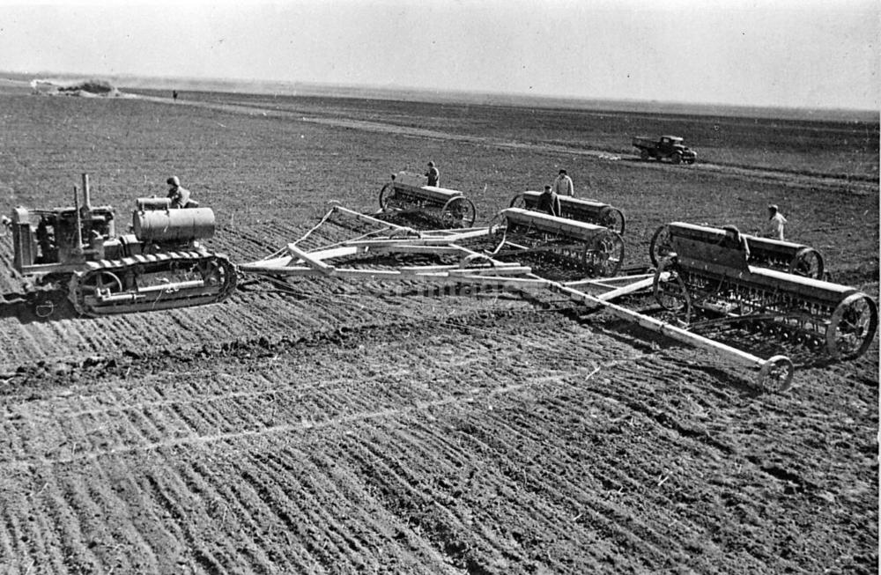
What is Collectivization?
He also began a policy of collectivization in the country, where he confiscated all farms and combined them into huge government-controlled farms to increase food production. Agricultural production increased, but many wealthy peasants (kulaks) protested and were killed.

Slide 16
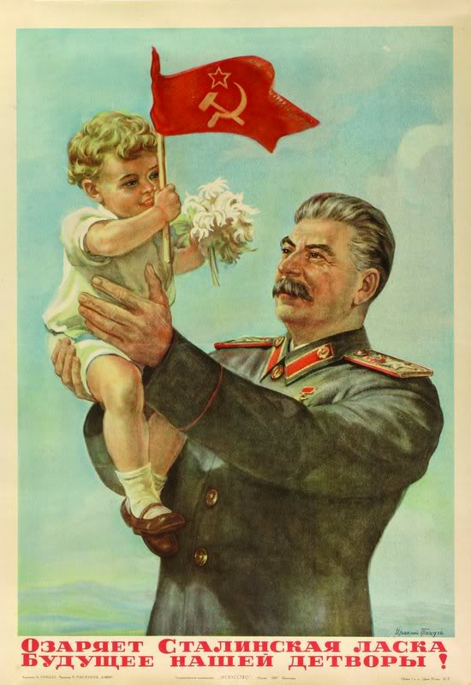
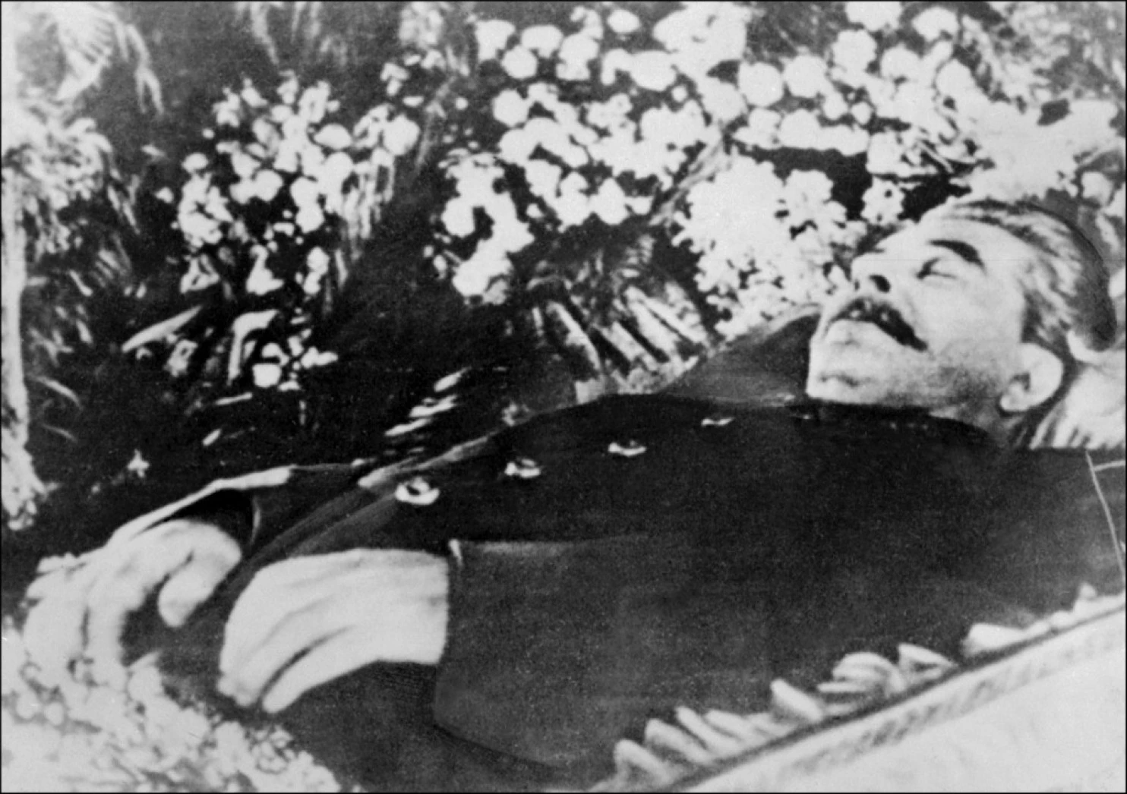
What is Stalin’s impact?
Stalin had improved education and the economy, but people had no political rights.

Slide 17
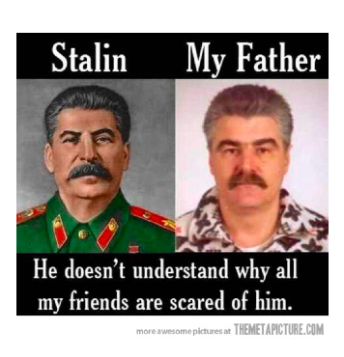
Stalin Joke of the Day:
*Note: This is not my Actual Dad.

Slide 18
Your Assignment: Stalin Wanted Poster
Create a “Wanted” Poster for Stalin that includes the following information:

Slide 19
Italy

Slide 20
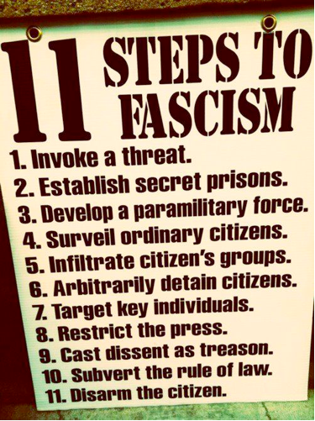
What is Fascism?
Fascism became popular in Italy and Germany because people blamed the democratic governments in the two countries for the problems that existed after WWI. Fascism was the political movement that emphasized an extreme form of nationalism and power to the state. Fascist governments denied people their individual liberties and were led by authoritarian leaders.

Slide 21
Comparison....Ironically they hate each other

Slide 22
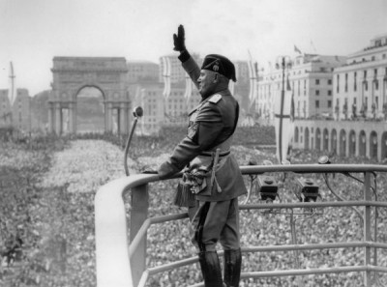
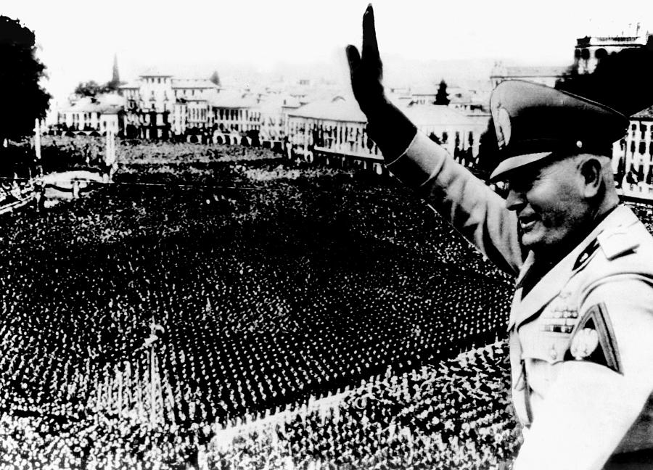
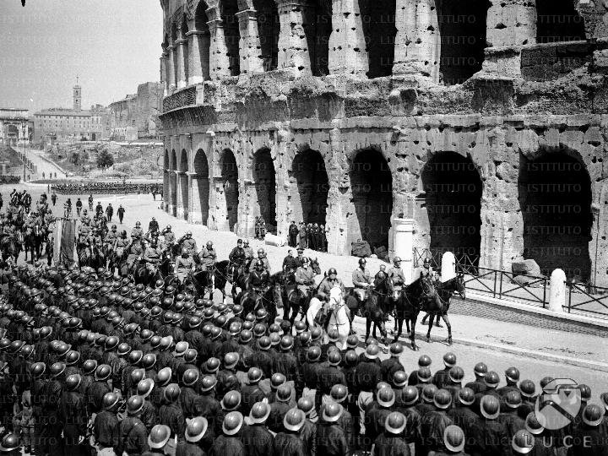
How did Fascist Leaders Rule?
Fascist leaders used various methods to create unity and consolidate their power, like special salutes, military steps, emblems, rallies and military parades and elite military groups.

Slide 23
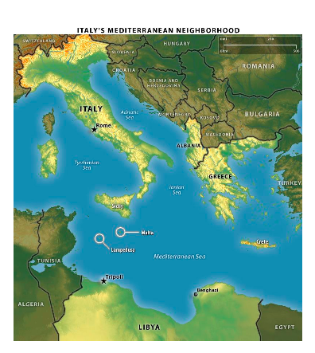
Why was Italy unhappy?
Italy was unhappy because the Treaty of Versailles had not given them a large amount of land. Benito Mussolini was able to use their unhappiness to gain power by founding the Fascist Party in 1919.

Slide 24
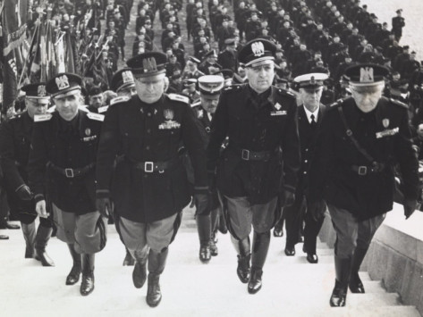
Why was Italy unhappy?
He formed a group of supporters called the Black Shirts, who started to attack Communists. Mussolini promised to strengthen the economy which allowed him to gain the support of the middle class. He seized power in 1922 when the Fascists marched on Rome and removed King Emmanuel from power.
Remember: Fascists are extreme Nationalists...Black Shirts is a play on the historical Red Shirts of Garibaldi & the elite Italian troops in WWI.

Slide 25
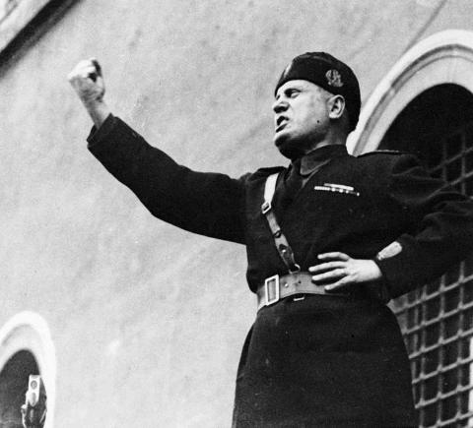
How did Mussolini maintain power?
Mussolini was given the title of “il Duce” or The Leader. He set up a Fascist dictatorship and used secret police and censorship to maintain his power. He increased the military and used it to invade Ethiopia in 1935 & 1937 to increase their territory.

Slide 26
Germany

Slide 27
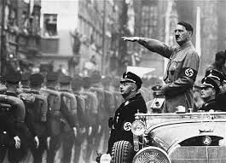
What is Nazism?
Nazism, which was based on Fascism, began in Germany. All of the political and economic dissatisfaction of the people allowed Adolf Hitler (who promised to restore the country to its former glory) to take power.
The full name for the Nazi party was: Nationalsozialistische Deutsche Arbeiterpartei

Slide 28
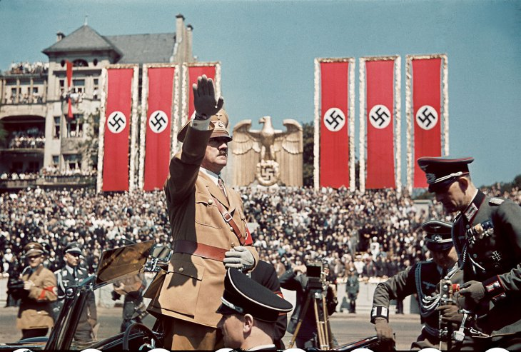
How did the Nazis rule?
Hitler helped form the National Social German Workers or the Nazi Party and like the Italian Fascists, they used mass rallies, special salutes, and special troops called the Brown Shirts. Their special symbol was the swastika.
More info on the Swastika: http://www.ushmm.org/wlc/en/article.php?ModuleId=10007453

Slide 29
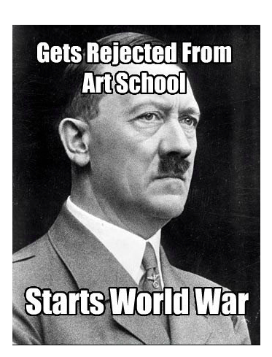
What happened when Hitler tried to gain power?
In 1923, Hitler and the Nazis attempted to overthrow the Weimer Republic (the democratic government set up after WWI) but failed. He was jailed and wrote Mein Kampf (My Life), which outlined his goals for Germany.

Slide 30
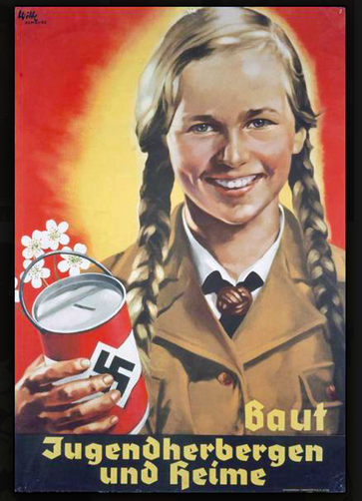
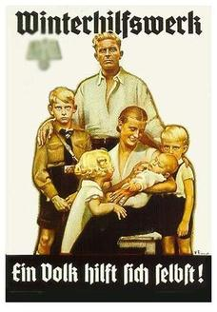
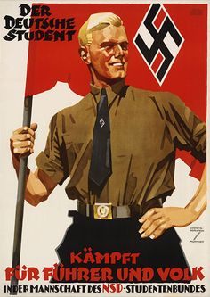
What was Hitler’s philosophy?
Hitler claimed that the Germans, who he called “Aryans” were the “master race” and blamed others (mostly minority groups and other countries) for Germany’s problems. Mein Kampf includes his hatred for the Jews, his desire to regain German territory and unite all German-speaking people.

Slide 31
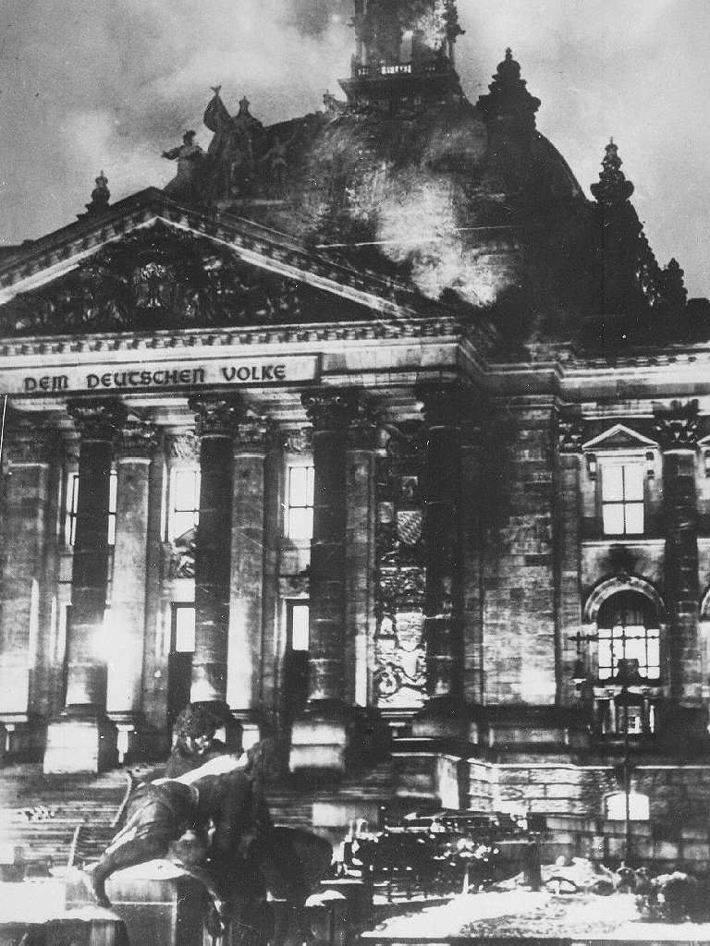
How did Hitler Gain power?
As the Depression grew worse in Germany, the Nazi Party became the largest political party. President Paul von Hindenburg appointed Hitler chancellor. He then gained control of the new government and created a totalitarian state by establishing a secret police called the Gestapo, outlawing other parties, imprisoning political opponents, using censorship and propaganda, banning unions and controlling the economy.

Slide 32
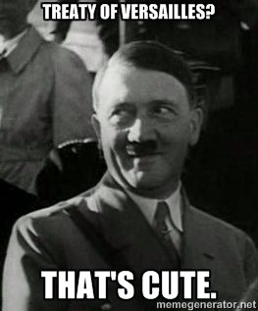
How did Hitler break the Treaty of Versailles?
Known as the Fuhrer (leader) he ignored the stipulations of the Treaty of Versailles and began to rebuild the German military. He moved troops into the Rhineland in 1936, took over Austria in 1938, took over the Sudetenland in 1938, and claimed Czechoslovakia in 1939.

Slide 33
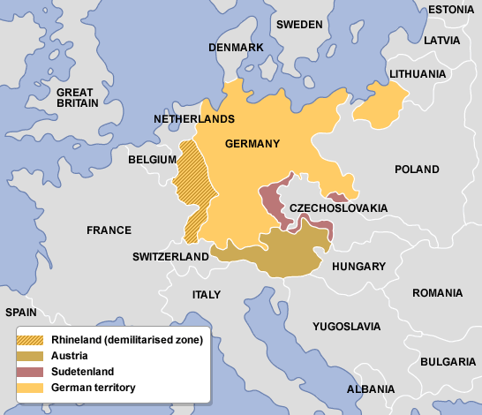
Hitler’s Start to Territorial Expansion

Slide 34
Japan

Slide 35
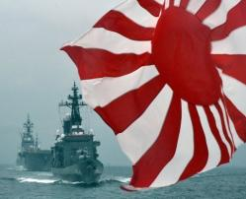
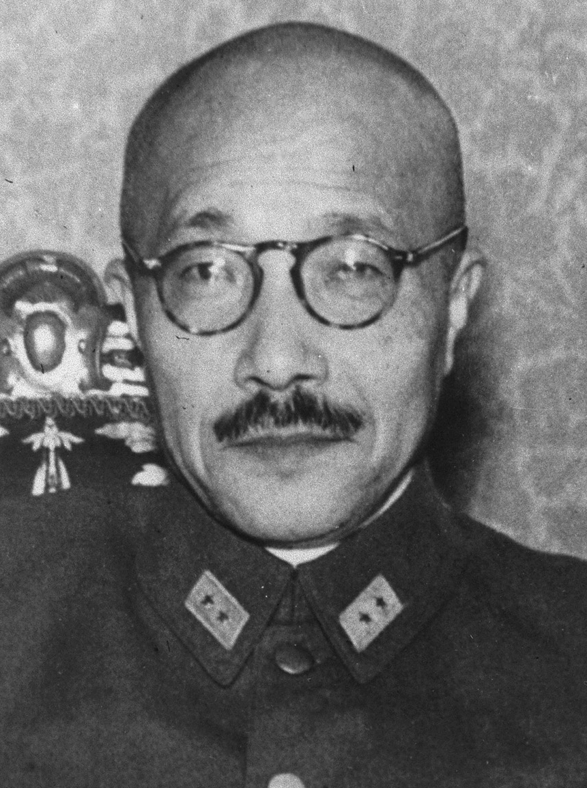
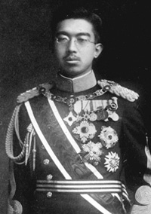
Why did Japan become totalitarian?
Japan was hit hard by the Depression and then also suffered because of the drop off of sales in silk and luxury products (their specialty) during the 1930s and bad harvest in several regions. Their leaders tried to expand into East Asia as a solution. Military leaders took control of the government, and left the Emperor as a figurehead.

Slide 36
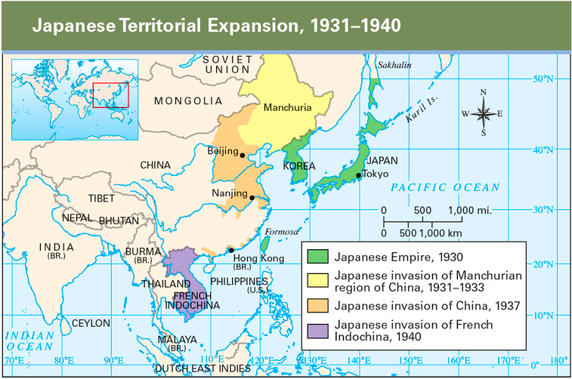
How did Japan contribute to the start of WWII?
Under military leadership, the Japanese invaded Manchuria and then withdrew from the League of Nations in 1933. Japan attacked China in 1937, which caused communist and noncommunist forces in China to united against Japan.

