Slide 1
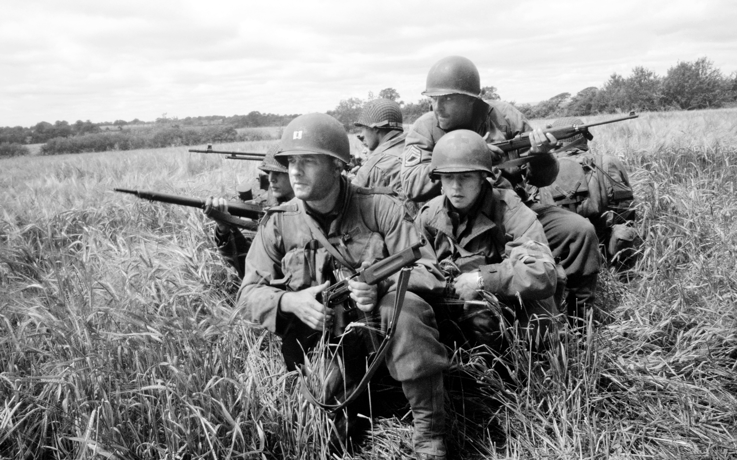
Fighting WWII
7-4.5

Slide 2
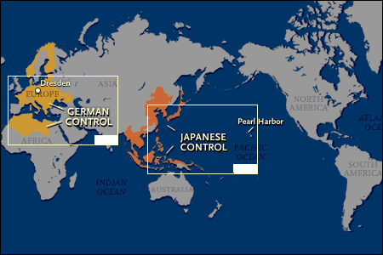
What were the two theaters of fighting?
WWII had two theaters of fighting: Europe and Asia.

Slide 3
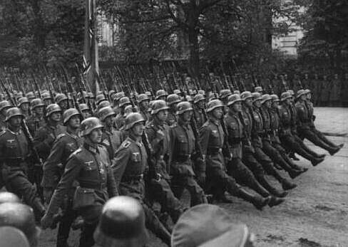
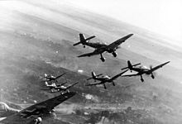
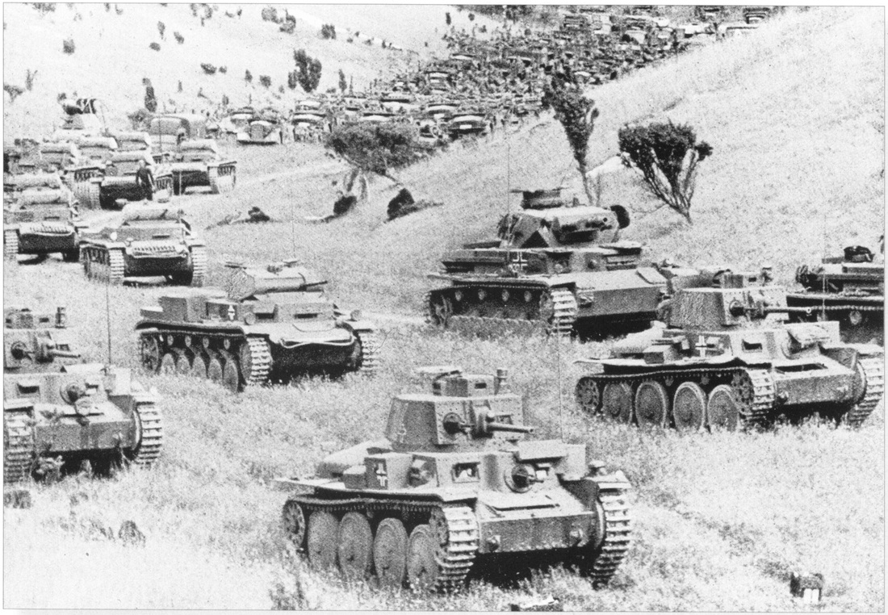
Germans & Soviets in Poland
Germans conducted a blitzkrieg (lightening war) against Poland. The Soviets had signed the Soviet Non-Aggression Pact in 1939 with Germany making them Allies. They attacked Poland from the west.

Slide 4
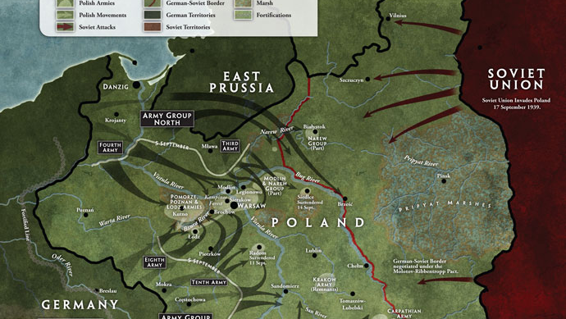
Into Poland
Blitzkrieg

Slide 5
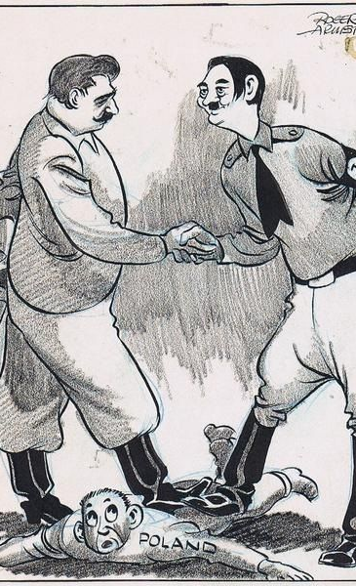
Soviet Non- Aggression Pact

Slide 6
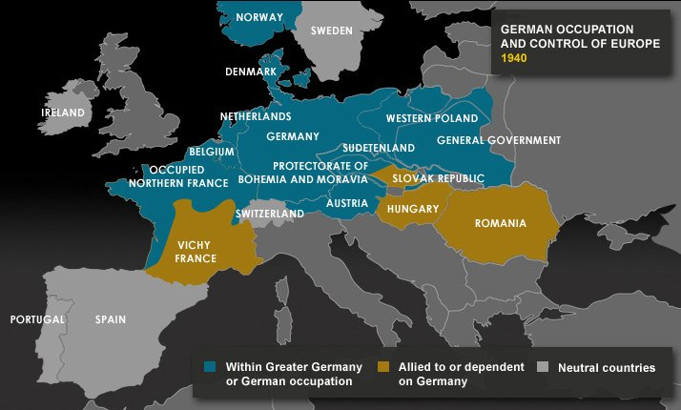
German Invasions
Denmark and Norway soon fell to Germany and France surrendered to the Germans in 1940. Hitler then focused on invading Great Britain.

Slide 7
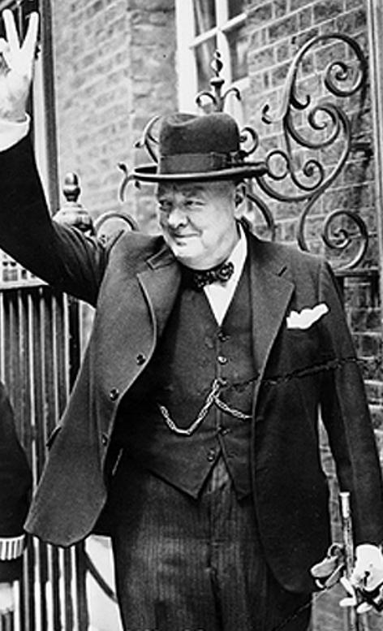
“Their Finest Hour” Speech
by Prime Minister Winston Churchill

Slide 8
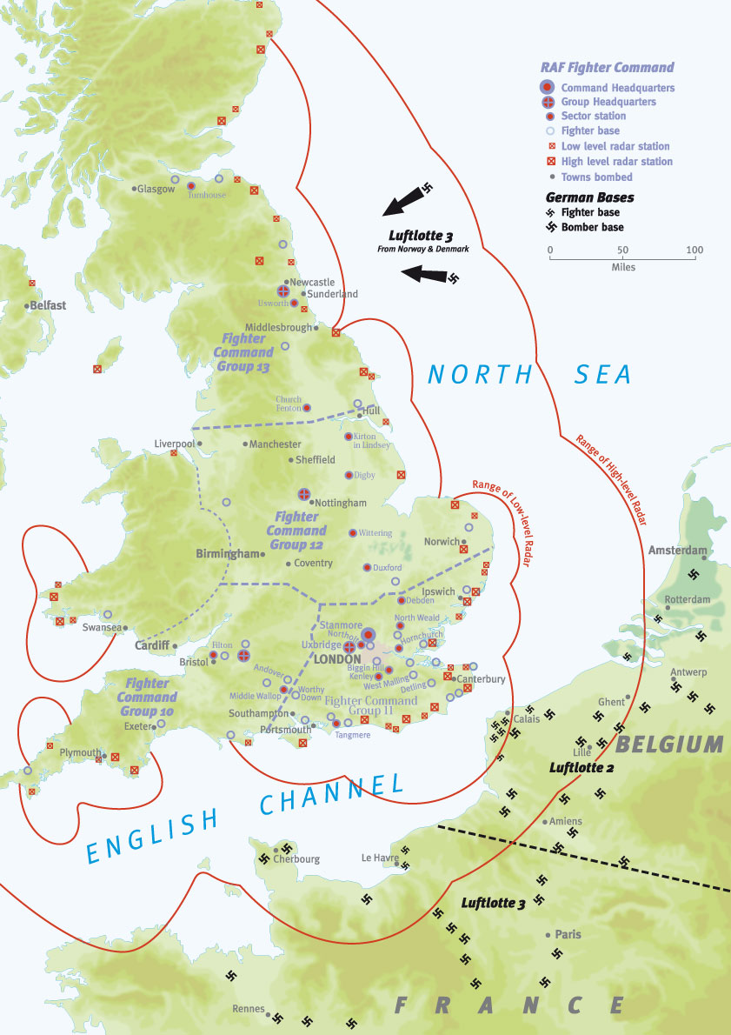
Battle of Britain
During the Battle of Britain (1940-41), the German air force repeatedly bombed the country. The British, used radar to prepare for attacks and had technology to decode German secret messages. Under the leadership of Prime Minister Winston Churchill, they refused to surrender. Hitler then had to move and focus on other areas in Europe.

Slide 9
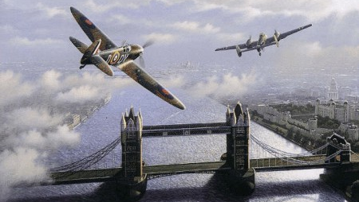
June 1940-Sept 1940
Battle of Britain

Slide 10
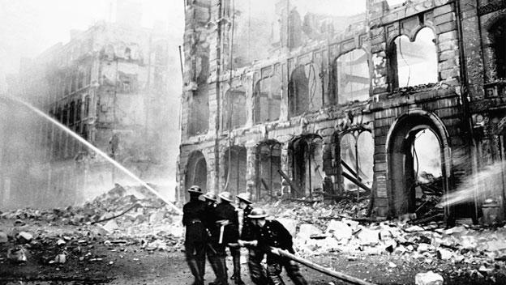
June 1940-Sept 1940
Battle of Britain

Slide 11
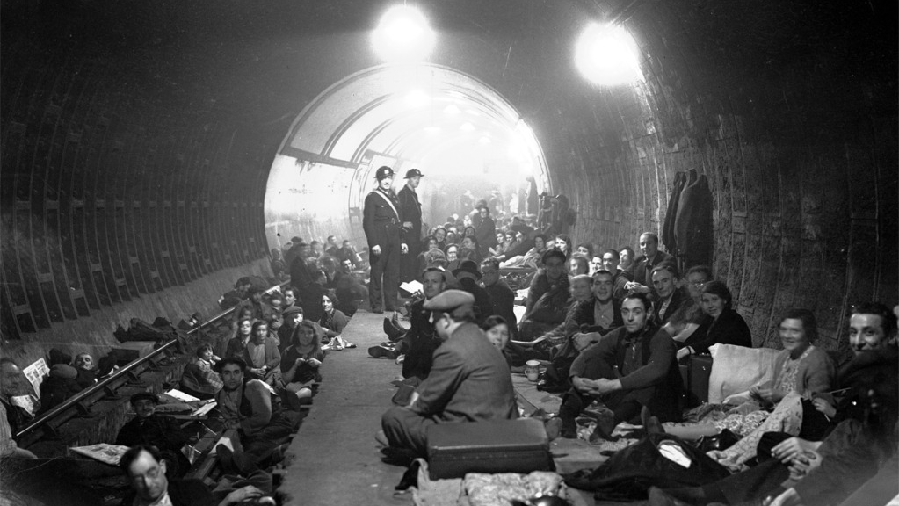
June 1940-Sept 1940
Battle of Britain

Slide 12
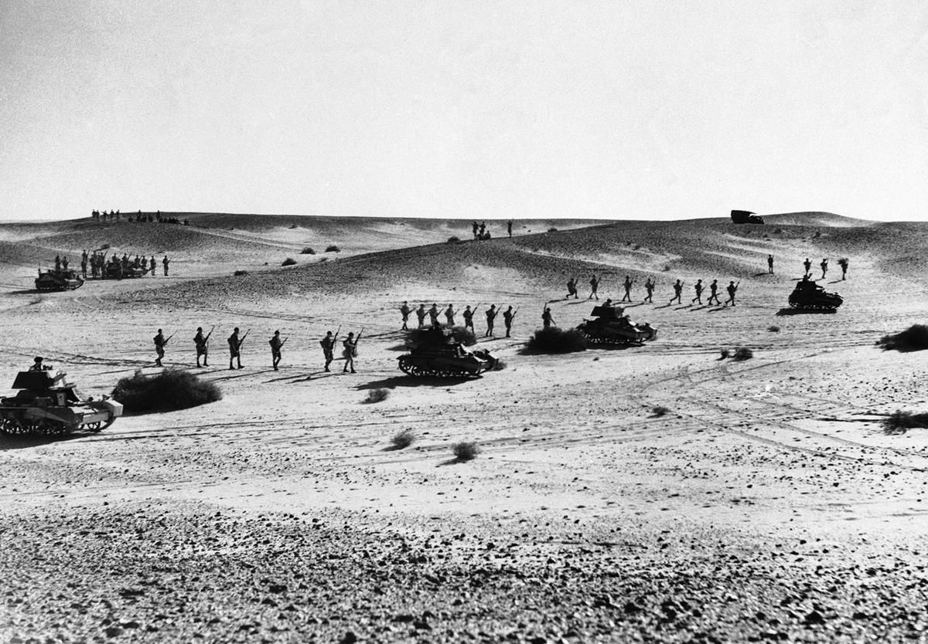
Fighting in North Africa
Fighting also occurred in North Africa and in the Balkans. The Germans wanted control of the Suez Canal (access to oil-rich Middle East). Yugoslavia and Greece fell to the Axis Powers in 1941.

Slide 13
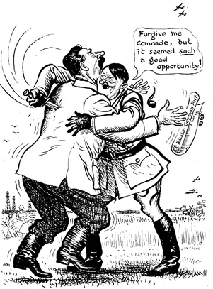
Soviets Join the Allies
Hitler then betrayed his own ally, the Soviet Union, and attacked them in 1941. The invasion of the USSR was unsuccessful in taking both Leningrad and Moscow. 500,000 Germans died during the invasion.

Slide 14
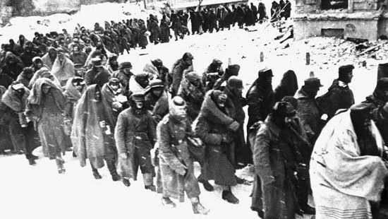
Invasion of the USSR

Slide 15
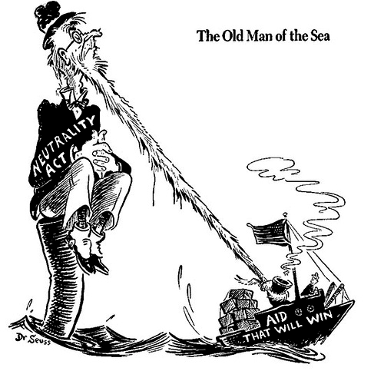
U.S. Involvement
The U.S. stayed isolated and passed Neutrality Acts in 1935 & 37, but FDR realized that the U.S. would have to be involved to defeat the Nazis and stop their takeover of Europe. In 1939, Congress amended the isolationist policy and allowed the U.S. to sell weapons to the Allies if they paid for cash and were delivered on their own ships (cash and carry policy).

Slide 16
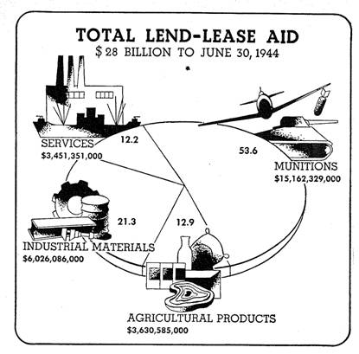
Lend-Lease Act
It was not enough, so in 1941 Congress passed the Lend-Lease Act allowing FDR to lend or lease weapons and other supplies to countries that were important to the U.S. interests.

Slide 17
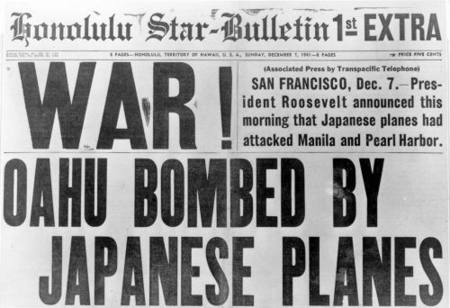
U.S. Enters the War
Japan invaded French Indochina in 1941, prompting the US to place an oil embargo on Japan to prevent more aggression. On Dec. 7th, 1941 the Japanese attacked Pearl Harbor and Congress declared war on Japan the next day.

Slide 18
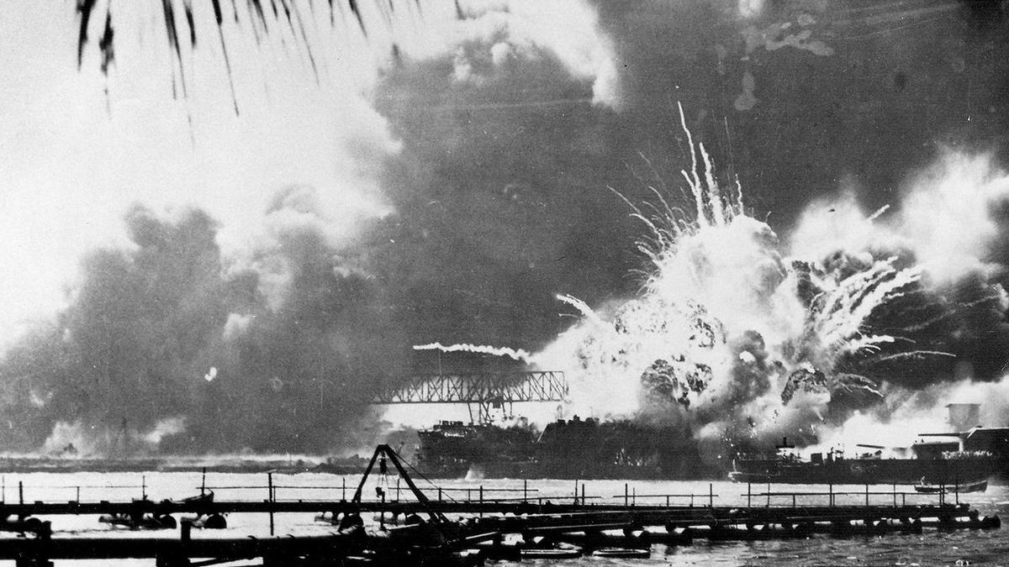
Pearl Harbor

Slide 19
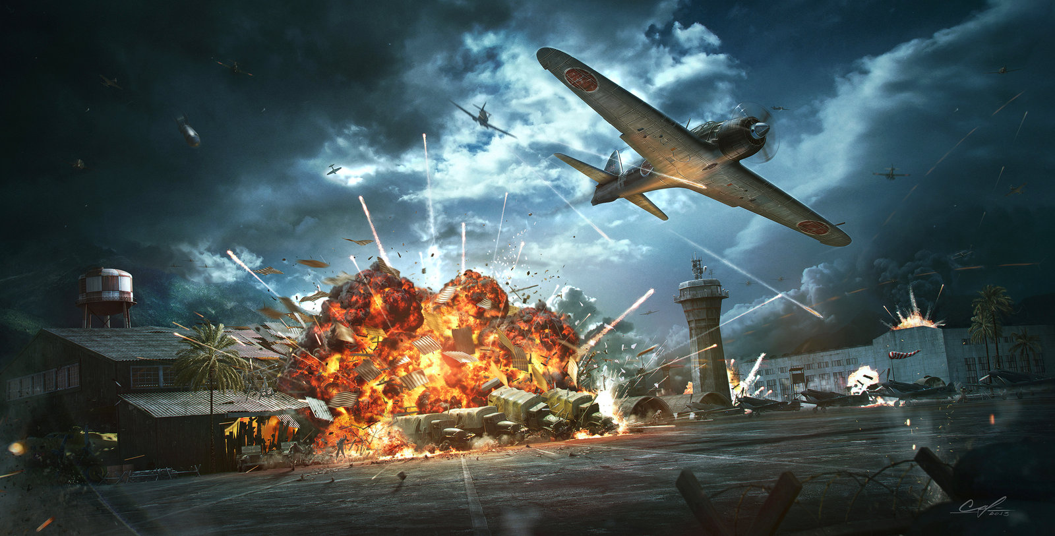
Pearl Harbor

Slide 20
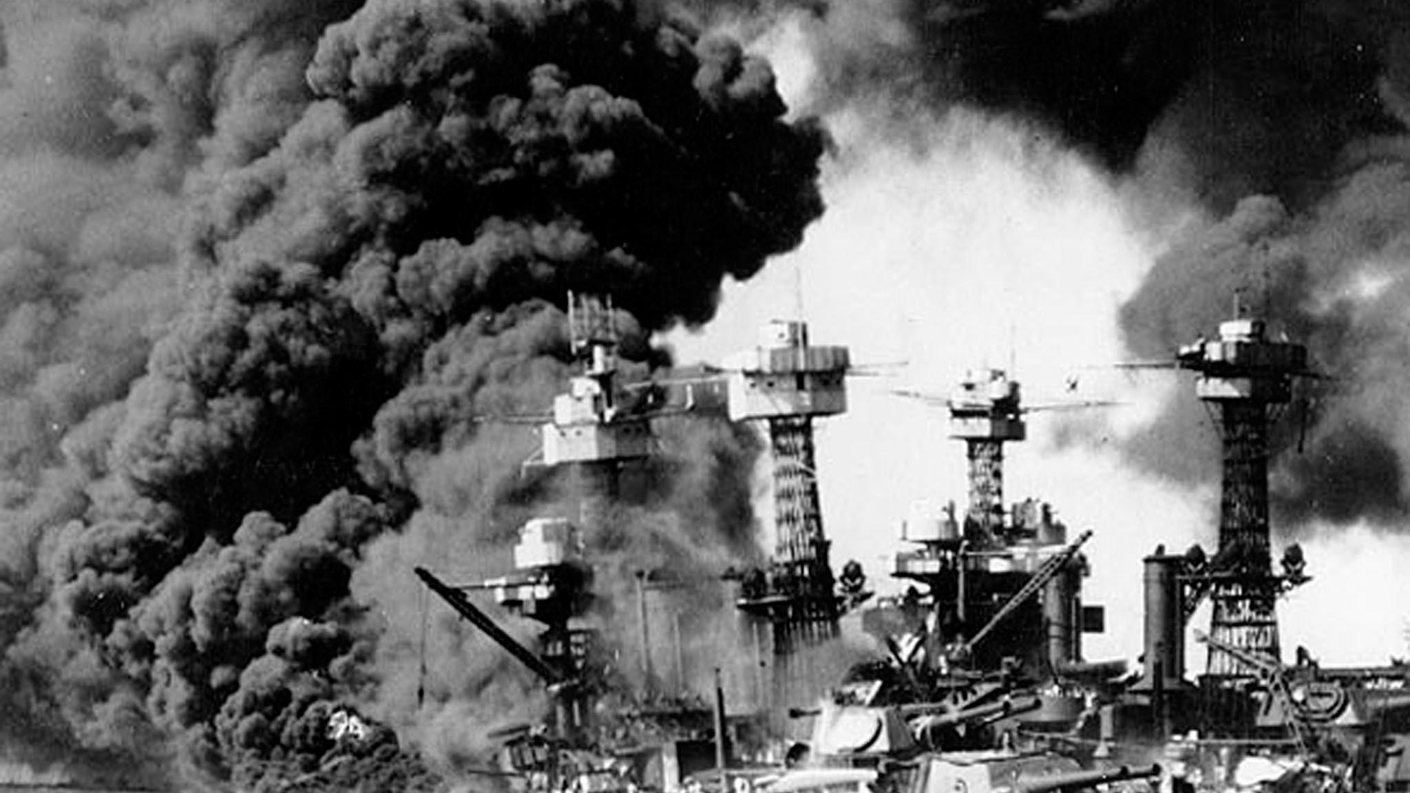
Pearl Harbor

Slide 21
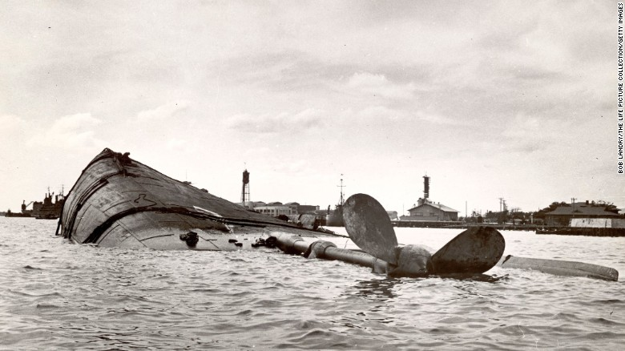
Pearl Harbor

Slide 22
A Date Which Will Live Infamy

