Slide 1
The Spread of Communism
7-5.3

Slide 2
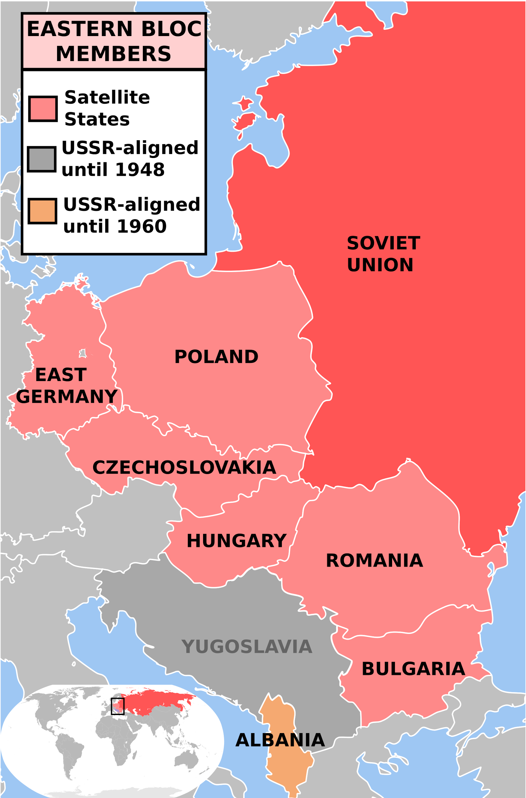
How did the Soviets keep Communist control in Eastern Europe?
The soviets continued to spread communism in Eastern Europe through countries that had freed from Germany at the end of WWII by establishing communist governments and refusing to grant elections. These countries included: Yugoslavia, Romania, Bulgaria, Czechoslovakia, Poland, Albania, and Hungary. These nations became known as satellite nations for the USSR as they were clustered around the Soviet Union and their economic policies orbited within Soviet influence and control.

Slide 3
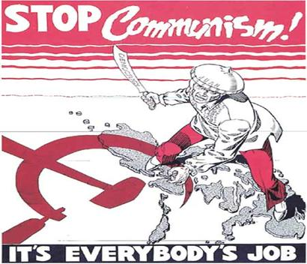
How did the United States respond?
Truman’s policy of containment in Eastern Europe was therefore directed at making sure other nations did not become satellite states. Little did they know they needed to prepare for the Soviet’s attempts at spreading communism around the world.

Slide 4
How did the United States respond?
What were the Soviets looking for to help them spread communism?
The Soviet Union began trying to spread its influence of communism in Asia, Africa, and Latin America, often looking in areas where revolutions were already taking place or where revolution was very likely.
The Soviets offered revolutionary countries assist in the form of economics and or military support in return for cooperation in establishing communist governments in their nations.

Slide 5
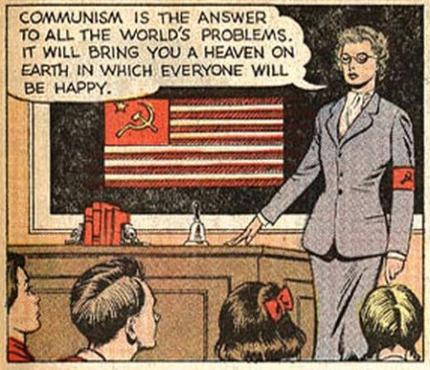
How did the United States respond?
The Soviets also used political means to spread communism by sending representatives to nations to discuss and explain the benefits and successes of communism. They also allowed visiting delegates from interested nations to come to the Soviet Union to examine the success of the Soviet’s political and economic system.

Slide 6
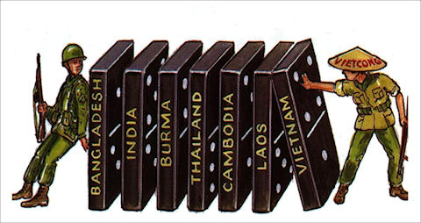
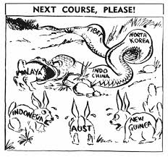
What was the Domino Theory?
The United State’s policy of involvement became known as the “domino theory”. The idea was that if one nation fell to communism, then others, like dominos, around the country would also become communist. The idea of containment therefore spread from Europe to Asia as the U.S. tried to stop the spread of communism in order to try to avoid the domino effect.

Slide 8
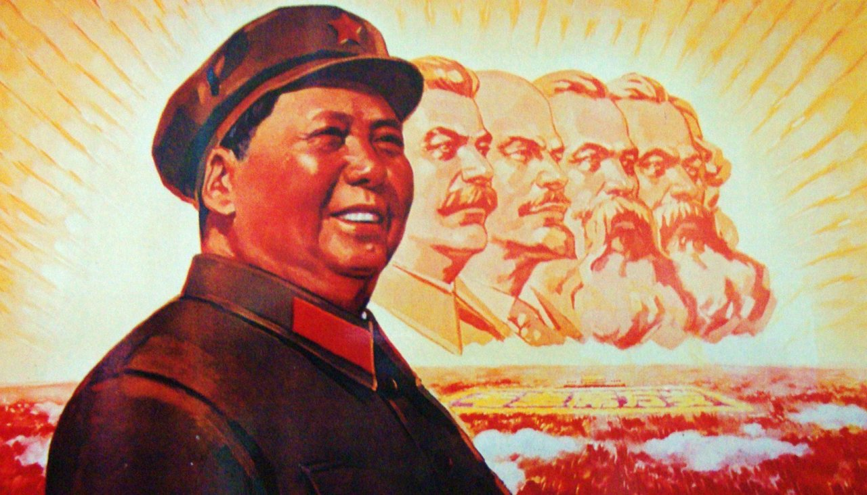
How did communism spread to Asia?
China was the first big victory for the Soviet Union. China had a Civil War going on that begun during WWII between the noncommunist Nationalists and the Communists. The Communists were led by Mao Zedong and experienced victory in 1949 allowing the communists to take over China, renaming it the Peoples Republic of China with Mao Zedong as its leader.

Slide 9
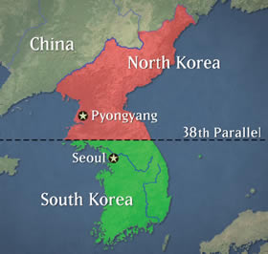
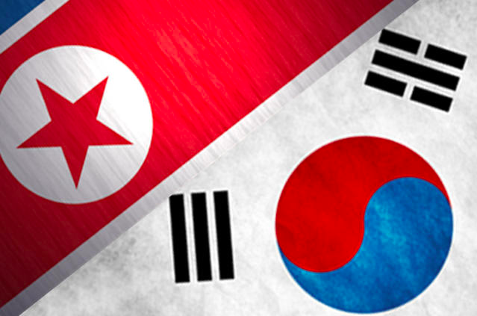
How was Korea affected by Communism?
Korea, formerly a Japanese colony gained its independence at the end of WWII. In the continual competition over political and economic ideologies, the Soviet Union supported the development of communism in Korea while the U.S. supported the development of a democracy. In order to avoid civil war, Korea was divided into two parts: The Democratic People’s Republic of Korea (North Korea) as a communist nation and the Republic of Korea (South Korea) as a democratic nation.

Slide 10
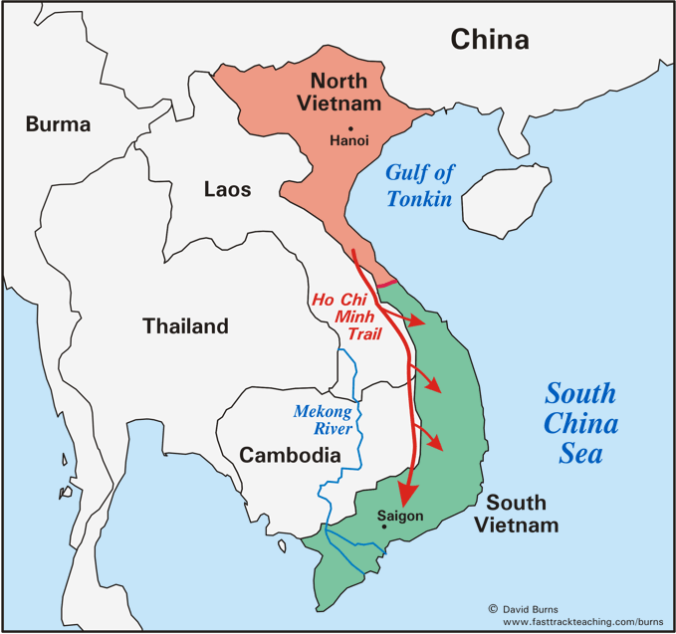
What about the rest of Asia?
In Vietnam the spread of communism caused scenarios similar to Korea. After WWII, Vietnam sought to gain independence from the imperial rule of France. The Soviet Union again sent support to revolutionaries in Vietnam while the U.S. backed democratic leaders. This leads to the Vietnam War.

Slide 11
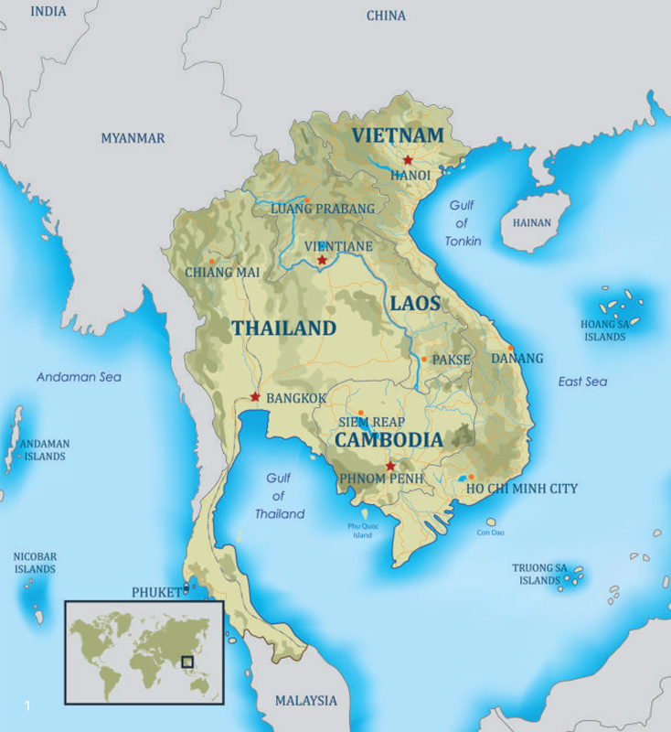
What about the rest of Asia?
Both Cambodia and Laos were influenced by the spread of communism and therefore changed their political system following WWII. The US fear of all Asian countries falling to communism like dominos, however, did not occur.

Slide 12
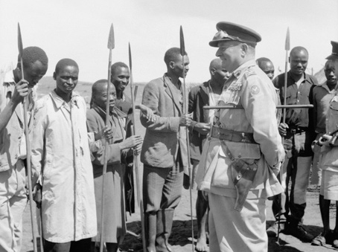
How did Africa adjust to the world after WWII?
In Africa, nations that had been under imperial rule since the 1800s saw WWII as a justification for standing up to unfair governments and took this opportunity to begin demanding independence from their European rulers.

Slide 13
How did the superpowers try to push their agendas in Africa?
The Soviet Union gave military support to Angola and Mozambique as well as to the African National Congress in South Africa. The Soviet Union also offered educational scholarships to young Africans, especially in English and Portuguese colonies, in hopes of persuading the youth of Africa to adopt communist ideas. Other nations such as Guinea, Egypt, Congo, Uganda, Ethiopia, Benin, and Somalia also received Soviet military or diplomatic aid.

Slide 14
How did the superpowers try to push their agendas in Africa?
The United States, as well as democratic nations of Europe, tried to prevent the spread of communism into these governments in Africa, continuing the idea of containment and preventing the domino effect, by providing military and economic aid.

Slide 15
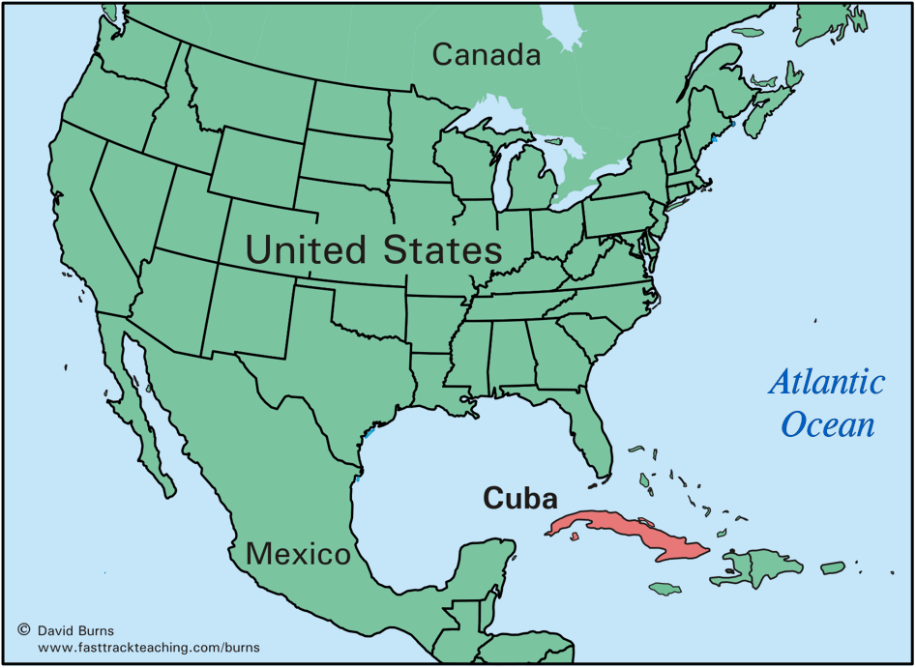
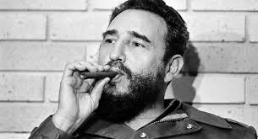
What was the impact of communism in Latin America?
Cuba was the first nation to establish a communist government under the leadership of Fidel Castro. Castro, with the aid of the Soviet Union, took over the government of Cuba in 1959. Tensions between the U.S., the Soviet Union, and Cuba almost led to war in the 1960s with the Cuban Missile Crisis.

Slide 16
What was the impact of communism in Latin America?
Castro, with the aid of the Soviet Union, then began trying to spread communism in Latin America in the 1970s & 1980s and the U.S. tried to prevent this.
1. In El Salvador, troops supported by Castro and the Soviet Union fought troops backed by the U.S.
2. In Nicaragua, rebels known as Sandinistas overthrew the government and got aid from Castro and the Soviets. The U.S. then helped a group known as the “Contras,” to help fight against the Sandinistas.

