Slide 1
8-4.1:
Antebellum SC

Slide 2
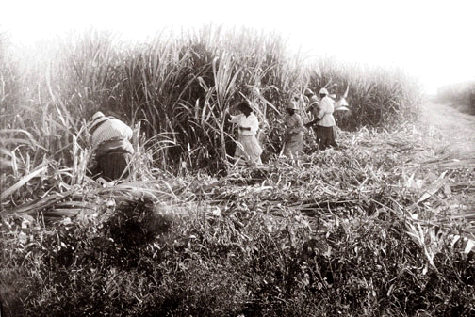
Antebellum
Antebellum = before the war
This term refers to the time period before the Civil War.

Slide 3
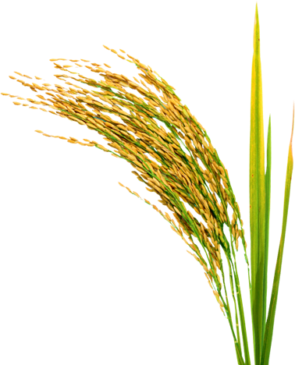
SC Economy
Earlier in SC, indigo & rice were staple crops in the lowcountry. The Upcountry was centered around small farms.
All that changed with the invention of the cotton gin by Eli Whitney.

Slide 4
Gone With the Wind
Clip

Slide 5
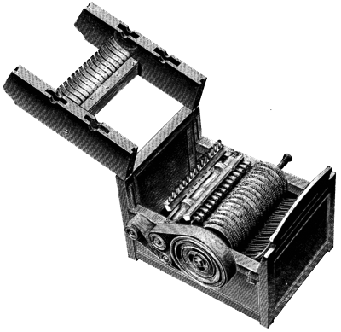
Cotton Gin
The cotton gin made cotton king. (Indigo fell to foreign markets & rice declined later). Slavery became widespread across the state.
In 1800, 25% of the families in the Upcountry owned slaves, 20 years later 40% did.

Slide 6
Political Power
Political power evened out between the lowcountry & upcountry with the increase of slavery.
By 1810, all white males had the right to vote in the state.

Slide 7
State of the Economy
While on the surface, SC’s economy looked prosperous there were warning signs of trouble ahead:
SC’s average wealth was high (but it lagged behind other southern states
Cotton was depleting the soil
Population of SC had a black majority
Other ports started replacing Charleston port
Manufacturing failed to take off

Slide 8
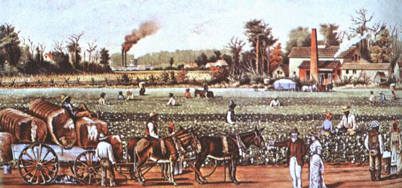
Social Classes in SC
Antebellum SC was divided between the elite planter class (not just in the Lowcountry anymore), smaller white farmers, free blacks, and slaves.

Slide 9
45.8%
20%
61%
White families who owned slaves
Planters who owned 20 or more slaves
Owned fewer than 10 slaves 14% had just one

Slide 10
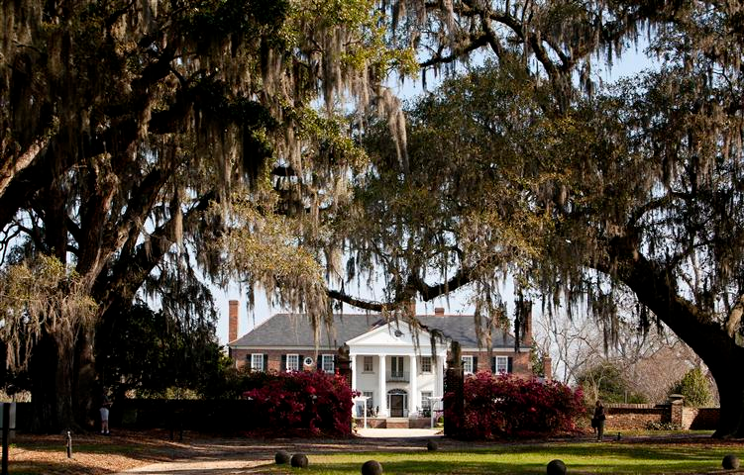
Planters
Owned 20 or more slaves
had most of the social & political power
had large homes
educated privately
managed the business of the plantation, but did not labor
wives managed the household

Slide 11
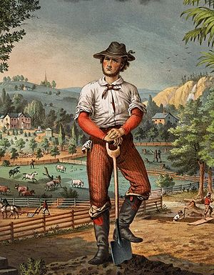
Smaller Farmers
Smaller farmers who owned less slaves often worked alongside their slaves

Slide 12
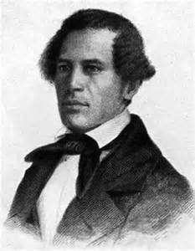
Free Blacks
Free Blacks numbered 10,000 by 1860. Life was difficult. They had to pay a tax & register. Some owned slaves. They established a “brown elite” and distanced themselves from slaves. Often could be recaptured into slavery.
William Ellison

Slide 13
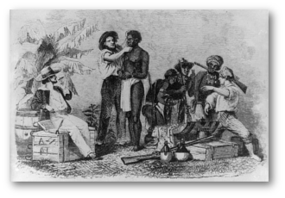
Slaves
Slaves’ lives depended entirely on their masters & what type of plantation they worked on.
Rice plantation = task system
Cotton plantation = gang system (much worse)

Slide 14
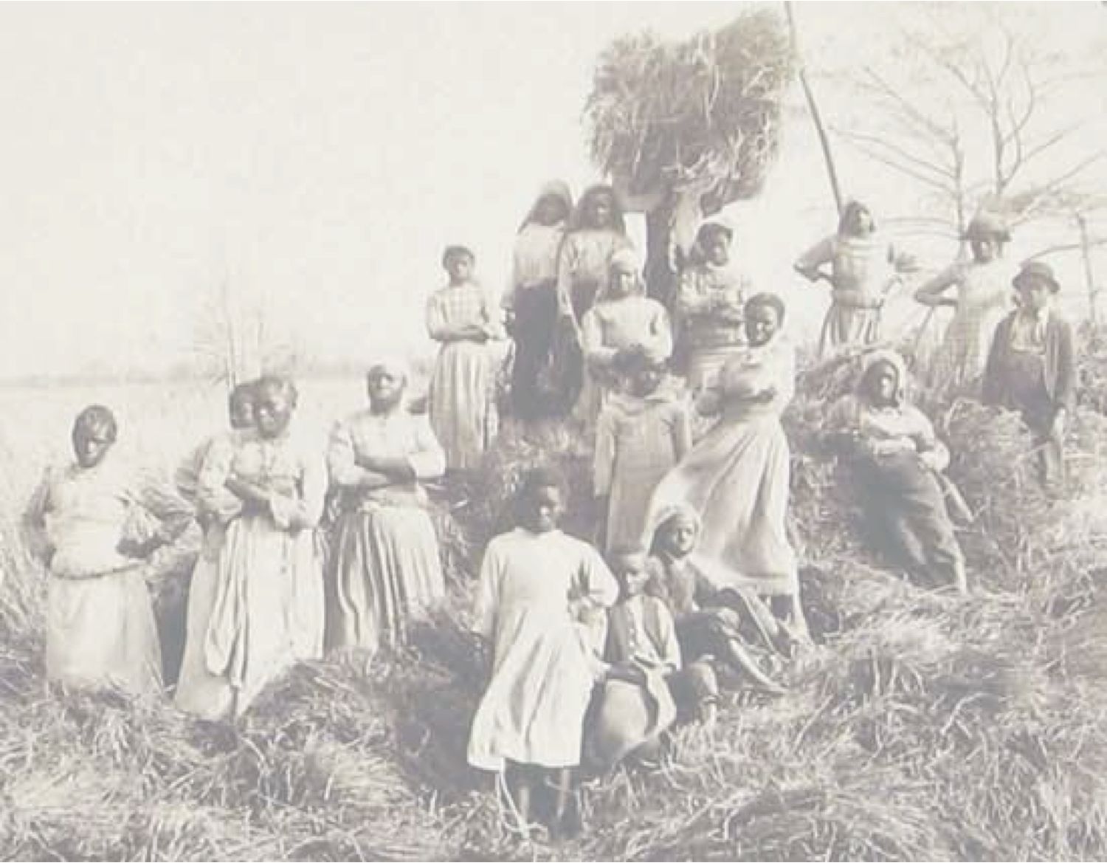
Average Day of a Slave
5:00-Wake up
5:15-8:00: Work in the fields
8:00-8:15: Breakfast
8:15-1:00: Work in the fields
1:00-1:45: Midday Meal (Dinner)
1:45-Dark: Work in the fields
After they returned to their quarters, they tended their own gardens & ate a light supper.

Slide 15
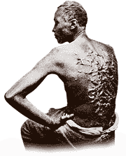
Supervision & Punishments
Work was supervised by a white overseer or a black driver.
Punishments ranged from deprivation of food or privileges to whipping and loss of limbs.

Slide 16
Food & Housing
Slaves were fed with corn (cornbread, mush, grits, etc) and whatever meats & vegetables they managed on their own.
Slave quarters were often cramped, with dirt floors & poor ventilation.

Slide 18
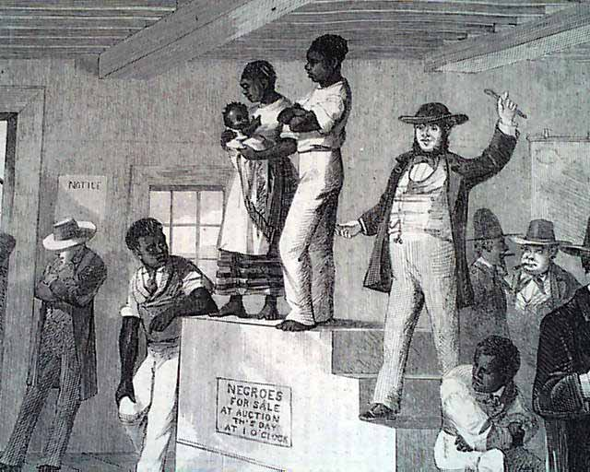
Other Horrors
Slaves had no protections. They risked separation from their families & rape or other cruelties by their masters.

Slide 19
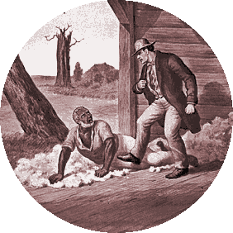
Southern Justification
The Southerners justified slavery any way they could (as necessary for the economy, Bible sanctioned, better than the treatment of Northern workers, necessary for the care of Africans, etc.)

Slide 20
“Few white Carolinians had any real concept of what life was like under slavery. ‘The negro, left to himself, does not dream of liberty,’ said Louisa McCord. She, like most whites, misinterpreted the happy darkies who always had a smile and a ‘yessuh, Boss’ as being satisfied with their condition. Of course, they were not.”

Slide 21
Slavery in Hollywood
Clip #1

Slide 22
Slavery in Hollywood
Clip #2

Slide 23
Slavery in Hollywood
Clip #3

Slide 24
Slavery in Hollywood
Clip #3 cont.

Slide 25
Slavery in Hollywood
Clip #4

