Slide 1
8-4.2:
Sectionalism

Slide 2
Sectionalism
Sectionalism is loyalty to a particular region or section of a country instead of to the nation as a whole.
It developed in the U.S. as the economies, cultures, and political interests of the North & South became more different.

Slide 4
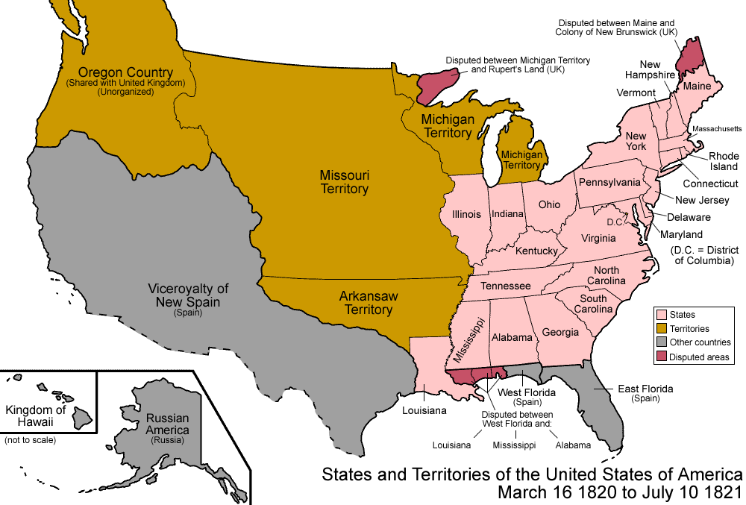
North
Northern states had many factories and businesses.
They wanted tariffs, to protect them from foreign competition from Britain.
Northern states also wanted the government to stop selling cheap land in the west.
They wanted people to work in factories instead of becoming farmers.
Northern states had a high immigrant population and did not rely on slave labor.

Slide 5
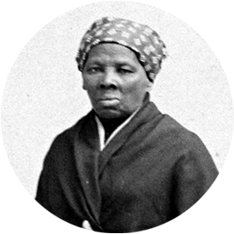
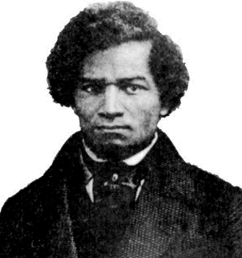
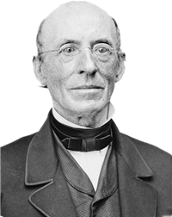
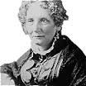
Abolitionist Movement
Abolitionists wanted to outlaw slavery across the United States. While not popular with most Northerners, the movement was based in the Northern states.
Frederick Douglass was a famous orator..
Harriet Tubman was a “conductor” on the Underground Railroad.
William Lloyd Garrison published an antislavery newspaper called The Liberator
Harriet Beecher Stowe wrote “Uncle Tom’s Cabin”

Slide 6
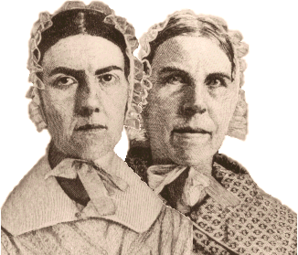
Grimke Sisters
Sarah
The Grimke sisters were the rare Southern Abolitionists. They were raised on a plantation in Charleston. They travelled around the Northern states and gave speeches about the horrors of slavery.
Angelina

Slide 7
Abolitionists

Slide 8
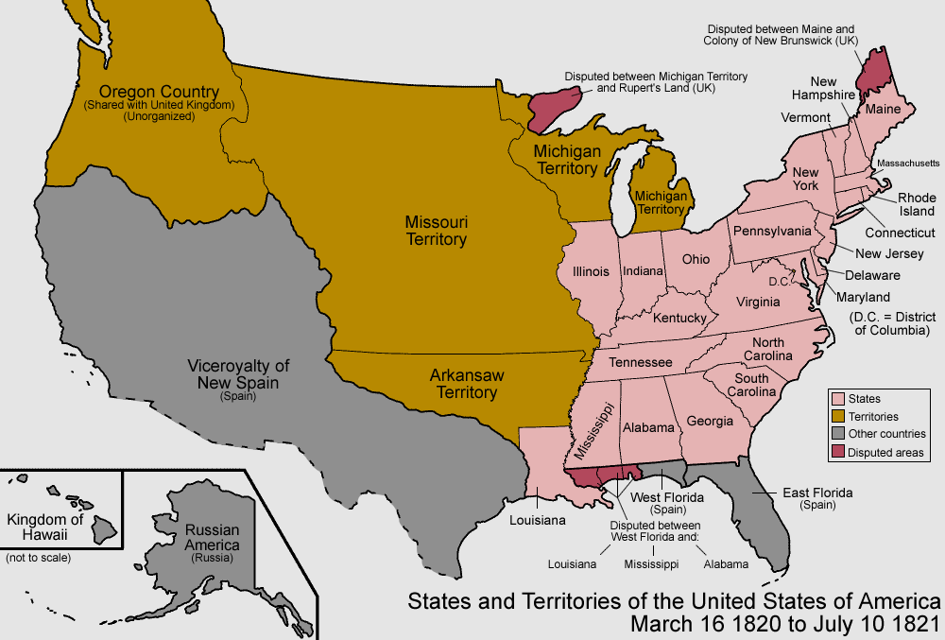
South
southern economy was based in agriculture and the use of slave labor.
Southern plantations sold most of their crops to Britain.
They were against tariffs because they angered Britain and made goods more expensive.
Southern states also wanted the government to support slavery and allow it to spread into western territories. (If it didn’t spread out west, soon the non-slave states would outnumber Southern states and they would use that advantage to outlaw slavery).

Slide 9
West
Manifest Destiny: Americans felt like it was their destiny to spread from coast to coast. This fueled their desire to move out west.
Western territories wanted cheap land from the government. The government had been using land as an incentive to get people to move out west...they wanted more.
They also wanted the government to keep building railroads, roads and canals.

Slide 10
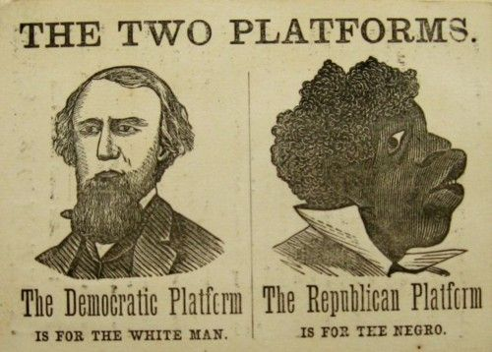
Political Divide
Politically the North & South were divided as well.
Traditionally Southerners supported the Democratic-Republicans, which would become known as Jackson’s Democrats.
The North supported the Federalists, later called the Whigs and finally Lincoln’s Republicans.

Slide 11
Denmark Vesey
Denmark Vesey, a free black who had purchased his freedom and preached at the African Methodist Church, planned an uprising.
Supposedly hundreds of slaves were involved in the plot which was to take place in July. At the end May, a house servant reported to his master that he had been approached to join.
Authorities captured dozens of “conspirators” and put them on trial. Over 20, including Vesey were executed.
Again, South Carolina became terrified of a slave rebellion.
Vesey’s Ties to Emanuel AME

Slide 12
Denmark Vesey

Slide 13
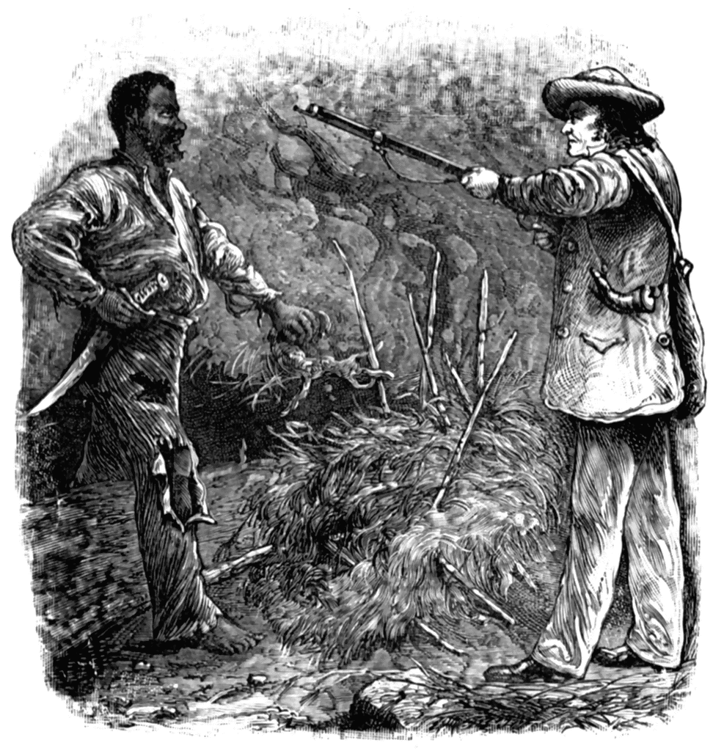
Nat Turner
A slave uprising in Virginia, known as the Nat Turner Rebellion, further increased tension throughout the region.
In 1831, Nat Turner, a slave, led up to 70 slaves in a revolt. Killing 55-65 people, the rebellion lasted for 48 hours before most slaves were captured. Nat Turner eluded capture for 2 months, then captured, tried, and hung.

Slide 14
Nat Turner

Slide 15
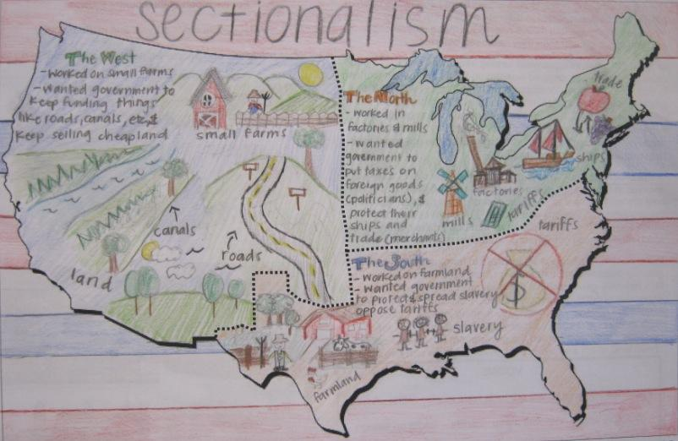
Sectionalism Infographic
Draw an infographic that shows the regional differences between the North, South, & West.

Slide 16
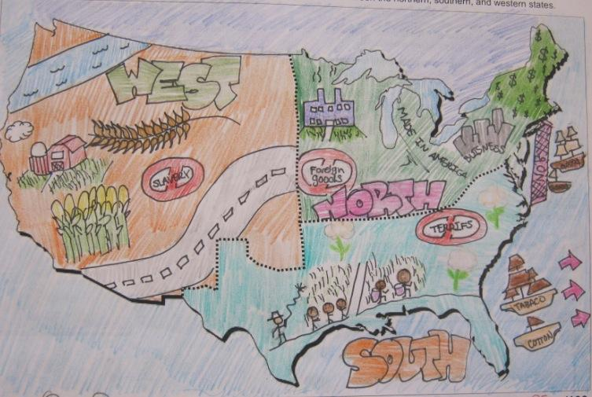
Sectionalism Infographic

