Slide 1
8-4.3: Road to Secession

Slide 2
Road to Secession
Compromise of 1850
Cultural Differences
Dred Scott Case
Slavery
Fugitive Slave Law
States’ Rights
Missouri Compromise
Starting in the 1820s, a series of events led America to the boiling point of war.
Election of 1860
Bleeding Kansas
John Brown’s Raid
Civil War

Slide 3
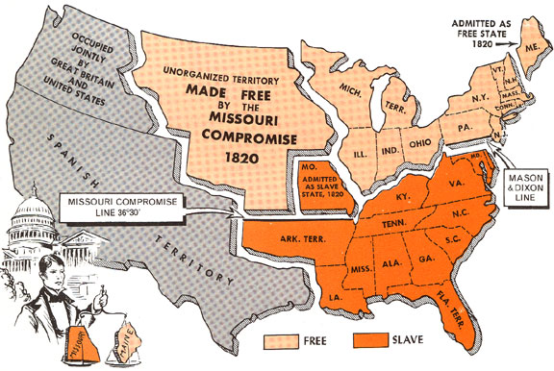
Missouri Issue
Missouri applied to be a state in 1819.
Maine applied in 1820.
The North wanted them to be free states & the South wanted them to be slave states.

Slide 4
Missouri Compromise
They decided to enter Missouri as a slave state & Maine as a free state.
They drew a line at 36’ 30 latitude that would apply to the rest of the territory. (Above the line = free, below = slave)

Slide 5
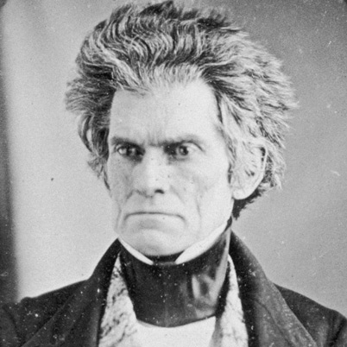
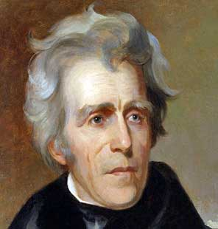
Nullification Crisis
SC was angry about a protective tariff passed in 1828 (Tariff of Abominations). They tried to pass a state law that gave them the right to “nullify” (ignore) the tariff.
John C. Calhoun resigned as Vice President to support SC.
President Andrew Jackson passed the Force Bill (which said the U.S. govt. could send in troops to get the tariff money).
They reached a compromise, when SC agreed to get rid of their nullification law. In exchange, Congress agreed to lower tariffs for the next 20 years.
*SC voted to nullify the Force Bill, just to prove they could.
Calhoun
Jackson

Slide 6
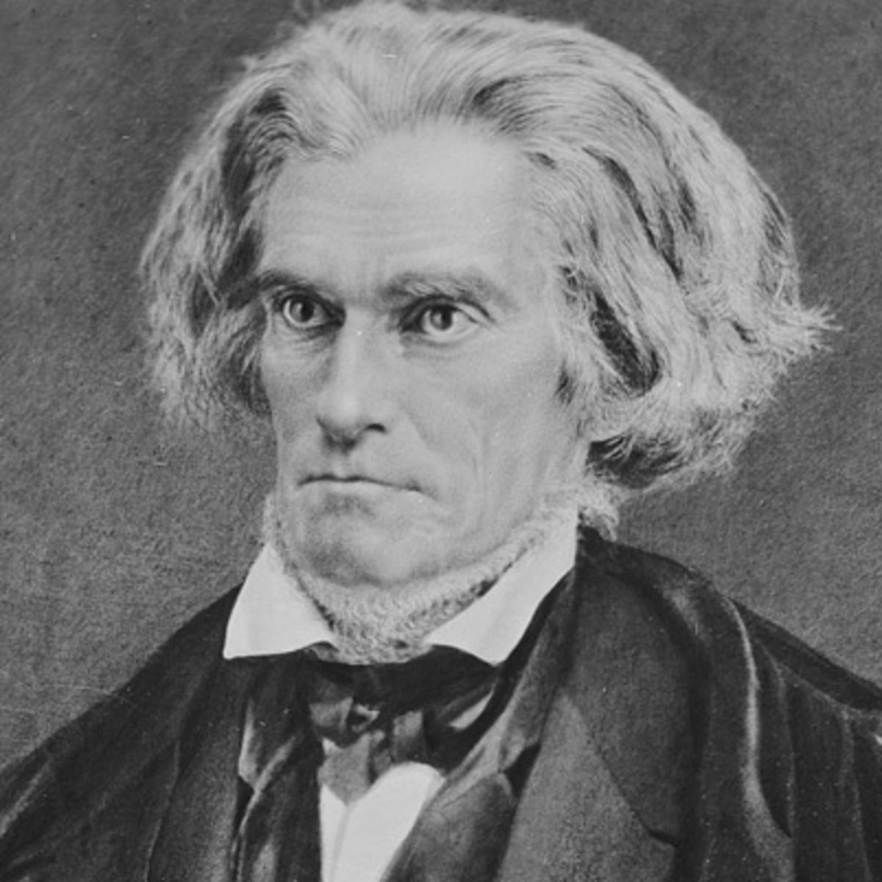
Theory of Secession
Tension kept building. South Carolina and other southern states started arguing for greater states’ rights. The North felt like the U.S. govt was the ultimate power.
The debate turned into the Theory of Secession. This theory stated that the United States was merely a confederation (loose alliance) and they had the right to leave if their rights were being threatened.
The state right I really care about is my right to own slaves
Secede or Secession = withdraw Membership from an organization

Slide 7
Compromise of 1850
In 1849, California wanted to enter as a free state. The South freaked out because this would upset the balance between the free and slave states.
After nearly a year of debate, they settled on the Compromise of 1850 which was a series of laws that tried to give both side something:
California was entered as a free state
Utah & New Mexico would get to decide by a vote
Slave trade was abolished in D.C.
Fugitive Slave Act

Slide 8
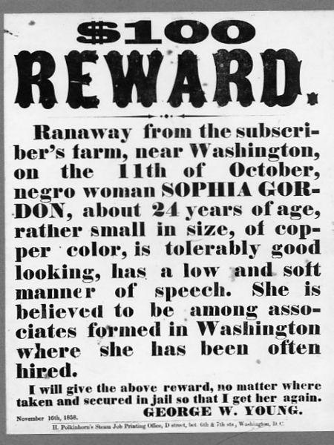
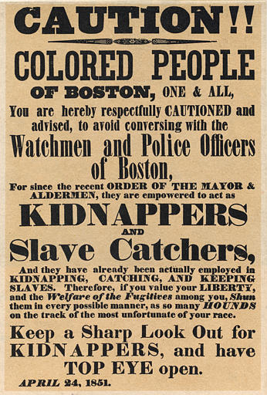
Fugitive Slave Law
All citizens must help capture runaway slaves or face jail time & $1,000 fine
*$1,000=$30,000 today

Slide 9
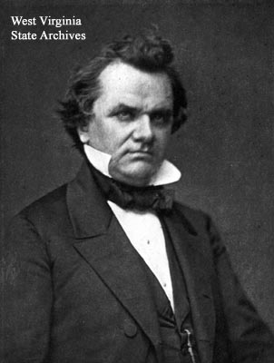
Kansas-Nebraska Act
Senator Stephen Douglas wanted to develop the rest of the Louisiana Purchase territory and build a transcontinental railroad.
He proposed the Kansas-Nebraska Act, which divided the territory into two states (Kansas & Nebraska).
Each state would then be allowed to vote whether or not to have slavery (popular sovereignty).
*This got rid of the Missouri Compromise line.
Stephen Douglas

Slide 10
Bleeding Kansas
They actually didn’t end up admitting Kansas as a state until 1861.
Pro-slavery residents of Missouri flocked into Kansas to sway the vote.
Fighting broke out between pro-slavery and antislavery residents. 200 people were killed, nicknaming the state “Bleeding Kansas”

Slide 11
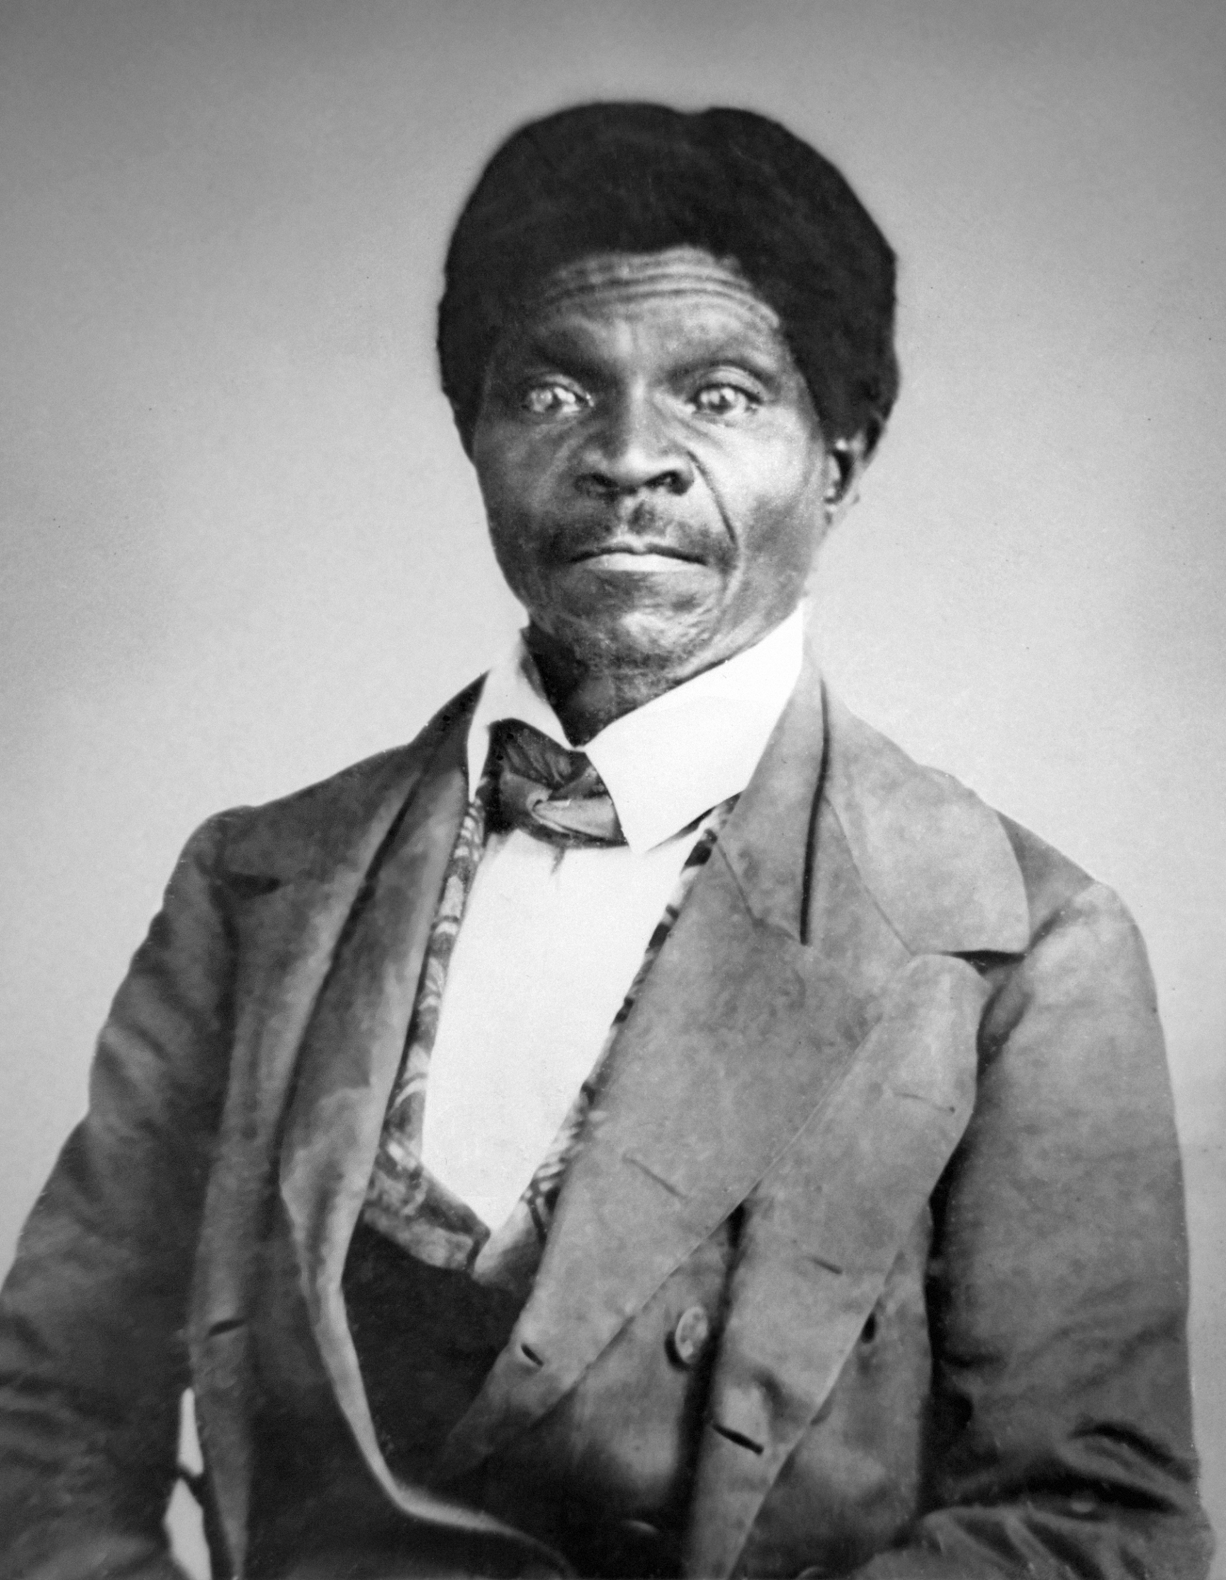
Dred Scott vs. Sanford
The Dred Scott case was one of the worst Supreme Court Case decisions in U.S. History.
Dred Scott was a slave whose owner brought him to live in Illinois (free state) for 5 years before returning to Missouri (slave state).
Scott sued for his freedom, claiming that he couldn’t be a slave because he had lived in a place where slavery didn’t exist.
Dred Scott

Slide 12
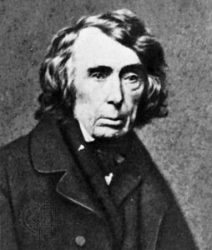
Dred Scott Decision
The Supreme Court (led by Chief Justice Roger B. Taney) decided against Dred Scott.
They also took it a step further.
They ruled that Dred Scott and other African Americans were property not people. Therefore they didn’t have the right to sue in court.
Additionally, the court ruled it had to protect “property” so it was unconstitutional to block slavery in territories.
Roger B. Taney

Slide 13
They had for more than a century before been regarded as beings of an inferior order and altogether unfit to associate with the white race, either in social or political relations; and so far inferior that they had no rights which the white man was bound to respect”
-Chief Justice Roger B. Taney

Slide 14
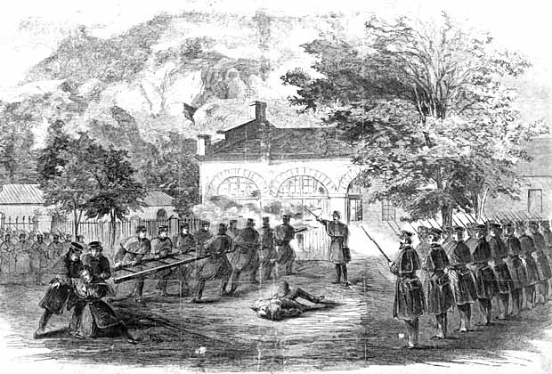
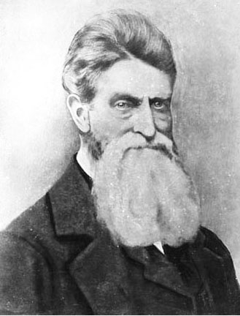
John Brown’s Raid
John Brown
John Brown led a disastrous raid on a federal arsenal in Harper’s Ferry, VA in 1859. He hoped to get guns to arm slaves who would use them to rise up against their masters.
He wasn’t a great tactician or a clear thinker, so it was an epic failure. He did become a martyr for the abolitionist cause.

Slide 15
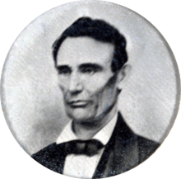
Election of 1860
The election for President in 1860 ended up being the tipping point.
Abraham Lincoln ran on the Republican ticket. He had become famous from his unsuccessful Senate campaign (he lost to Stephen Douglas).
Northern Democrats favored Stephen Douglas. Southern Democrats wanted John C. Breckinridge of Kentucky.
John Bell ran for the Constitutional Union Party.
Creepy without the beard right???

Slide 16
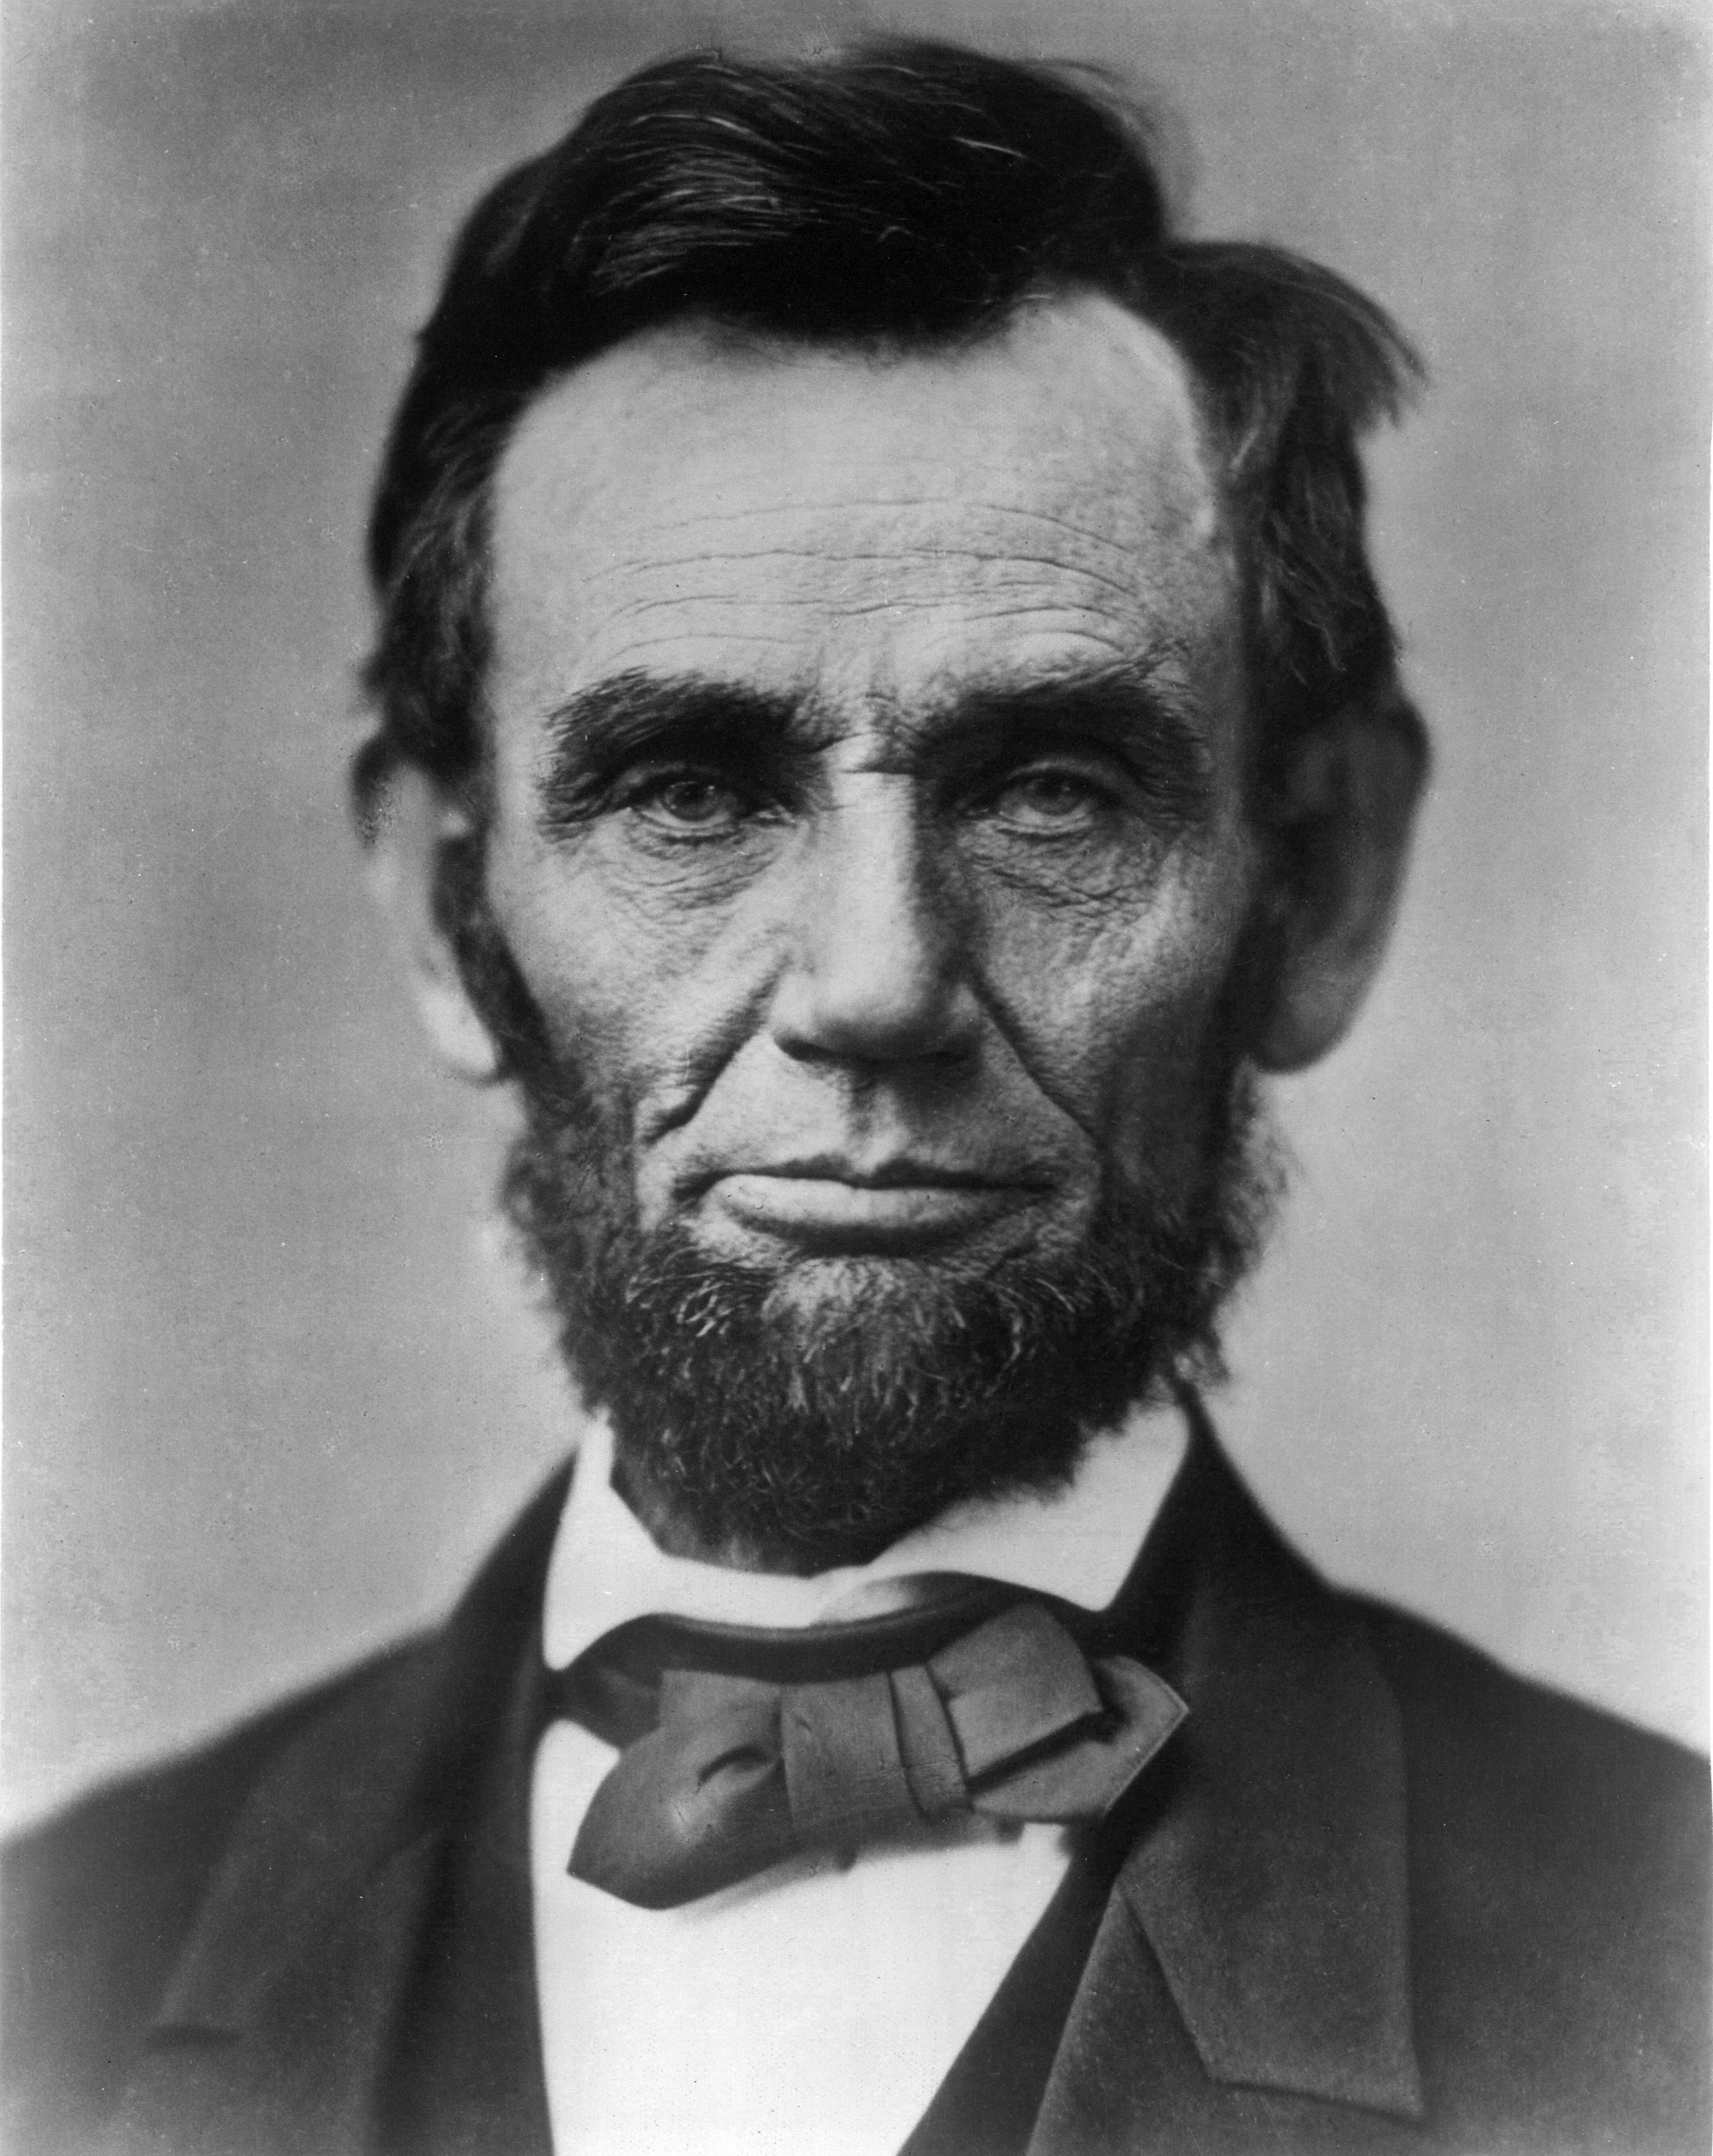
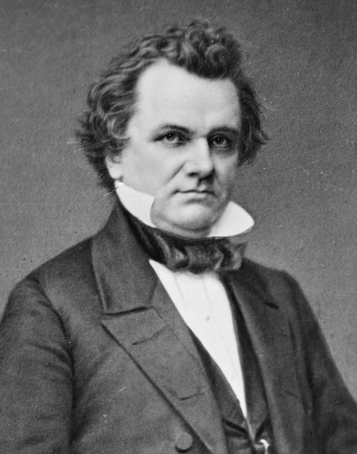
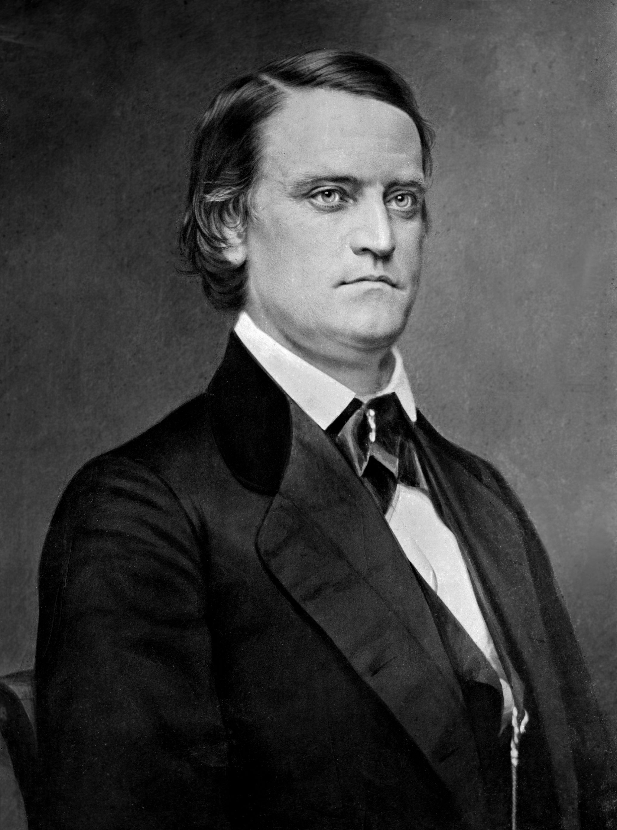
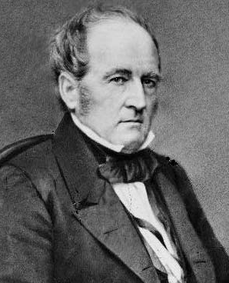
Election of 1860
Results
Lincoln
40%
Douglas
Breckinridge
Bell
29%
18%
13%

Slide 18
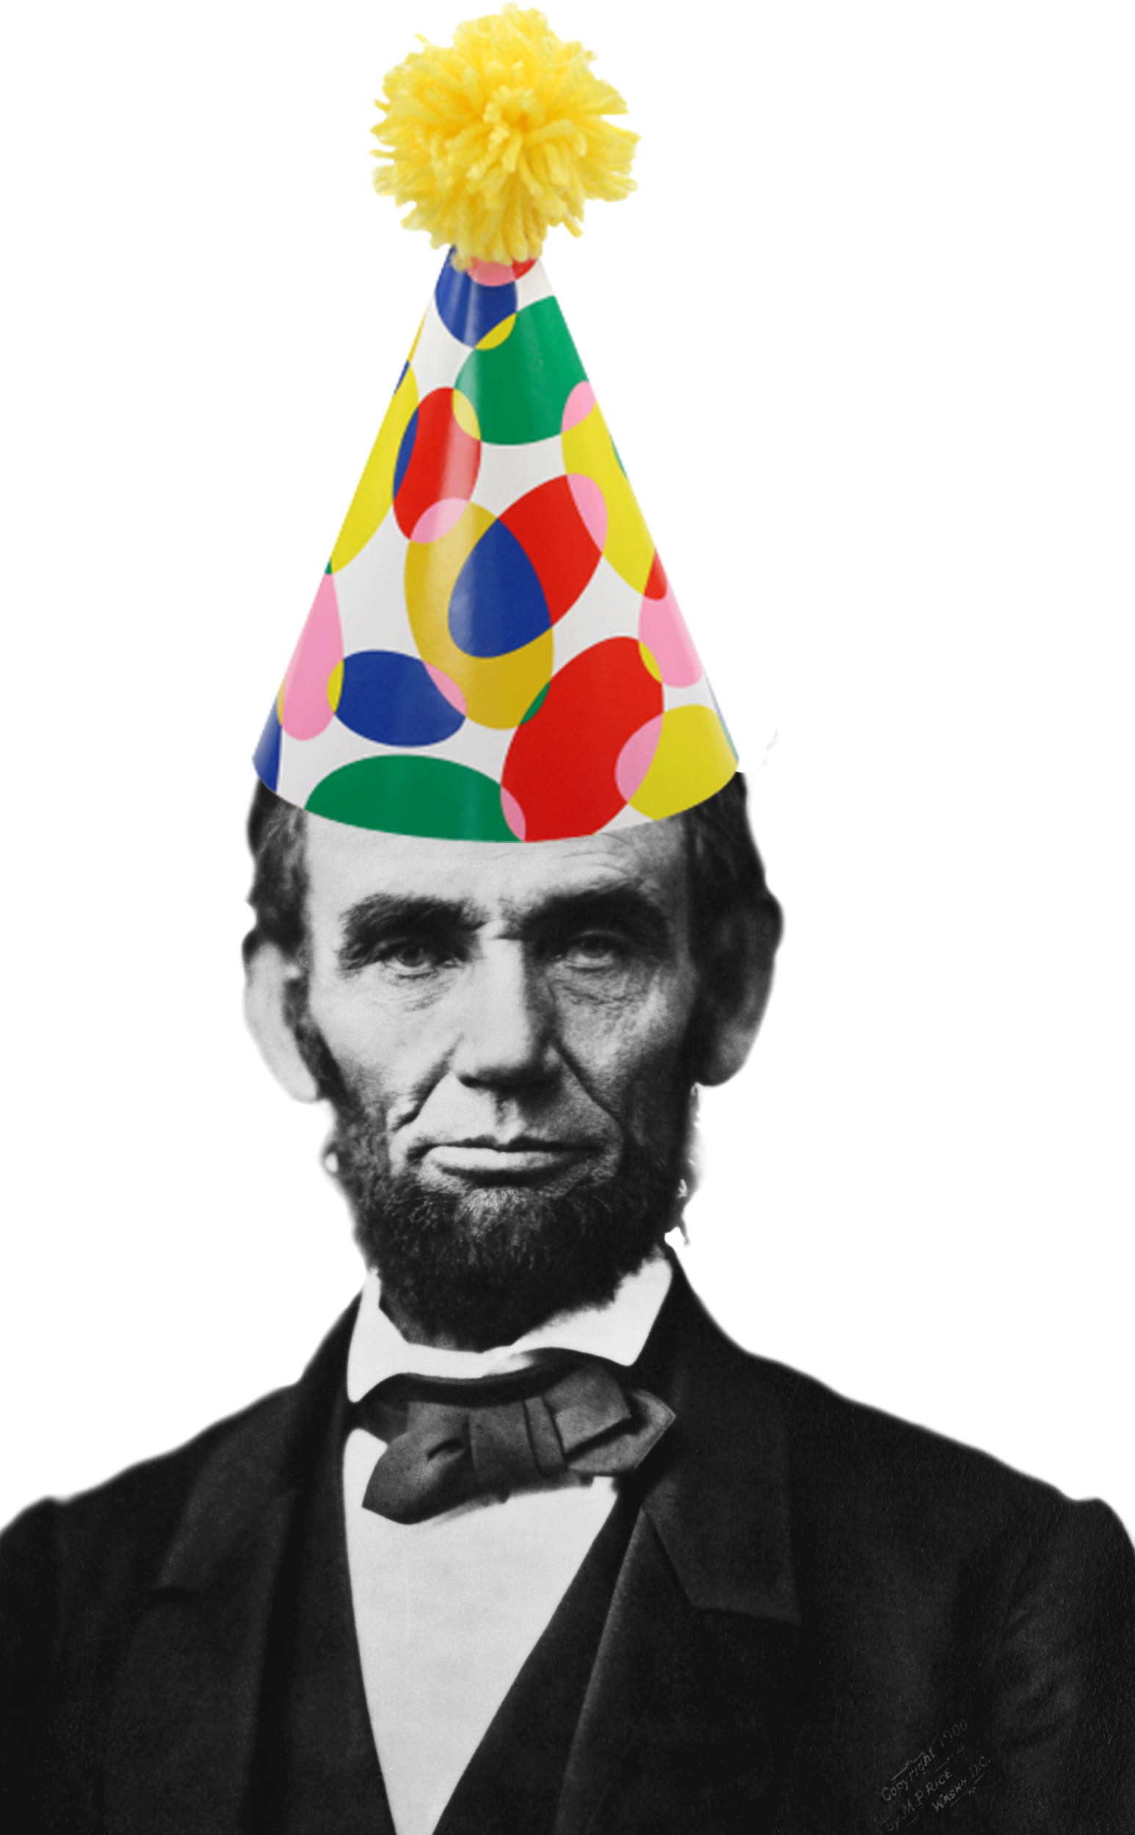
Election of 1860
Lincoln won without getting a single vote in 9 states, but he won 40% of the overall popular vote (more than any other candidate) and he had the most votes in many of the most populated states.
He didn’t even appear on many ballots in the South (who feared that he would abolish slavery...even though he repeatedly said he would not).

Slide 19
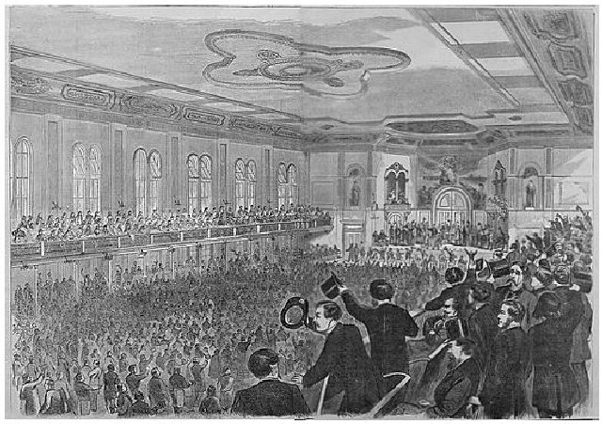
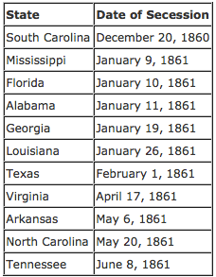
Outcome
As a result of Lincoln’s victory, South Carolina voted to secede from the Union. (Ordinance of Secession)
Mississippi, Florida, Alabama, Georgia, Louisiana, and Texas all followed SC within two months.

