Slide 1
8-4.4:
Perspectives on Secession

Slide 2
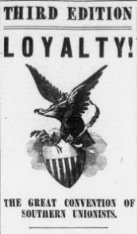
Unionists
Unionists were people who strongly discouraged secession prior to the national election of 1860. They did not agree with the actions of the Northern states or federal government, but they believed the Constitution would protect their way of life.

Slide 3
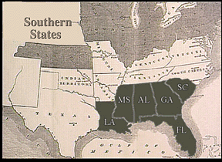
Cooperationists
Cooperationists were South Carolinians who favored seceding from the Union, only as a last resort and only if ALL southern states supported it.

Slide 4
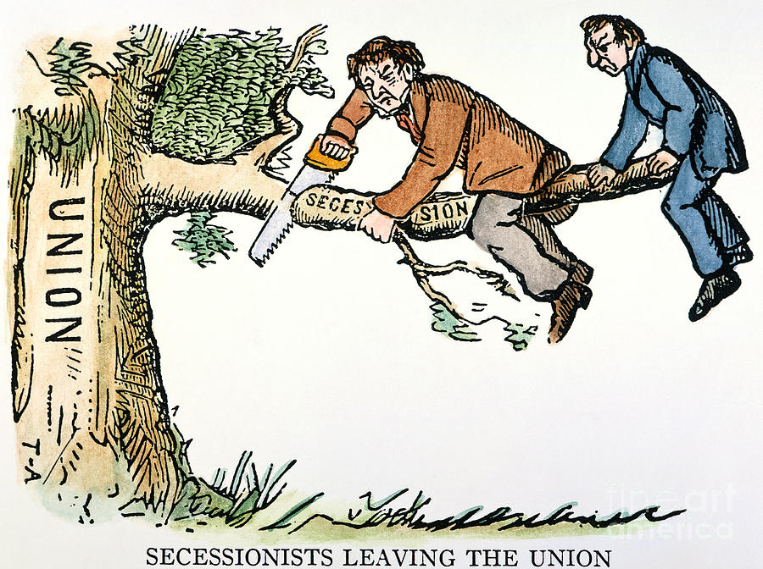
Secessionists
Secessionists (or radicals or “fire-eaters”) argued that breaking apart from the Union was the only answer for South Carolina. After the events of the 1850s, most South Carolinians were Secessionists.

Slide 5
Secession Convention
When Lincoln was elected as the 16th president, the leaders of SC carried through with their threat to secede. The legislature called a special convention.
The Convention was held in Charleston because Columbia had a smallpox outbreak (and Charleston was more in favor of secession).

Slide 6
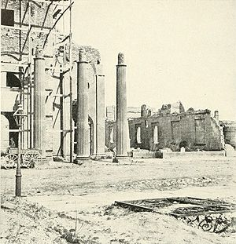
Institute Hall: Before & After the War

Slide 7
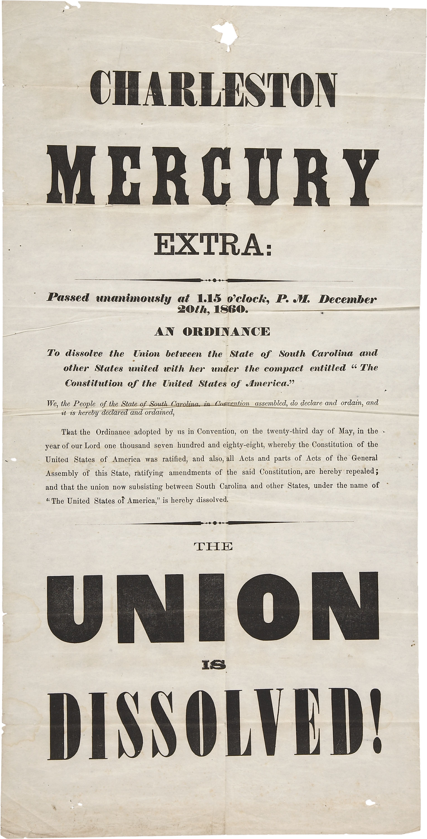
Ordinance of Secession
The leaders voted unanimously for the Ordinance of Secession. The statement read that the federal govt should not interfere with decision making and freedoms of individual states. They assumed that Lincoln would abolish slavery--which would end the southern way of life: politically, economically, and socially.

