Slide 1
8-4.5/6:
The Civil War

Slide 2
Overview
Civil War

Slide 3
Overview
fought from 1861 to 1865
The Union (or North) fought against the Confederate States of America (or South)
680,000 – 800,000 total casualties---deadlier for Americans than the American Revolution, WWI, WWII, & Vietnam combined
Union wins the war (unsurprising, since they had major advantages)
The most fighting took place in northern Virginia

Slide 4
Was the North winning inevitable?
Northern advantages:
Population: North had 22 million people, South had 9 million (3.5 million slaves)
Manufacturing: North made 90% of all goods in America; turned out 17x more textiles, 30x more shoes & boots, 13x more iron, and 32x more firearms
Railroad: North had 20,000 mi of RR; South had 10,000 mi
Enlistment: North had 2 million soldiers; South had 900,00
Agriculture: North had better food stores (farmers used more mechanization)

Slide 5
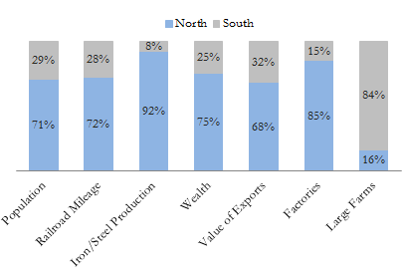
Was the North winning inevitable?

Slide 6
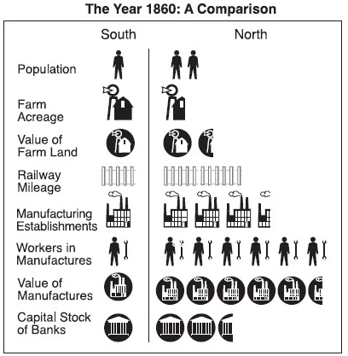
Was the North winning inevitable?

Slide 7
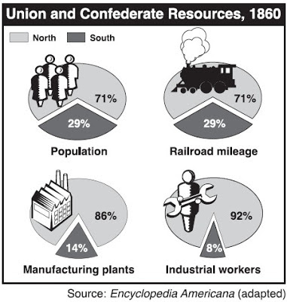
Was the North winning inevitable?

Slide 8
South’s Advantages
Southern advantages:
Better leaders: like Robert E. Lee, Stonewall Jackson, J.E.B. Stewart, etc.
They didn’t have to win territory or invade the North, just had to defend. North had to go into the South and win in order to achieve their goal of “preserving the Union.”

Slide 9
Was the result a foregone conclusion?
Confederacy had to start and organize a country from scratch (with ppl who were committed to their own state first)
they had a lot of class conflicts b/c the ruling elite rarely fought (if you owned 20 slaves or more you were exempt from conscription)
Confederates just had to outlast North’s resolve—but South’s resources would be depleted first

Slide 10
1.
1860-1861
The First Year

Slide 11
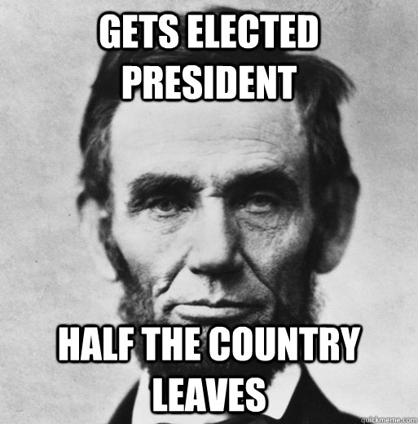
Nov/Dec 1860
Abraham Lincoln is elected (November)
South Carolina secedes (December)

Slide 12
“South Carolina is too small to be a Republic, and too large to be an insane asylum.”
-James L. Petigru, a Charlestonian Unionist

Slide 13
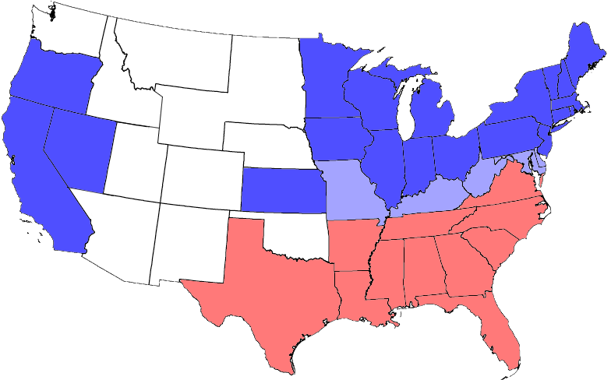
Jan-June 1861
Dec-Feb 1861: SC, MS, FL, AL, GA, LA, & TX secede
April-June 1861: VA, AR, NC, & TN seceded
Border States who don’t secede: MD, KY, DE, & MO
Union
Confederate
*West Virginia left Virginia in 1863 to join the Union.

Slide 14
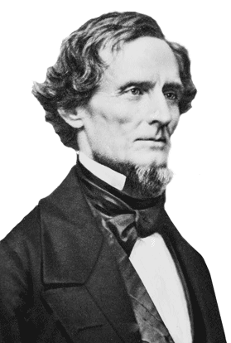
Feb. 4th, 1861
The seceded states met at a convention in Montgomery, AL. There they wrote a constitution for the newly formed Confederate States of America and elected Jefferson Davis president.
Jefferson Davis of MS

Slide 15
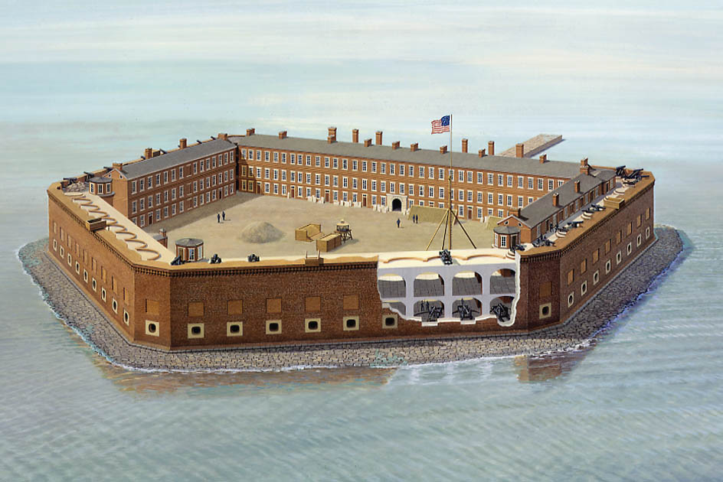
Dec. 1860-March 1861
In Dec. 1860, amid the secession drama U.S. Major Robert Anderson moved his 85 soldiers from Ft. Moultrie to Ft. Sumter.
When Lincoln was inaugurated in March, Anderson reported that he had six weeks of food left in the fort.

Slide 16
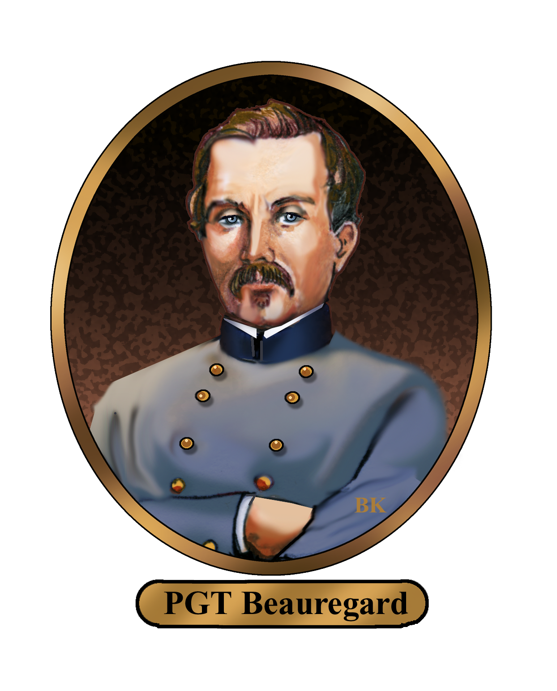
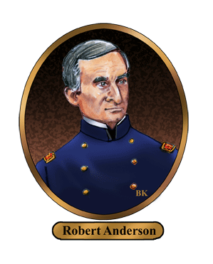
April 11-14th, 1861
On April 11, Confederate General P.G.T Beauregard demanded Anderson surrendered the fort.
Mr. Carney smells.
At 4:30am on April 12, Confederate batteries (including from Ft. Johnson) fired on the fort.

Slide 17
April 11-14th, 1861
After the Confederates fired on the fort for 34 hours, Anderson surrendered the fort. No soldiers were killed, but the Civil War had begun.
Mr. Carney really smells.
*2 men died in the Union surrender ceremony or because Mr. Carney smelled so bad.
Battle Of Fort Sumter Video

Slide 18
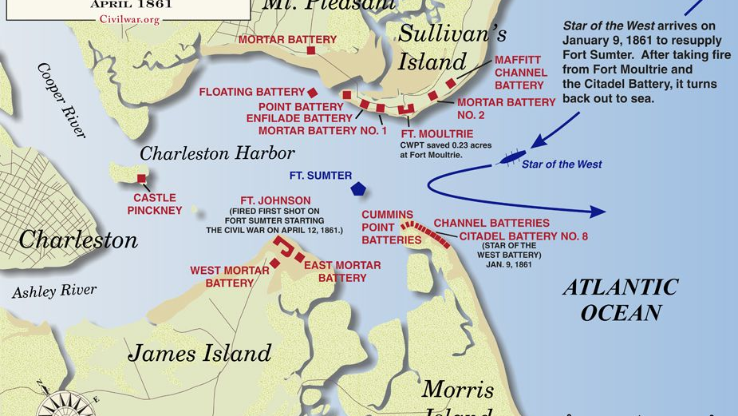

Slide 19
“Two battles will close the war and our independence will be acknowledged. Great Britain and France will offer their mediation and the Yankees will gladly accept it and make peace.”
-States Rights Gist, May 17, 1861

Slide 20
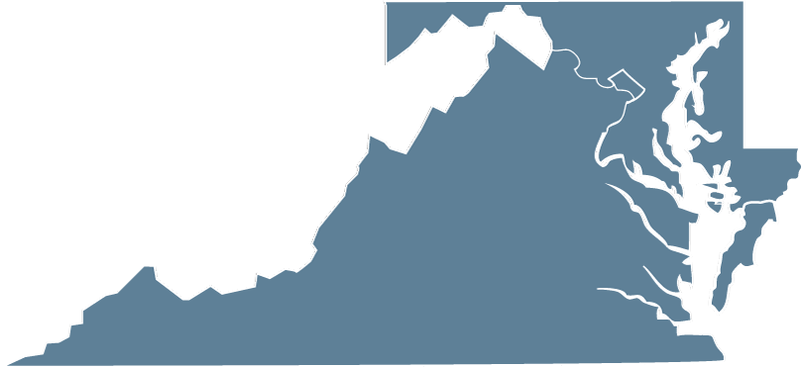
July 1861
At Bull Run Creek in the town of Manassas, VA, the Union & Confederate armies met for the first major land battle of the Civil War. Both sides were inexperienced.
Washington D.C
Manassas
Richmond
Bull Run video

Slide 21
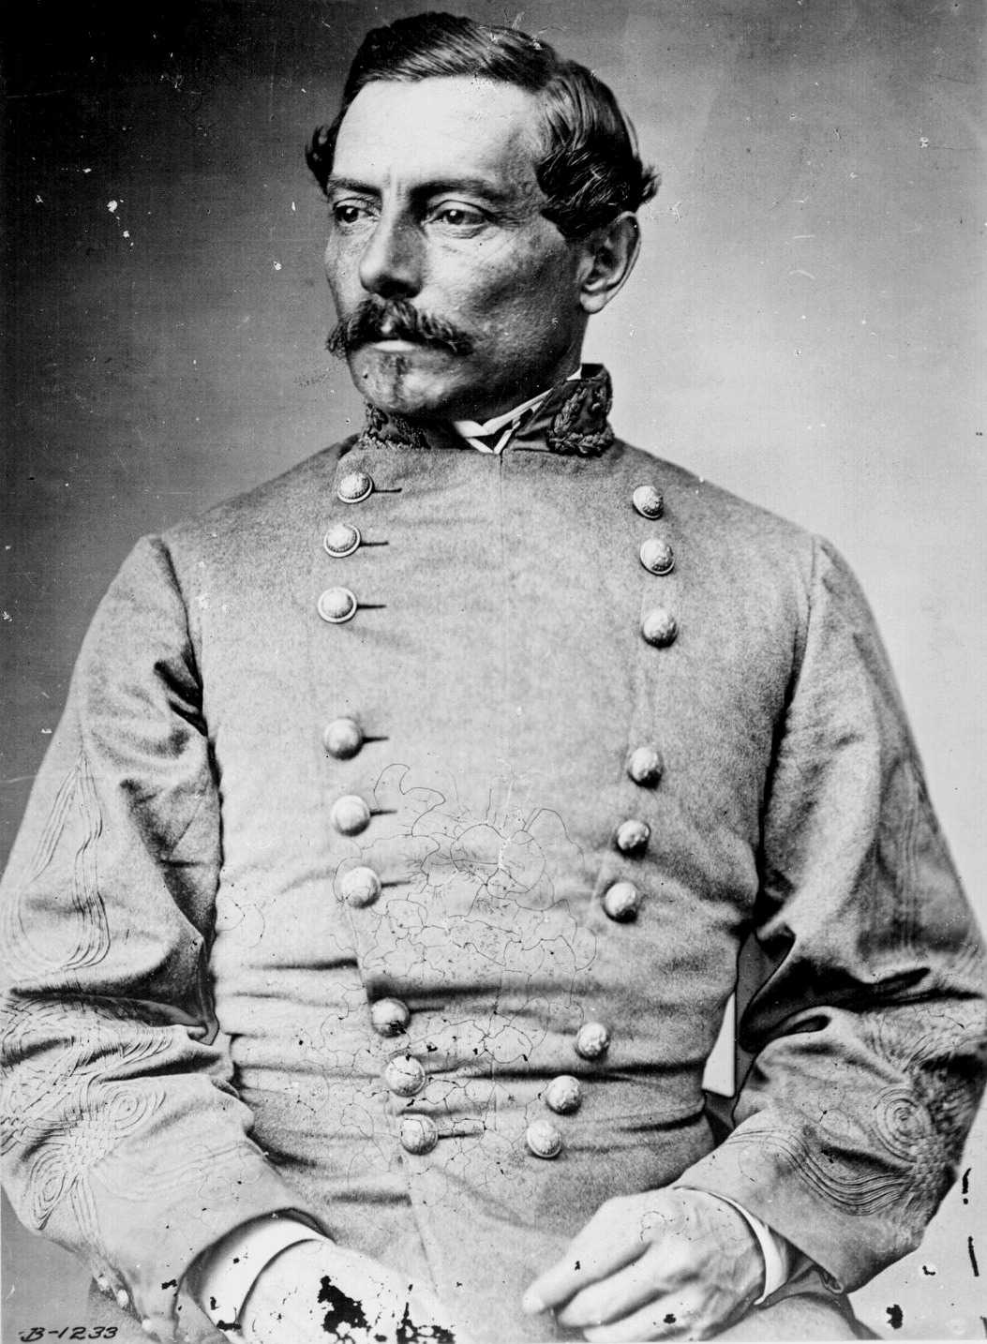
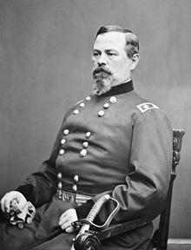
July 1861
Union Commander Irvin McDowell attempted to attack Confederate forces under General P.G.T Beauregard.
He wanted to quickly defeat the bulk of the Confederate army, march to Richmond (Confederate capital) and end the war.
P.G.T Beauregard
Irvin McDowell

Slide 22
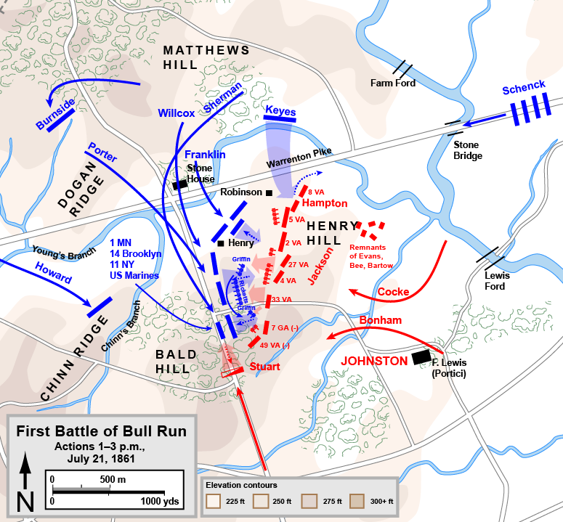
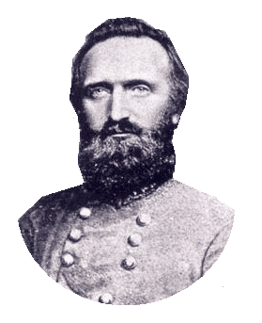
July 21st, 1861
On the morning of July 21st, fighting began. Despite errors on both sides, the Union was able to drive back Confederate forces to Henry House Hill (which was held through the impressive effort of Col. Thomas Jackson...who earned the nickname “Stonewall”).

Slide 23
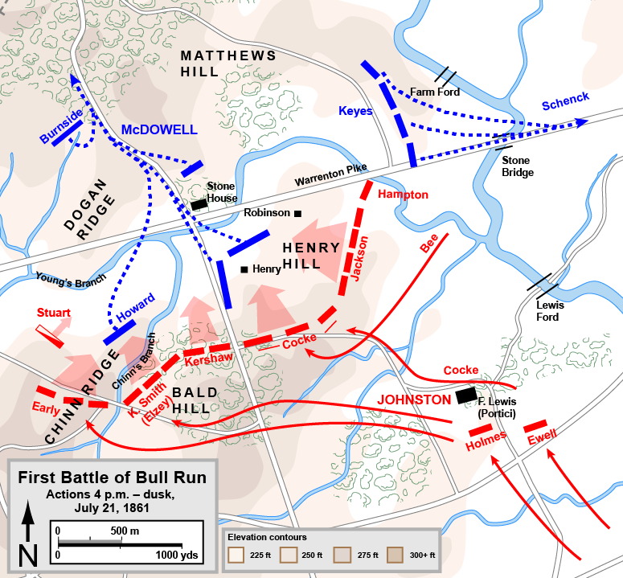
July 21st, 1861
Late in the afternoon, Confederate reinforcements arrived and pushed through the Union right flank. The Union retreated in chaos (impeded by their own artillery and spectators).

Slide 24
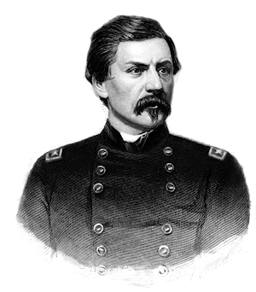
July 21st, 1861
Although the Confederates won, they were too disorganized to pursue the retreating forces towards D.C.
The battle proved to Lincoln & the North that the Civil War would be long and costly. Lincoln fired McDowell as commander and replaced him with George B. McClellan.
George B. McClellan

Slide 26
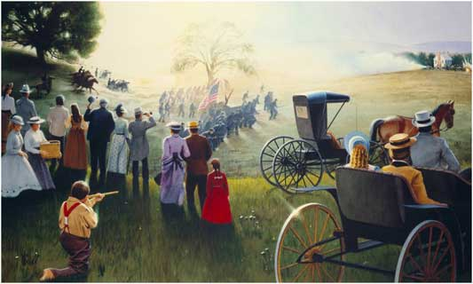

Slide 27
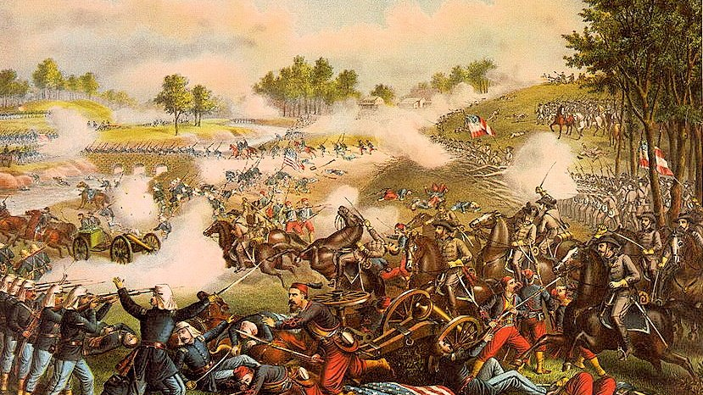

Slide 28
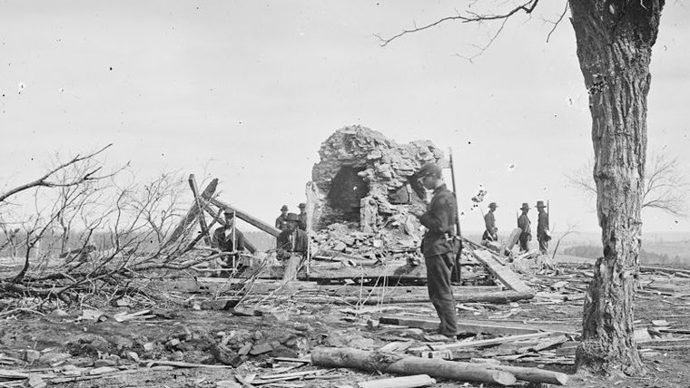
Bull Run Aftermath
Henry Hill House Ruins

Slide 29
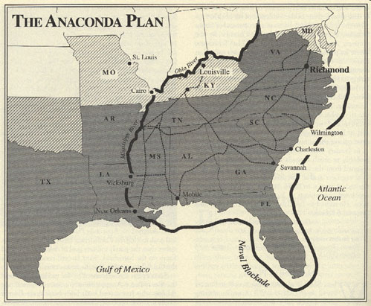
Anaconda Plan
The Union strategy was titled the “Anaconda Plan.”
It’s objectives were to:
Blockade Southern ports
Split the Confederates at the Mississippi River
Capture Richmond

Slide 30
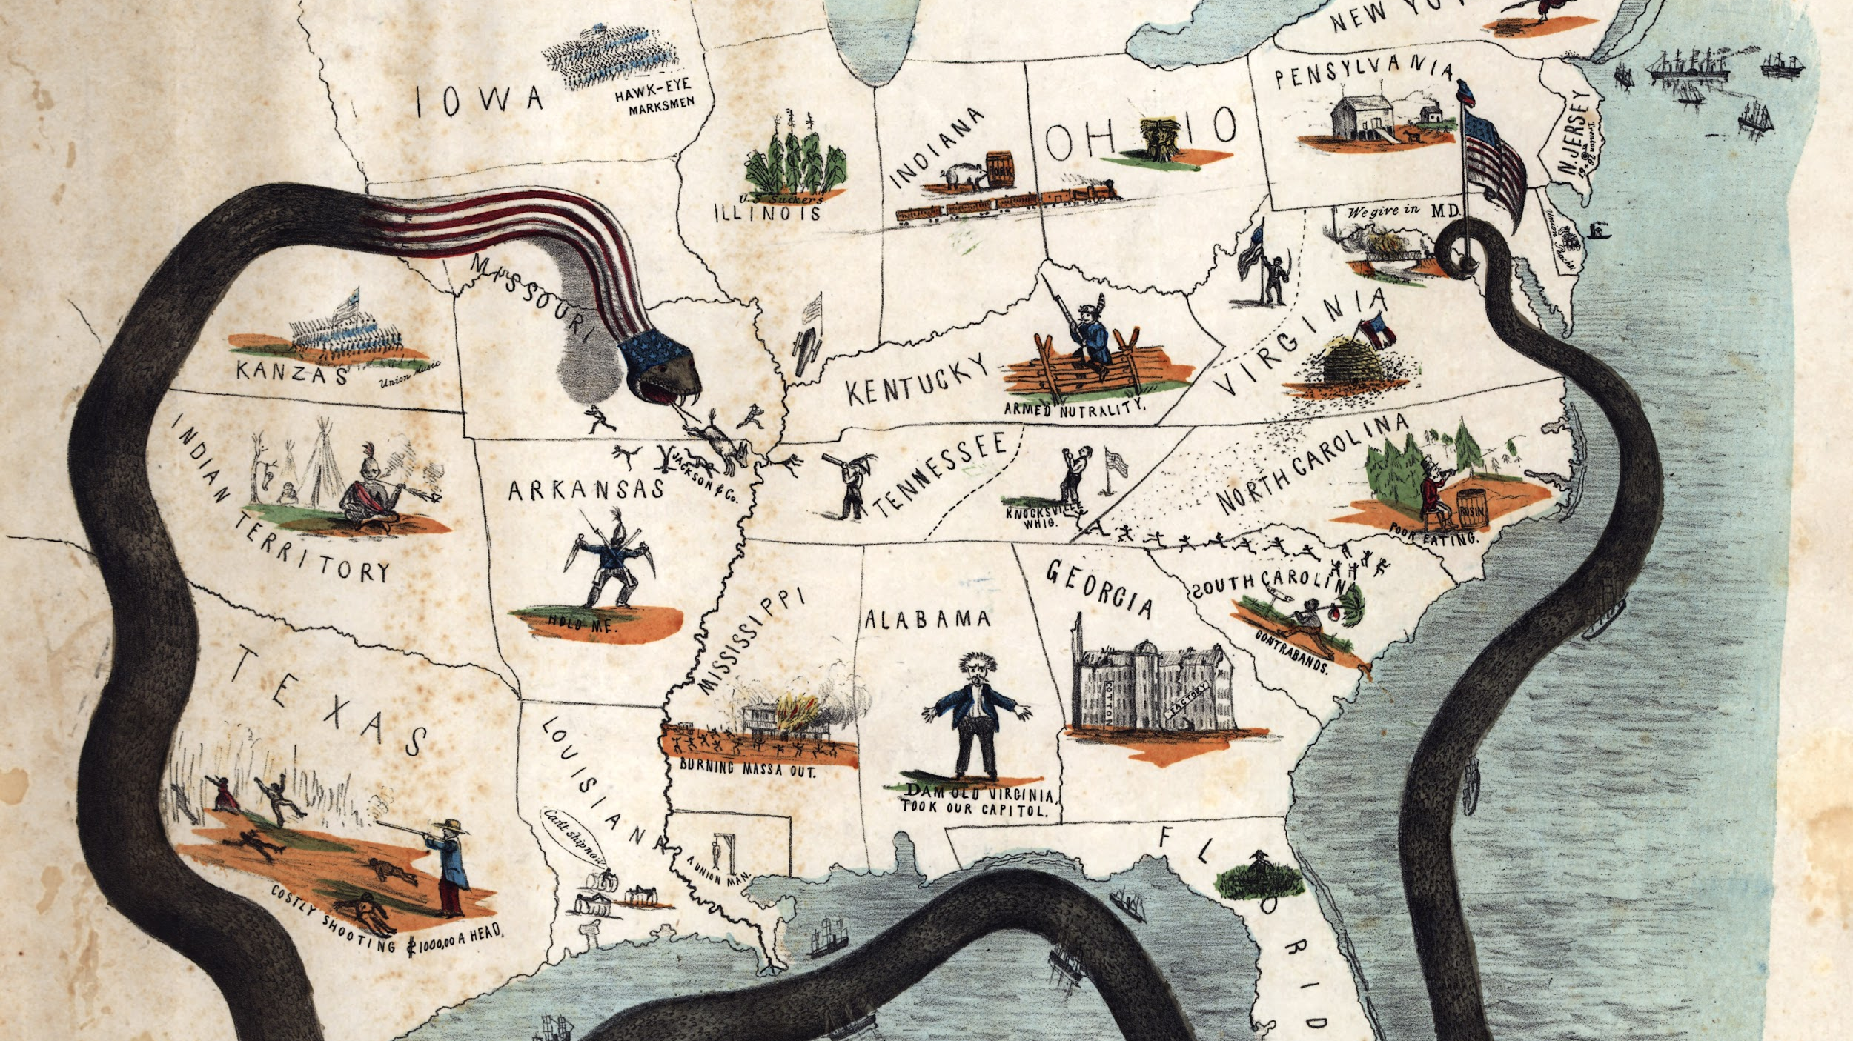

Slide 31
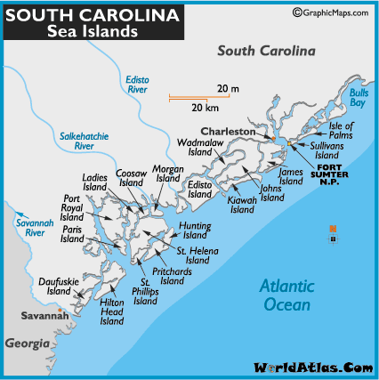
Nov. 1861
The Confederates experienced their first major loss in the war at Port Royal sound (Hilton Head and Parris Island).
As part of the Anaconda Plan, the Union implemented a blockade of Charleston.
In order to do that, they needed a base to launch attacks from.

Slide 32
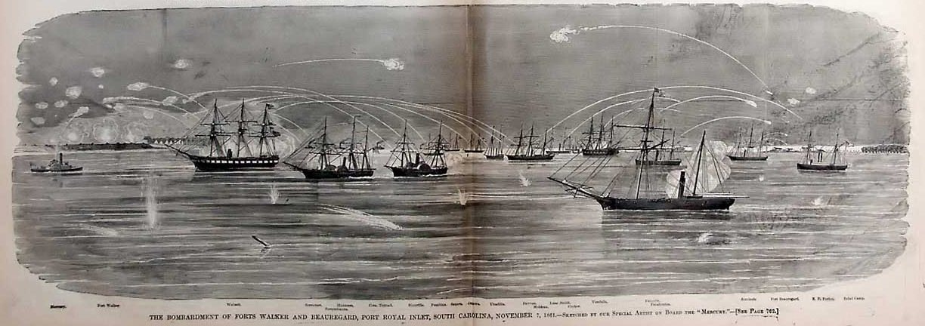
Nov. 7, 1861
On Nov. 7th, 1861, the Union fleet sailed into Port Royal sound. The Confederate fortifications were outgunned and they fled. By midafternoon, the islands had evacuated and the Union controlled the Fort on Hilton Head Island.

Slide 33
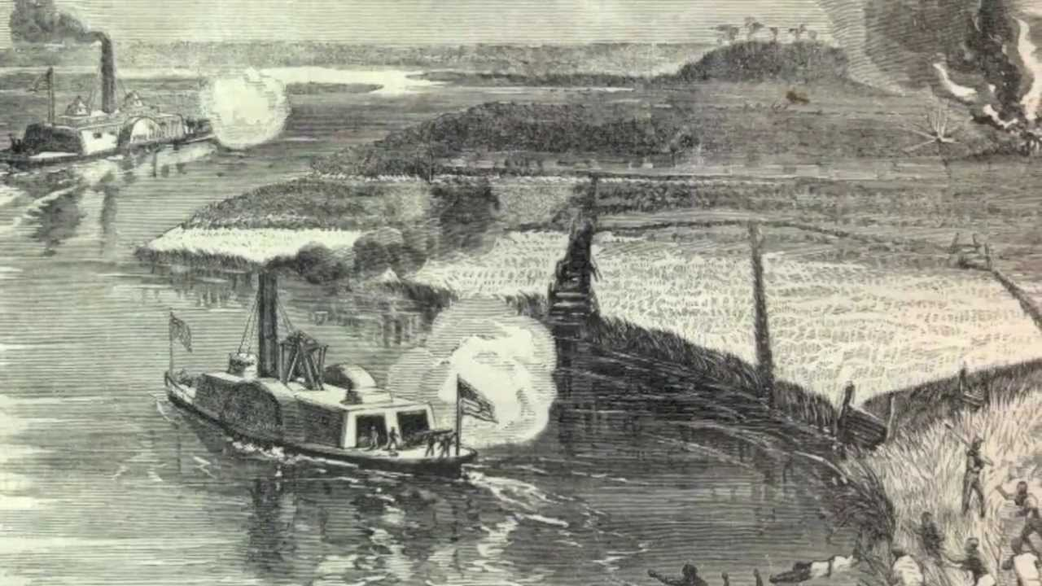
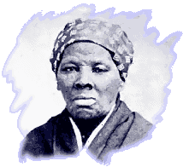
Nov, 1861-1865
From Port Royal they conducted the blockade, but also launched raids into the interior of SC.
They also conducted the Port Royal Experiment.
*Harriet Tubman helped lead a raid on the Combahee River in 1863. Read more at: http://www.libertyletters.com/resources/civil-war/harriet-tubman-civil-war-spy.php

Slide 34
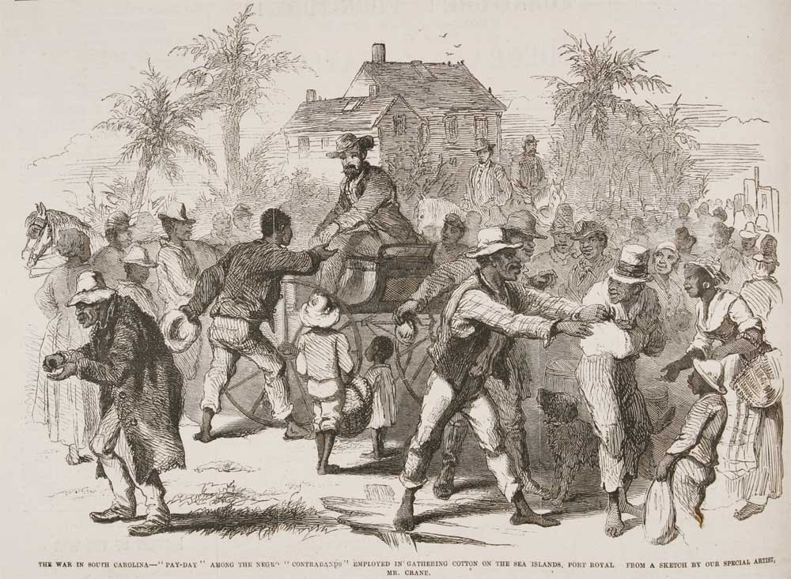
Nov, 1861-1865
After Port Royal was captured, the planters fled and left their slaves. The Union conducted the Port Royal Experiment which served as a “Reconstruction Rehearsal” on what to do with former slaves.

Slide 35
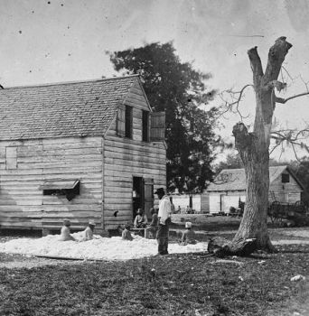
Nov, 1861-1865
The Union freed approx. 10,000 slaves.
These freedmen, called “Contraband” worked the land for money and even became landowners.

Slide 36
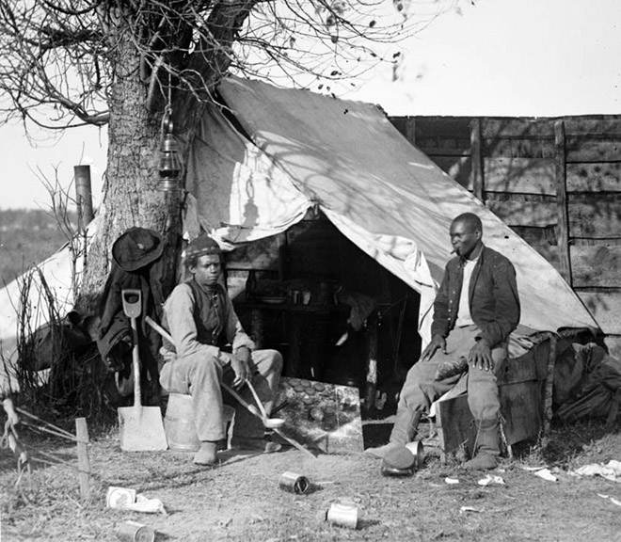
Nov, 1861-1865
The Union freed approx. 10,000 slaves.
These freedmen, called “Contraband” worked the land for money and even became landowners.

Slide 37
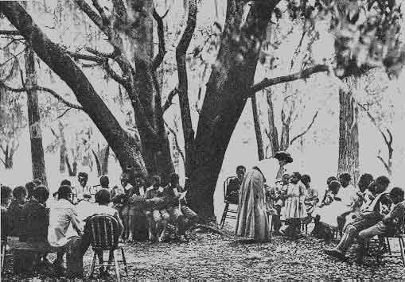
Nov, 1861-1865
A group of Northern missionaries, called Gideon’s Band, came down to open schools and teach the freedmen.

Slide 38
Nov, 1861-1865
Freedmen were also enlisted in the Union army and became the 1st Regiment of SC Volunteers.

Slide 39
2.
1862
The Second Year

Slide 40
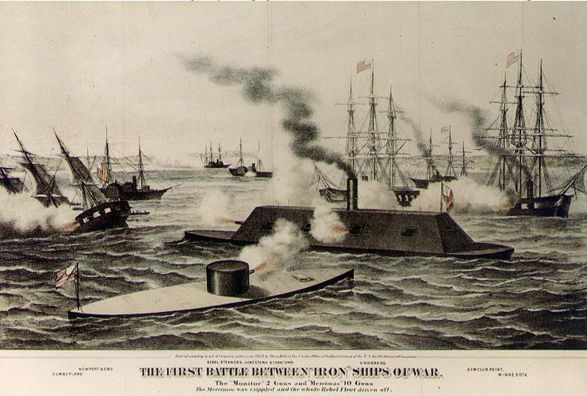
March 1862
First battle between 2 iron-clad steam ships
USS Monitor took on the CSS Virginia (Merrimack) after the Virginia had destroyed several Union wooden ships.
The battle ended in a tie, but it changed naval warfare forever.

Slide 41
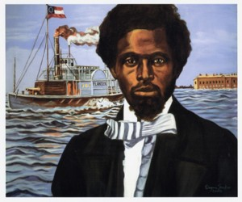
May 1862
Robert Smalls Video
Robert Smalls was a black harbor pilot who lived with his wife and children in Charleston. He wanted to purchase his wife and children’s freedom, but the cost was $800 (he had $100).

Slide 42
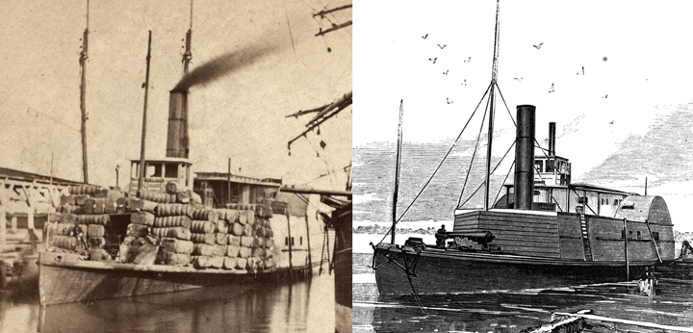
May 1862
Smalls worked on the CSS Planter with 3 other enslaved men.
In the early morning of May 13, 1862, Smalls and the 3 men, loaded their families onto the Planter to escape to the Union ships off the coast of Charleston.

Slide 43
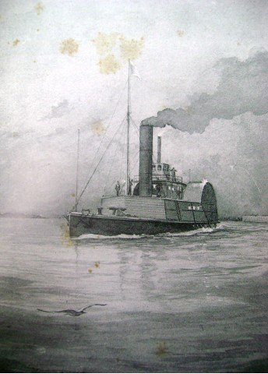
May 1862
He was familiar with the rebel routines and steamed the Planter past 5 Confederate gun batteries giving the correct signals for safe passage.
By dawn, they were free and had delivered the Planter to Union forces.

Slide 44
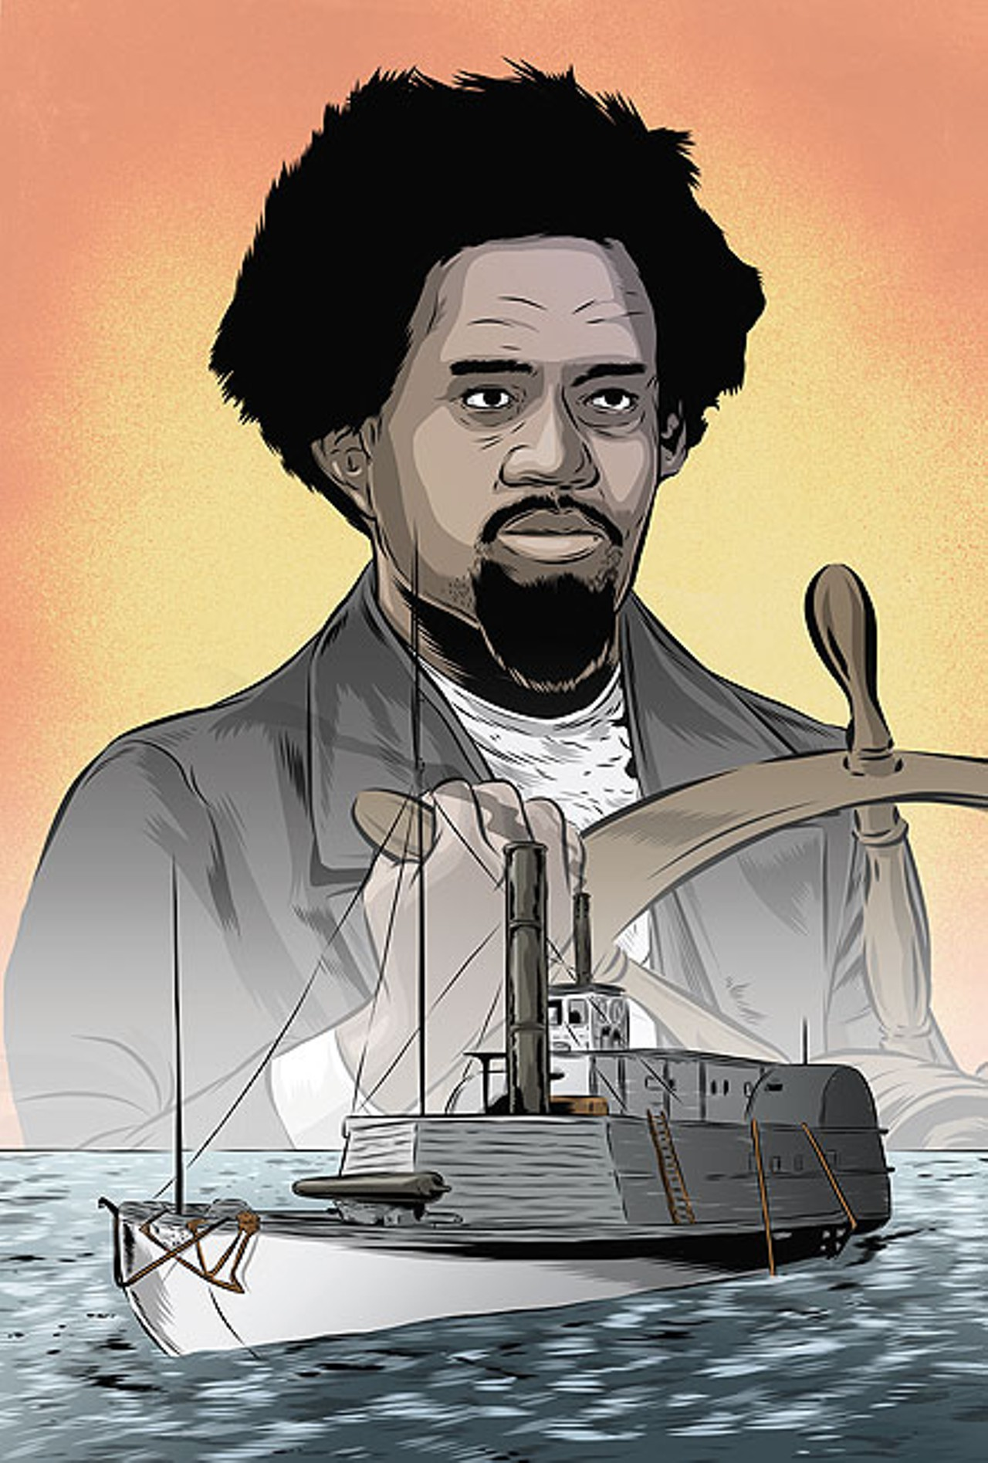
1862-1865
Because of his actions, Smalls was awarded a meeting with Lincoln. He convinced Lincoln to support enlisting black men to fight for the Union.
He helped recruit 5,000 African American men. He captained the Planter & helped scout for Union forces around Charleston.

Slide 45
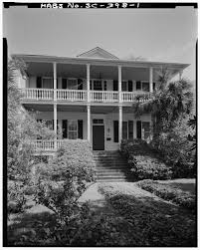
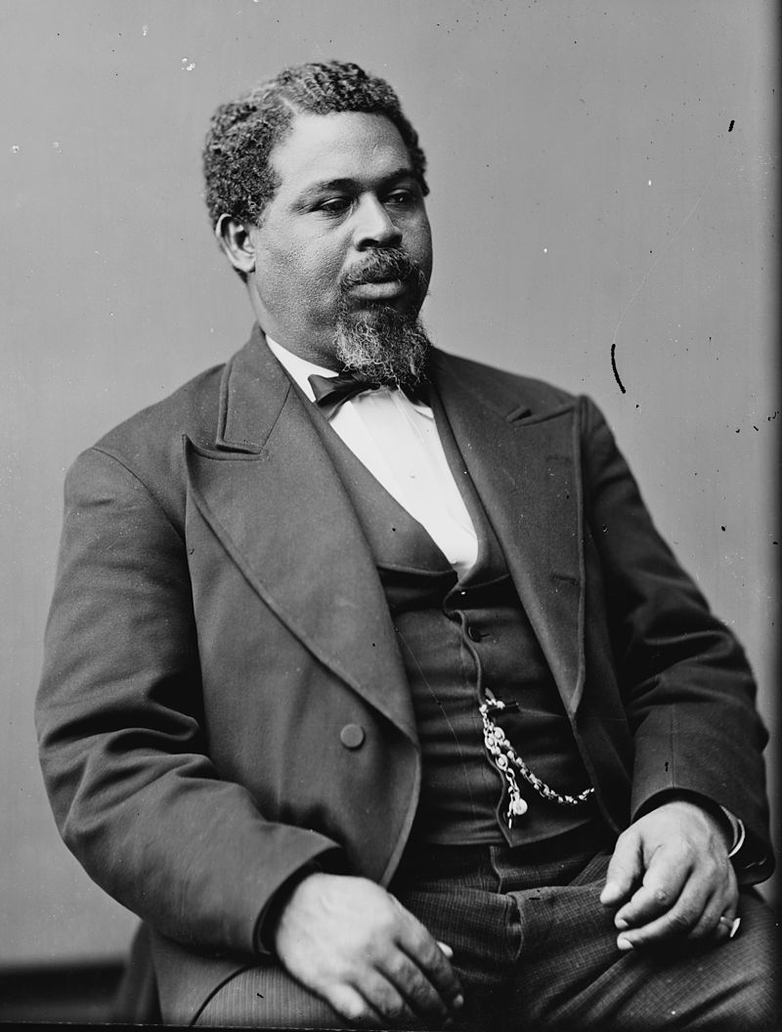
1865-Beyond
Later in life, he purchased the house where he & his mother had been enslaved.
He became a prominent SC politician after the war.

Slide 46
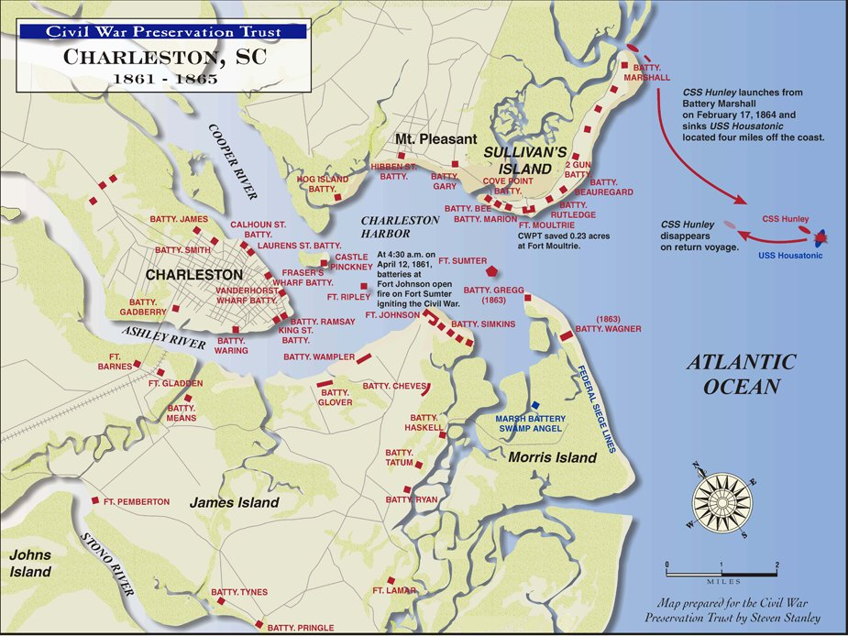
June 1862
With intel from Robert Smalls, the Union attempted to take Charleston by landing on James Island.

Slide 47
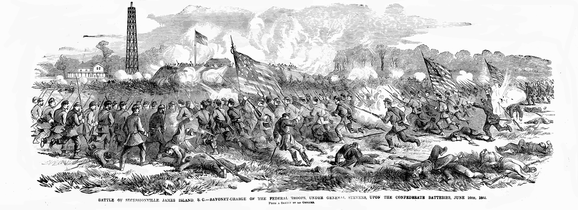
June 1862
On June 16, the Union launched an unsuccessful frontal assault against Ft. Lamar at Secessionville.
The Confederate victory saved Charleston from Union control.

Slide 48
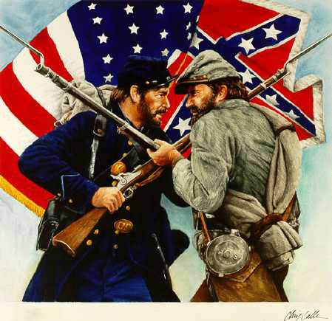
June 1862
Two Brothers Battle at Secessionville
http://www.teachingushistory.org/flash_files/Page1NEW_023.swf
http://www.teachingushistory.org/flash_files/Page2NEW_021.swf
http://www.teachingushistory.org/flash_files/Page3NEW_013.swf
http://www.teachingushistory.org/flash_files/Page4NEW_007.swf
http://www.teachingushistory.org/flash_files/Page5NEW_002.swf
Transcript: http://www.teachingushistory.org/lessons/Campbellpapers.htm

Slide 49
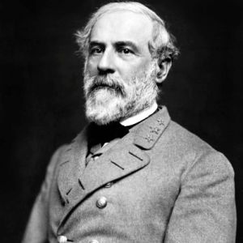
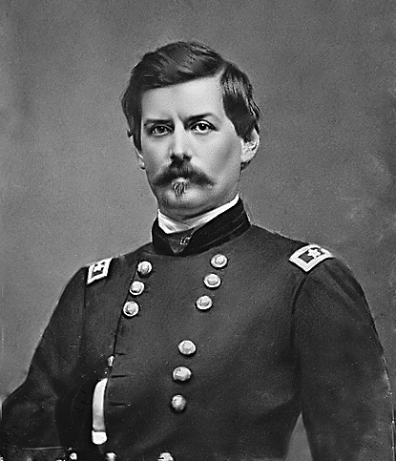
Sept 1862
On Sept 17, 1862, Union General McClellan’s forces faced off against Confederate General Robert E. Lee at Sharpsburg, MD.
Robert E. Lee
George B. McClellan

Slide 50
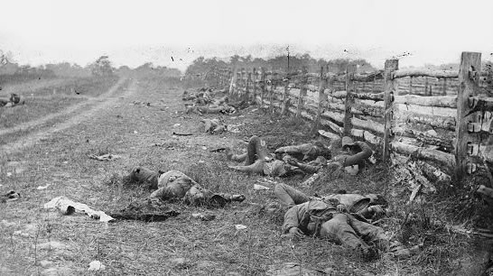
Sept 1862
Both sides swept back & forth across the battlefield which led Antietam to become the bloodiest single day in American history.

Slide 51
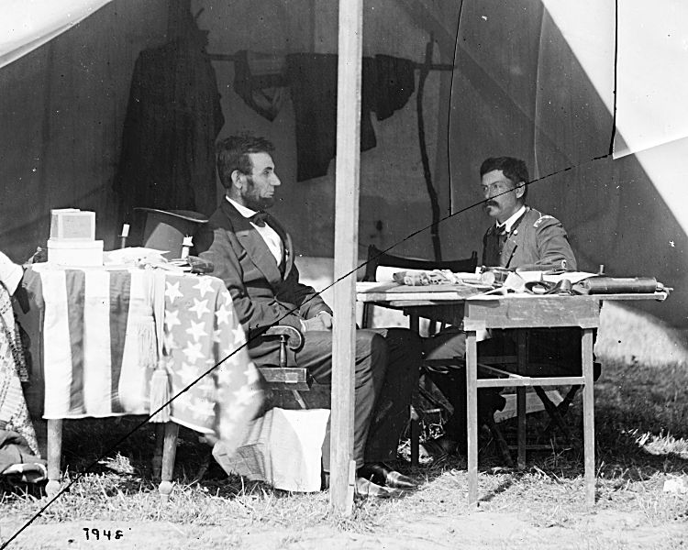
Sept 1862
The Union had double the forces of the Confederates, but McClellan was overly cautious and sent in less than 3/4ths of his men.
The battle pretty much ended in a draw, but the Union claimed victory. Lincoln was upset with McClellan for not being more aggressive.
The slight victory was enough to propel Lincoln to issue the Emancipation Proclamation.

Slide 53
3.
1863
The Third Year

Slide 54
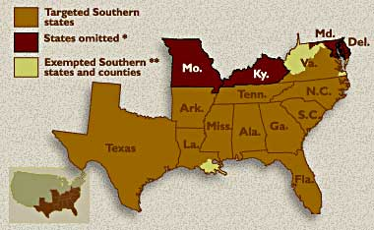
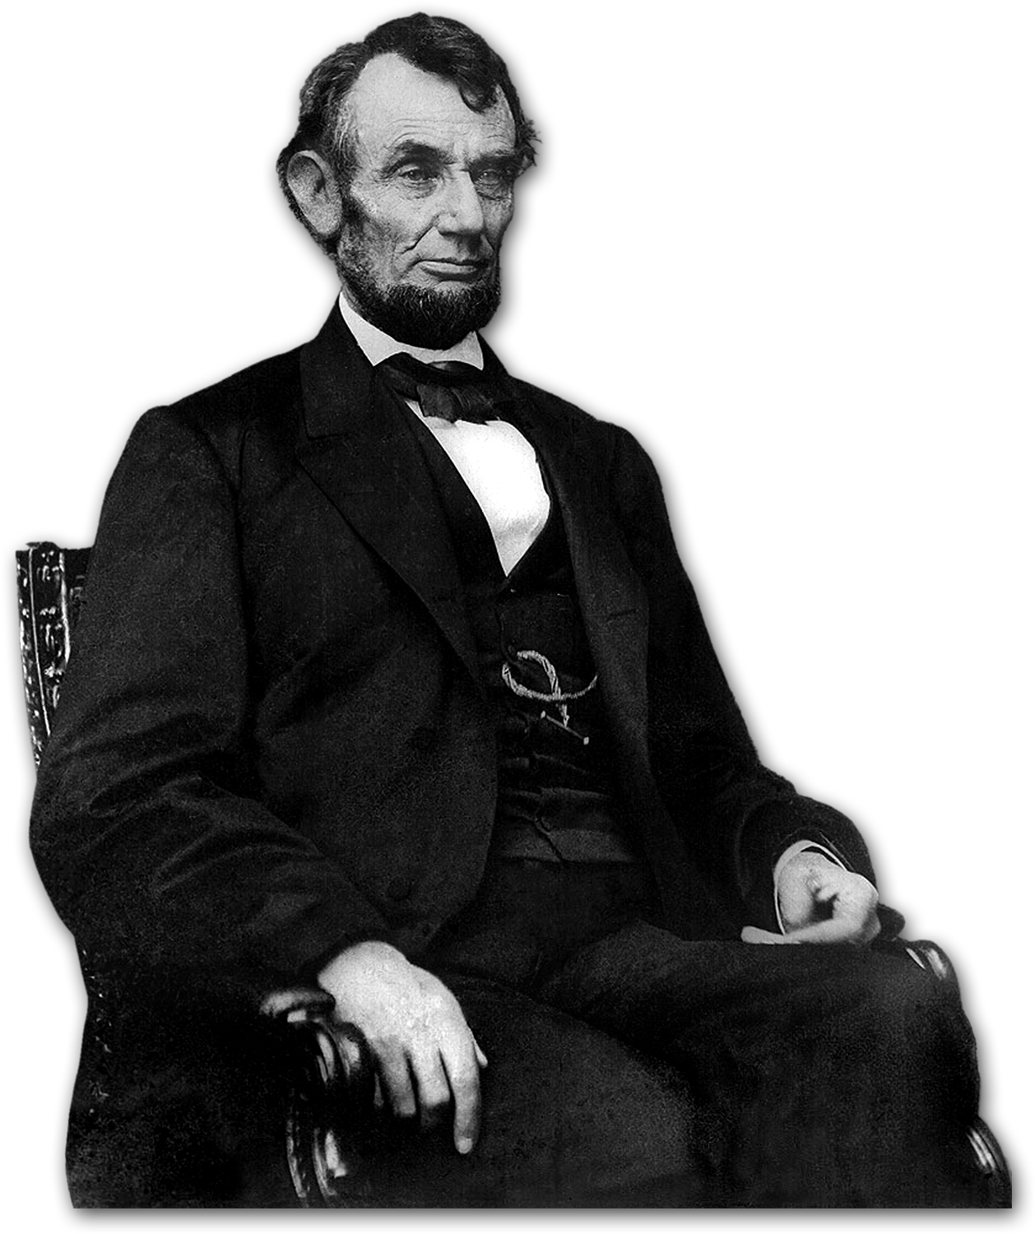
Jan. 1863
Lincoln issued the Emancipation Proclamation which declared slaves in rebelling areas free.
He did not free all slaves (b/c he feared the border states would leave).

Slide 55
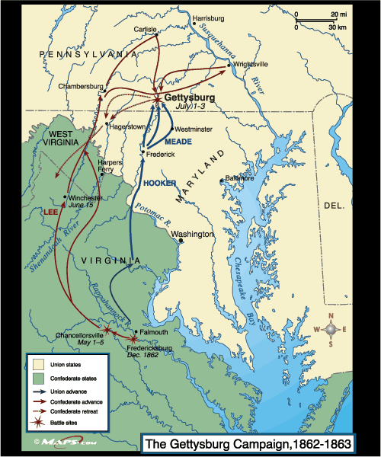
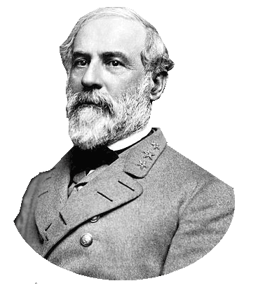
July 1863
Confederate General Lee led his forces for a second time into the North.
He hoped to resupply and scare the North into ending the war.

Slide 56
July 1863
Gettysburg Video
Lee’s forces met against Gen. Meades’ forces in the three day battle (July 1-3) at Gettysburg, PA.
The battle was incredibly costly, but the Union won.
Lee retreated to VA on July 4th and offered to resign.

Slide 58
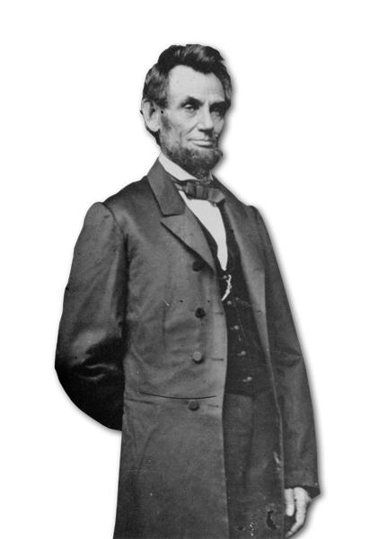
Nov 1863
Four months later, Lincoln returned to the site for the dedication ceremony of the cemetery and gave the Gettysburg Address.
This speech changed the purpose of the war from “preserving the Union” to abolishing slavery.

Slide 59
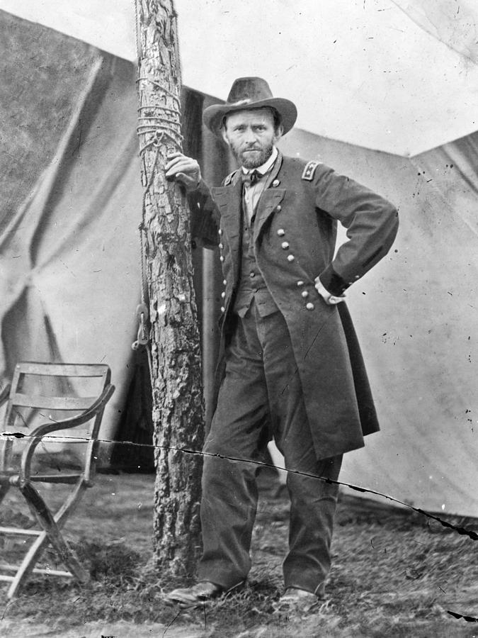
July 1863
Union General Ulysses S. Grant wanted to take Vicksburg, MS. This would give the Union control of the Mississippi River and split the Confederacy in half.

Slide 60
July 1863
After a failed assault, Grant launched a 47 day siege. Vicksburg surrendered and combined with the victory at Gettysburg, the tide of the war had changed.

Slide 62
July 1863
The Union tried to take Battery Wagner on Morris Island.
On July 18th, the 54th Massachusetts (all black regiment) led an unsuccessful frontal assault on the fort.
The Union then carried out a 50 day siege, taking the fort on Sept. 7, 1863.

Slide 63
4.
1864
The Fourth Year

Slide 64
Feb 1864
The Confederates built the Hunley to try to get around the Union blockade.
The Hunley attacked & sank the USS Housatonic (the 1st sub to sink a warship).
The Hunley then sank for mysterious reasons. It had little impact on the war, but would change naval warfare forever.

Slide 66
Nov 1864
The political turning point of the war was Lincoln’s re-election.
He ran against McClellan, who was less committed to preserving the Union.
Lincoln’s win proved that the North was resolved enough to win the war.

Slide 67
Nov-Dec 1864
After capturing Atlanta, Union Gen. William T. Sherman began his “scorched earth” or total war campaign to convince the Southerners to surrender.

Slide 68
Nov-Dec 1864
In his “March to the Sea” Sherman moved his 62,000 men from Atlanta to Savannah.
Along the way they foraged for food & valuables, and destroyed crops, bridges, railroads, etc.

Slide 70
5.
1865
The Final Year

Slide 71
Jan-April 1865
From Savannah, Sherman’s forces marched North through the Carolinas.
He was particularly destructive to SC because of their role in starting the war.

Slide 72
Jan-April 1865
Columbia was destroyed when it was taken in February of 1865.
Charleston also surrendered in February.

Slide 73
April 1865
Union General Grant was able to surround Lee’s forces at Appomattox Court House, VA
Realizing he’d lost, Lee surrendered on April 9, 1865. The terms were pretty lenient. While there was still some fighting, this is acknowledged as the end of the war.

Slide 74
6.
The Impact
on South Carolinians

Slide 75
Impact on Wealthy & Lower Class
wealthy elite served as officers (Planters could exempt from draft)
men from the lower classes died disproportionately
plantations were destroyed; war ended slavery and owners lost their fortunes
⅓ of white South Carolinians of age died in the war

Slide 76
Impact on Women
women were left to tend farms & run plantations during war
had a difficult time because of shortages
served as nurses or worked to fundraise
many were widowed

Slide 77
Impact on African Americans
many fled to the north
others stayed on the plantation--the Emancipation Proclamation didn't really effectively free the slaves until the military occupied the territory
African American troops served with distinction, but were discriminated against (white officers, less pay, etc.)
some African Americans were forced into service with the CSA army

Slide 78
Impact on Children
helped on the plantations or farms
some boys as young as 10 enlisted
many lost their fathers

Slide 79
A picture is worth a thousand words
A complex idea can be conveyed with just a single still image, namely making it possible to absorb large amounts of data quickly.

Slide 80
Want big impact?
Use big image

Slide 81
89,526,124
Whoa! That’s a big number, aren’t you proud?

Slide 82
89,526,124$
185,244 users
100%
That’s a lot of money
And a lot of users
Total success!

Slide 83
Justice icons by Arthur Shlain
https://thenounproject.com/ArtZ91/

Slide 84
SlidesCarnival icons are editable shapes.
This means that you can:
Resize them without losing quality.
Change line color, width and style.
Isn’t that nice? :)
Examples:

