Slide 1
8-5.4 - 8-5.8: Gilded Age & Progressive Era

Slide 2
Gilded Age:
An Era of Enormous Wealth

Slide 3
Gilded Age:
An Era of Enormous Poverty

Slide 4
1
Video

Slide 5
Gilded Age

Slide 6
Gilded Age
The second half of the 19th century became known as the Gilded Age. Gilded means covered in gold. The name refers to the fact that on the surface things seemed shiny and bright, but underneath the surface people were really struggling.
A handful of Americans got rich, but corruption in business & government, poor working conditions for factory workers, struggling agriculture, child labor, poverty, & discrimination was common.

Slide 7
Gilded Age:
“Robber Barons”

Slide 8
The external glitter of wealth conceals a corrupt political core that reflects the growing gap between the very few rich and the very many poor.
-Mark Twain

Slide 9
Gilded Age:
“Robber Barons”

Slide 10
Railroads
The U.S. increased economic development and movement out west by quadrupling the amount of railroads across the country.
Movement out West was encouraged by the Homestead Act (the govt gave free land to people if they agreed to live on it for 5 years) In SC, railroad growth came slowly...however, Columbia became a regional hub.
Link to Video

Slide 11
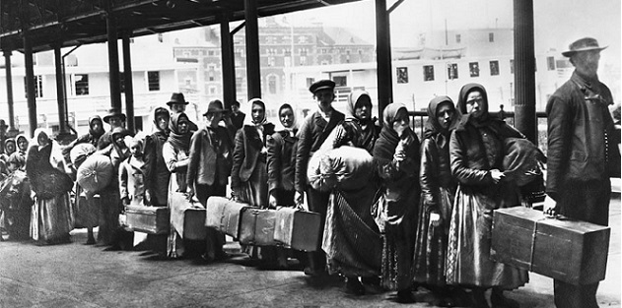
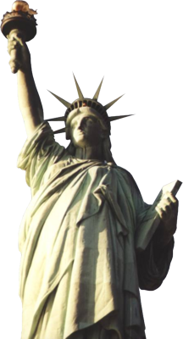
Industrial Boom
Ellis Island Video Link
Other industries like oil and steel across the U.S. experienced a huge boom. Because of a need for labor in factories, the U.S. saw a huge rise in immigration. 25 million people arrived in the U.S. between 1865 to 1915.
Factories started using mass production, so they no longer needed skilled workers. Immigrants, blacks, and poor whites provided unskilled labor and in exchange they were subject to low wages, long hours, and poor working conditions.

Slide 12
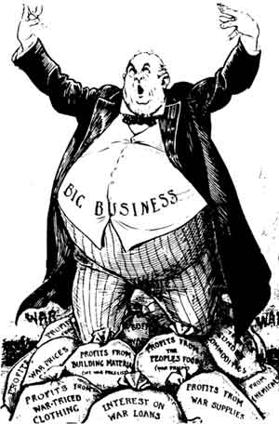
Nativism & Social Darwinism
The rise in immigration led to a wave of prejudice against those newcomers. Nativism, a prejudice of new immigrants by “original Americans” developed in the North. They used “Social Darwinism” a fake science that claimed that certain races of people were superior. It claimed that these better races had benefitted from “survival of the fittest” and therefore they were justified in taking advantage of the lesser groups of people.

Slide 13
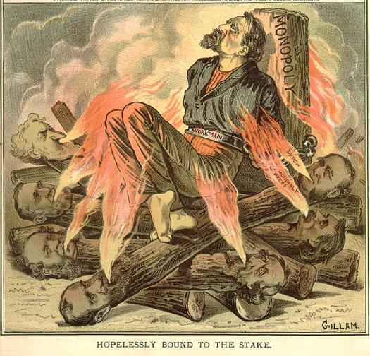
Gilded Age Political Cartoon
Create a political cartoon that represents the Gilded Age.
Remember political cartoons often use: labels, irony, exaggeration, captions, etc. to make a point.

Slide 14
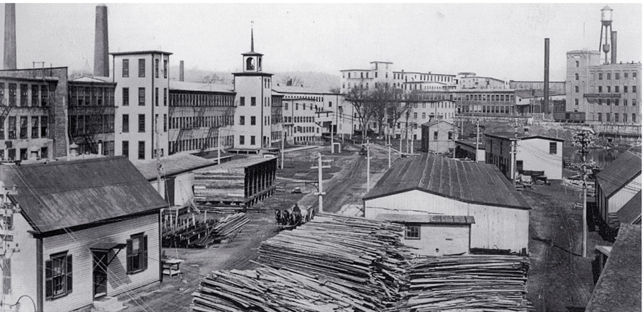
Textile
Industry
SC did not see the same economic boom or rise in immigration because the Conservative Democrats under Governor Wade Hampton wanted to stick with the old agricultural SC.
The textile industry did boom in SC. In the Upcountry along rivers for power, textile mills started popping up. By 1910, there were 167 mills employing 47,000 people.

Slide 15
Mill Life
Mills in SC typically hired poor whites. Conditions in the mills were terrible. Workers worked 12 hour shifts Monday-Saturday. Because there were no labor unions (organized group of workers formed to negotiate with employers) wages were very low.
Mill owners built mill towns to house their employees. Owners therefore controlled almost every aspect of workers lives. It was hard to get out of the cycle of debt.

Slide 16
Gilded Age:
Mill Life

Slide 17
Gilded Age:
Mill Life

Slide 18
Gilded Age:
Mill Town

Slide 19
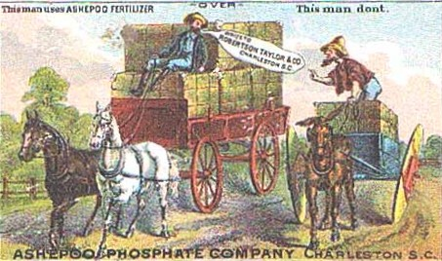
Other Industries
The other major industry that developed was phosphate, which is used as fertilizer. During the 1880s, SC was the world’s leading producer of phosphates. Other industries developed in lumber and turpentine

Slide 20
Textile Mill Assignment:
With the laptops or ipads and your partner(s), create a slide presentation, imovie, or brochure on mill town life.
Your presentation must include:
-a description on what life was like, what jobs were done, etc. (Be detailed!)
-2 photographs
-a direct quote from someone who worked in the mill (use the interviews)
-Bonus points for how visually appealing your work is
Use this website to start your research: http://www.ibiblio.org/sohp/laf/factory.html

Slide 21
Hampton & the Redeemers

Slide 22
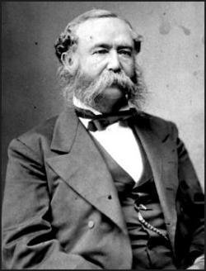
Wade Hampton
After Reconstruction, Wade Hampton and the Conservative Democrats were in control of the state. They immediately set out to reverse the Reconstruction policies that had given African Americans rights in SC.

Slide 23
Wade Hampton
The Democrats blocked the vote of African Americans in three ways:
-Eight Box Law: This law required voters to place their ballots in one of eight boxes. For a vote to count, the voter had to put his ballot in the correct box. This was hard for voters who could not read.
-Poll Tax: Voters had to pay a special tax in order to vote. Often due before profits from harvest time, this law also made it difficult for poor whites to vote, so SC instituted a Grandfather Clause (if your Grandfather or Father had voted in the 1860 election you did not have to pay the tax).
-Gerrymandering: creative redrawing of districts to make sure each area had a Democratic majority

Slide 24
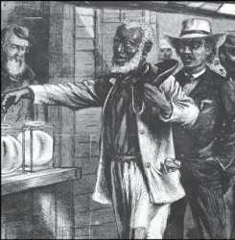
Eight Box Law
This law required voters to place their ballots in one of eight boxes. For a vote to count, the voter had to put his ballot in the correct box. This was hard for voters who could not read.

Slide 25
Eight Box Law

Slide 26
Poll Tax
Voters had to pay a special tax in order to vote. Often due before profits from harvest time, this law also made it difficult for poor whites to vote, so SC instituted a Grandfather Clause (if your Grandfather or Father had voted in the 1860 election you did not have to pay the tax).

Slide 27
Grandfather Clause

Slide 28
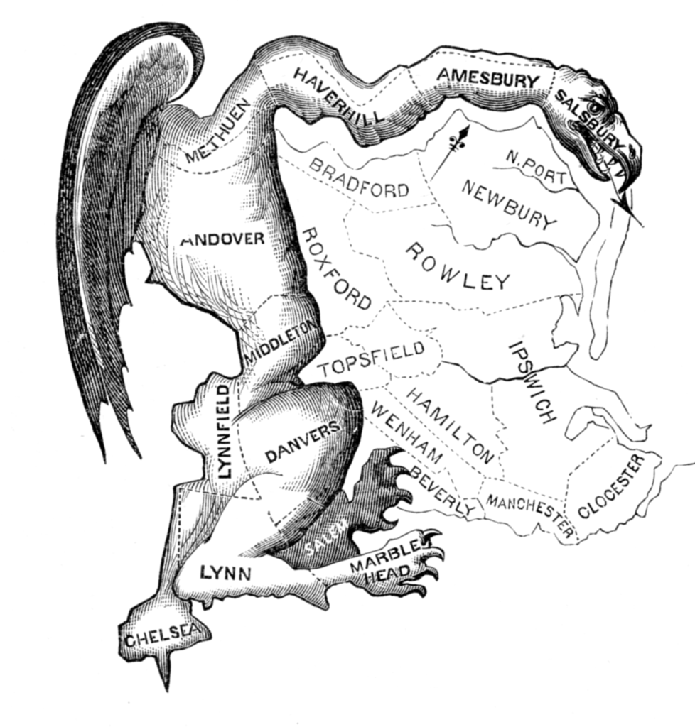
Gerrymandering
creative redrawing of districts to make sure each area had a Democratic majority

Slide 29
Gerrymandering

Slide 30
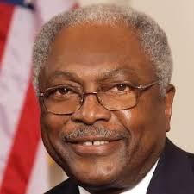
Results
These measures worked. In 1876, before the end of Reconstruction, nearly 92,000 African Americans had voted. Six years into the Gilded Age, less than 14,000 voted. African Americans would not hold office in U.S. Congress until 1993.
Jim Clyburn

Slide 31
Populism & the Tillman Era

Slide 32
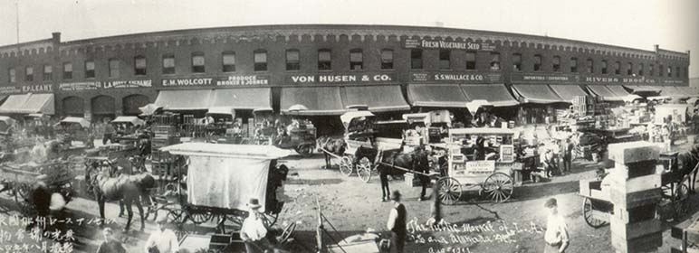
Farming
Farmers in post Reconstruction SC really struggled. Sharecropping & crop liens created a cycle of debt. Cotton wasn’t selling well because it was in oversupply. Prices dropped and many farmers turned to truck farming (which could be sold locally out of the back of your truck). Two major environmental disasters (earthquake of 1886 & hurricane of 1893) also took a toll on farming. Rice never recovered as customers turned to Asia to provide rice.

Slide 33
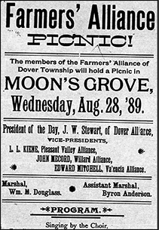
The Grange & Farmers Alliance
Farmers began to blame big business and government for their problems. Following the example of labor unions, farmer began to organize. In 1871, SC farmers formed The Grange---a group that tried to persuade politicians to pass laws that helped farmers. It had little success, so they formed the Farmers’ Alliance to replace it. The Alliance was divided by race.

Slide 34
Populist Movement
Out of the farmers’ struggle and the Farmers’ Alliance came the Populist movement. The People's party (Populist), was organized to represent the common folk—especially farmers—against the interests of the industrial capitalists.

Slide 35
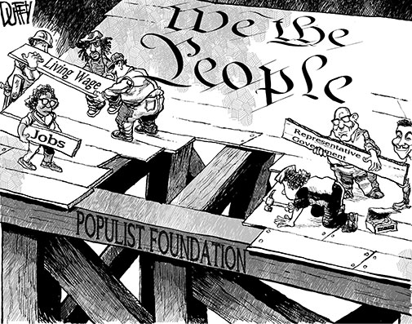
Populist Movement
Populists wanted:
federal farm loans
block African American vote (unique to the SC Populists)
graduated income tax
direct election of Senators

Slide 36
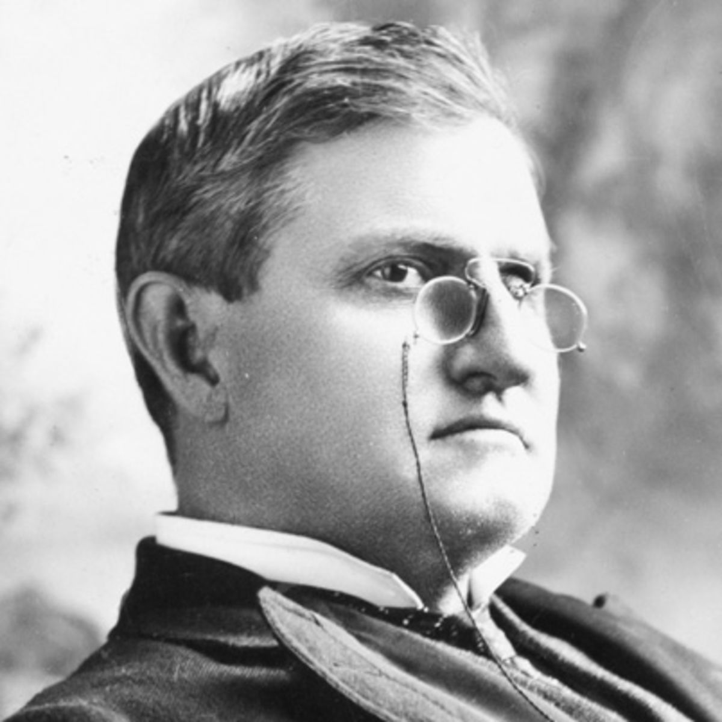
Pitchfork Ben
The Populists supported Ben Tillman. Nicknamed “Pitchfork Ben,” he advocated for greater support for farmers. He openly attacked the Hampton Democrats for their conservative policies and ridiculed Hampton himself. The Tillmanites elected him Governor. Tillman formed a political machine by playing on poor farmers and racism to gain votes. Unlike in other states, the Populists remained a part of the SC Democratic party.

Slide 37
Tillman with Woodrow Wilson: Notice his “farmer getup”

Slide 38
Clemson University
Gov. Tillman supported the establishment of Clemson University as an agricultural school to teach better farming practices. The land had been donated by Thomas Green Clemson (John C. Calhoun’s son-in-law). Clemson was created as a land-grant college (Morrill Act: paid for the University with funds off the sale of western land).

Slide 39
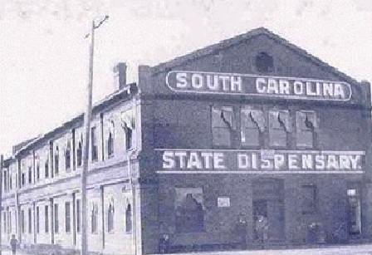
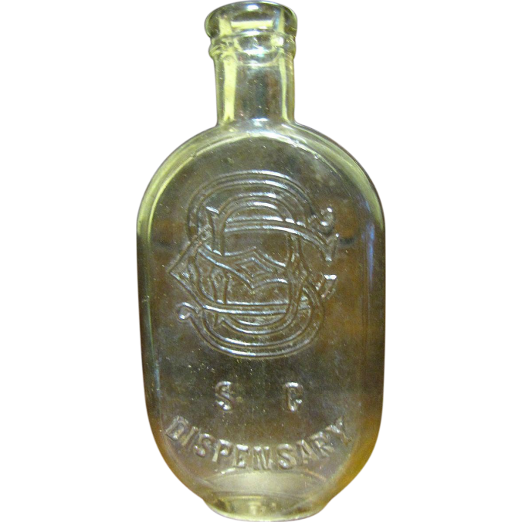
Dispensary
Tillman also successfully created the Dispensary. Temperance (the banning of alcohol movement) was growing in SC. The SC Dispensary took over the sale of alcohol in the state and profits went to government initiatives.

Slide 40
Constitution of 1895 & Jim Crow

Slide 41
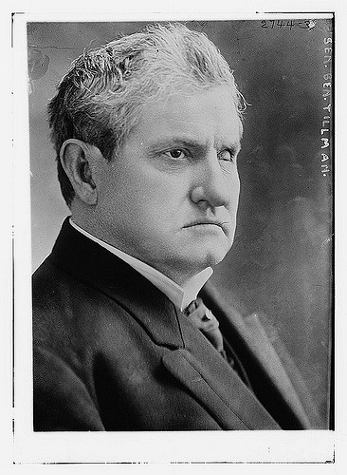
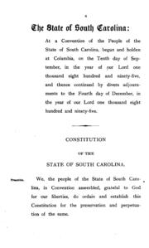
Tillman & the Constitution
On President Cleveland-- “He is an old bag of beef and I am going to Washington with a pitchfork and prod him in his old fat ribs.”
Tillman went on to become a US Senator. He used his influence to rewrite the state constitution with the goal to restore white supremacy in the state.

Slide 42
Constitution of 1895
In September of 1895, they rewrote the constitution. The Constitution of 1895 included: poll taxes, literacy tests, the denial of voting rights to “criminals.” The new constitution also set the stage for segregation (racial separation) by requiring separate schools for black and white children.

Slide 43
Voting Under Tillman

Slide 44
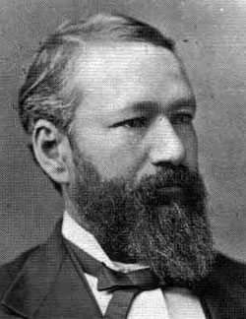
Plessy v Ferguson
Later in the year, the Supreme Court ruled that laws segregating blacks and whites in public places did not violate the Constitution, as long as they were “separate but equal.” The case (Plessy v Ferguson) paved the way for Jim Crow laws which forced blacks to ride in separate rail cars, use separate public facilities, and inhabit “Colored only” areas.
Not Homer Plessy...this is Pinckney Benton Stewart Pinchback

Slide 45
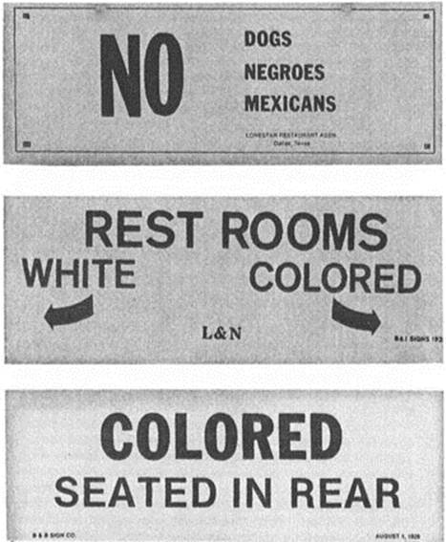
Plessy v Ferguson

Slide 46
Plessy v Ferguson stands until Brown v Board of Education

Slide 47
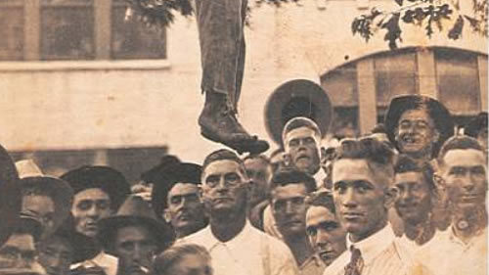
Lynchings
A record number of violent acts broke out. In the 1890s, there were an average of 187 lynchings a year. Hundreds of thousands of African Americans migrated North out of the state to escape the violence

Slide 48
Natural Disasters
Earthquakes & Hurricanes & Asteroids (Except the Asteroids)

Slide 49
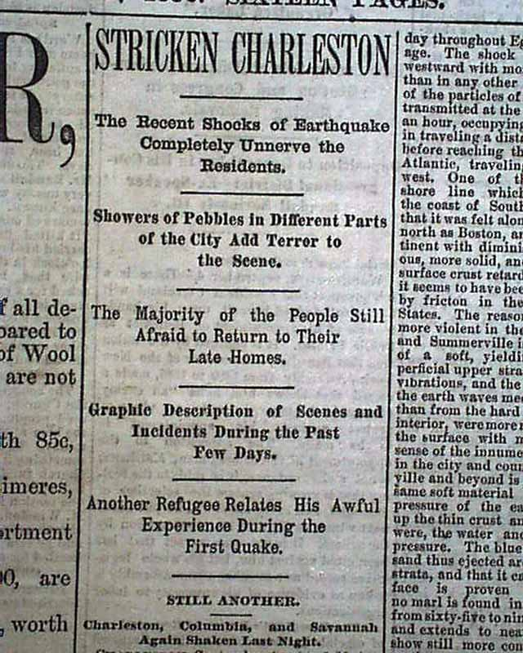
Natural Disasters
On Aug 31, 1886, an earthquake destroyed Charleston. Over 100 were confirmed dead (counting of African American deaths was inaccurate). Thousands of buildings were destroyed. In the 1890s, seven hurricanes struck the coast. The disasters contributed further to the farmers’ struggle.

Slide 50
Earthquake Aftermath

Slide 51
Earthquake Aftermath

Slide 52
Progressive Era
People push for reform

Slide 53
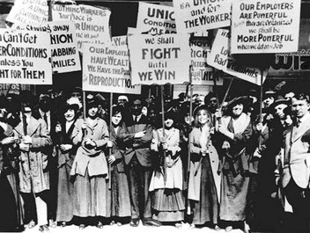
Progressives
In the late 1800s and early 1900s, reformers wanted to fix the problems of the Gilded Age. They called themselves Progressives. Progressives were members of both political parties, but in SC they were a part of the Democratic party.

Slide 54
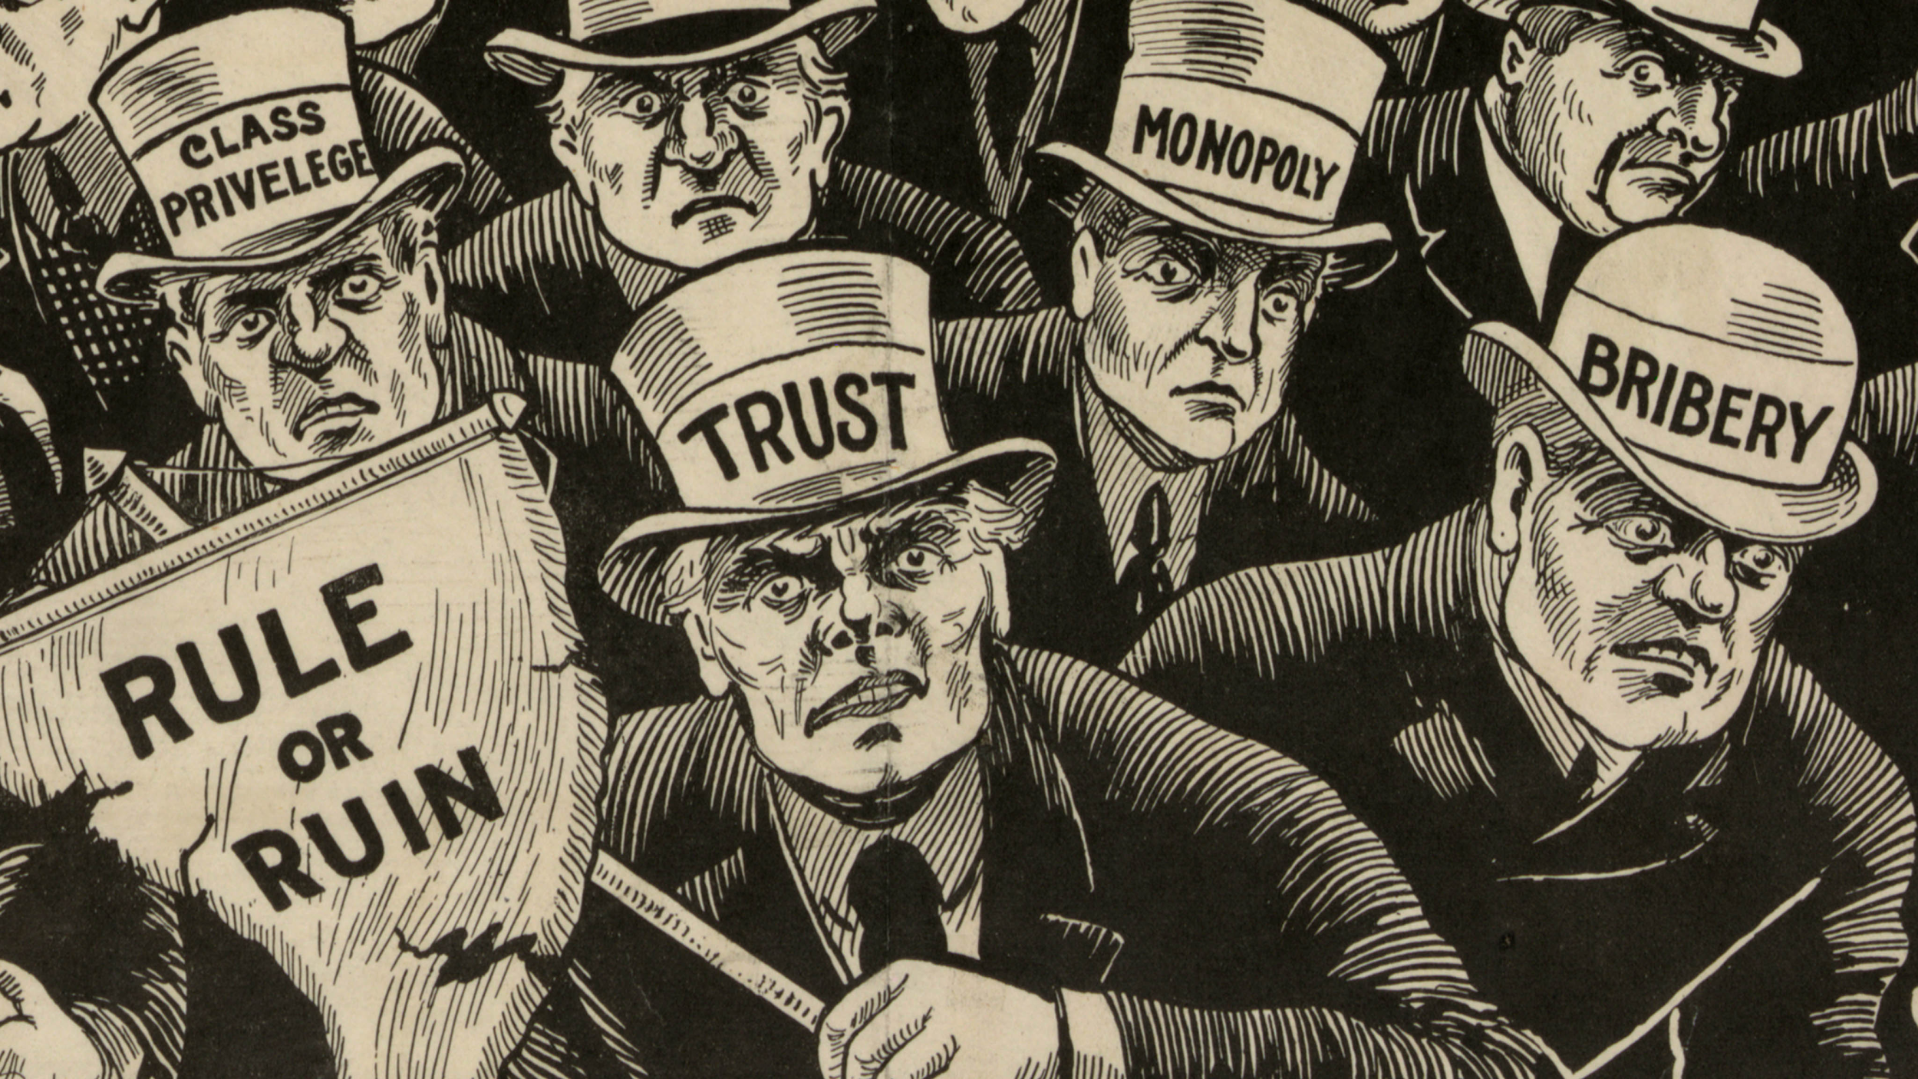
Goals
Progressives targeted political machines and monopolies in industry. They tried to improve working conditions and low wages for workers.

Slide 55
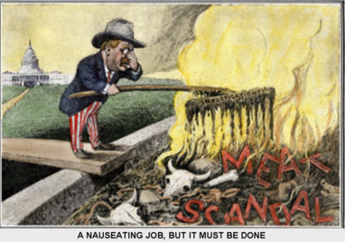
Progressives
Muckrakers worked to expose some of the corrupt practices of businesses and government. For example, Upton Sinclair published his book The Jungle to expose the unsanitary conditions in the meatpacking industry. Jacob Riis, a photojournalist published How the Other Half Lives to show the conditions poor people were living in the cities.

Slide 56
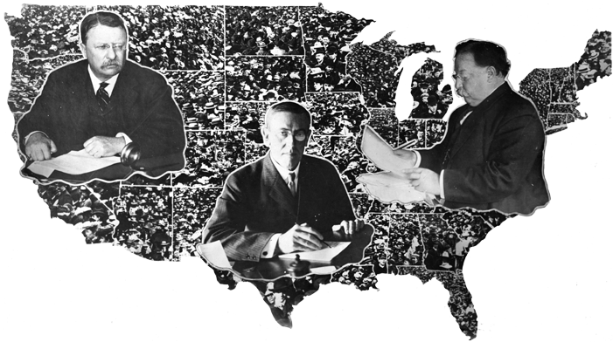
Progressive
Amendments
Progressive Presidents also contributed to change. Theodore Roosevelt broke up monopolies and created the national park system. William Howard Taft passed the 16th Amendment (established an income tax) and the 17th Amendment (direct election of Senators). Under Woodrow Wilson, the 18th Amendment (prohibition: made the sale, manufacturing, and transport of alcohol illegal) was passed.

Slide 57
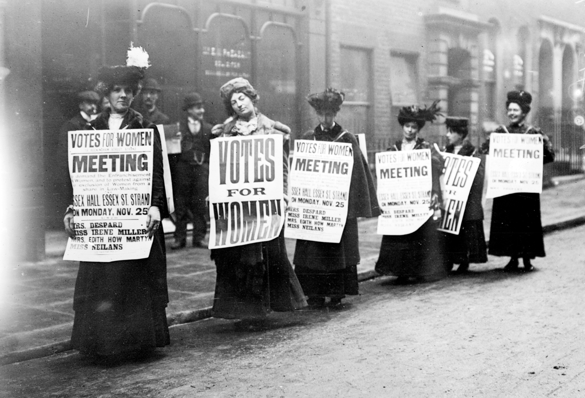
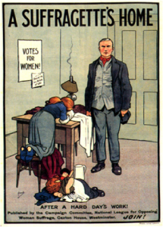
Women’s Vote
Women suffragettes also fought for the right to vote. In 1920, the 19th Amendment (gave women the right to vote) was passed. SC refused to ratify it until 1967, but because other states did, women earned the right to vote.

Slide 58
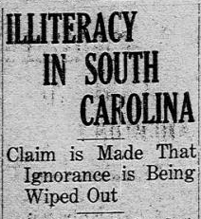
SC Progressives
In SC, the major issues for progressives were: child labor, working conditions, temperance, and improving education. They were able to set a minimum work age (10 years old). The progressives also worked to pass a attendance law for schools because 45% of SC could not read or write. They worked to establish hospitals to fight diseases like tuberculosis (which was rampant in mill towns).

