Slide 1
World War I
8-6.1

Slide 2
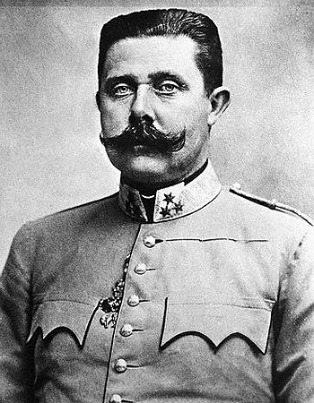
What caused World War I?
The main causes of World War I were Militarism, Alliances, Imperialism and Nationalism. The event that marks the official start of the war was the assassination of archduke Franz Ferdinand (the heir to the Austria-Hungarian throne).

Slide 3
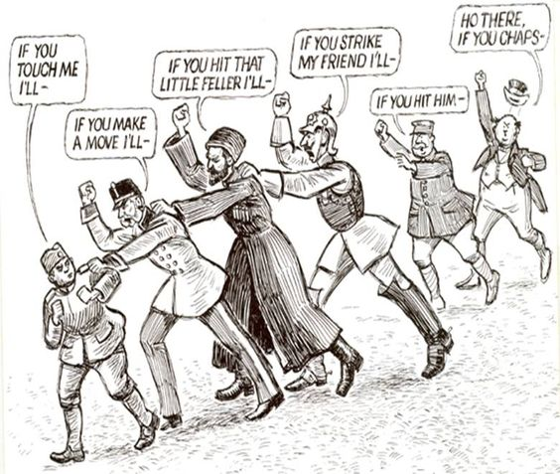
What were the sides during World War I?
There were two sides during WWI: The Allied Powers, formerly known as the Triple Entente, and The Central Powers, which was formerly the Triple Alliance.

Slide 4
What were the sides during World War I?
The allied Powers included France, Great Britain, Russia, Serbia, and later the US. The Central Powers consisted of Germany, Austria-Hungary, and the Ottoman Empire. Italy switched from the Central Powers to the Allied Powers 1 year after the war started.

Slide 6
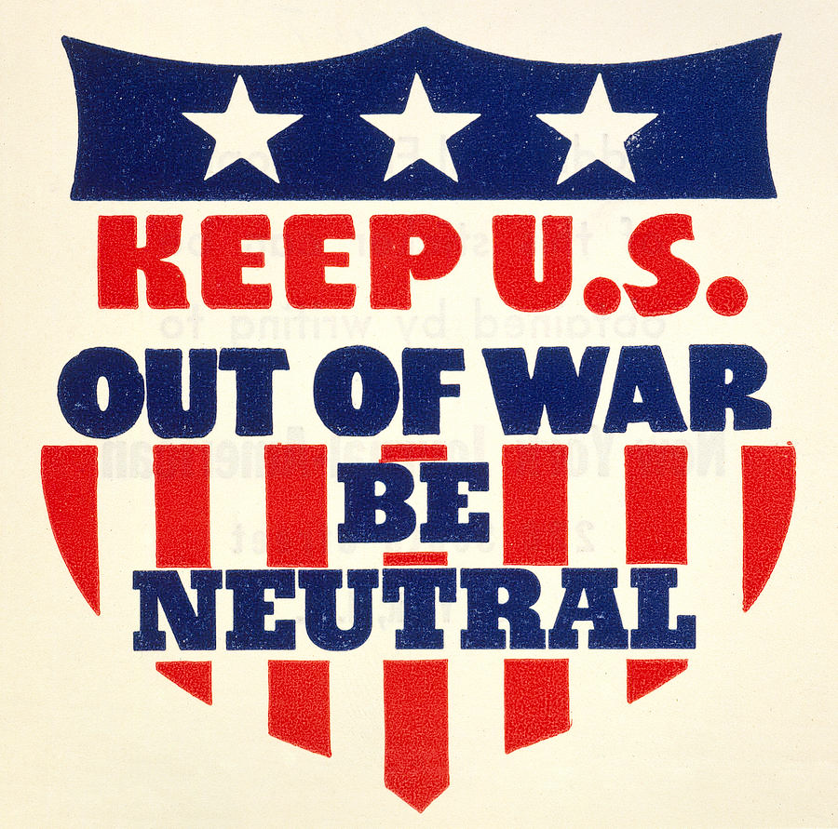
What caused the US to join WWI?
At the outbreak of the war, The United States declared neutrality. However, various factors challenged America’s neutrality and eventually led to their involvement in what would be known as the Great War:
Economic ties to the Allied Powers
Sinking of the Lusitania
Zimmerman Telegram
Russian Revolution

Slide 7
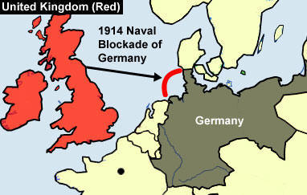
How did economic ties lead to the US joining the war?
Initially, the US traded with both sides, however, the traditional trading partnership with Great Britain and the blockade of German ports
by the British navy severely
limited American trade with
Germany. Americans became
economically invested with the
Allies in order to continue trade.

Slide 8
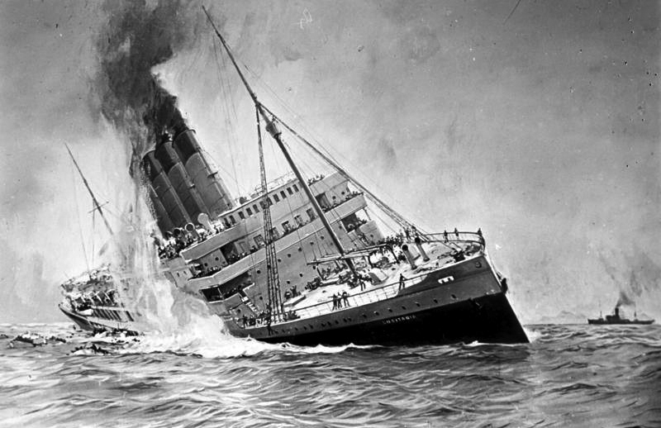
What was the Lusitania?
In 1915, German U-boats sank the British passenger ship, the Lusitania. America was angered by this event, however it did not cause them to join the war. Instead, Germany pledged to restrict their use of submarines (the Sussex Pledge).

Slide 9
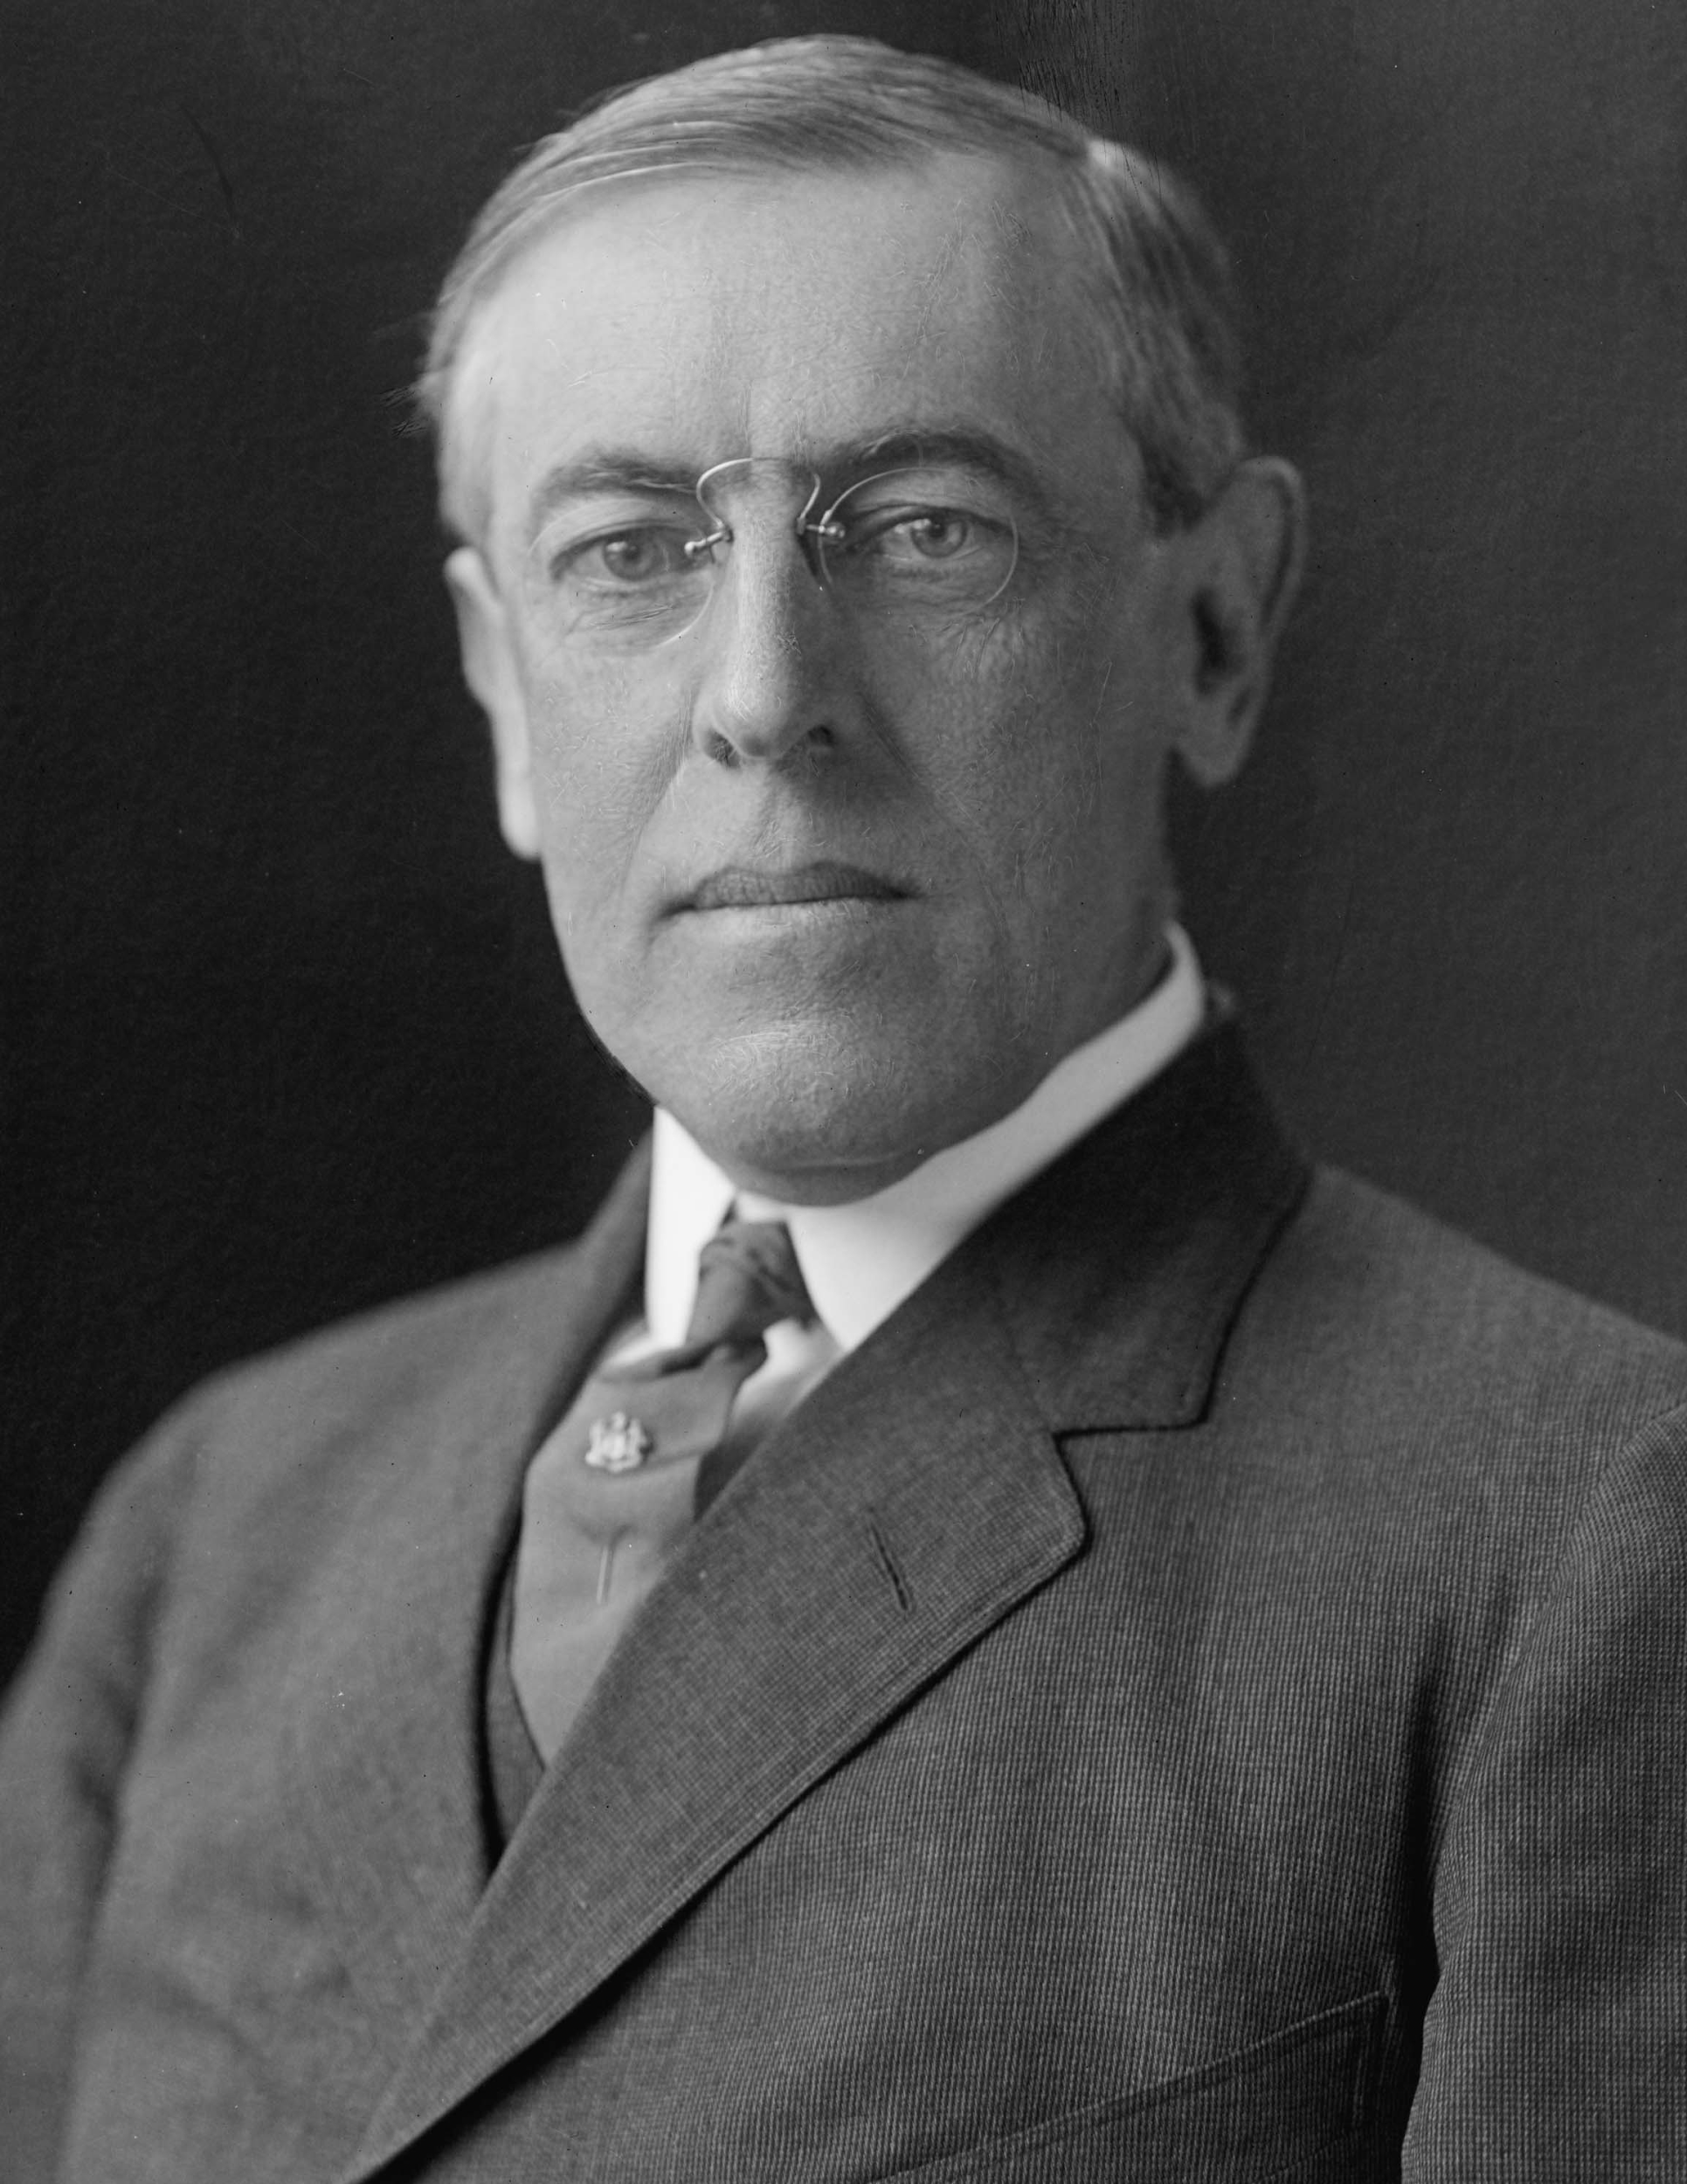
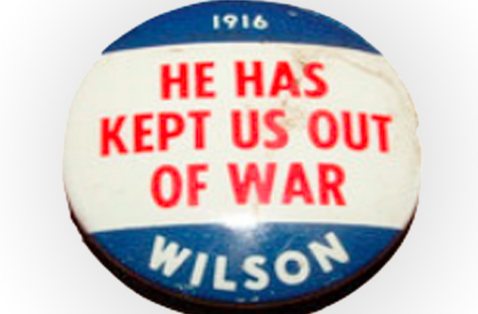
Woodrow Wilson’s Campaign
When running for re-election in 1916, Wilson campaigned using the slogan “he kept us out of war.”

Slide 10
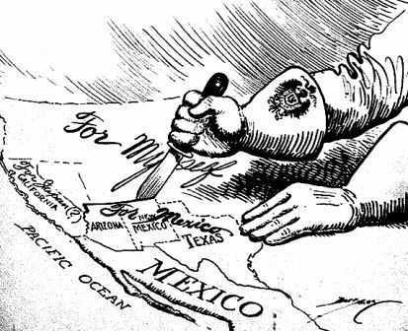
How did the Zimmermann Telegram
lead to the US joining?
Britain intercepted a message sent from Germany to Mexico promising them US land
if they joined the Central
Powers. This became known as
the Zimmermann Telegram.

Slide 11
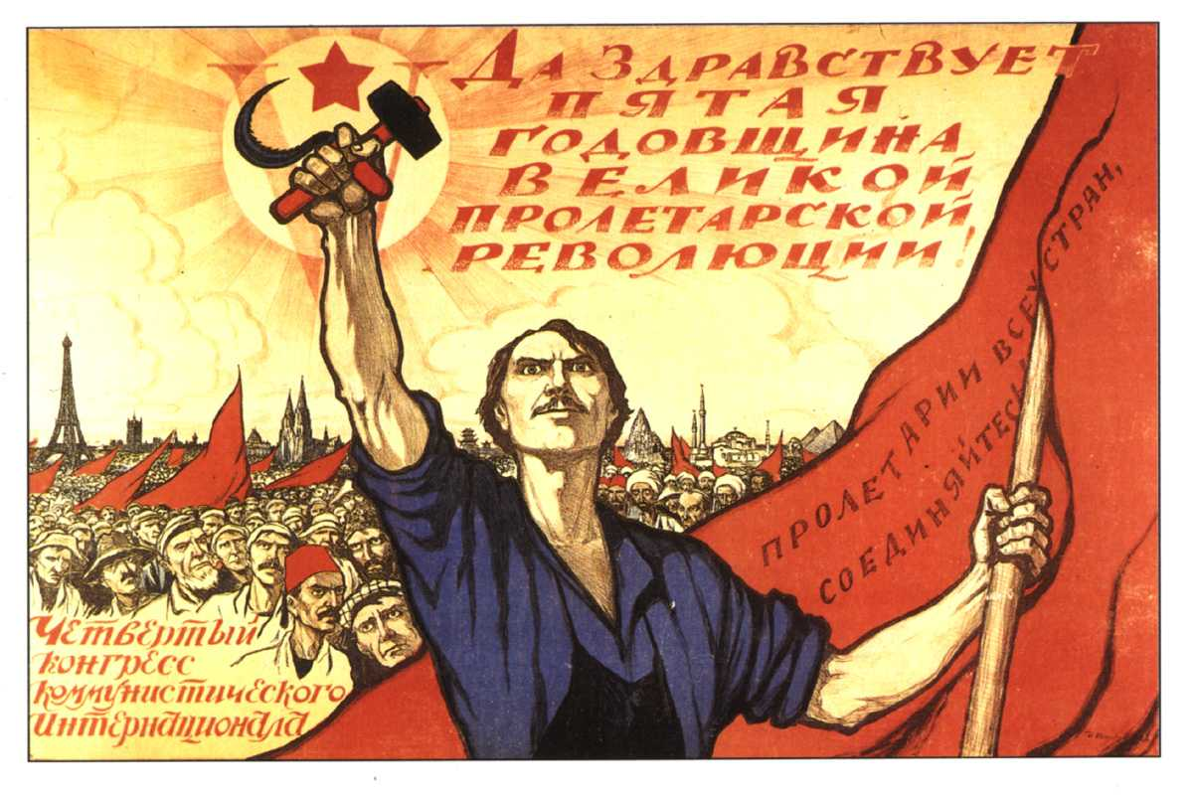
The Russian Revolution
In 1917, a revolution in Russia replaced the monarchy with a republic and President Wilson could now consider allying the United States with the democratic Russia.

Slide 12
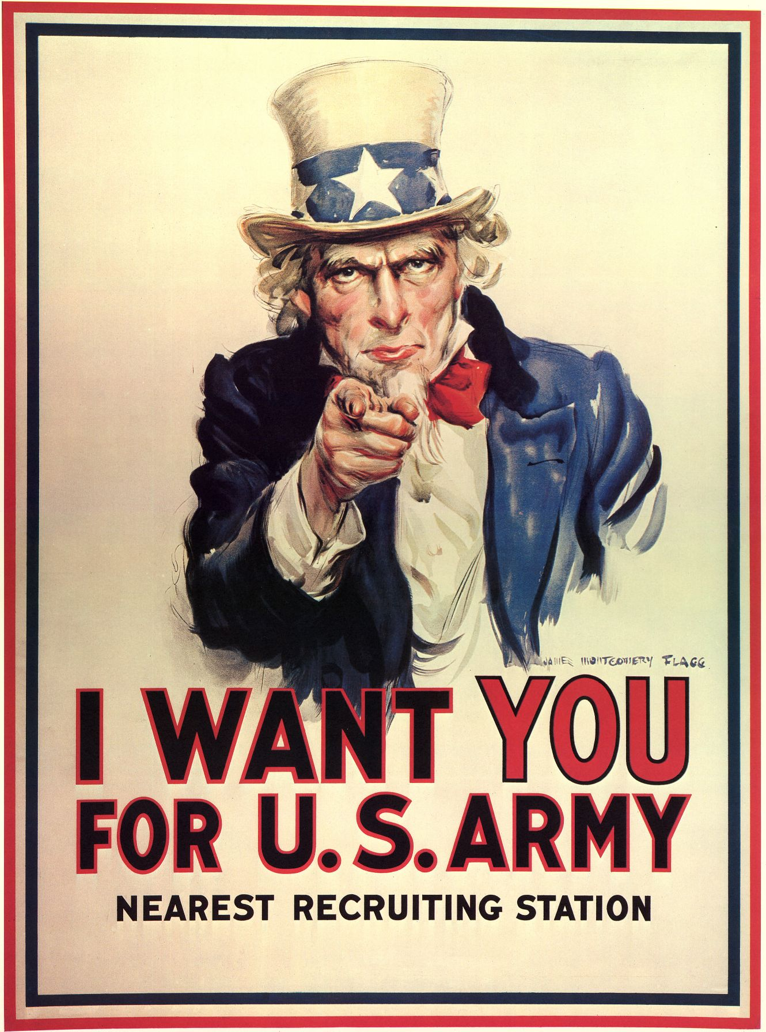
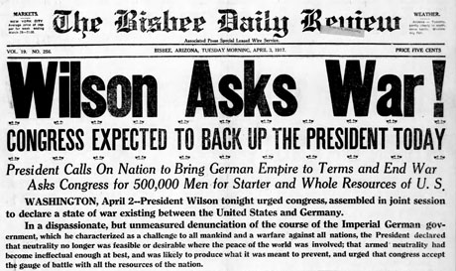
The US Declares War
After promising to cease, Germany resumes their use of unrestricted submarine warfare in 1917. This prompts Wilson to ask Congress to declare war on Germany in April of 1917. Wilson announced his intention to “make the world safe for democracy”.

Slide 13
US ENTRY ASSIGNMENT
Write a letter to Woodrow Wilson explaining why you think the United States should or should not join World War I. Provide at least three reasons to support your opinion. Be thorough in your letter!

Slide 14
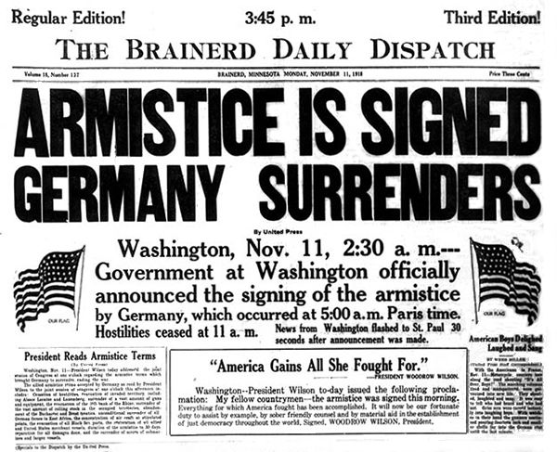
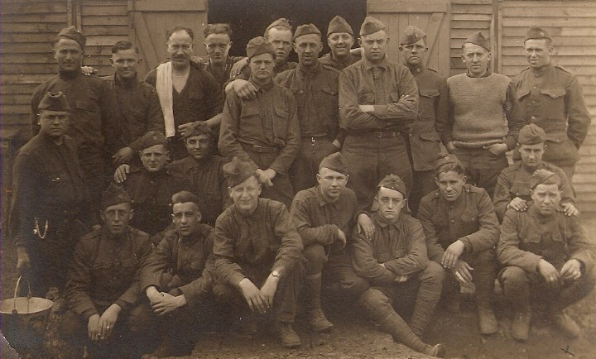
The American Expeditionary Force
The American Expeditionary Force affected the course of the war by deflecting the last push of the Germans on the western front. On November 11, 1918 an armistice was declared.

Slide 15
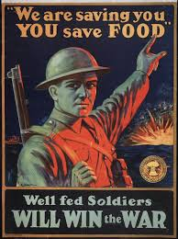
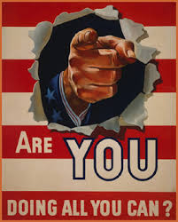
How did South Carolina react to WWI?
As a result of the United State’s entrance into World War I in 1917, there was a resurgence of patriotism in South Carolina. Both white and African American South Carolinians signed up for the draft, bought bonds, and did their part to conserve food and fuel for the front.

Slide 16
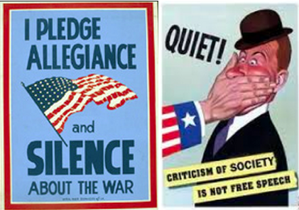
How did South Carolina React to WWI?
Anti-German feelings were shown in the shutdown of a German language newspaper in Charleston and the changing of the name of the town of Hamburg to North Augusta. Any South Carolinians who opposed the war were silenced through the Sedition Act.

Slide 17
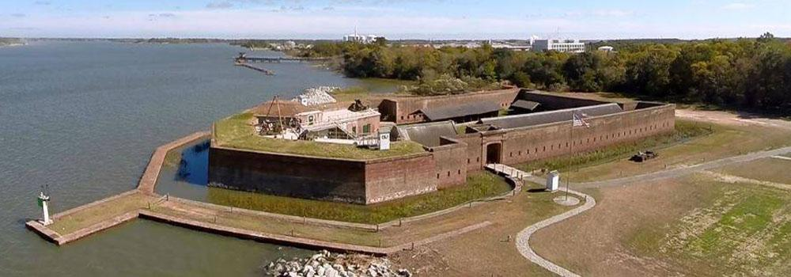
Economic Benefits in SC
Economically, South Carolina benefited from the war. New military bases were constructed at Camp Jackson in Columbia and in Spartanburg and Greenville. The Charleston Navy Yard and the US Marine Corps base at Parris Island grew to meet the needs of wartime.

Slide 18
Economic Benefits in SC
South Carolina’s cotton farmers, including the sharecroppers and tenant farmers, saw rises in prices for their crops, which were now in high demand.
Despite the improvement of the farm economy, many South Carolinians, especially African Americans, were drawn to jobs in the war industries of the North.

Slide 19
African Americans During WWI
African Americans volunteered for service in World War I to prove their patriotism and make a claim to equal treatment under the law. However, African American South Carolinians who had served their country returned to a racist South Carolina.
In early 1919, a convention of African Americans met in Charleston to protest against Jim Crow and restrictions on voting and to ask for improvements in schools.

Slide 20
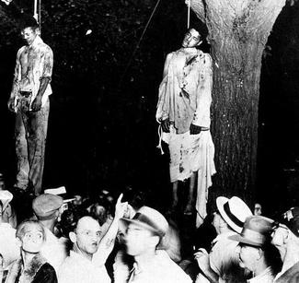
African Americans During WWI
Later in the year, a race riot in charleston, sparked by a white attack on African American citizens, claimed the lives of three African Americans. Similar riots
occurred in other parts of the country.
Throughout the South many African
Americans, some still in their army
uniforms, were lynched in the year
after the war ended.

