Slide 1
The Roaring 20s in the United States & South Carolina
8-6.2 & 8-6.3

Slide 2
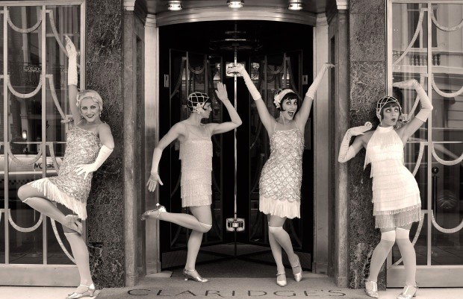
How did the US and South Carolina live during the 1920s?
In the United States and in South Carolina, the 1920s seemed to be a prosperous time. Economic change resulted from the prosperity brought by the war years. During the war, farmers’ economic conditions improved because of increased demand for their products.

Slide 3
Did the Prosperity Last?
Bankers and merchants, as well as landowners, sharecroppers and tenant farmers shared in the good times and went on a spending spree. Prosperity did not last and soon cotton and tobacco prices fell as a result of overproduction and the loss of overseas markets.

Slide 4
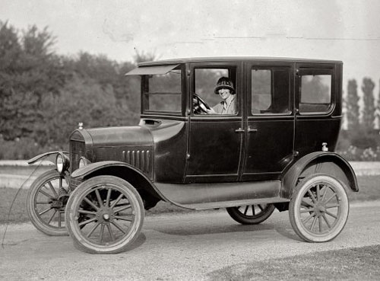
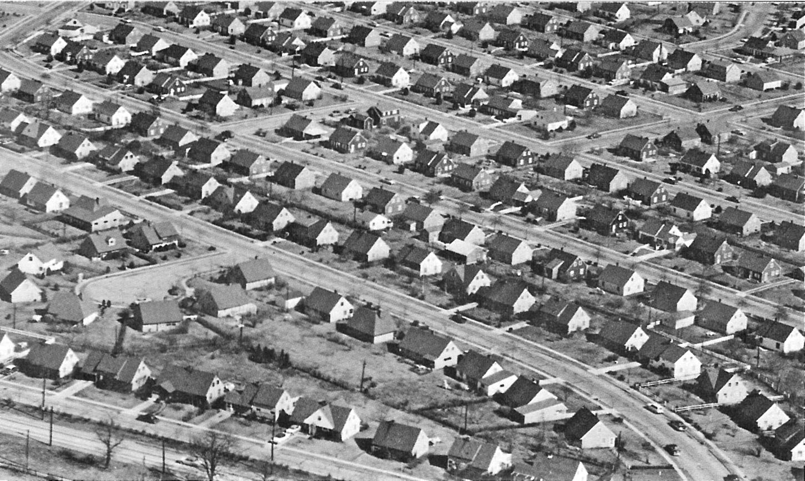
Improvement in Urban Life During the 1920s
In the 1920s, some social change came as the result of improvements in urban life because of new technologies. Water and sanitation systems were built in towns and cities of South Carolina. Because of trolley systems and the automobile, some people moved to suburbs on the outskirts of cities such as Columbia.

Slide 5
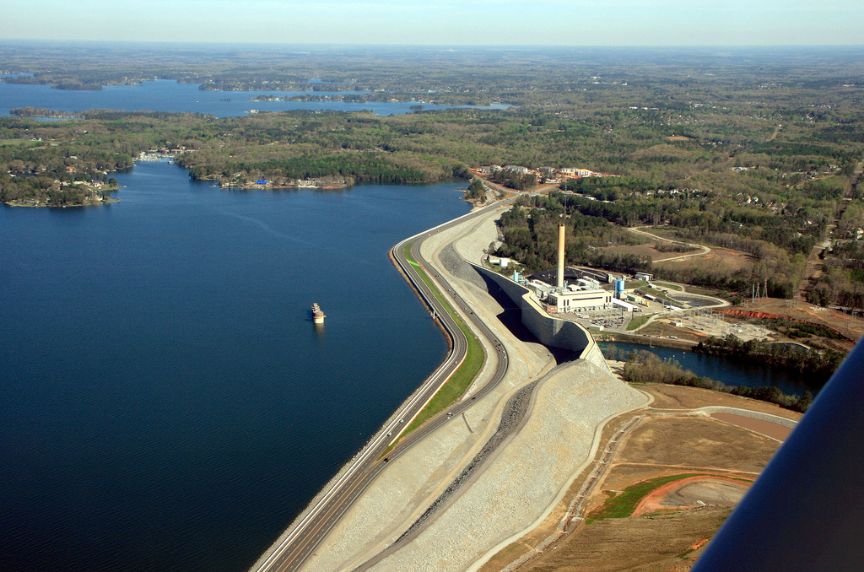
The Impact of Electricity on South Carolinians
Electricity became more available to people in towns and cities as the result of the harnessing of water power through the building of dams along South Carolina’s rivers, including the dam that formed Lake Murray, but electricity did not reach rural areas.

Slide 6
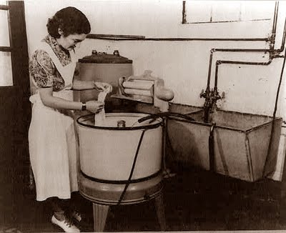
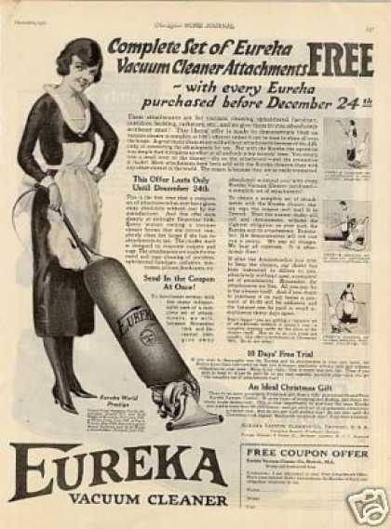
The Impact of Electricity on South Carolinians
Improvements in daily life were the result of greater availability of electricity and the new appliances that used it. Some South Carolinians, bought automobiles, vacuum cleaners and washing machines on the installment plan, just as people did throughout the United States.

Slide 7
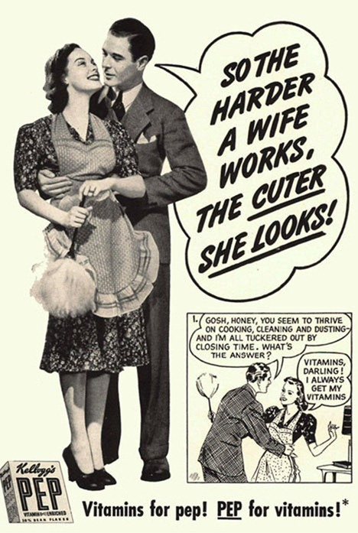
Women in South Carolina
Although appliances eased the workload of housewives, few South Carolina women joined the ranks of the flappers. South Carolina society continued to be stratified, sexist and segregated.

Slide 8
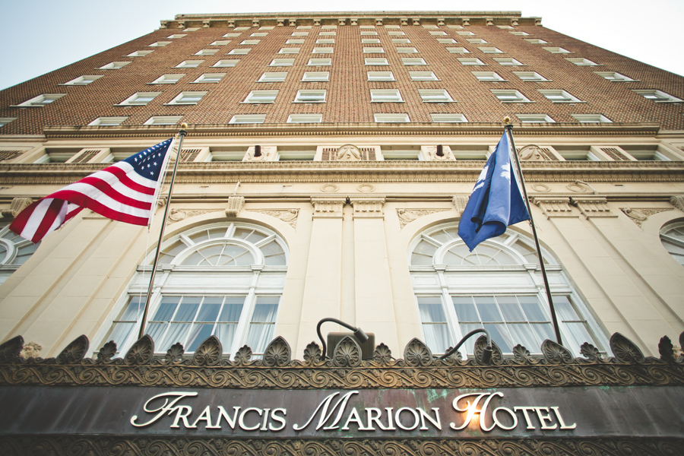
Tourism in Charleston
In response to the decline of the agricultural and industrial sectors of the economy, South Carolinians attempted to boost tourism by opening hotels in Charleston, promoting development along the coast and beginning the national historic preservation movement in Charleston.

Slide 9
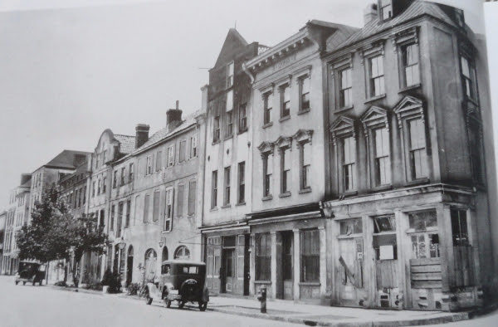
Tourism in Charleston
The increased number of automobiles made travel possible and visitors from the North were attracted to the climate and culture of the Old South, preserved in the stately homes and buildings of a bygone era.

Slide 10
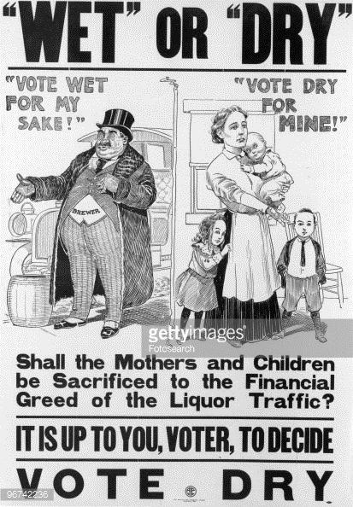
Was Prohibition a success?
Prohibition (the banning of alcohol) was a failure in South Carolina, just as it was in the rest of the country, but it created a social phenomenon. It led to an increase in crime and corruption as “bootleggers” and “moonshiners” violated the law.

Slide 11
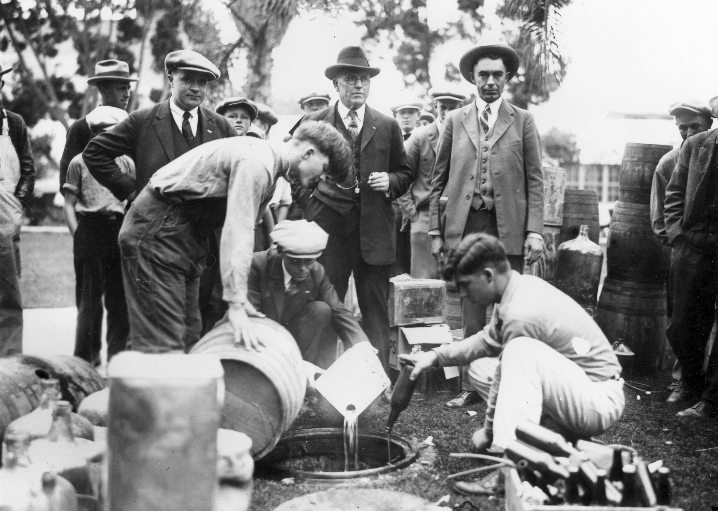
What happened as a result of
Prohibition?
The increase in crime and corruption led to a backlash of conservatives who were disgusted by the moral decline that such flagrant violation of the law exemplified. Blue laws were strictly enforced and the Ku Klux Klan found a new target in the immoral bootleggers and immigrant groups who continued to drink.

Slide 12
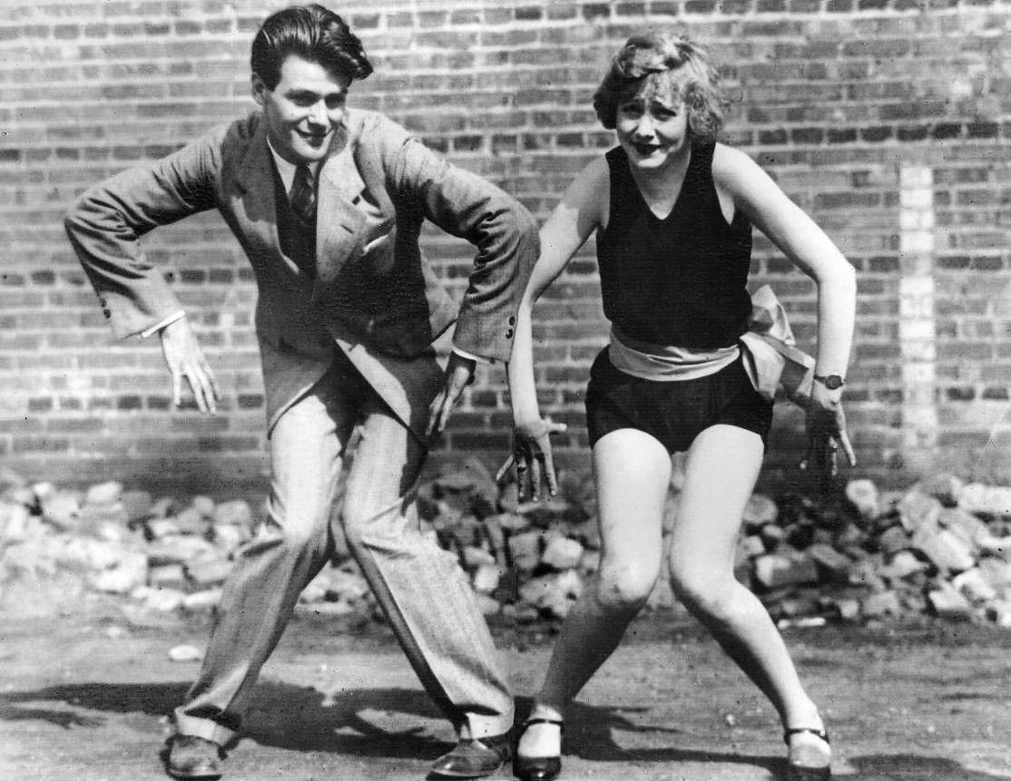
How did Mass Media Impact South Carolina
In 1930, the first radio station in South Carolina went on the air in Charleston and provided entertainment and news to those who could afford it. South Carolinians learned about flappers and the latest music and dance crazes and even started some, like the Big Apple, named after the African-American nightclub where the steps originated.

Slide 14
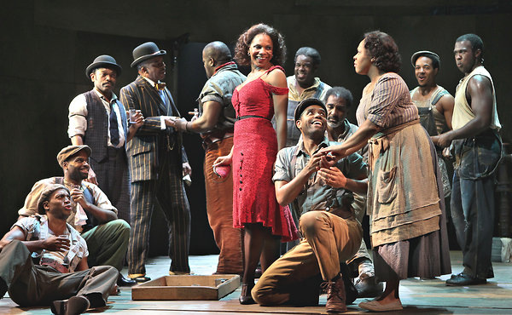
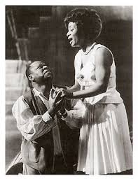
Literature in South Carolina
Responding to criticisms of South Carolina as a cultural wasteland, the Southern Literary renaissance furthered the celebration of South Carolina’s heritage. The Poetry Society of South Carolina led this revival and contributors included Julia Peterkin, who won a Pulitzer Prize for Literature, and Dubose Heyward, who wrote Porgy, which later became the opera Porgy and Bess.

Slide 15
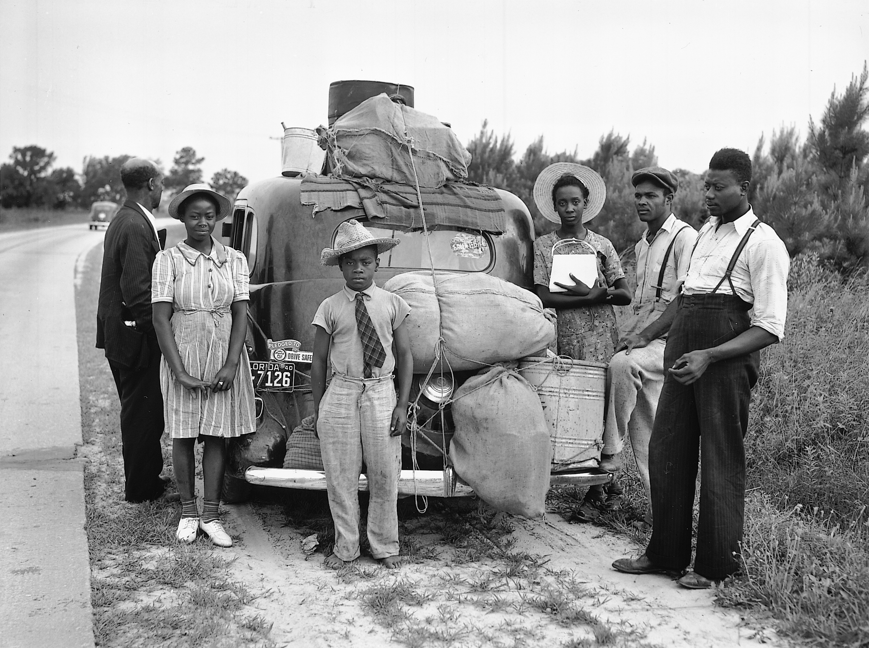
The Harlem Renaissance
South Carolinians contributed to the arts through the Harlem Renaissance. This cultural renaissance was the result of the Great Migration that brought African Americans to the cities of the Northeast and Midwest and furthered the development of a growing black middle class.

Slide 16
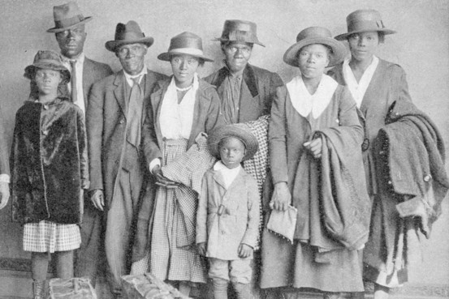
Why did African Americans leave the South?
African Americans left the South in response to push factors such as Jim Crow discrimination, violence and poverty and pull factors such as job opportunities in the Northern cities.

Slide 17
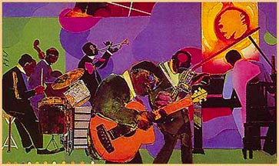
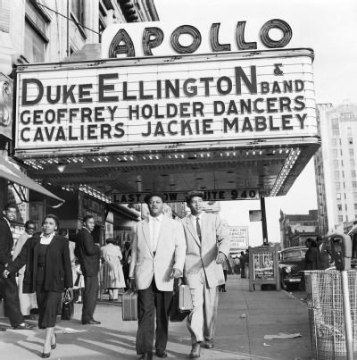
What was the Harlem Renaissance
The Harlem Renaissance exalted the unique culture of African Americans and brought recognition and pride to black artists in a variety of genres, particularly musicians.
The radio helped to spread appreciation
for new trends in music such as jazz to
white audiences and promoted a shared national culture.

Slide 18
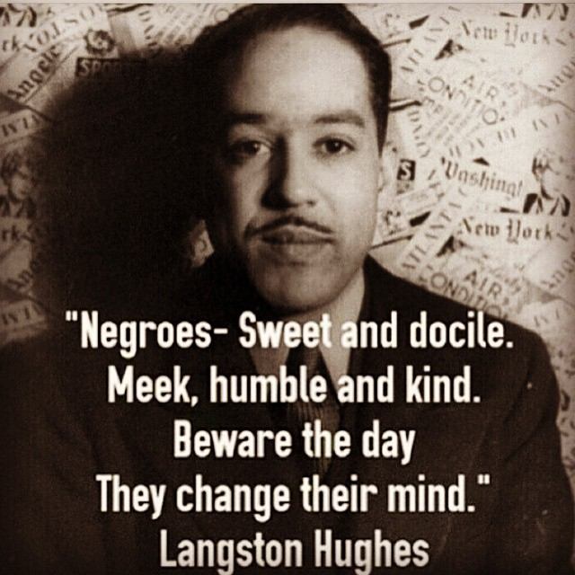
Writers of the Harlem Renaissance
Writers of the Harlem Renaissance, such as Langston Hughes, celebrated ties to African cultural traditions and black pride and questioned the position of African Americans in American life.The Harlem Renaissance further pointed out the second class citizenship of African Americans.

Slide 19
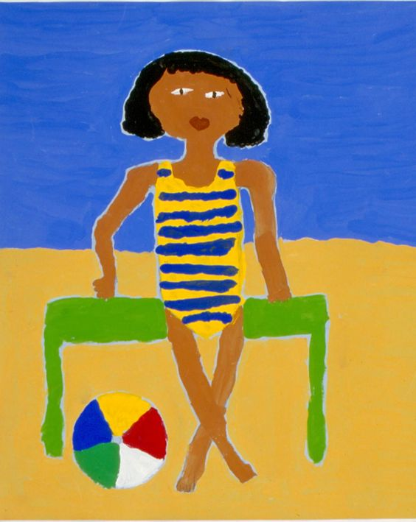
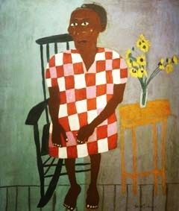
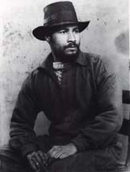
William H. Johnson
Visual artists, such as William H. Johnson of Florence, South Carolina, splashed their canvases with vibrant color that captured the dance halls, jazz bands and the emotion of the era. Johnson traveled to Paris in 1926, where he settled, painted and studied the works of modern European masters.

Slide 20
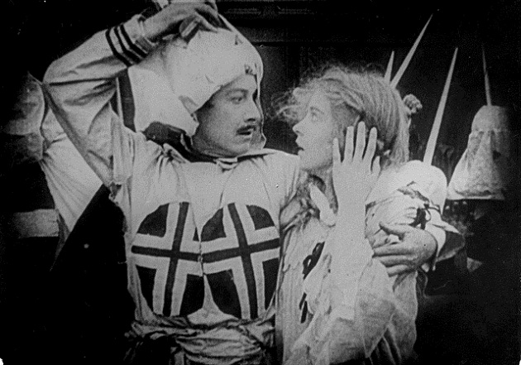
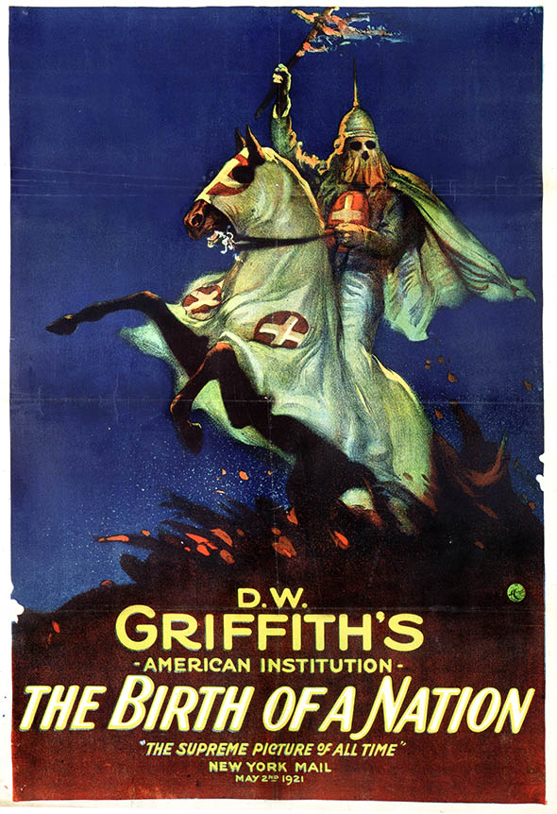
The Resurgence of the KKK
Despite the growing popularity of African American music and art, the 1920s saw a revival of the Ku Klux Klan. In 1915, the movie The Birth of a Nation depicted the Klan positively as the Redeemers of the Reconstruction era and the saviors of white womanhood. The movie aroused racist sentiment against African Americans throughout the country.

Slide 21
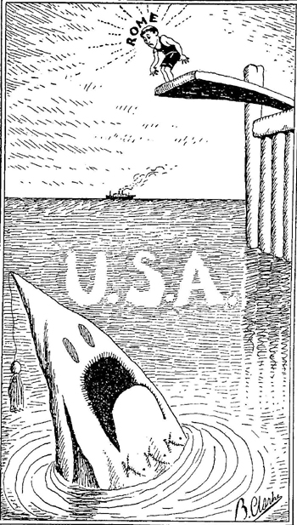
Who did the ‘new’ Klan target?
Anti-immigrant sentiments fueled by the Great War and by anti-immigrant legislation in the 1920s, added radicals, immigrants and Catholics to the list of groups targeted by the new Klan. The business climate of the 1920s allowed the Klan to use advertising and business organizations to promote membership and gain political power.

Slide 22
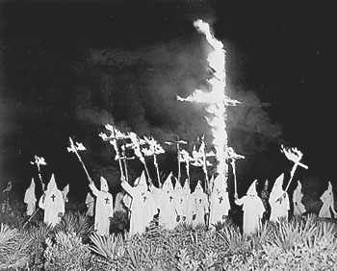
Who did the ‘new’ Klan target?
In the 1920s, the Klan was a national organization with a strong following in the small towns and cities of the Midwest as well as in the South. Seeing themselves as moral regulators, Klansmen targeted bootleggers and gamblers with cross burnings, public beatings and lynching.

Slide 23
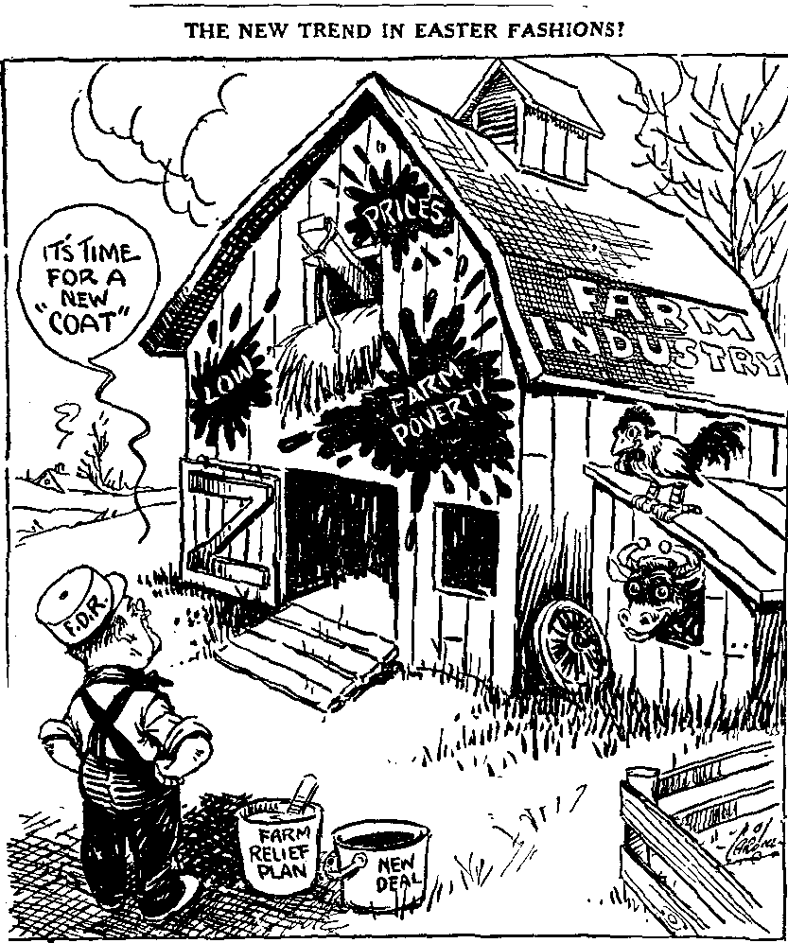
South Carolina Farmers
The economic prosperity brought about by wartime needs soon plummeted when the war ended. The troops came home and Europeans were able to resume farming to feed their own populations. South Carolina farmers suffered as demand for their crops plunged and so did the prices.

Slide 24
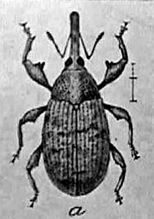
Boll Weevil
The agricultural economy further suffered when the boll weevil, an insect pest, attacked the cotton crop. Prices improved a little in 1922, because of the plunging supply due to the boll weevil, but never reached prewar levels.

Slide 25
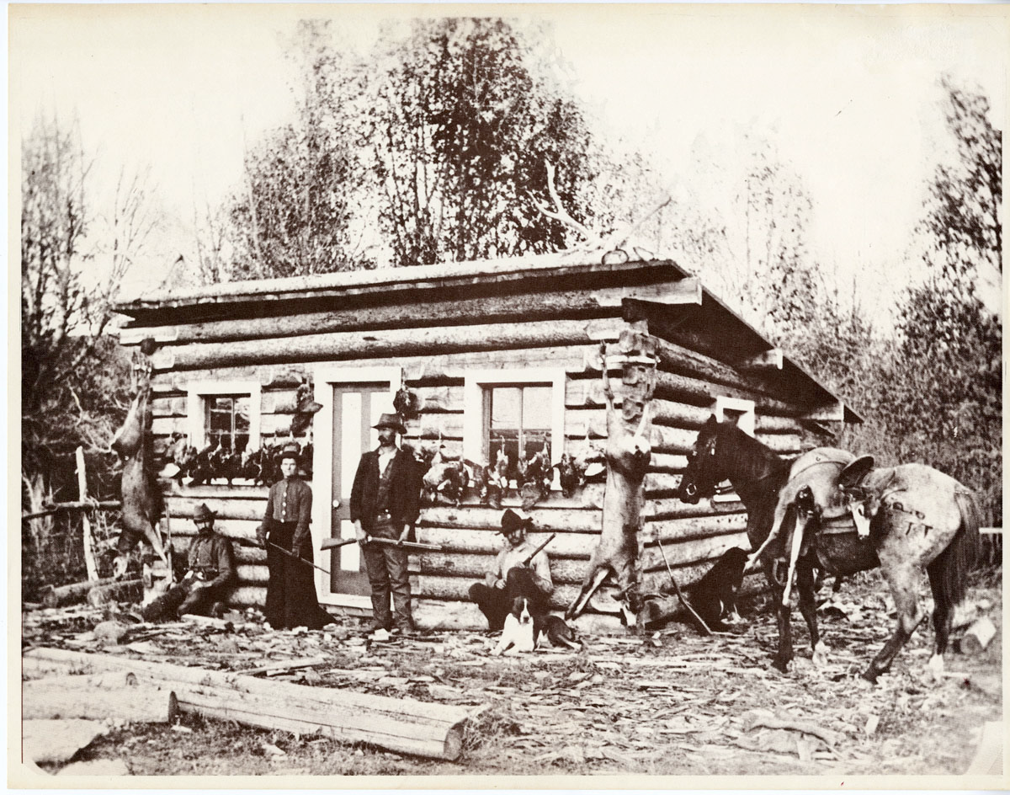
Agricultural Issues
By the end of the 1920s, cotton, like rice before it, was no longer a viable crop in the Lowcountry. Farmers turned to other crops such as peaches and livestock. Drought, erosion and soil depletion further worsened the conditions in farming.

Slide 26
Farmers in the 1920s
During the boom of the war years, farmers had borrowed from their local banks to expand, buying land, equipment and later, in a desperate attempt to save their crops, pesticides to kill the boll weevil. With low prices for their increasingly lower crop yields, farmers were unable to make payments on loans.

Slide 27
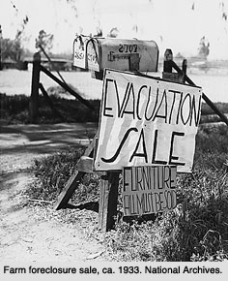
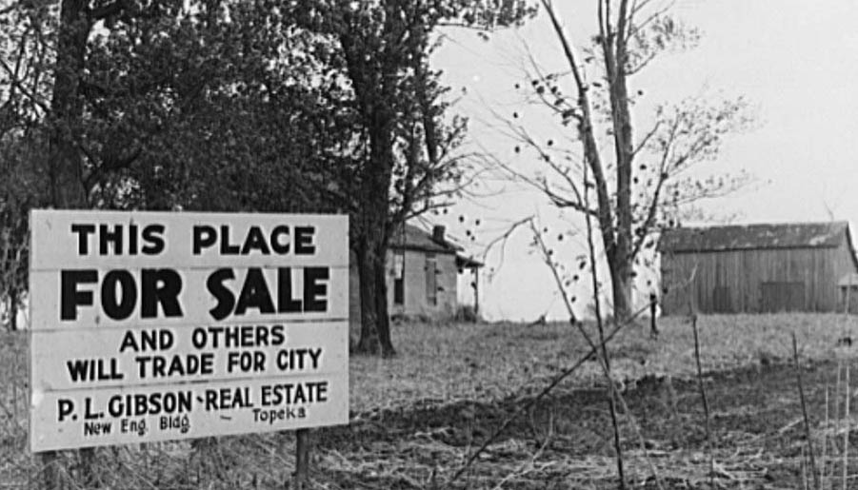
Banks in the 1920s
Banks foreclosed on delinquent mortgages or farms were taken by the state because the farmers could not pay their taxes. Because they could not make money on their loans or sell the devalued land that they had foreclosed on, banks were failing in South Carolina even before the stock market crash of 1929.

Slide 28
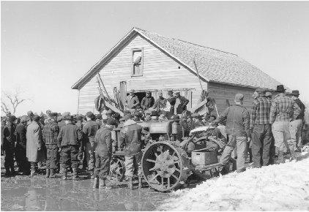
What happened to the farmers who lost their farms?
Dispossessed farmers became sharecroppers or tenant farmers or left the state to seek opportunities in the factories of the North. White farmers and sharecroppers moved to mill towns to find work in the textile mills.

Slide 29
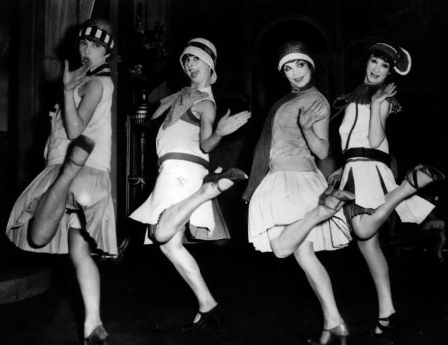
How was the textile industry affected during the 1920s?
The textile industry experienced changes due to a declining
demand in the 1920s. Synthetic fibers, such as nylon, replaced
cotton in the fashions of the era
and shorter skirts used less
material. International competition also increased as tariffs that had protected the domestic textile industry were reduced

Slide 30
What other factors affected the textile industry?
Despite these challenges, the textile industry in South Carolina grew throughout the 1920s as New England textile mills closed in response to these poor economic conditions and moved south. Northern industrialists were attracted to South Carolina because of the ready supply of cheap labor.

Slide 31
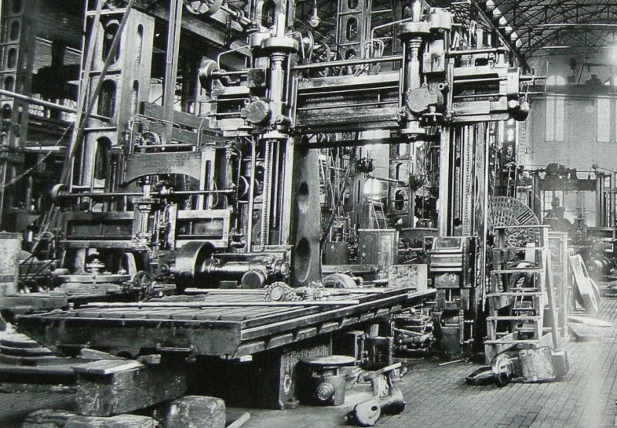
What changes were mill owners making during this time?
Mill owners improved living conditions in the mill villages by adding electricity and running water. They also tried to combat continued economic competition and increase their profit by using methods such as the “speed-up”, where machines were set to run faster, and the “stretch-out”, where fewer workers were used to tend a larger number of machines.

Slide 32
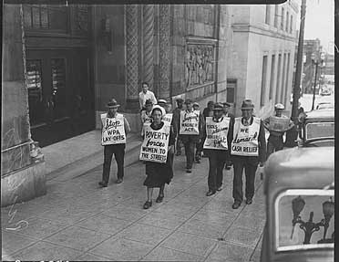
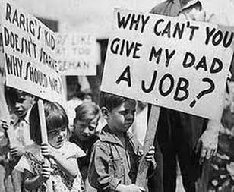
Mill Workers in the 1920s
Workers’ wages remained low, which affected their purchasing power. As mills produced more cloth than was demanded by a weakening economy, reductions were made in the work week or workers were laid off.

Slide 33
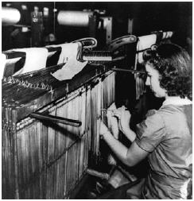
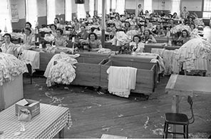
South Carolina by the end of the 1920s
By the end of the 1920s, the South Carolina textile industry, like agriculture and industry throughout the United States, suffered from declining demand and overproduction.

