Slide 1
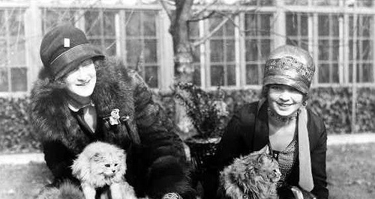
1920-1928
Notes:
Lecture Notes Key: ^ means discuss before notes
v means discuss after notes
In the 20s, there is rapid change. THE NATION EMERGES A WEALTHY POWER, A CREDITOR NATION RATHER THAN A DEBTOR NATION.
All of the industrialization and immigration has transformed the U.S. into an URBAN NATION.
A younger generation returning from war is going to challenge traditional values and ignite a revolution in manners and morals.
The Flapper is a symbol of this. It was a new type of young woman. Rebellious, energetic, bold.

Slide 2
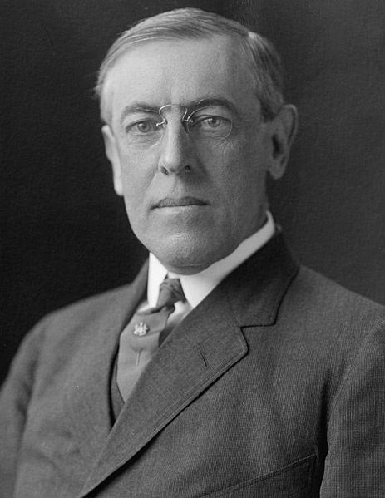
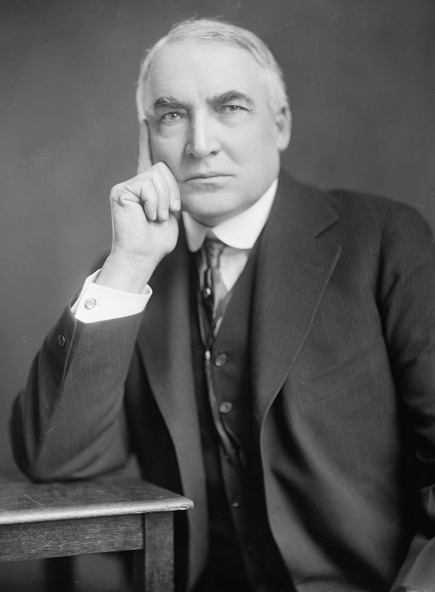
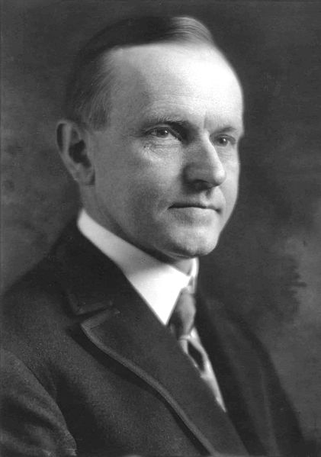
I. U.S. Leadership
Warren G. Harding
Who’s in charge?
-After Woodrow Wilson, Warren G. Harding became president.
-He helped big business growth & passed tariff
-Died of heart attack in 1923 & Calvin Coolidge took over. (Hoover will replace him just in time for the Stock Market Crash)
Woodrow Wilson
Notes:
An embedded link to a 5:12 minute Harding Youtube video begins here.
Mac users, click on black circle to open browser and view a 5:12 minute Harding Youtube video.
Original link: https://www.youtube.com/watch?v=0yNSbmX0km0&feature=youtu.be
Americans wanted to stay out of world affairs. But the United States still wanted France and Britain to repay the money they had borrowed during World War I.
Those two nations had suffered during the war. Their economies were too weak for them to repay the loans. Worse, Congress passed the Fordney-McCumber Tariff in 1922. This tariff protected American business from foreign competition. But the tariff made it impossible for Britain and France to sell their goods in the United States.
A Huge corruption was known as the Teapot Dome scandal tainted Harding’s presidency. It involved pieces of land called Teapot Dome and Elk Hills. This land was owned by the government and held large reserves of oil. Albert B. Fall, Harding’s secretary of the interior, secretly leased the land to two oil companies. He received money and property in return. Harding was not charged with corruption, but it questioned his judgement when his own cabinet members were so corrupt.
Harding suddenly died of a heart attack in1923, and Calvin Coolidge became president. Coolidge was then elected president in 1924.

Slide 3
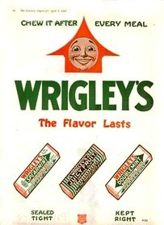
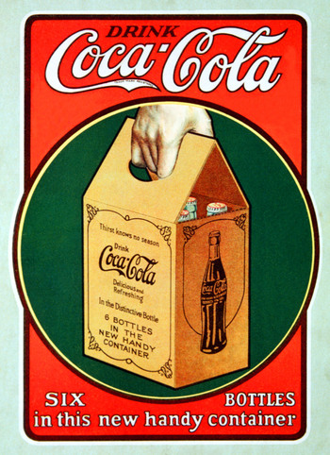
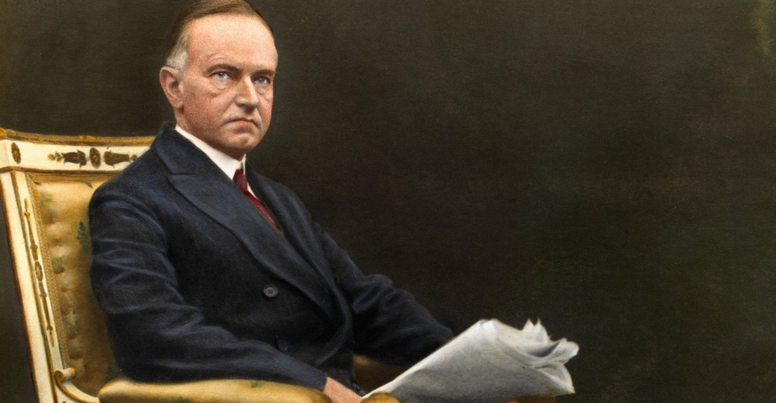
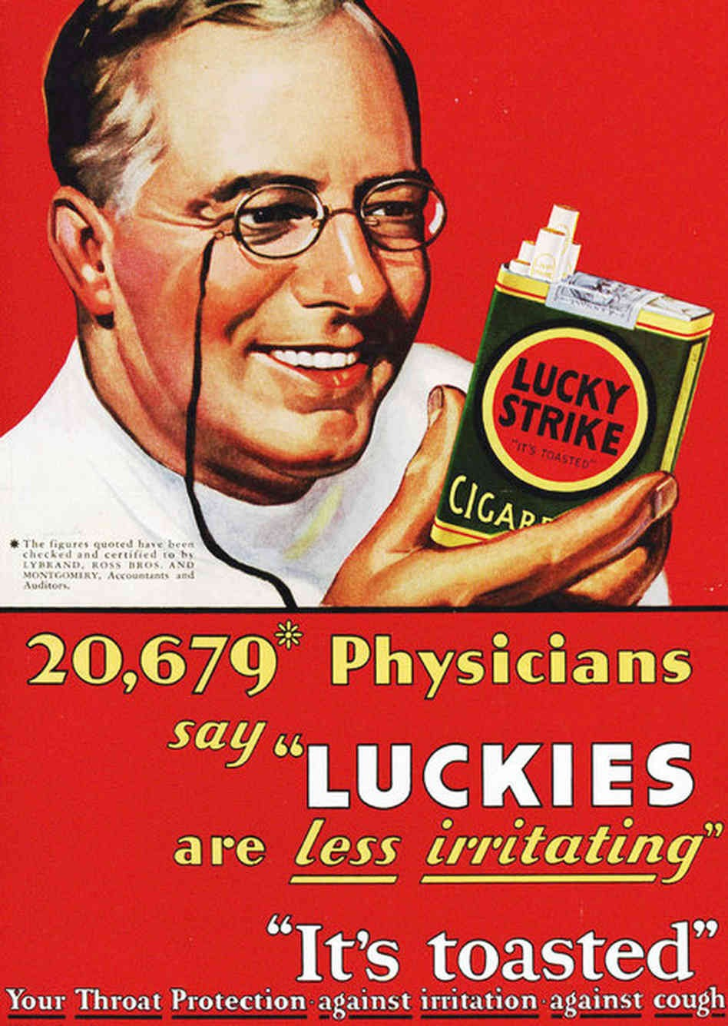
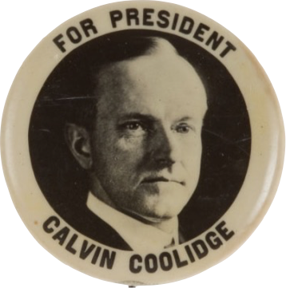
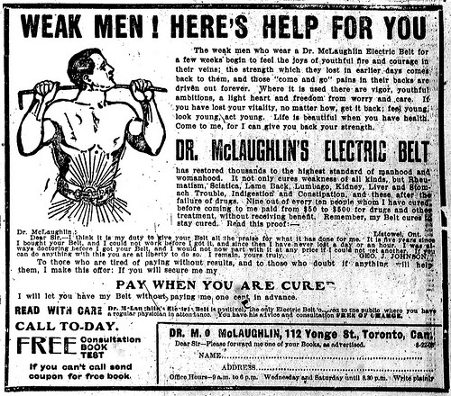
2. Prosperity
Prosperity
a. Incomes rise (1920-1929 incomes rose
35%)
b. WWI helped out SC econ.
c. Greater technology
- Electricity spread (not in rural areas)
Water & Sanitation systems
Built dam that formed Lake Murray
Appliances made life easier (radios,
refrigerators, toasters)
d. Modern Advertising
- Psychologists hired to sell new goods
- Est. Brand Names across
country.
Notes:
The new president, Calvin Coolidge said, “The chief business of the American people is business.” Both Coolidge and his Republican successor, Herbert Hoover, favored government policies that promoted business and limited government interference. For almost a decade, American prosperity soared. From 1920-1929, Americans owned 40 percent of the world’s wealth. The average income during the period rose 35% from $522 to $705 year.
Prosperity. Americans began to use all kinds of electrical appliances. Radios, washing machines, and vacuum cleaners became popular. These appliances made housework easier. One result was more leisure time for families.
Advertising. With all the new goods in the market, companies turned to Advertising to sell the goods. More consumer goods appeared on the market. Ads didn’t just give information about the product. Now, they used psychology. They tried to use people’s desire for youth, beauty, and popularity to sell products. Things that once were luxuries became necessities. Some brand names became known nationwide.

Slide 4
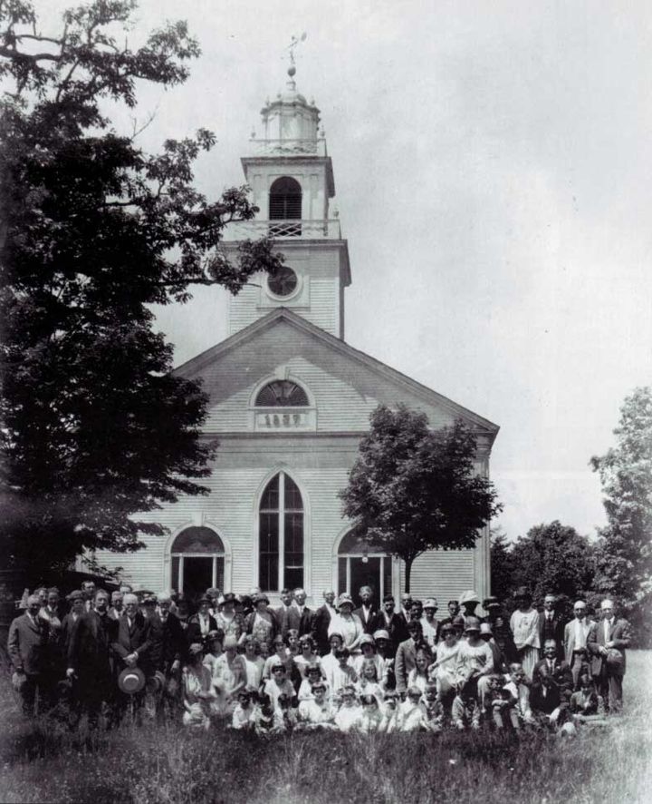
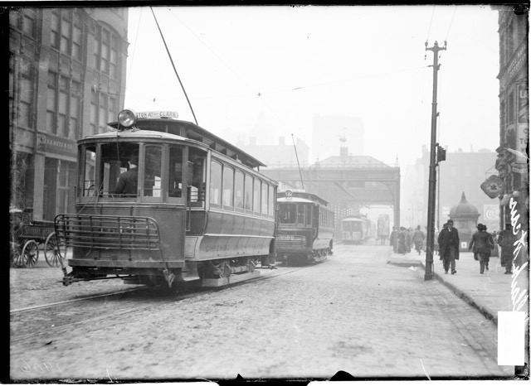
3.Migration
3. Escape to the Suburbs
a. Cities built transportation
- electric trolleys then busses allowed people to get from homes to suburbs for work in cities
Movin’ to the City
a. Rural - Urban Split
- agricultural products prices fell & 6 mil moved to city for jobs.
- Effects
- High School attendance shot up
- rural fear of dying traditional values
b. African Americans
- The Great Migration - movement of 4.1 mil. blacks to the north because of Jim Crow & Jobs
Notes:
The 1920 census showed that for the First time in American history, more Americans lived in the city than in rural areas.
-------High School attendance shot up because children had to be able to compete in urban-based industry. On the farm, they left school to work in the fields.
In 1920 high school attendance went from 2.2 million to 4.4 million by 1930 - it doubled.
-----GREAT Migration - Blacks worked in factories for lower wages and faced discrimination from whites who were competing with jobs.
---As a result of the migrations of the 1920s, American Suburbs grew -
Electric Trolley - cars that ran on rails laid in the streets, and were powered by overhead wires. Trolley allowed people to get from their suburban homes to jobs and stores in the city cheaply.
New York City provides a good example of how the demographic changes that occurred during the 1920s. The number of residents decreased in Manhattan, the heart of the city, while the suburb of Queens saw its population double.

Slide 5
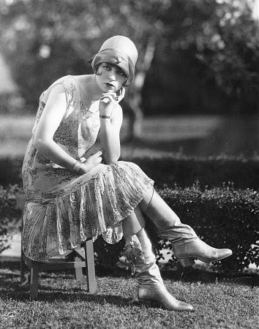
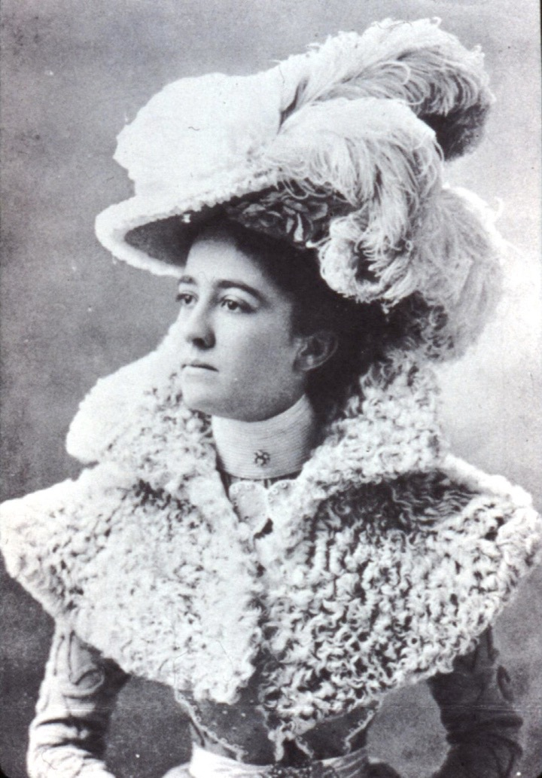
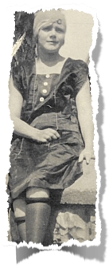
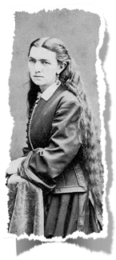
4. Women
Women’s Changing Roles
a. Flapper image
- short dress
- short hair
- heavy makeup
- smoke & drank
b. Women Work & Vote
- Women worked-largely clerical work
-Weren’t considered for jobs
-SC women rarely were “flappers”, but adopted shorter hair & clothes for convenience
Notes:
During the War women were working in factories, after the war many women remained in the workforce. After the 19th amendment, women were eager for greater equality with men. 19th amendment was a symbol and a motivator of this new independence.
----1. Flapper - NYTimes declared 1920 - “the American woman has lifted her skirts far beyond any modest limitation.” Between 1913-1928, the average amount of fabric used to make up a woman’s outfit shrank from 19.5 yards - just 7 yards.
- Women’s hair grew long and they would pin it up and wear a stylish hart Young women bobbed their hair.
**THEY went from THIS(picture-ling hair), to this (CLICK for animation- short hair)
- makeup - only prostitutes and actresses wore makeup. Now women in the cities were wearing make-up
- The strongest drink a woman would ever have would be a glass of wine, now LIQUOR.
- Cigarette production double in these years
ALL THIS SHOCKED AND ENRAGED PARENTS
2. Most women weren’t flappers, but many did adopt shorter hair and adopt the fashions because they were more convenient. CONVENIENCE was an issue for young WORKING women.
- less time for elaborate wardrobes or hairstyles.
- Many hospitals refused to hire female doctors, legal firms rejected female lawyers or only offered them secretarial jobs. Businesses rarely trained women for jobs beyond entry level and paid them on an equal scale as men. Few in leadership positions and were expected to quit if they became married or pregnant.
3. VOTING - Politicians feared women would vote as a bloc.

Slide 6
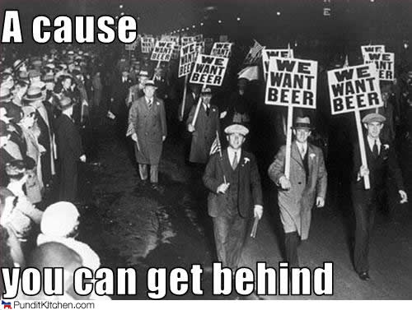
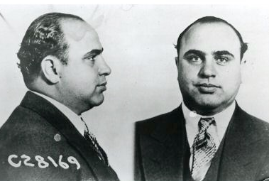
II. Cultural Conflicts
II. Cultural Conflicts
5. Prohibition
Prohibition - 18th Amendment
- Epic failure
- enforcers understaffed, underpaid - open to bribery
- Speakeasies(bars) & bootleggers supplied liquor
- 21st Am. Ends prohibition (1933)
- Result
- Organized Crime
- Al Capone”Scarface” in Chicago
Conservative backlash (fuel for KKK)
Blue Laws become strictly enforced
Notes:
Lecture Notes Key: ^ means discuss before notes
v means discuss after notes
An embedded link to a 2 minute Prohibition Youtube video begins next slide.
Mac users, click on black circle to open browser and view a 2 minute Prohibition Youtube video.
Original Link: https://www.youtube.com/watch?v=AEV4Abgoqb8
Prohibition of all alcoholic beverages became the law of the land when the 18th Amendment to the Constitution took effect Jan 16, 1920. Many people just continued to drink, including the Presidents. Harding and crew drank all the time.
The main goals of prohibition were to 1. Eliminate drunkenness & resulting abuse of family members, 2. Get rid of saloons, where prostitution, gambling & other vice’s thrived. 3. Prevent absenteeism and on-the-job accidents stemming from drunkenness.
VOLSTEAD ACT difficult to enforce - 1,500 agents total for entire U.S.
--Bootleggers, or suppliers of illegal alcohol. Some bootleggers made their own w/stills. Others smuggled liquor overland from Canada or by ship from the Caribbean. A smuggler’s ship might anchor far off the coast, where the booze would be loaded onto speedboats fast enough to outrace the Coast Guard.
Bars that operated illegally, known as speakeasies, were either disguised as legitimate businesses or hidden in some way, often behind heavy gates.
--You have huge demand for sacramental wine because that’s still legal, and by 1929 alcohol consumption was about 70% of the prewar level. It also increased the number of liquor-serving establishments in some major cities to far above pre-Prohibition levels.
Successful bootlegging organizations often moved into other illegal activities as well, including gambling, prostitution, and racketeering. As rival groups fought for control in some American cities, gang wars and murders became commonplace.
One of the most notorious criminals of this time was Al Capone, nicknamed “Scarface,” a gangster who rose to the top of Chicago’s organized crime network. Capone proved talented at avoiding jail but was finally imprisoned in 1931.
---------------------NEXT SLIDE----------------------------------------------
Prohibition highlighted the differences between urban and rural areas of the country. Another issue that tended to split Americans along urban and rural lines was the teaching of evolution conflicted with their religious beliefs. Even today - the debate continues.
Years prior to the 20s, there was a challenge to religion. 3 reasons - 1. Science & technology were a part of everyday life. 2) War & societal problems caused more people to question God’s active role or even his existence. 3)Some scholars were saying that the Bible was written by man & had contradictions & historical inaccuracies. SOOOOOO. . . In response, religious traditionalists published a series of 12 pamphlets called The Fundamentals.

Slide 7
II. Cultural Conflicts
II. Cultural Conflicts
A. Prohibition - 18th Amendment
- Epic failure
- enforcers understaffed, underpaid - open to bribery
- Speakeasies(bars) & bootleggers supplied liquor
- 21st Am. Ends prohibition (1933)
- Result
- Organized Crime
- Al Capone”Scarface” in Chicago
Conservative backlash (fuel for KKK)
Blue Laws become strictly enforced
Notes:
Lecture Notes Key: ^ means discuss before notes
v means discuss after notes
An embedded link to a 2 minute Prohibition Youtube video begins here.
Mac users, click on black circle to open browser and view a 2 minute Prohibition Youtube video.
Original Link: https://www.youtube.com/watch?v=AEV4Abgoqb8
Prohibition of all alcoholic beverages became the law of the land when the 18th Amendment to the Constitution took effect Jan 16, 1920. Many people just continued to drink, including the Presidents. Harding and crew drank all the time.
The main goals of prohibition were to 1. Eliminate drunkenness & resulting abuse of family members, 2. Get rid of saloons, where prostitution, gambling & other vice’s thrived. 3. Prevent absenteeism and on-the-job accidents stemming from drunkenness.
VOLSTEAD ACT difficult to enforce - 1,500 agents total for entire U.S.
--Bootleggers, or suppliers of illegal alcohol. Some bootleggers made their own w/stills. Others smuggled liquor overland from Canada or by ship from the Caribbean. A smuggler’s ship might anchor far off the coast, where the booze would be loaded onto speedboats fast enough to outrace the Coast Guard.
Bars that operated illegally, known as speakeasies, were either disguised as legitimate businesses or hidden in some way, often behind heavy gates.
--You have huge demand for sacramental wine because that’s still legal, and by 1929 alcohol consumption was about 70% of the prewar level. It also increased the number of liquor-serving establishments in some major cities to far above pre-Prohibition levels.
Successful bootlegging organizations often moved into other illegal activities as well, including gambling, prostitution, and racketeering. As rival groups fought for control in some American cities, gang wars and murders became commonplace.
One of the most notorious criminals of this time was Al Capone, nicknamed “Scarface,” a gangster who rose to the top of Chicago’s organized crime network. Capone proved talented at avoiding jail but was finally imprisoned in 1931.
---------------------NEXT SLIDE----------------------------------------------
Prohibition highlighted the differences between urban and rural areas of the country. Another issue that tended to split Americans along urban and rural lines was the teaching of evolution conflicted with their religious beliefs. Even today - the debate continues.
Years prior to the 20s, there was a challenge to religion. 3 reasons - 1. Science & technology were a part of everyday life. 2) War & societal problems caused more people to question God’s active role or even his existence. 3)Some scholars were saying that the Bible was written by man & had contradictions & historical inaccuracies. SOOOOOO. . . In response, religious traditionalists published a series of 12 pamphlets called The Fundamentals.

Slide 8
II. Cultural Conflicts
6. Tourism.
SC hoped to boost tourism by opening hotels in Charleston
Started historic preservation movment (people from North were attracted to the culture of the Old South)
Notes:
Lecture Notes Key: ^ means discuss before notes
v means discuss after notes
An embedded link to a 2 minute Prohibition Youtube video begins here.
Mac users, click on black circle to open browser and view a 2 minute Prohibition Youtube video.
Original Link: https://www.youtube.com/watch?v=AEV4Abgoqb8
Prohibition of all alcoholic beverages became the law of the land when the 18th Amendment to the Constitution took effect Jan 16, 1920. Many people just continued to drink, including the Presidents. Harding and crew drank all the time.
The main goals of prohibition were to 1. Eliminate drunkenness & resulting abuse of family members, 2. Get rid of saloons, where prostitution, gambling & other vice’s thrived. 3. Prevent absenteeism and on-the-job accidents stemming from drunkenness.
VOLSTEAD ACT difficult to enforce - 1,500 agents total for entire U.S.
--Bootleggers, or suppliers of illegal alcohol. Some bootleggers made their own w/stills. Others smuggled liquor overland from Canada or by ship from the Caribbean. A smuggler’s ship might anchor far off the coast, where the booze would be loaded onto speedboats fast enough to outrace the Coast Guard.
Bars that operated illegally, known as speakeasies, were either disguised as legitimate businesses or hidden in some way, often behind heavy gates.
--You have huge demand for sacramental wine because that’s still legal, and by 1929 alcohol consumption was about 70% of the prewar level. It also increased the number of liquor-serving establishments in some major cities to far above pre-Prohibition levels.
Successful bootlegging organizations often moved into other illegal activities as well, including gambling, prostitution, and racketeering. As rival groups fought for control in some American cities, gang wars and murders became commonplace.
One of the most notorious criminals of this time was Al Capone, nicknamed “Scarface,” a gangster who rose to the top of Chicago’s organized crime network. Capone proved talented at avoiding jail but was finally imprisoned in 1931.
---------------------NEXT SLIDE----------------------------------------------
Prohibition highlighted the differences between urban and rural areas of the country. Another issue that tended to split Americans along urban and rural lines was the teaching of evolution conflicted with their religious beliefs. Even today - the debate continues.
Years prior to the 20s, there was a challenge to religion. 3 reasons - 1. Science & technology were a part of everyday life. 2) War & societal problems caused more people to question God’s active role or even his existence. 3)Some scholars were saying that the Bible was written by man & had contradictions & historical inaccuracies. SOOOOOO. . . In response, religious traditionalists published a series of 12 pamphlets called The Fundamentals.

Slide 9
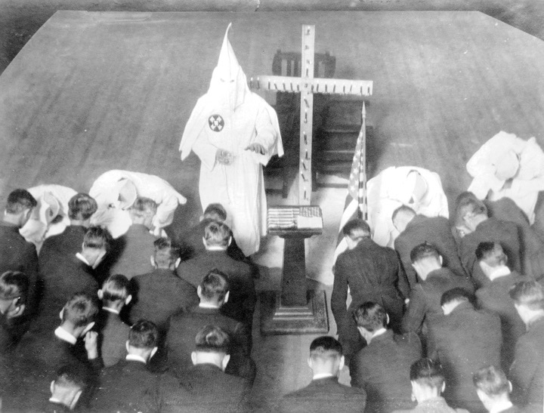
7. Return of KKK
KKK Re-emerges
- 1915 film, The Birth of a Nation showed Klan positively as Redeemers of the South & saviors of white womanhood
- not only racist against African Americans, but also targeted immigrants, bootleggers, gamblers & Catholics
- big in small towns & cities of South and Midwest
Notes:
An embedded link to a 3:45 minute KKK Youtube video begins next slide
Mac users, click on black circle to open browser and view a 3:45 minute KKK Youtube video.
Original link: https://www.youtube.com/watch?v=GlRncI5nem8
During reconstruction, President Grant’s campaign against the KKK had largely eliminated it. However, in 1915 a former Methodist circuit preacher from Atlanta, Colonel William J. Simmons revived the organization.
W.A.S.P. White Anglo-Saxon Protestant
In 1925 Indiana’s politically powerful Grand Dragon, David Stephenson, raped his young secretary. She swallowed poison the next day, he panicked, didn't call a Dr. She died weeks later and Stephenson went to jail. From Jail, he revealed the details of the political corruption of the Klan and how it was used to make loads of money. The soon faded after that.

Slide 10
Notes:
An embedded link to a 3:45 minute KKK Youtube video begins here.
Mac users, click on black circle to open browser and view a 3:45 minute KKK Youtube video.
Original link: https://www.youtube.com/watch?v=GlRncI5nem8
During reconstruction, President Grant’s campaign against the KKK had largely eliminated it. However, in 1915 a former Methodist circuit preacher from Atlanta, Colonel William J. Simmons revived the organization.
W.A.S.P. White Anglo-Saxon Protestant
In 1925 Indiana’s politically powerful Grand Dragon, David Stephenson, raped his young secretary. She swallowed poison the next day, he panicked, didn't call a Dr. She died weeks later and Stephenson went to jail. From Jail, he revealed the details of the political corruption of the Klan and how it was used to make loads of money. The soon faded after that.

Slide 11
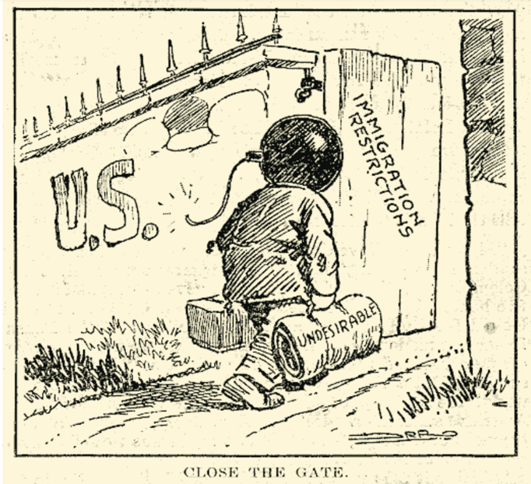
Targeting Immigrants
Immigrants from Primarily Eastern & Southern Europe
Limiting Immigration
- Nativism continues
-The Emergency Quota Act 1921 - quota system that cut
European immigration
- mostly Catholics & Jews
Quotas from 1924 Act
Average Annual Flow
1907 - 1914
Quotas from 1921 Act
Notes:
From 1919 to 1921 immigration to the U.S. increased from 141,000 to 805,000 people, an increase of almost 600 percent. Because of nativist views, fear of immigrants particularly from Eastern and Southern Europe, Congress passed the Emergency Quota Act of 1921. This limited Eastern and Southern Europeans to the U.S which consisted of mostly Jews from the East, and Catholics from the South. The Act would be amended in 1924.
Ask the class to Look at the political cartoon to the right.
From what point of view does this cartoon represent? - Americans for the quota system
According to the cartoon, why should the U.S. limit immigration? - Immigrants are “undesirable” and the bomb on their head shows that they are Communist and Anarchist radicals. Immigrants are dangerous.
Click for bar graph.
Ask students if the Emergency Quota Act worked?

Slide 12
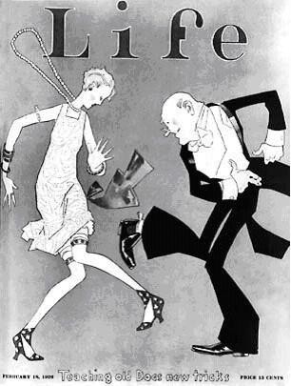
8. Mass Media
Rise in radio, movies, music, etc. all in new nationalized culture
1930- first radio station in SC
-gave news and entertainment
Silent films transitioned to sound
Dance crazes like the Charleston & the Big Apple
Notes:
After the War, Americans were tired. Americans didn’t want anything to do with Europe or world affairs.
Soldiers were coming home to unemployment, many of their jobs were replaced by minorities and women. Many just wanted to return of the earlier days, prior to war.
Many Americans would turn to their blame on non-traditional Americans. Nativism took over the American public. Many Americans looked at foreigners and minorities with suspicion.
Communism - During WWI, Communist radicals had taken over Russian during the Russian Revolution. Communism was a from of government where the government controls all property and means of production. It is in practice, ruled by a dictator.
Red Scare - After the war, 70,000 Americans had joined the Communist party because it promised economic equality for everyone. Radicals had sent bombs to public officials and business leaders. Russia had fallen to the Communists, and many Americans believed they were next. Anyone out of the ordinary, could be accused of being a radical. Communists were called Reds, thus the Red Scare.
Palmer Raids
Attorney General A. Mitchell Palmer set up an agency later called the FBI, to arrest communists, socialists, and anarchists, who opposed all forms of government. Palmer’s agents trampled on people’s civil rights. Many radicals were deported without trial. But Palmer found no evidence of a plot to overthrow the government.
Two Italian immigrants, Nicola Sacco and Bartolomeo Vanzetti were arrested for robbery and murder in Massachusetts. Witnesses had said the criminals appeared to be Italians Sacco and Vanzetti had alibis, but admitted they were anarchists and denied committing any crime. The case against them was weak. But they were convicted anyway. Many people protested the conviction because they believed it was nativism or because of their radical views. It became a world wide controversy. Sacco and Vanzetti were executed in 1927.

Slide 13
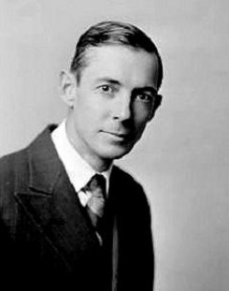
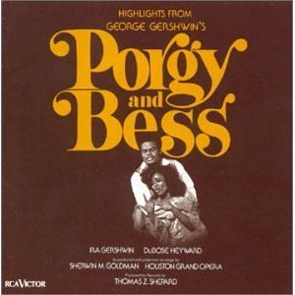
9. Southern Literary Renaissance
SC was criticized as cultural wasteland
Movement celebrated SC’s heritage
Led by Poetry Society of SC
Julia Peterkin won Pulitzer Prize for Literature
DuBose Heyward wrote Porgy which later became the opera Porgy & Bess
Notes:
After the War, Americans were tired. Americans didn’t want anything to do with Europe or world affairs.
Soldiers were coming home to unemployment, many of their jobs were replaced by minorities and women. Many just wanted to return of the earlier days, prior to war.
Many Americans would turn to their blame on non-traditional Americans. Nativism took over the American public. Many Americans looked at foreigners and minorities with suspicion.
Communism - During WWI, Communist radicals had taken over Russian during the Russian Revolution. Communism was a from of government where the government controls all property and means of production. It is in practice, ruled by a dictator.
Red Scare - After the war, 70,000 Americans had joined the Communist party because it promised economic equality for everyone. Radicals had sent bombs to public officials and business leaders. Russia had fallen to the Communists, and many Americans believed they were next. Anyone out of the ordinary, could be accused of being a radical. Communists were called Reds, thus the Red Scare.
Palmer Raids
Attorney General A. Mitchell Palmer set up an agency later called the FBI, to arrest communists, socialists, and anarchists, who opposed all forms of government. Palmer’s agents trampled on people’s civil rights. Many radicals were deported without trial. But Palmer found no evidence of a plot to overthrow the government.
Two Italian immigrants, Nicola Sacco and Bartolomeo Vanzetti were arrested for robbery and murder in Massachusetts. Witnesses had said the criminals appeared to be Italians Sacco and Vanzetti had alibis, but admitted they were anarchists and denied committing any crime. The case against them was weak. But they were convicted anyway. Many people protested the conviction because they believed it was nativism or because of their radical views. It became a world wide controversy. Sacco and Vanzetti were executed in 1927.

Slide 14
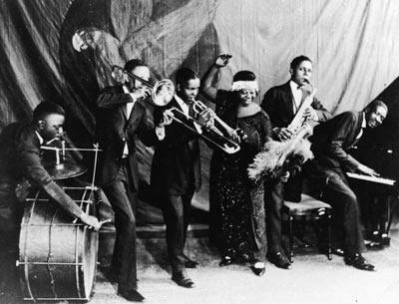
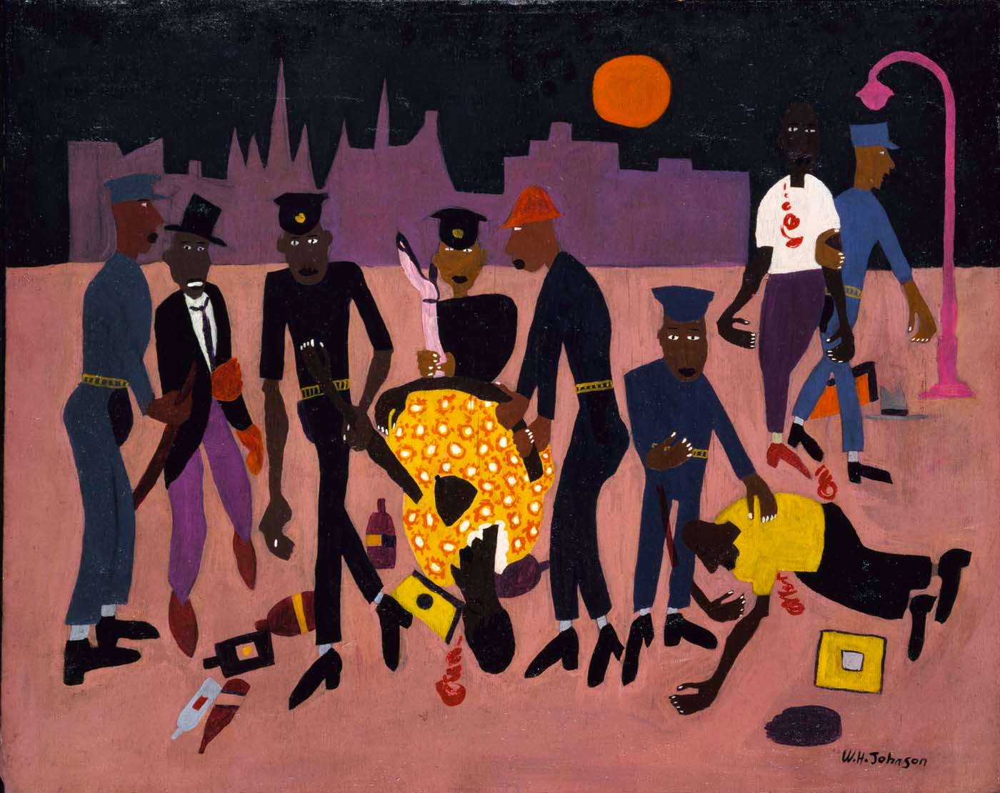
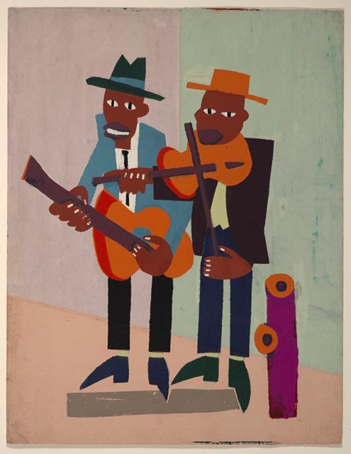
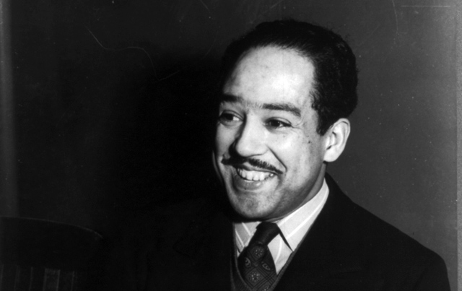
10. Harlem Renaissance
Celebrated African American culture
Spread new music, esp. Jazz to white audiences
Black writers like James Weldon Johnson or Langston Hughes) wrote of black pride & questioned position in society
Artists like William H. Johnson captured the era
Further pointed out the second class citizenship of African Americans
Notes:
After the War, Americans were tired. Americans didn’t want anything to do with Europe or world affairs.
Soldiers were coming home to unemployment, many of their jobs were replaced by minorities and women. Many just wanted to return of the earlier days, prior to war.
Many Americans would turn to their blame on non-traditional Americans. Nativism took over the American public. Many Americans looked at foreigners and minorities with suspicion.
Communism - During WWI, Communist radicals had taken over Russian during the Russian Revolution. Communism was a from of government where the government controls all property and means of production. It is in practice, ruled by a dictator.
Red Scare - After the war, 70,000 Americans had joined the Communist party because it promised economic equality for everyone. Radicals had sent bombs to public officials and business leaders. Russia had fallen to the Communists, and many Americans believed they were next. Anyone out of the ordinary, could be accused of being a radical. Communists were called Reds, thus the Red Scare.
Palmer Raids
Attorney General A. Mitchell Palmer set up an agency later called the FBI, to arrest communists, socialists, and anarchists, who opposed all forms of government. Palmer’s agents trampled on people’s civil rights. Many radicals were deported without trial. But Palmer found no evidence of a plot to overthrow the government.
Two Italian immigrants, Nicola Sacco and Bartolomeo Vanzetti were arrested for robbery and murder in Massachusetts. Witnesses had said the criminals appeared to be Italians Sacco and Vanzetti had alibis, but admitted they were anarchists and denied committing any crime. The case against them was weak. But they were convicted anyway. Many people protested the conviction because they believed it was nativism or because of their radical views. It became a world wide controversy. Sacco and Vanzetti were executed in 1927.

Slide 15
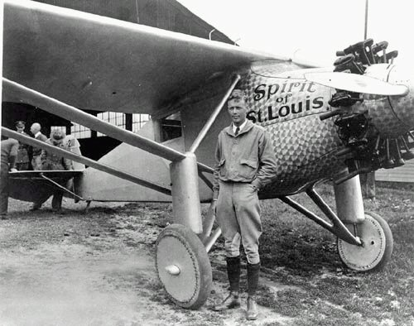
11. American Heroes
I. Society
American Heroes
a. Charles Lindbergh - 1st nonstop flight from NY to Paris
- proved worth of solid moral values in rural America
b. Amelia Earhart
- 1st woman to fly the Atlantic
- opened aviation to women
c. Sports Heroes
- Jim Thorpe - Football
- Jack Dempsey - Boxing
- Babe Ruth - Baseball
Notes:
An embedded link to a 3:16 minute Charles Lindberg Youtube video begins here.
Mac users, click on black circle to open browser and view a 3:16 minute Charles Lindberg Youtube video.
Original link: https://www.youtube.com/watch?v=UBQBLUBnYFM&feature=youtu.be
Charles Lindbergh became a national hero because he was seen as a
1. modest, handsome daredevil, 2. He embodied American traditional values in the new industrialized society. AND 3. His success incorporated elements of technology and individualism.
Amelia Earhart - Lindbergh’s feat inspired later flyers, including Amelia Earhart. In 1932, she became the 1st woman to fly solo across the Atlantic, and later became not the first woman, but the first person to fly solo from Hawaii to California, a challenge that resulted in the deaths of many aviators before her. In 1937, she tried to fly around the world. After completing 2/3s of the trip, they disappeared while crossing the Atlantic.
Jim Thorpe - American Indian/Irish - He was an Olympic gold medalist in decathlon and pentathlon and played professional baseball. At the end of his career he was asked to play in a new emerging sport, Football. This new league in sports wanted to gain some national attention, so they hired a athletic hero to promote their league. Thorpe was elected the first president of what later became the National Football league.
Babe Ruth - George Herman “Babe” Ruth, During his career with the Boston Red Sox and then the NY Yankees, Ruth hit 714 home runs, a record that was unbroken for nearly 40 years. In 1927 he set the legendary record of 60 home runs in a 154 game season.
----------Next Slide---------------------------------------------
^ Before the 20s, the U.S. had been largely a collection of regional cultures. Interests, tastes, and attitudes varied widely from one region to another. Most Americans simply did not know much about the rest of the country, talk with people in other regions or even read the same news as other Americans.
Now we have the emergence of the MASS MEDIA. The emergence of Films, radio, popular magazines and national papers.
MOVIES - Between 1910-1930, the number of theater rose from about 5,000 - 22,500.
- Out of a national population of about 125 Million, the nation’s theaters sold roughly 80 million tickets each weak.
JAZZ SINGER - changed movie history - It was the first movie with sound, and it starred a former vaudvill actor, Al Jolson. It contained music, singing, dancing, and sound effects. Audiences loved it.
MANY foreign Silent Stars either had to learn English or give up their Careers. GREATA GARBO chose to learn English and succeeded despite her heavy Swedish Accent.
Charlie Chapman - still remained a silent star during the twenties and thirties, but just added music for sound
- Gossip Column - By 1930 Winchell’s article was syndicated and was the most widely read column.

Slide 16
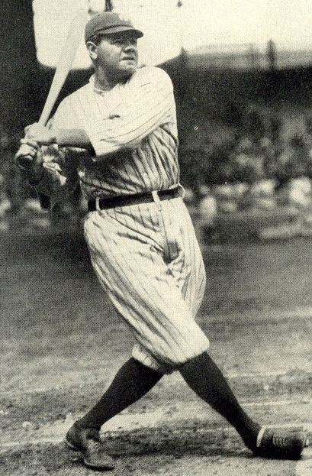
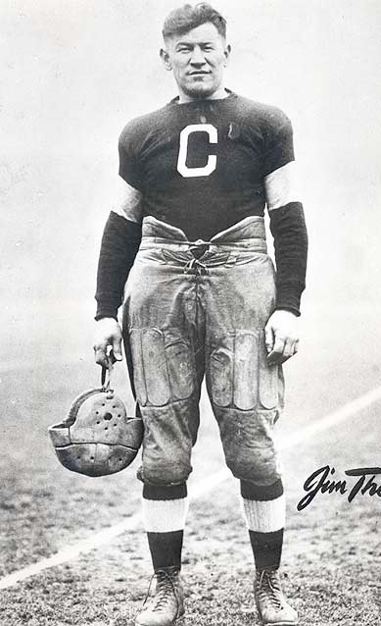
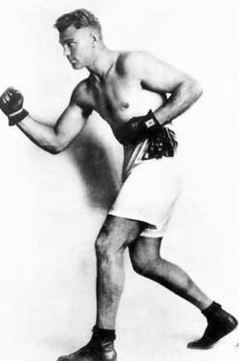
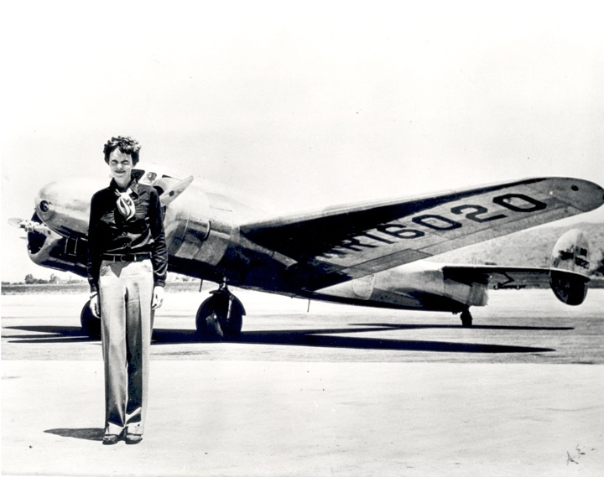
3. American Heroes
a. Charles Lindbergh - 1st nonstop flight from NY to Paris
- proved worth of solid moral values in rural America
b. Amelia Earhart
- 1st woman to fly the Atlantic
- opened aviation to women
c. Sports Heroes
- Jim Thorpe - Ftball
- Jack Dempsey - Boxing
- Babe Ruth - Baseball
c. Sports Heroes
- Jim Thorpe - Football
- Jack Dempsey - Boxing
- Babe Ruth - Baseball
Notes:
Charles Lindbergh became a national hero because he was seen as a
1.modest, handsome daredevil, 2. He embodied American traditional values in the new industrialized society. AND 3. His success incorporated elements of technology and individualism.
Amelia Earhart - Lindbergh’s feat inspired later flyers, including Amelia Earhart. In 1932, she became the 1st woman to fly solo across the Atlantic, and later became not the first woman, but the first person to fly solo from Hawaii to California, a challenge that resulted in the deaths of many aviators before her. In 1937, she tried to fly around the world. After completing 2/3s of the trip, they disappeared while crossing the Atlantic.
Jim Thorpe - American Indian/Irish - He was an Olympic gold medalist in decathlon and pentathlon and played professional baseball. At the end of his career he was asked to play in a new emerging sport, Football. This new league in sports wanted to gain some national attention, so they hired a athletic hero to promote their league. Thorpe was elected the first president of what later became the National Football league.
BABe Ruth - George Herman “Babe” Ruth, During his career with the Boston Red Sox and then the NY Yankees, Ruth hit 714 home runs, a record that was unbroken for nearly 40 years. In 1927 he set the legendary record of 60 home runs in a 154 game season.
----------Next Slide---------------------------------------------
^ Before the 20s, the U.S. had been largely a collection of regional cultures. Interests, tastes, and attitudes varied widely from one region to another. Most Americans simply did not know much about the rest of the country, talk with people in other regions or even read the same news as other Americans.
Now we have the emergence of the MASS MEDIA. The emergence of Films, radio, popular magazines and national papers.
MOVIES - Between 1910-1930, the number of theater rose from about 5,000 - 22,500.
- Out of a national population of about 125 Million, the nation’s theaters sold roughly 80 million tickets each weak.
JAZZ SINGER - changed movie history - It was the first movie with sound, and it starred a former vaudvill actor, Al Jolson. It contained music, singing, dancing, and sound effects. Audiences loved it.
MANY foreign Silent Stars either had to learn English or give up their Careers. GREATA GARBO chose to learn English and succeeded despite her heavy Swedish Accent.
Charlie Chapman - still remained a silent star during the twenties and thirties, but just added music for sound
- Gossip Column - By 1930 Winchell’s article was syndicated and was the most widely read column.

Slide 17
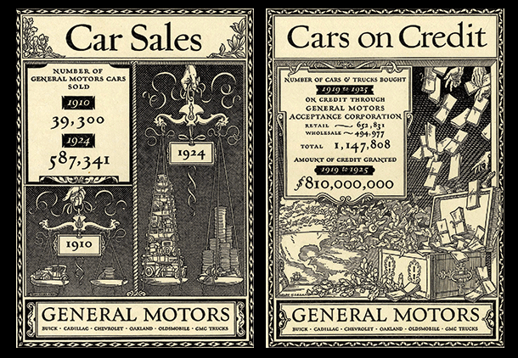
I2. Problems on the Horizon
Hidden Problems
- Big Business Growth left
many of its workers w/low
wages
- farm, RR, Iron industries
losing money
- Consumer debt was huge
- Installment plans - allowed
easily purchase of goods by
borrowing money
Notes:
Most Americans had confidence in the wealth of the 1920s. Remember, the national income rose from $64 billion in 1921 to $87 billion in 1929. Most businesses seemed to make fortunes. The stock market reached new heights. But this prosperity hid two big problems.
First, business was not as healthy as it seemed. As workers produced more goods, businesses grew. Large businesses bought up, or merged with, smaller ones. But as businesses grew, business managers made much more money than workers did. Also, mining companies, railroads, and farms were not doing well.
Second, consumer debt rose to high levels. Businesses needed to sell all the goods they were now producing. So they encouraged customers to buy on the installment plan. This was a form of borrowing. Customers could make low payments over a period of time. That way people could afford to buy more. Banks provided money at low interest rates. Advertising also pushed the idea of buying on credit. Average Americans were spending more money than they actually had.

