Slide 1
World War II & SC
8-6.5

Slide 2
WWII Overview
1939-1945
Caused by acts of aggression by Axis nations
Main Allied nations: Great Britain, France, USSR, China, & US
Main Axis nations: Germany, Italy, and Japan
Fighting occurred in two theaters: European & Pacific
Allies defeated Germany on May 8th, 1945 (known as V-E Day) and defeated Japan on August 14th, 1945 (known as V-J Day)

Slide 3
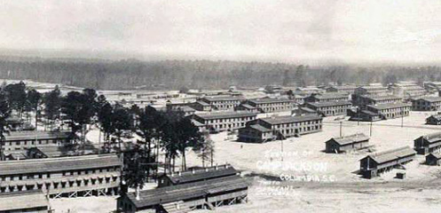
Before the War
U.S. started drafting young men to prepare for war.
The bases established during WWI, served as training bases:
Camp Jackson became Fort Jackson.
The Charleston Navy Yard increased its production of destroyers.
James Byrnes helped to guide the Lend Lease Act (policy where U.S. loaned supplies, food, etc. to the Allies). He also served as the director of the war mobilization.

Slide 4
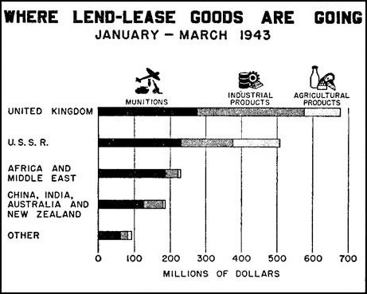
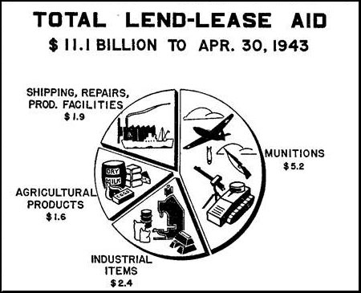
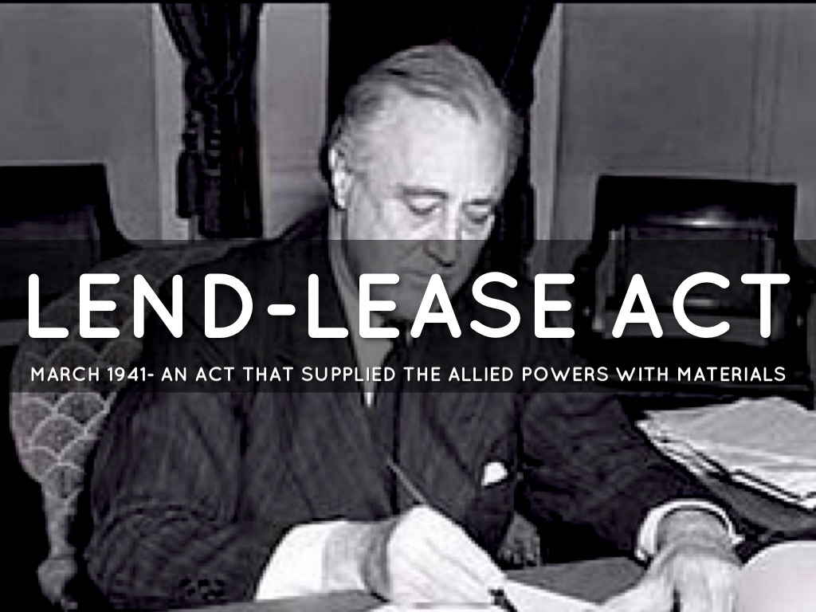

Slide 5
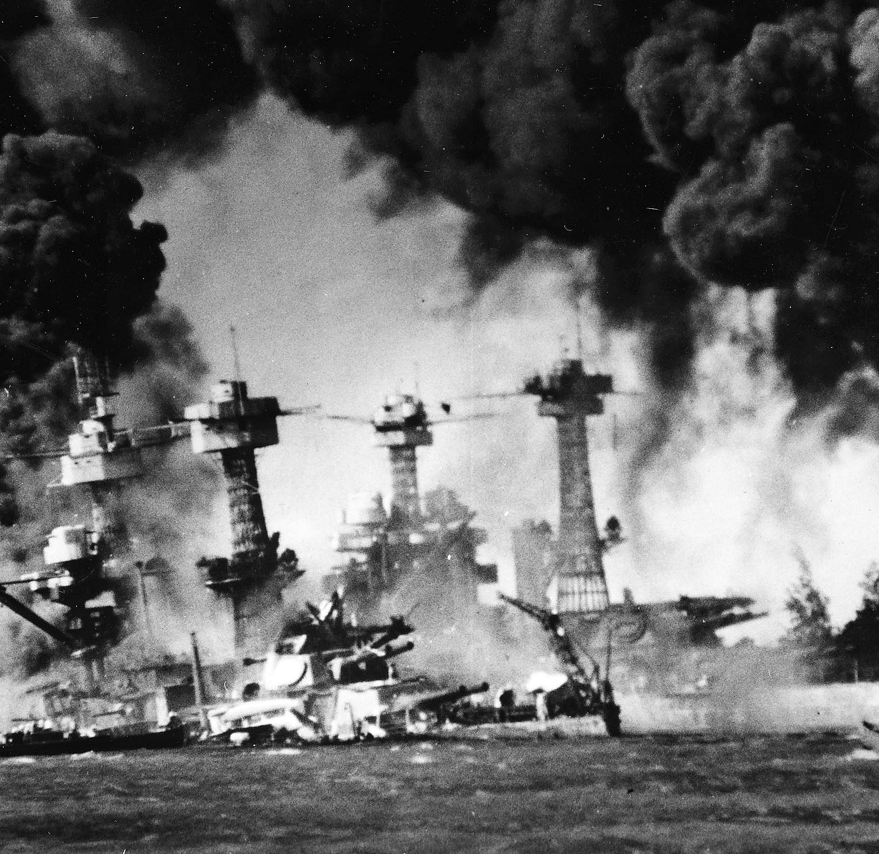
Pearl Harbor
Attack at Naval base, Pearl Harbor, in Hawaii (Dec. 7, 1941)
Japan was seeking to wipe out the Pacific Fleet and cripple the U.S.
U.S. declares war, the very next day--Dec. 8th, 1941

Slide 6
“Yesterday, Dec. 7, 1941 - a date which will live in infamy - the United States of America was suddenly and deliberately attacked by naval and air forces of the Empire of Japan.”
–President Franklin D. Roosevelt, 1941

Slide 7
Doolittle Raids
U.S. wanted to retaliate for Pearl Harbor, so crafted a sneak attack plan--the Doolittle Raid.
The plan was for Army bomber pilots to launch from Navy aircraft carriers who would sail as close to Japan as they could without being detected. The pilots would then drop bombs on Tokyo and then have enough fuel to land safely in China.
Trained in SC
It was more of a morale boost than a military one.

Slide 8
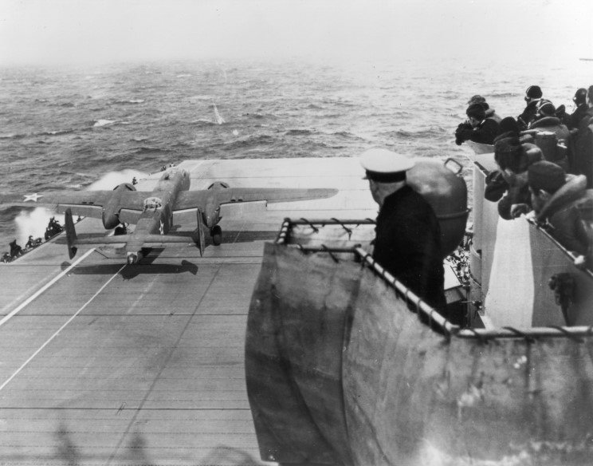
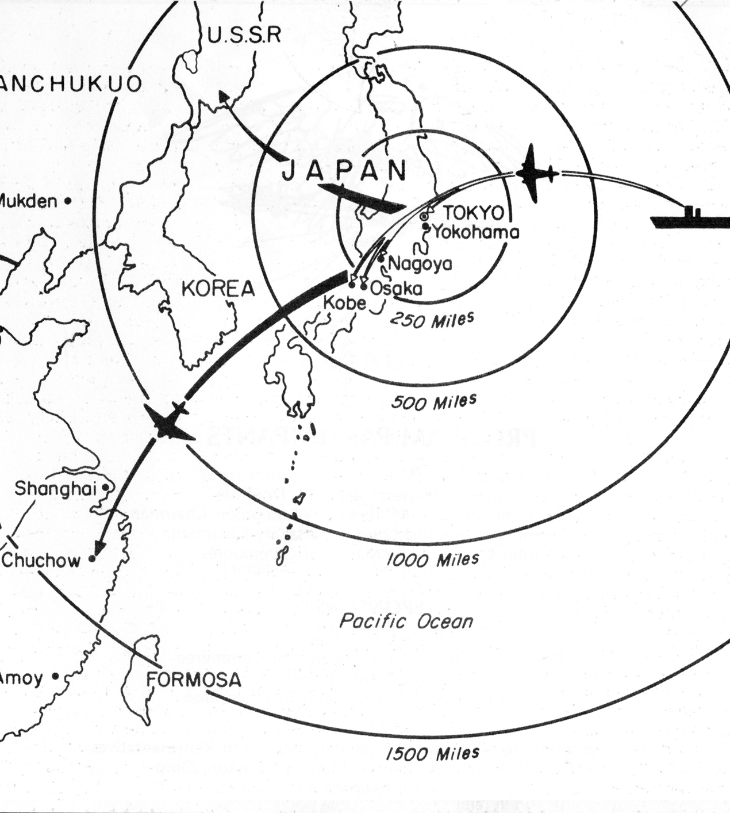
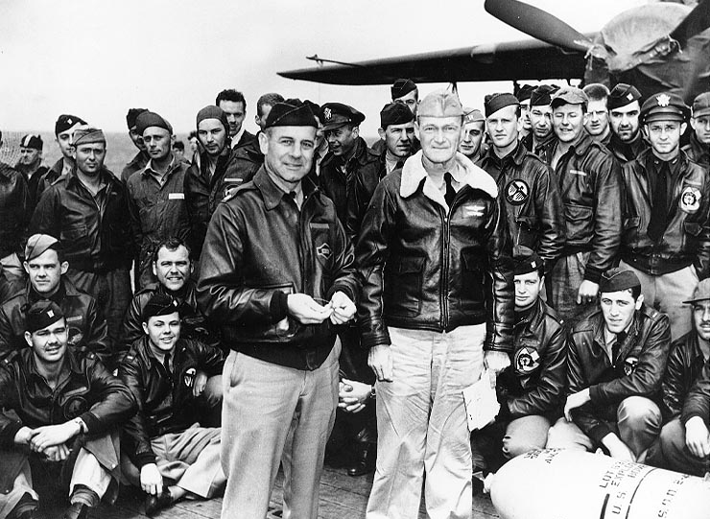

Slide 9
Tuskegee Airmen
African American pilots were trained at the air base at the Tuskegee Institute in Alabama.
Commanded by white officers, the Tuskegee airmen provided air support for the allied invasion of Italy
They were then assigned to escort heavy bombers on raids to weaken Germany prior to the D-Day invasion.
Many airmen earned the Distinguished Flying Cross & proved African American pilots could shoot down enemy aircraft as well or better than white air crews.

Slide 10
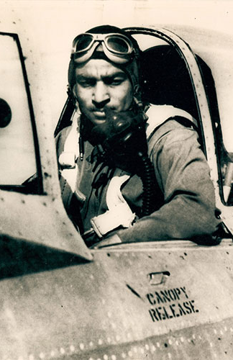
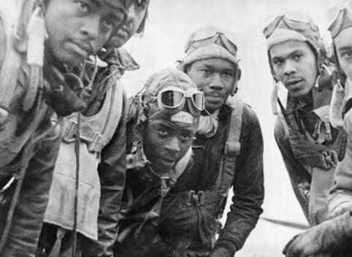
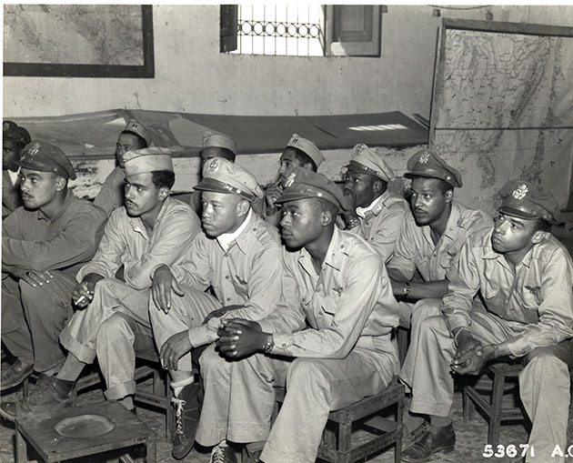

Slide 11
“They have a saying that excellence is the antidote to prejudice; so, once you show you can do it, some of the barriers will come down.”
–Dr. Roscoe Brown, Tuskegee Airmen

Slide 12
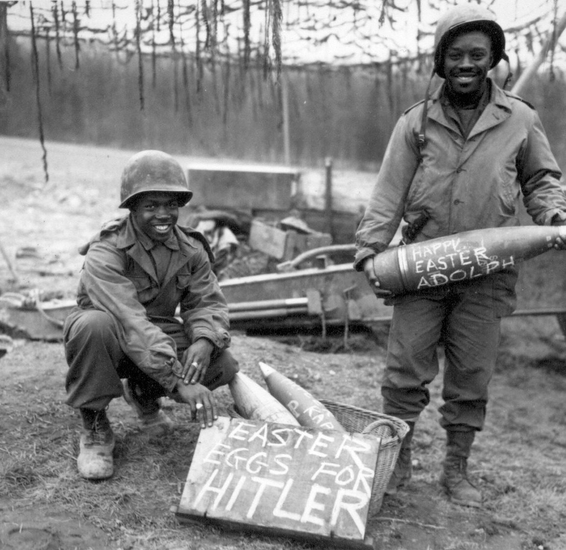
African American Service
African Americans served in segregated units commanded by white officers.
Their service spawned the Civil Rights movement.

Slide 13
D-Day
Part of the Battle of Normandy, which lasted from June 1944 to August 1944, resulted in the Allied liberation of Western Europe from Nazi Germany’s control
Codenamed Operation Overlord, the battle began on June 6, 1944 (D-Day)
156,000 American, British and Canadian forces landed on five beaches along a 50-mile stretch of the heavily fortified coast of France’s Normandy region
one of the largest amphibious military assaults in history

Slide 14
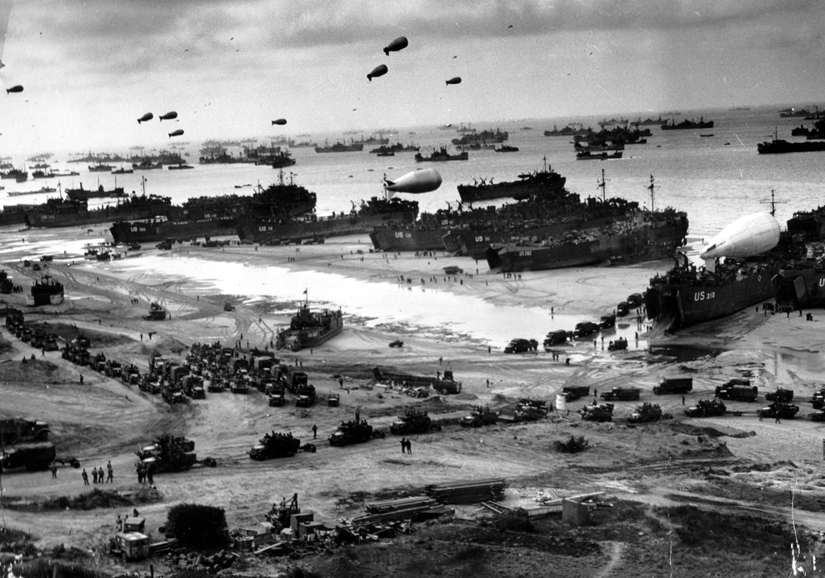

Slide 15
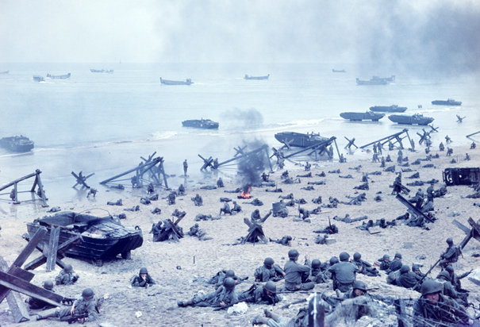

Slide 16
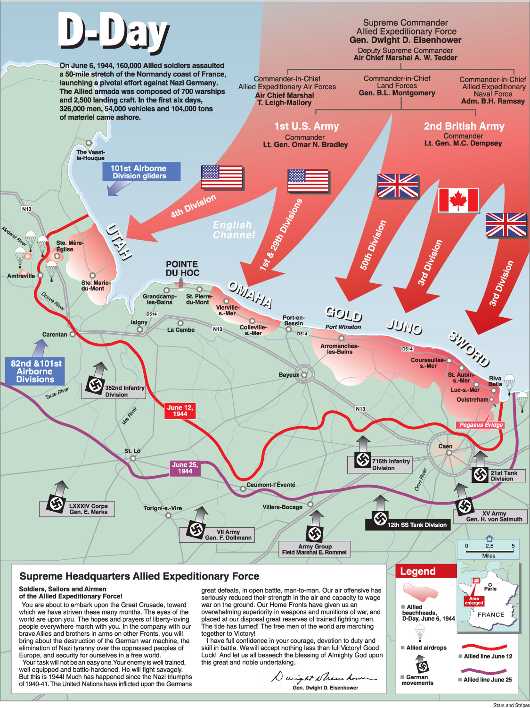

Slide 18
SC Service
South Carolinians served in the armed forces, but many others were not fit for service.
1/3 of young white men & 1/2 of black men were either illiterate or in such poor health that they could not serve--startling indication of the poverty of SC

Slide 19
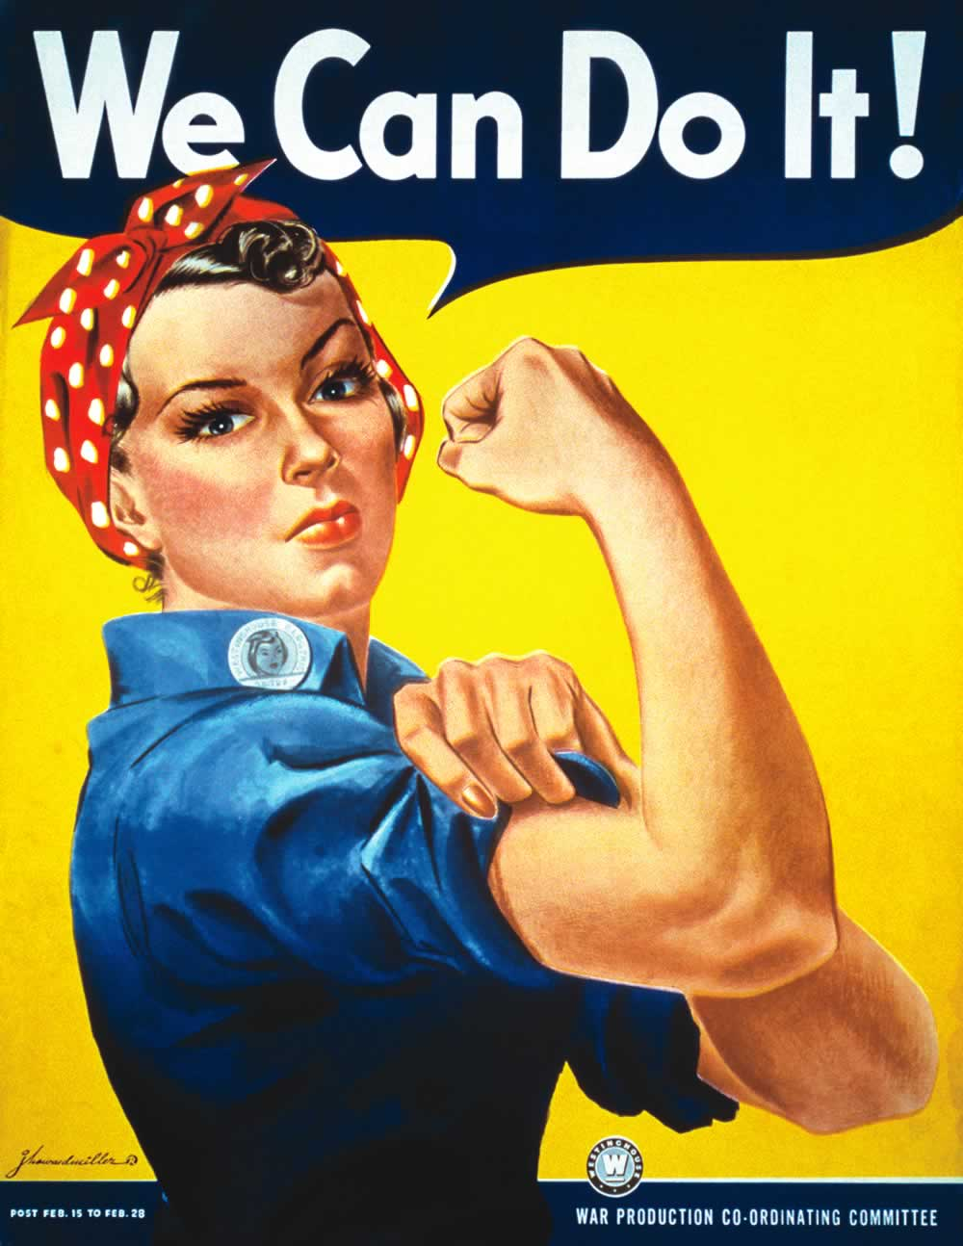
Home Front
War brought economic prosperity. Mobilization = more jobs
Women entered the workforce like never before (Rosie the Riveter)
When the war ended they had savings to use to buy what had been unavailable during the war. It started a period of economic prosperity.

Slide 20
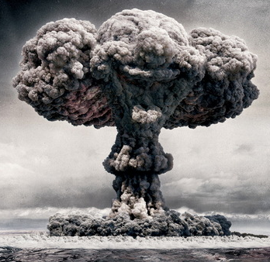
End of War
Allies defeated the Axis in Europe earlier. Mussolini was killed by Italians and Hitler committed suicide
Victory in Japan was achieved when the United States dropped the atomic bomb on Hiroshima & Nagasaki, forcing them to an unconditional surrender

