Slide 1
Origins of the Cold War
7-5.1

Slide 2
How did Roosevelt and Churchill
differ from Stalin?
Goals of Roosevelt and Churchill: | Goals of Stalin:
Represent constitutional or limited governments Want lands freed of Axis powers Want lands to be granted self-rule & have elections Want lands to establish constitutional governments Want lands to be capitalist systems | At first, Stalin agreed to allow elections in lands in Eastern Europe that the Soviet Union had freed and occupied during the war. However, after the war, he broke this promise and set-up very different goals. Want lands to be communist with socialist systems. Was not for free elections

Slide 3
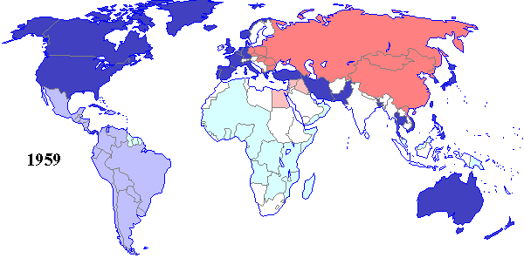
What would happen to Germany?
West Germany: | East Germany:
Great Britain, United States, & France had occupied the western portion of Germany by the end of the war. | The Soviets invaded Germany from the east, therefore by the end of the war the U.S.S.R. had a large “occupation zone” in eastern Germany.

Slide 4
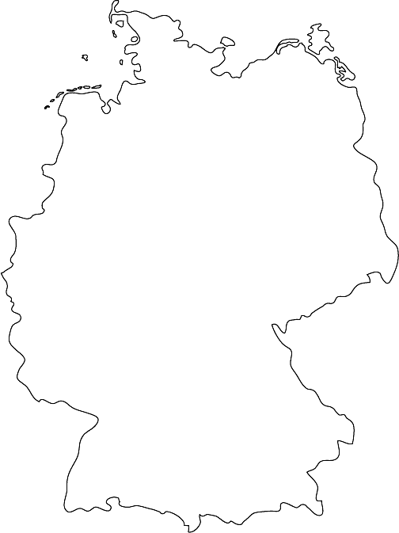
What were the sides of the War?
The United Nations Yalta conference at the end of the WWII agreed to the division of Germany into two separate countries.
WEST: Named the “Federal Republic of Germany” becomes West Germany.
EAST: Named the “German Democratic Republic” becomes East Germany.

Slide 5
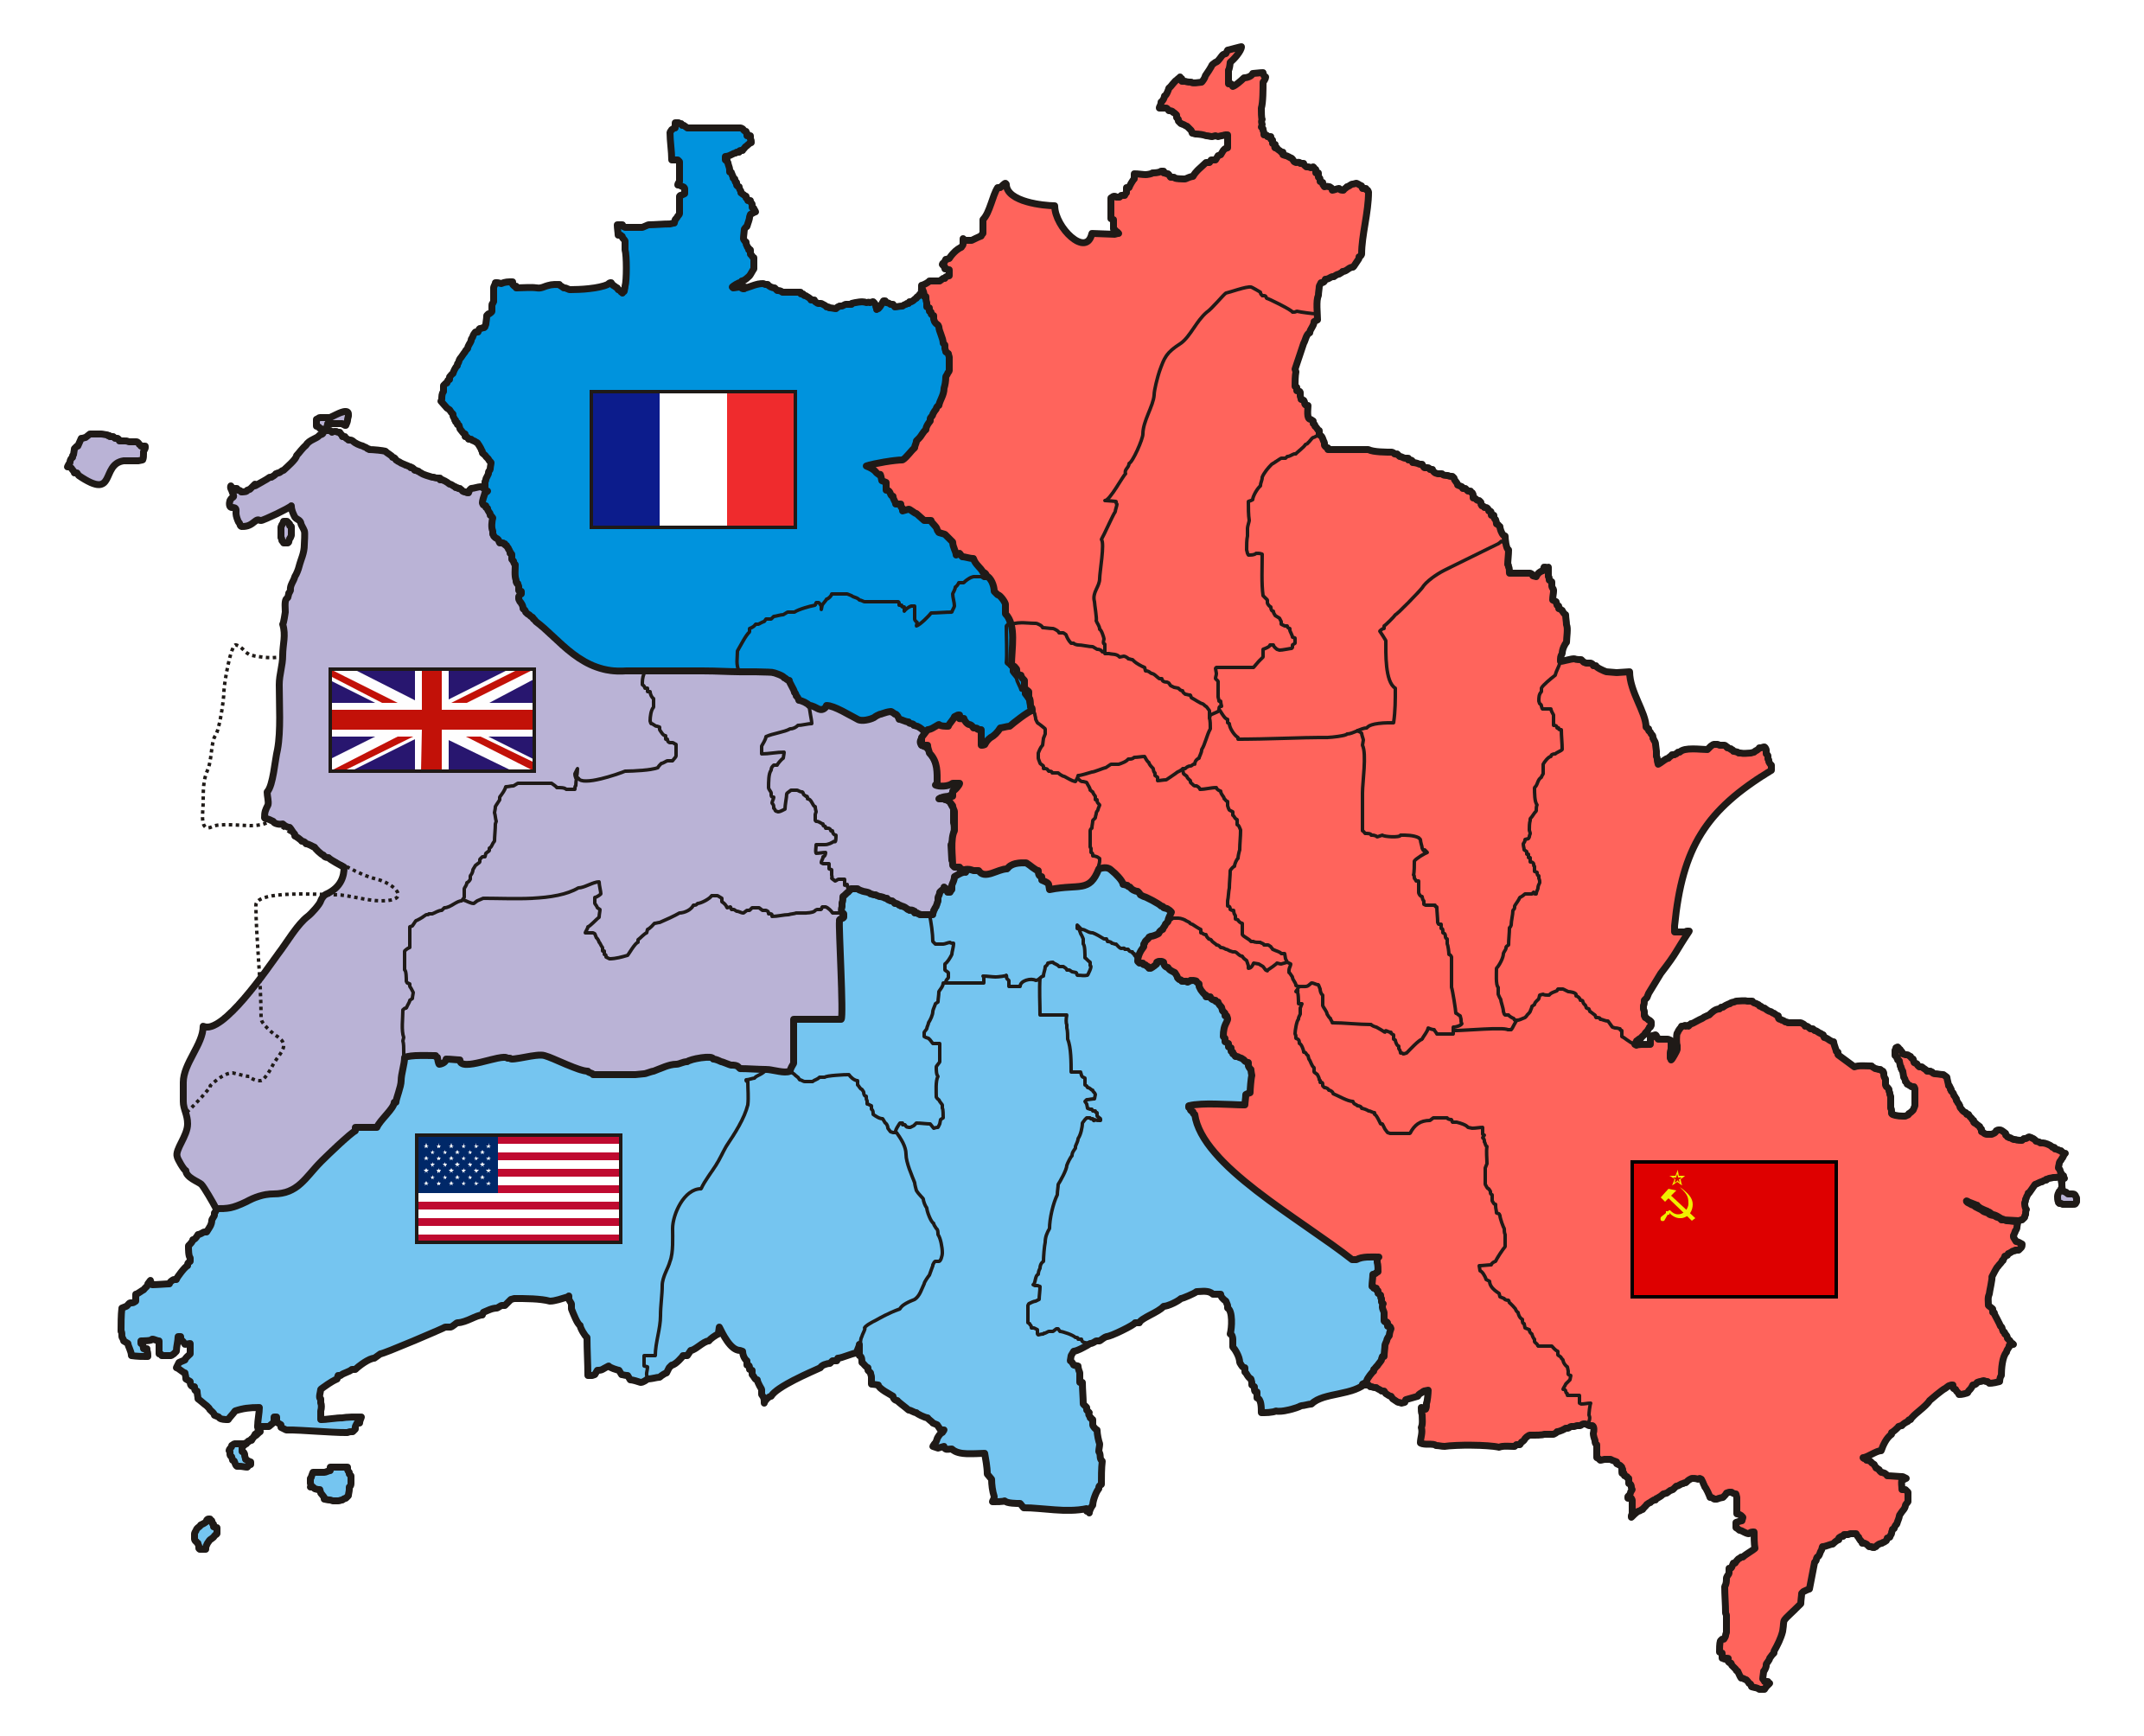
What were the sides of the War?
Berlin: The capital city is also divided into west and east even though it was located deep in East Germany.

Slide 6
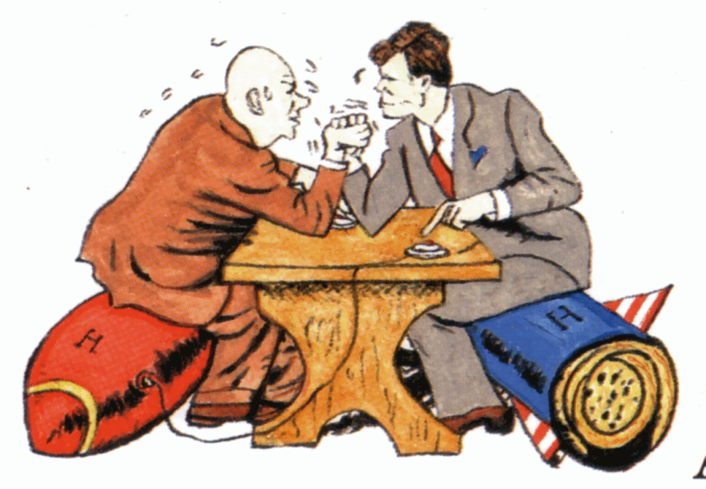
How to recap the ideology behind the war?
Capitalism- democratic vs. socialist-communist

Slide 7
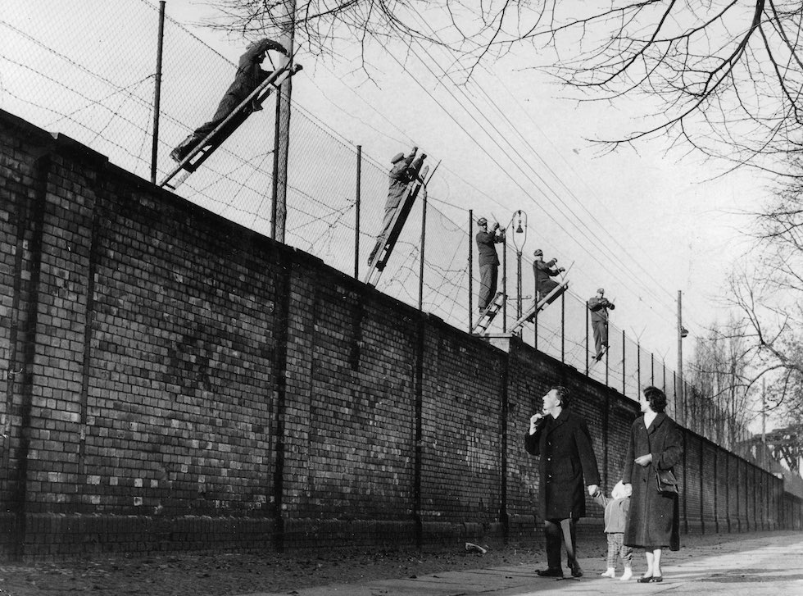
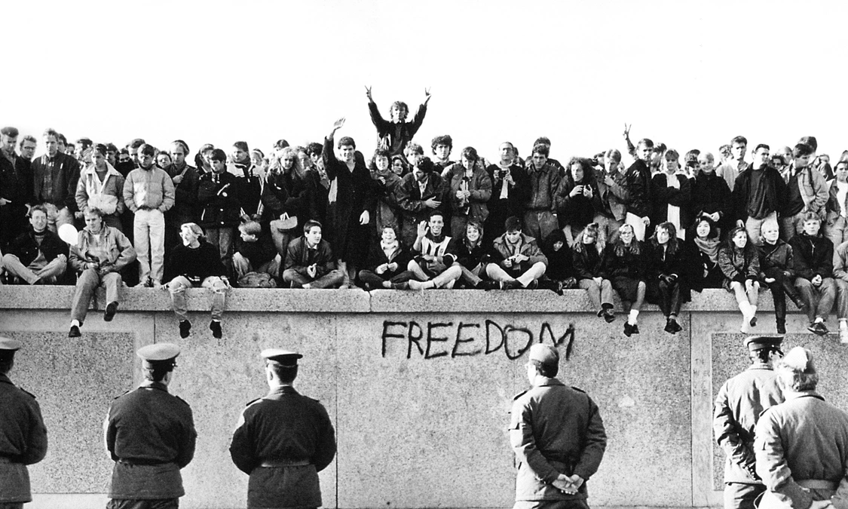
The Berlin Wall
Those who lived in East Berlin began to move west in search for better opportunities. The Soviets wanted to stop this, so they sealed off access between East and West Berlin. They began with barbed wire, which was then replaced by a six-foot-high 96-mile long wall of concrete blocks, guard towers and machine gun posts.

Slide 8
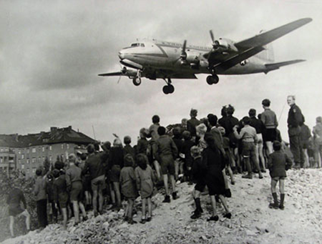
The Berlin Airlift
In an attempt to drive the Allies out of Berlin, the Russians closed all highways, railroads and canals connecting West Germany with West Berlin. Their hope was to make it impossible for people who lived in West Berlin to get food and supplies. Instead of leaving, the U.S. and the Allies supplied West Berlin using airplanes.

Slide 9
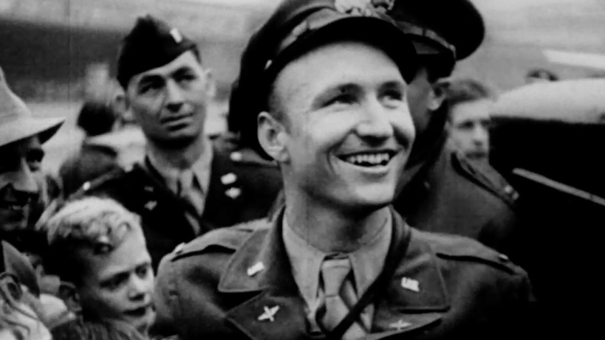
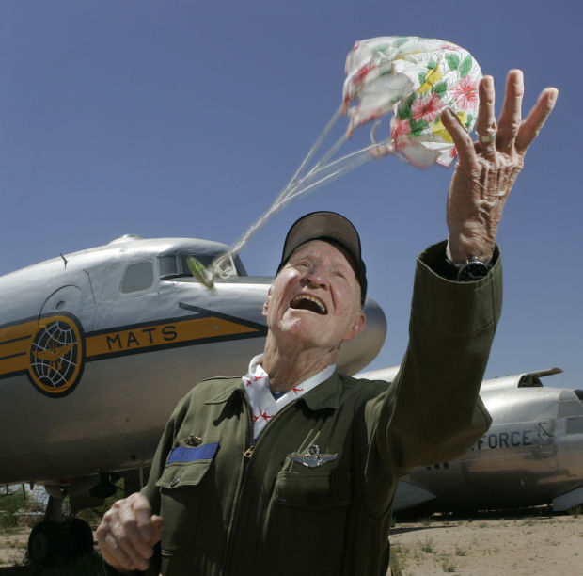
The Candy Bomber
Gail Halvorsen

Slide 10
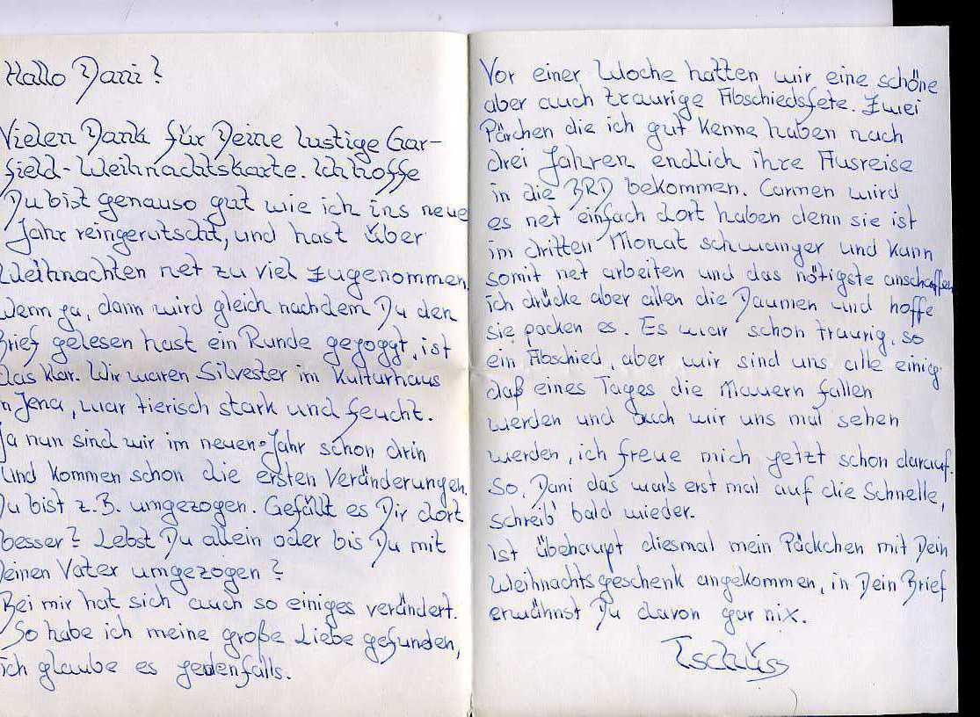

Slide 11
Directions
If you are in East Berlin: Write a letter to send over the wall to the people of West Berlin. Describe what life is like for you in East Berlin and the pros and cons of communism.
If you are in West Berlin: Graffiti the wall with positive words, phrases, poems, etc. Be thoughtful in what you write.

Slide 12
Textbook Page
On a white sheet of paper, you will be creating a textbook page about the Cold War from the perspective of the side you are on (West or East Berlin).
Include information, key terms and definitions, pictures, and maps.

