Slide 1
Competition and Conflict During the Cold War
7-5.4

Slide 2
The Korean War

Slide 3
Did Korea go “hot” during the Cold War?
The Korean War was a portion of the Cold War in which the ideological tensions became “hot” and fighting ensued, without troops from the Soviet Union & the US ever actually fighting each other.

Slide 4
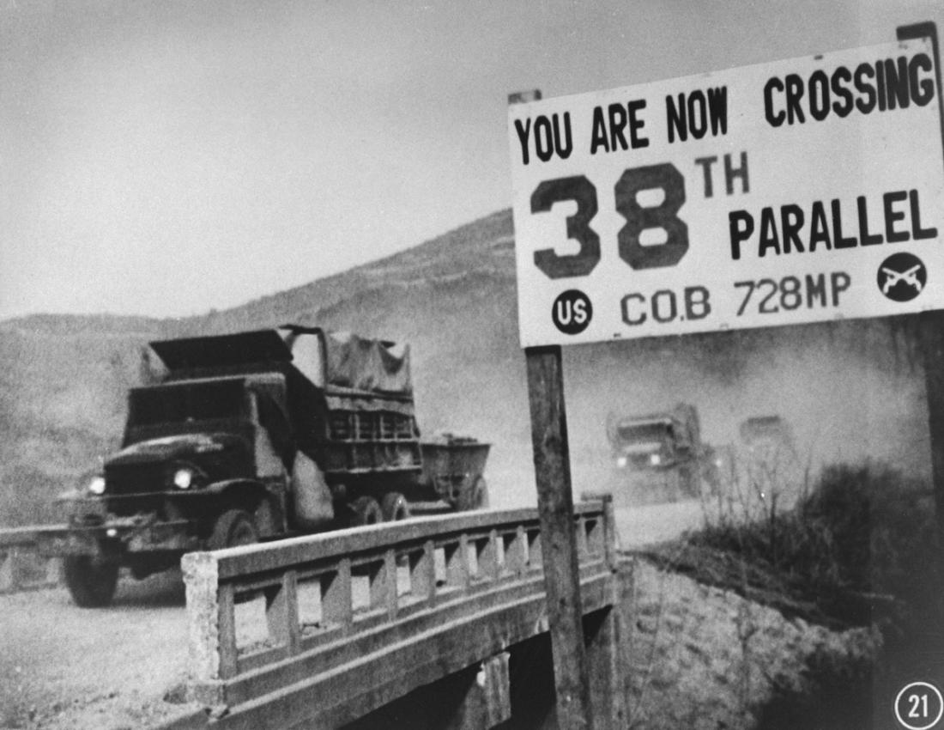
How did the Korean War begin?
After WWII, Korea was divided at the 38th parallel (Northern Korea- Communist and Southern Korea- democratic). The war began in 1950 as North Korea invaded South Korea with the hope of uniting the peninsula under one communist regime.

Slide 5
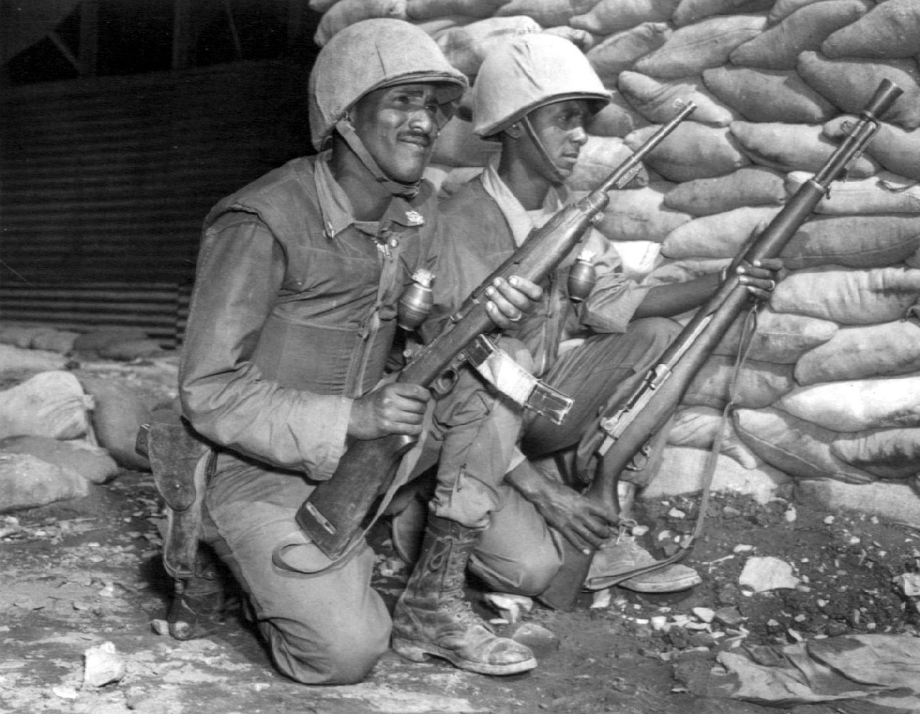
How did the superpowers try to influence the war?
The United States, led by
President Harry Truman,
and the United Nations sent troops to South Korea. The Soviets assisted North Koreans by giving them money & weapons, and the communist Chinese soon joined in sending troops to help North Korea.

Slide 6
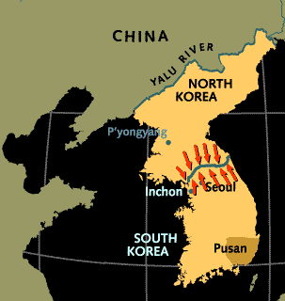
How did the war end?
The war quickly reached a costly impasse and the stalemate ended in 1953, when a cease-fire agreement was signed. Korea remains divided at the 38th parallel, which was used as a demilitarized zone.

Slide 7
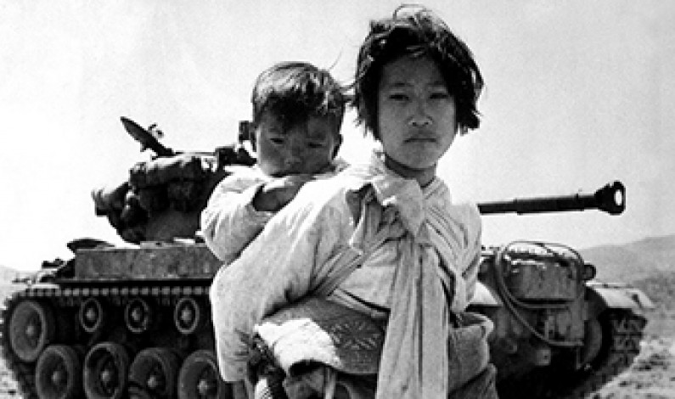

Slide 8
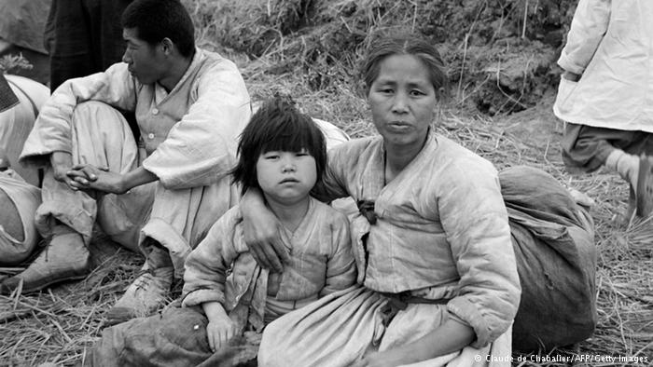

Slide 11
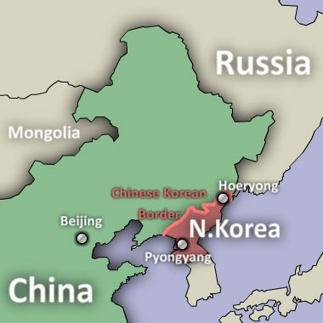
What two countries
border North Korea?
What impact do you think this has on North Korea?

Slide 12
The “Iron Curtain”

Slide 13
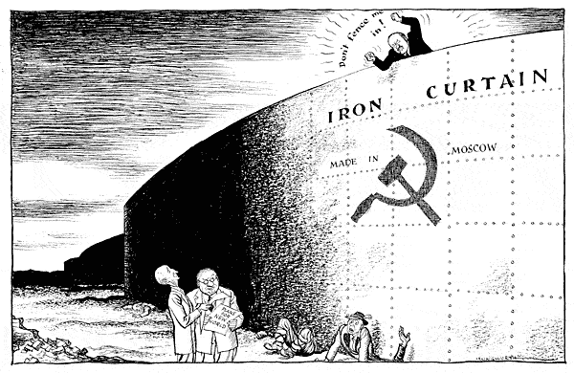
What was the “Iron Curtain”?
Europe during the Cold War was split with the Soviets dominating Eastern Europe under communist control and Western Europe remaining democratic. Prime Minister Winston Churchill coined the phrase “behind the iron curtain” to describe the area of the continent under communist control.

Slide 14
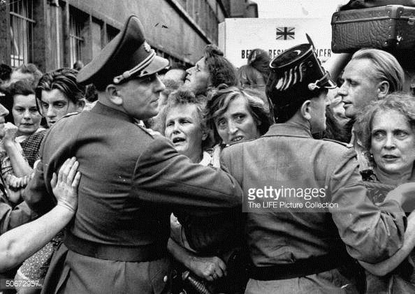
How was life different behind the iron curtain?
Life in Eastern Europe behind the iron curtain (most notably in Eastern Germany) was significantly worse as the lack of many consumer goods led to a much lower standard of living in the communist sectors. In 1961 the Communists in Eastern Berlin built the Berlin Wall as an attempt to prevent people from going into West Berlin. The Berlin Wall symbolized the iron curtain that separated the democratic West from the communist East.

Slide 15
Goal: To maximize learning
Problem: When we constantly leave our seats and move around the room we are distracting to others.
Solution: Raise your hand when you need to get out of your seat (this includes getting a tissue, sharpening your pencil, and getting hand sanitizer) and wait for Ms. Thompson to call on you. You should only get out of your seat if you have been addressed.

Slide 16
Rewards: RAMS coupons or other surprise
Consequences: Anyone who fails to follow this classroom guideline will be asked to return to their seat and their agenda will be signed.

Slide 17
The Vietnam War

Slide 18
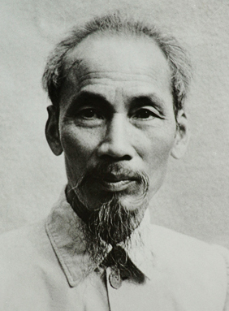
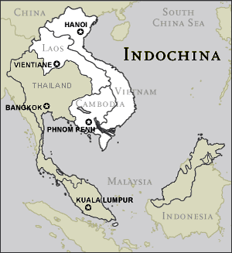
How did Vietnam go “hot”?
The Vietnam War was another “hot” extension of the Cold War. After WWII, the French wanted to reassert their control over Indochina, but the Vietnamese nationalist movement, led by the communist leader Ho Chi Minh, was very strong.

Slide 19
How did the US support France?
The United States gave money & weapons to France to fight the Communists because the US was afraid if one Asian country fell to communism, the rest of the region of the world would also become communist. Eventually Ho Chi Minh and his Communist forces defeated the French in 1954.

Slide 20
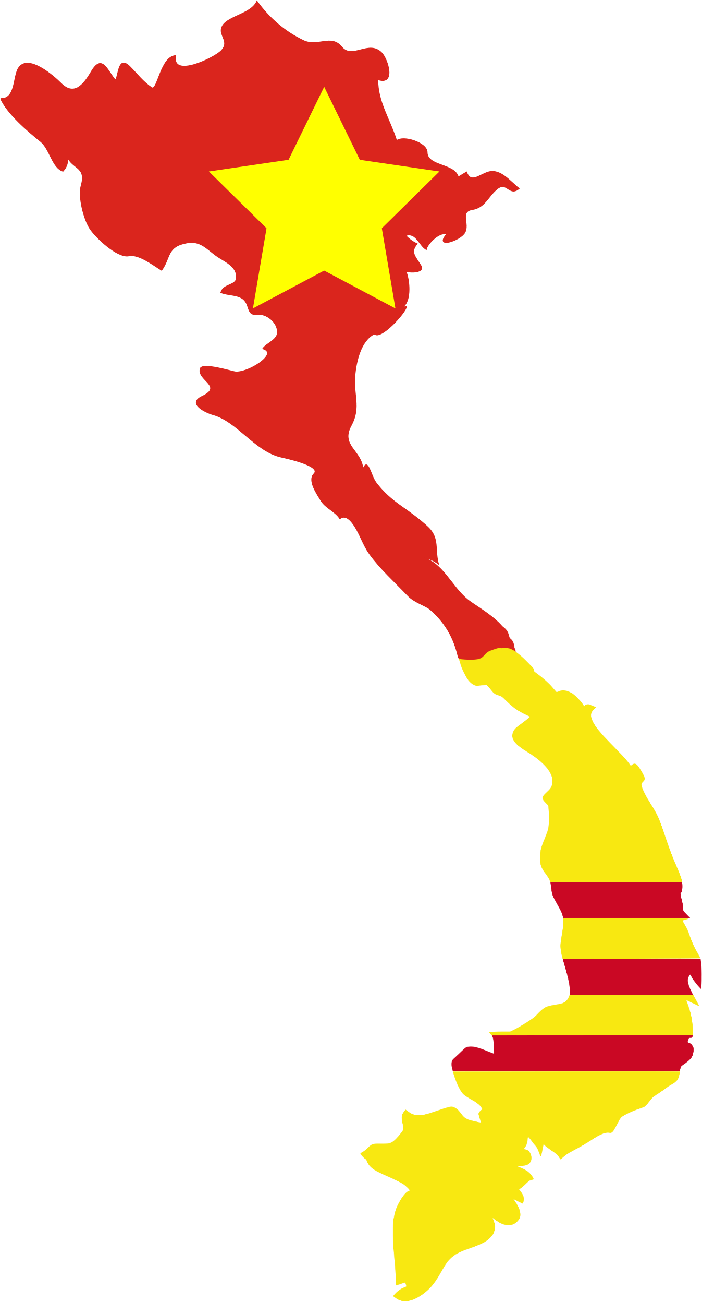
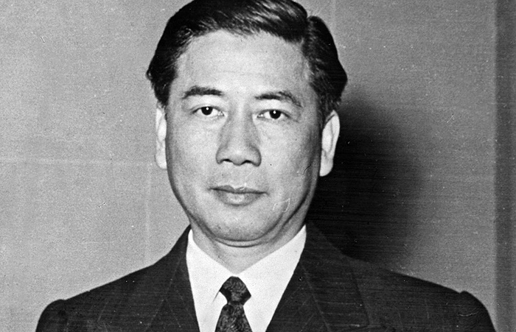
What happens to Vietnam after the defeat of France?
Vietnam was split into two regions at the 17th parallel: the Northern part became communist under the leadership of Ho Chi Minh and the Southern part was established as non-communist under the leadership of Ngo Dinh Diem.

Slide 21
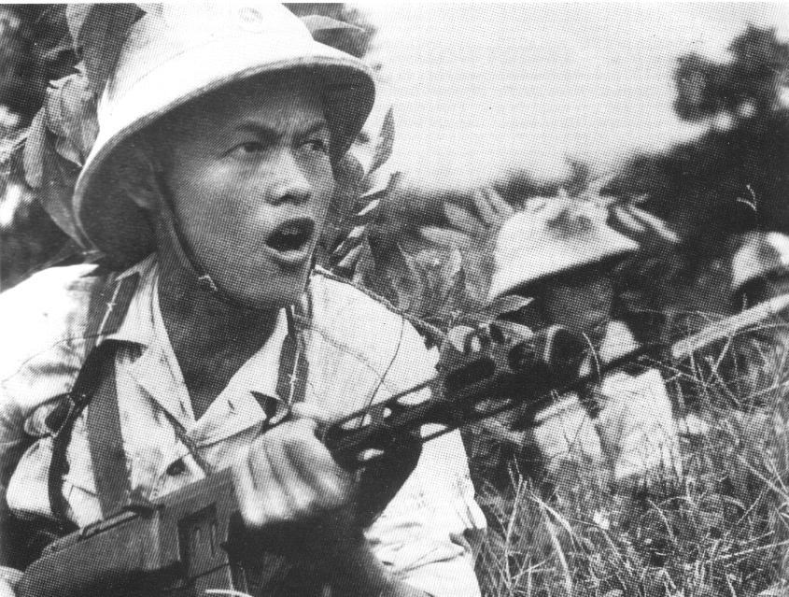
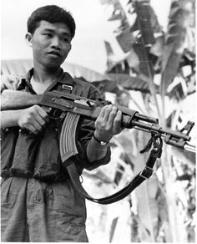
How did the US react to the invasion?
The US began sending weapons and advisors to South Vietnam in the 1950s. In the mid-1960s under President Lyndon Johnson, American troops were sent to help the South Vietnamese. Not only did the Americans fight the North Vietnamese, they also fought against the Vietcong, who were communists in South Vietnam.

Slide 22
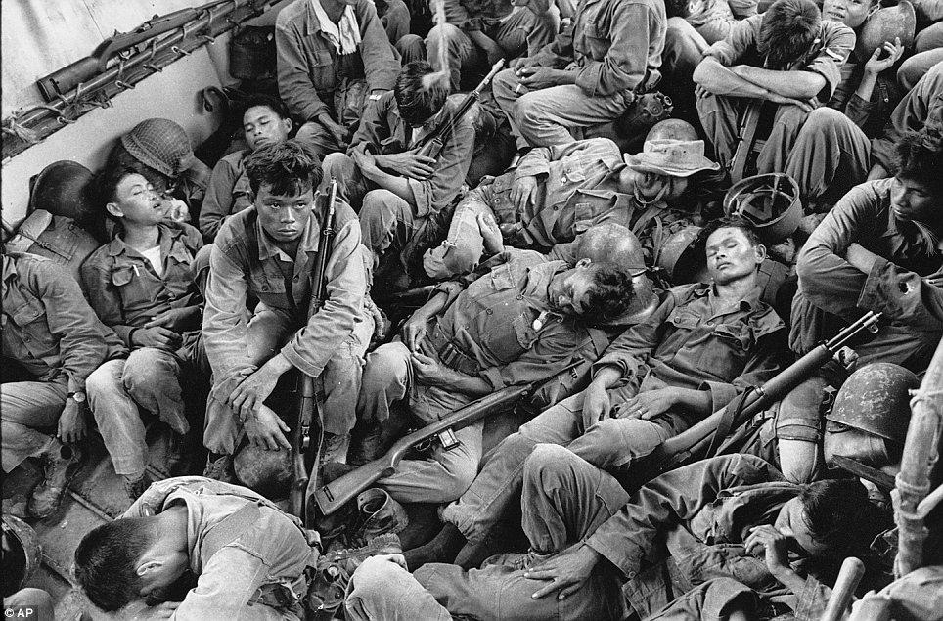

Slide 23
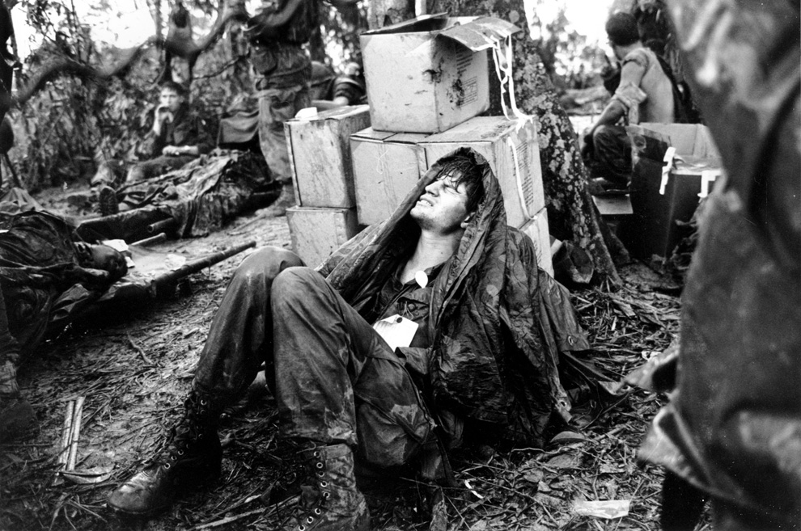

Slide 24
How did the war end?
The communists were very successful in their use of guerilla warfare against the US. The South Vietnamese government did not have the support of the people, and the US could not achieve a victory. The US withdrew, and the communist took over South Vietnam and unified the country under communist rule in 1975.

Slide 25
After a Viet Cong ambush, an injured South Vietnamese marine is held by a fellow soldier

Slide 26
A man holding his dead child speaks to South Vietnamese army rangers

Slide 27
Women and children hide from Viet Cong gunfire in a muddy canal

Slide 28
A woman weeps over her husband's body, which was discovered in a mass grave

Slide 29
A South Vietnamese marine carries the body of a fellow soldier.

Slide 30
Vietnam Veteran Finds a Fallen Buddy on the Wall

Slide 31
Your Job:
Create a memorial for the Vietnam War in memory of those who lost their lives. You may include pictures, quotes, and names of those who gave their lives to convey emotion and meaning.

Slide 32
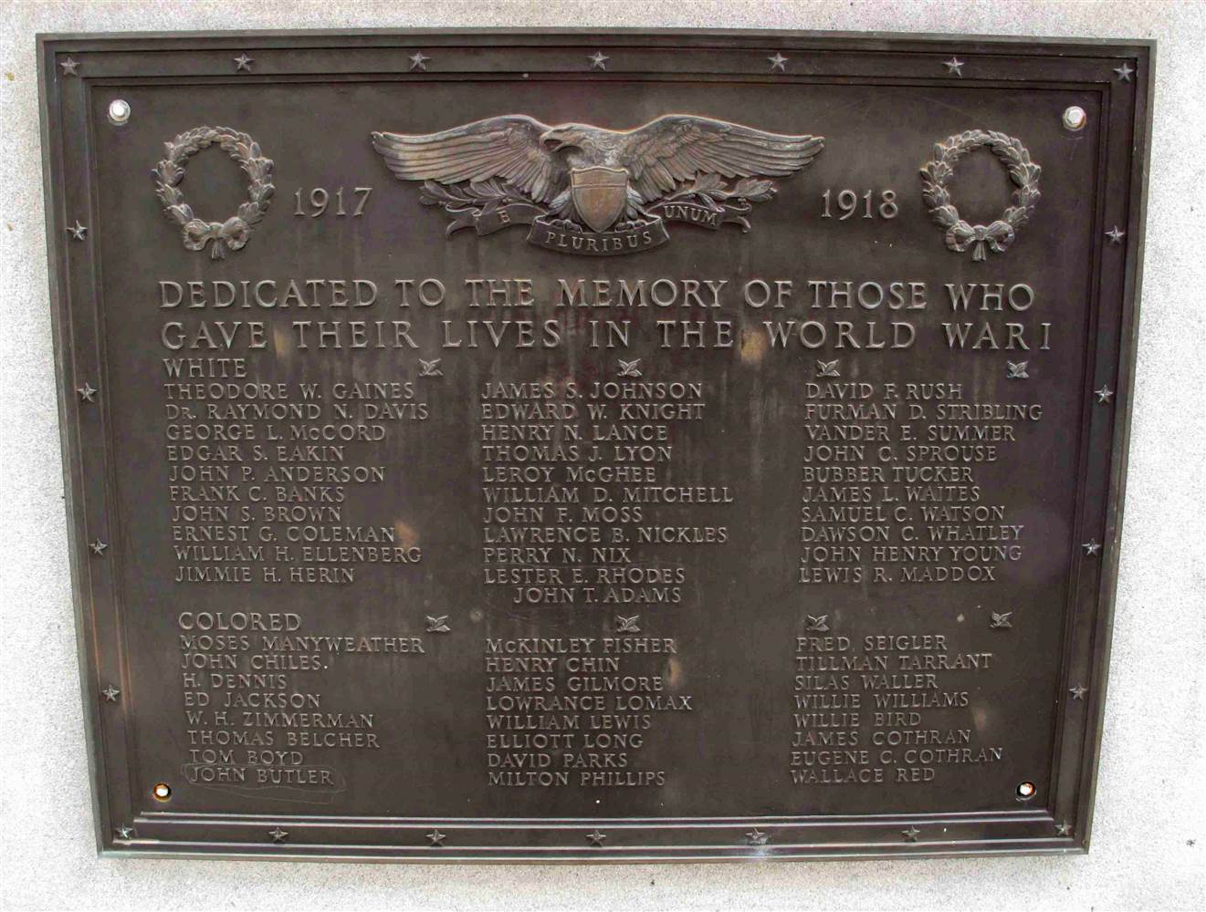
Plaques
Plaques are frequently included in war memorial designs, and can be the whole memorial, or a part of a larger design. Where they are used as part of a larger memorial, plaques are often the part that bear inscriptions or list names. As such they carry much emotional importance, since it is often the names on a memorial that are considered the most significant aspect of it.

Slide 33
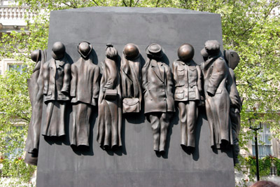
Sculptures or Monuments
Sculptures may form the whole memorial or be part of a larger monument and are often used to commemorate a specific group.

Slide 34
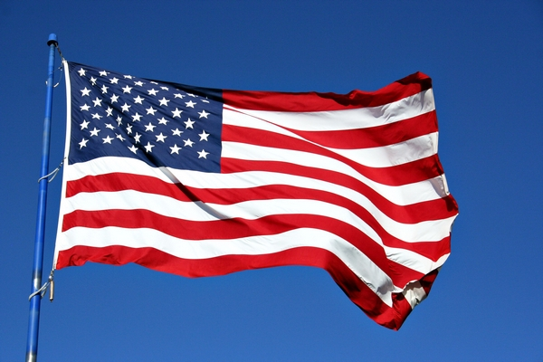
Imagery in Memorials
Memorials are often made to remember lives, so they often draw on the emotions of the viewers. Think of some words that would make the viewers feel somber or mournful. You may want to make a memorial that celebrates life in a happy way instead. Provide words that make viewers feel proud or patriotic.

Slide 35
Your Job:
Create a memorial for the Vietnam War in memory of those who lost their lives.
You need to include:
What the war was about/what caused the war
What the outcome was
Why this war was so difficult for the US to win

Slide 36
The Cuban Missile Crisis

Slide 37
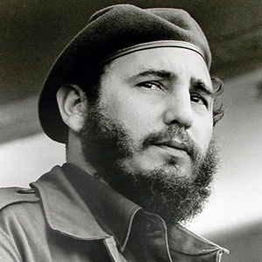
What started the Cuban Missile Crisis?
In 1962 another significant Cold War event with the potential of evolving into a nuclear showdown occurred. Fidel Castro had become the communist leader of Cuba in 1959.

Slide 38
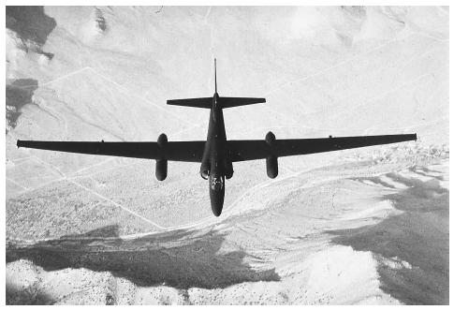
What started the Cuban Missile Crisis?
When an American spy plane (taking photos) flew over Cuba, they realized Soviet missiles were being assembled on the Island. President John F. Kennedy feared the Soviets would use them to attack the United States.

Slide 39
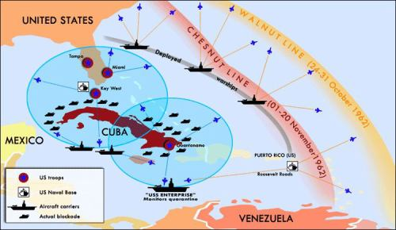
How did the United States react?
President Kennedy decided to implement a naval blockade around Cuba, and told the Soviets they would have to remove the missiles. After almost two weeks of intense maneuvering and negotiations at the United Nations and between the US and USSR, both sides made concessions (the world waiting during these two weeks fearing nuclear annihilation).

Slide 40
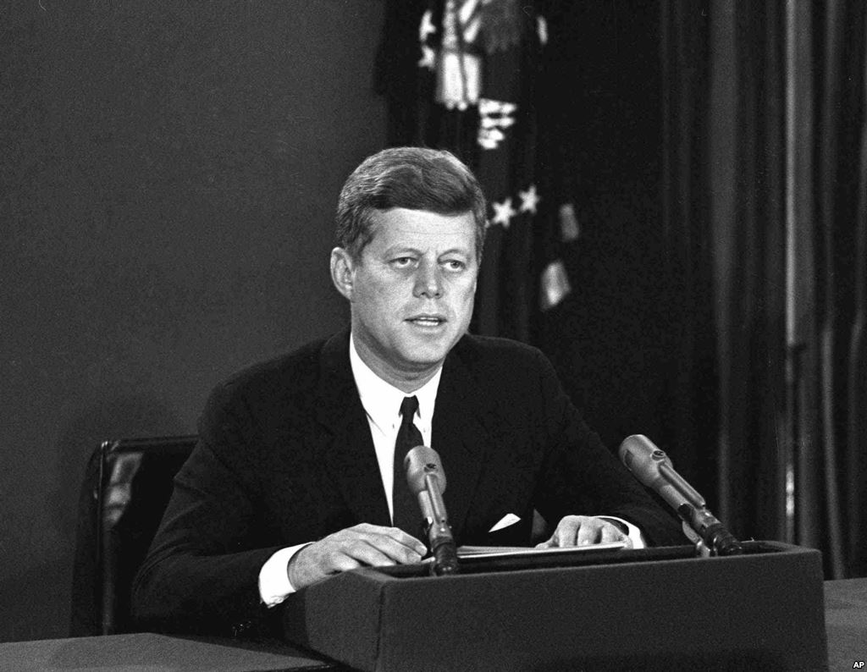
What was negotiated?
The Soviets removed their missiles from Cuba and in return the US removed their nuclear missiles that they had in Turkey that the USSR saw as a threat.

Slide 41
Superpowers Continue to Compete

Slide 42
What else did the superpowers compete over?
The US and Soviet Union also competed for global power through their space and arms (weapons) race. With the formation of NATO and the Warsaw Pact, both countries strengthened their militaries, increased their armaments, and focused on buildup of nuclear weapons. Both countries developed hydrogen bombs in the 1950s.

Slide 43
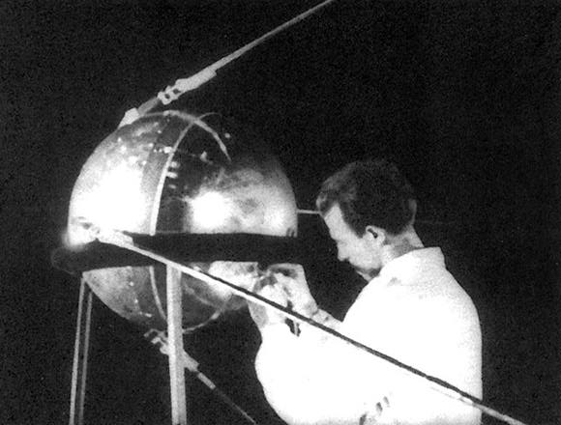
What was the “Space Race”?
Competition continued into space for the superpowers. The Soviets were the first to launch a satellite (Sputnik) into space in 1957. In response to the Soviet lead, the US strengthened its math and science educational programs.

Slide 44
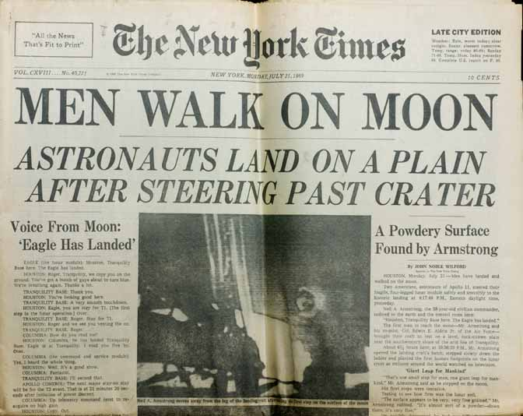
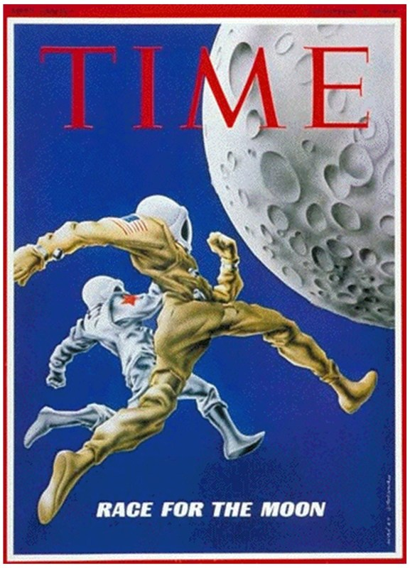
What was the “Space Race”?
The US created the National Aeronautics and Space Administration (NASA), soon launching its own satellite into space. The Americans were the first to land on the moon in 1969. Such competition between the superpowers would continue until the Cold War’s end in 1989.

Slide 45
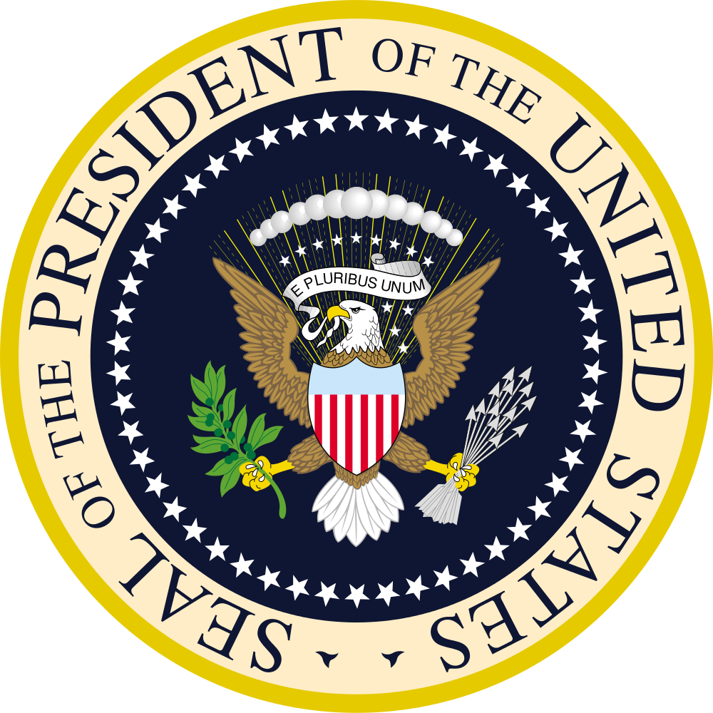
Top Secret Mission

Slide 46
Kennedy addresses the nation on the Cuban Missile Crisis, 1962

