Slide 1
Course of the Cold War
7-5.2

Slide 2
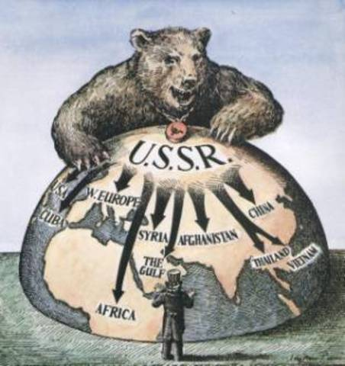
What were the tensions of the Cold War?
Tensions escalated as the Cold War mounted. The Soviet Union wanted to spread communism while the United States wanted to contain the spread of communism.

Slide 3
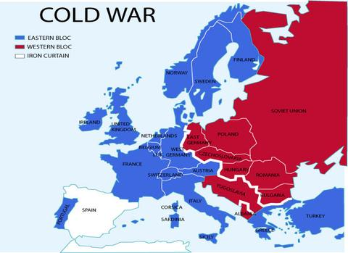

Slide 4
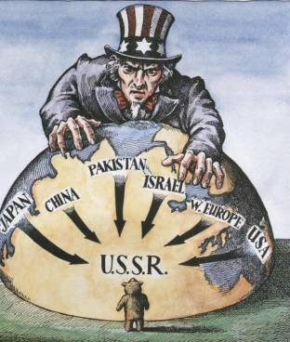
How did the U.S. attempt to contain communism?
President Harry Truman instituted several foreign policies based on giving ecomonic assistance to countries so they would not become communist.

Slide 5
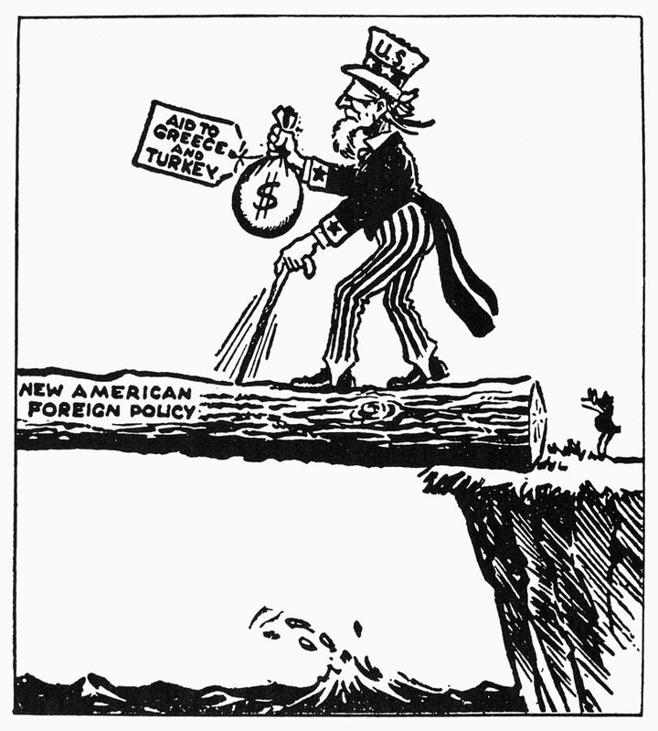
What were the economic assistance plans?
Truman Doctrine: A strategy use to return economic stability and success to countries in Western Europe countries so they would not fall to communism. The Truman Doctrine offered an alternative to communist support by infusing 400 million U.S. dollars in assistance to countries in Europe and proved to be very helpful.

Slide 6
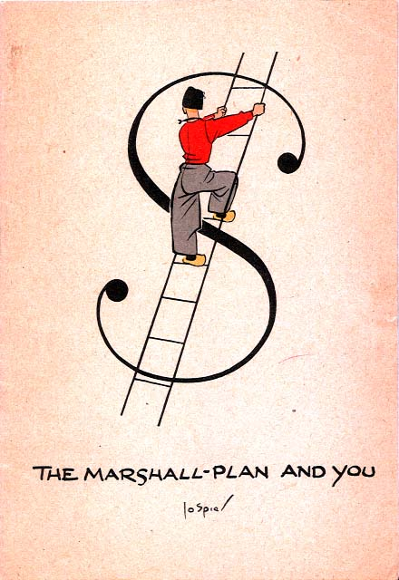
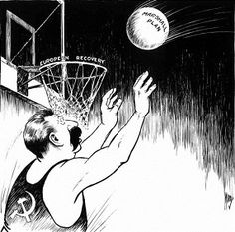
What were the economic assistance plans?
Marshall Plan: Another economic assistance plan that infused the region with 12.5 billion US dollars in reconstruction funds from US Congress to help revive Western Europe from the aftermath of World War II.

Slide 8
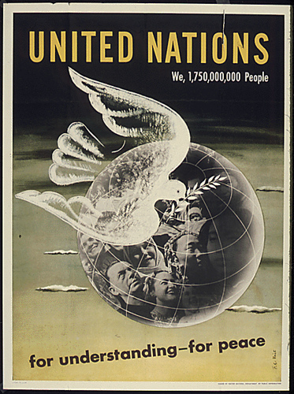
What else had changed since WWII?
Due to its failure to prevent another world war, the League of Nations was replaced in 1945 and became the United Nations. The purpose of the United Nations (UN) was the same of the League of Nations, which was to remain an international organization that would try to prevent future wars and settle conflicts globally.

Slide 9
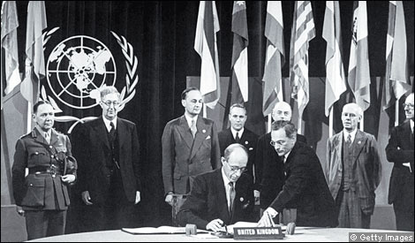
How did the UN differ from the League of Nations?
The UN would now have the ability to use military force if necessary to enforce their power in the world. The United States had also now joined the UN. The UN became instrumental in getting involved in some of the issues of the Cold War, such as
the division of Germany into
two nations, and the Korean
conflict.

Slide 11
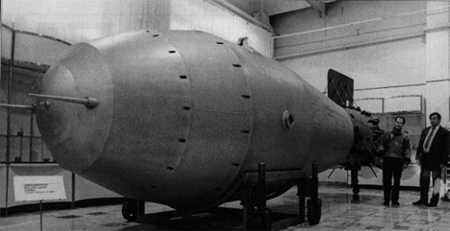
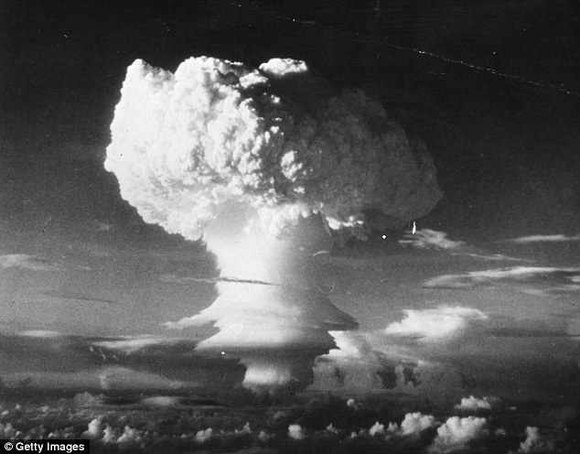
Why was the “Cold” War so scary?
The largest concern with the Cold War was its constant potential to instantaneously turn “hot” in a showdown between the two superpowers that had great probability of using atomic nuclear weapons with the capability of world-wide destruction.

Slide 12
Duck and Cover, 1951

Slide 14
What was the Berlin Airlift?
Beginning in 1948, the world saw the first “showdown” between the superpowers in Berlin. The partitioned German capital city became a political “hot spot” after the Soviets blocked access into Western Berlin (section occupied by Americans, British, and French, in order to drive Western/communist influences from the city).

Slide 15
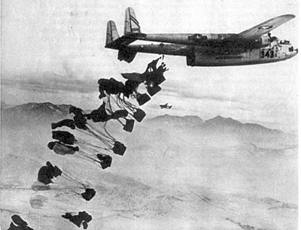
What was the Berlin Airlift?
The allied forces responded by airlifting supplies and food to the peaople of West Berlin for almost 11 months. The airlift proved successful.

Slide 16
What did the US learn from the Berlin Airlift?
After the tension and success of the airlift, the US decided it needed to protect iself and other democratic nations. In 1949, the US, Canada, and ten western European nations formed a military alliance called the North Atlantic Treaty Organization (NATO).

Slide 18
How did the Soviets respond to the creation of NATO?
The Soviet Union was threatened by the creation of NATO, and consequently built its own military alliance known as the Warsaw Pact. This organization included Poland, East Germany, Czechoslovakia, Bulgaria, Romania, and Albania.

