Slide 1
7-4.6 The Holocaust

Slide 2
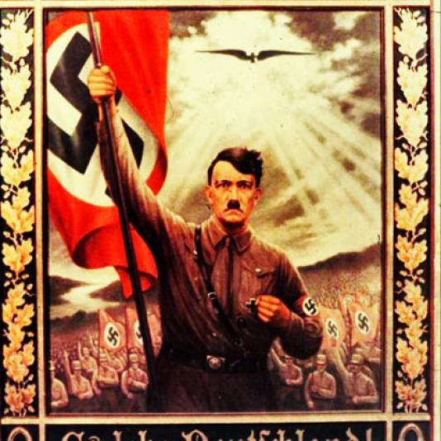
What was the Holocaust?
The Holocaust was a systematic plan of persecution and elimination of Jews and others considered “undesirable” that was coordinated by Hitler’s Nazi Party of Germany prior to and during World War II.

Slide 3
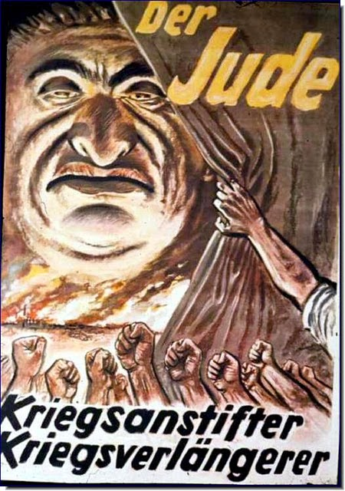
Why did it start?
The prejudice that caused the Holocaust was based on anti-Semitism (hatred of Jews). Religious and cultural differences coupled with suspicion and envy had made the Hebrew people frequent scapegoats during times of crisis throughout European history.

Slide 4
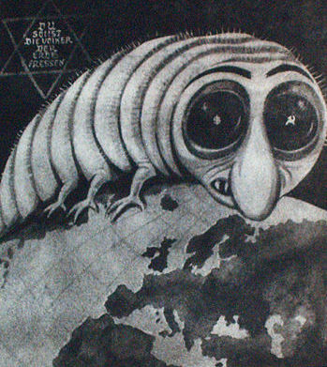
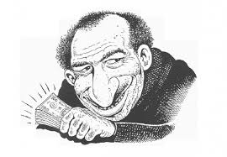
Why did it start?
As Jews moved into the mainstream of European life, the __________. Often Jews were stereotyped as intellectual, successful, and less nationalistic than others.

Slide 5
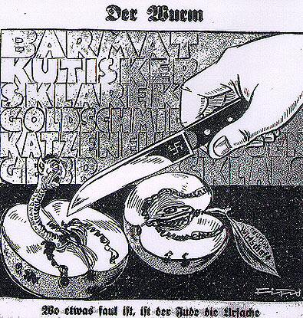
“Where something is rotten, the Jew is the cause”

Slide 6
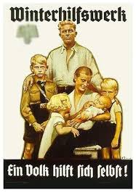
How did Hitler use anti-Semitism?
Hitler used anti-Semitism as a rallying point to unite the German people (first to recover the economy and then for empire, Aryan glory and world domination). Nazis claimed that all non-Aryan were inferior and he wanted to eliminate them.

Slide 7
Who were the victims?
The victims were those of Jewish ancestry, Poles, Russians, Communists, Gypsies, homosexuals, and anyone considered physically or mentally deficient.

Slide 9
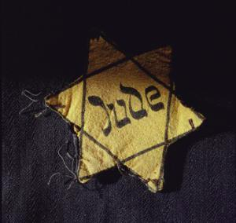
What were the Nuremberg Laws?
The Nazis passed the Nuremberg Laws in 1935, which denied Jews German citizenship and prevented them from marrying non-Jews. Jews were also ordered to wear the Star of David so they could immediately be recognized in public.

Slide 11
What happened on Kristallnacht?
On November 9, 1938 Nazi troops attacked Jewish businesses, synagogues, and homes and killed approximately 100 Jews. This nigh was known as Kristallnacht or “Night of Broken Glass”.

Slide 12
What happened to the Jews during the Holocaust?
Next, Jews were ordered to move into ghettos and lived in terrible conditions. Hitler’s “Final solution” forced Jews across Europe into concentration camps where many died en route in cattle cars, were exterminated in specially designed showers and crematoriums or through brutal experiments, or barely survived work camps.

Slide 14
What happened at concentration camps?
Most camps were located in Germany and Poland. When prisoners arrived at the concentration camps, they were examined by SS doctors. The Nazi soldiers allowed the strong (mainly men) to live in order to serve as laborers. Many of the women, elderly, young children, and the disabled were killed.

Slide 15
How many died?
The genocide (systematic killing of a specific group) killed well over six million Jews (about 2/3rds of Jewish population in Europe). The total fatalities in the Holocaust ranged from 11-17 million souls lost.

Slide 16
What happened at the Nuremberg Trials?
The Nuremberg Trials conducted in 1945-1946, tried ____ “crimes against humanity”. An international Military Tribunal, representing 23 countries, conducted the trial and 10 of the leaders were hung and their bodies burned at a concentration camp.

