Slide 1
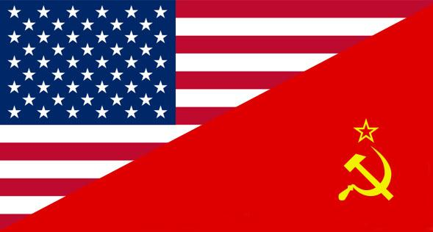
Origins of the Cold War
7-5.1

Slide 2
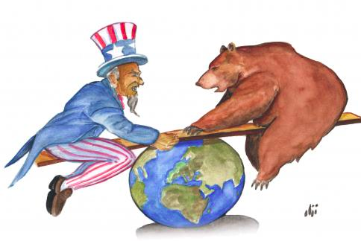
Who were the 2 superpowers of the Cold War?
The United States and the Soviet Union (also known as the Union of Soviet Socialist Republics or “USSR”)

Slide 3
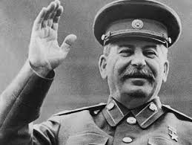
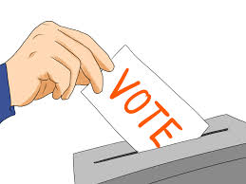
What were the political differences between the U.S. and the Soviet Union?
As WWII closed there were distinct differences between the United States and the Soviet Union. Politically, the United States had a limited government in the form of a representative democracy or constitutional government, while the Soviet Union had an unlimited government in the form of a communist state.

Slide 4
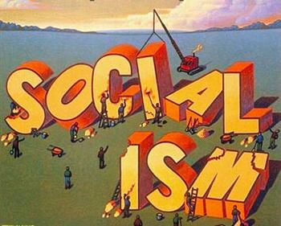
What were the economical differences between the U.S. & Soviet Union?
United States had a capitalist economy (free market & private ownership) while the Soviet Union had a socialist economy (no private ownership & redistribution of wealth).

Slide 5
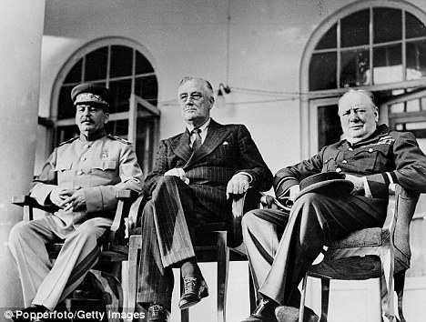
When did tensions of the Cold War begin?
Even before WWII ended, tensions began to develop among the Big Three Allied leaders (Franklin D. Roosevelt- U.S., Winston Churchill- Great Britain, & Joseph Stalin- Soviet Union) as they discussed the post-WWII world.

Slide 6
How did Roosevelt and Churchill differ from Stalin?

