Slide 1
Photo by Tony Fischer Photography - Creative Commons Attribution License https://www.flickr.com/photos/22714323@N06
Created with Haiku Deck

Slide 2
Photo by Tony Fischer Photography - Creative Commons Attribution License https://www.flickr.com/photos/22714323@N06
Created with Haiku Deck

Slide 3
Photo by Tony Fischer Photography - Creative Commons Attribution License https://www.flickr.com/photos/22714323@N06
Created with Haiku Deck

Slide 4
Photo by svaboda! - Creative Commons Attribution License https://www.flickr.com/photos/27010152@N06
Created with Haiku Deck

Slide 5
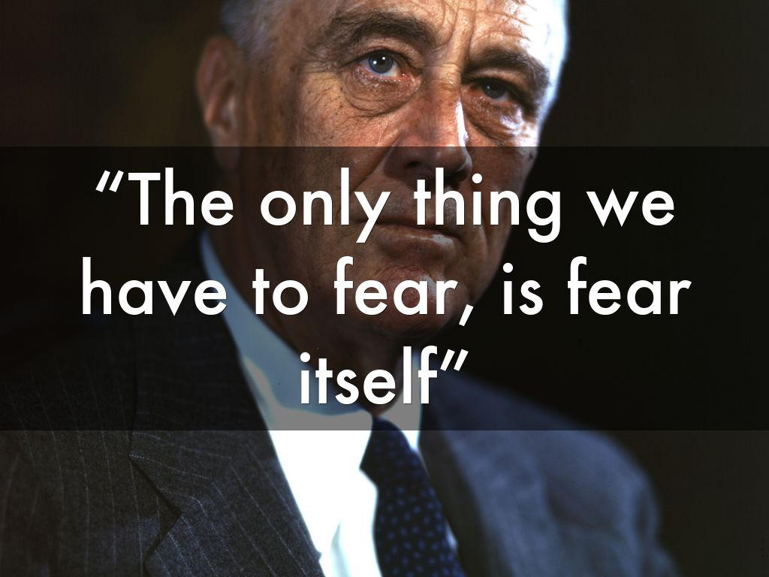
Photo by FDR Presidential Library & Museum - Creative Commons Attribution License https://www.flickr.com/photos/54078784@N08
Created with Haiku Deck

Slide 9
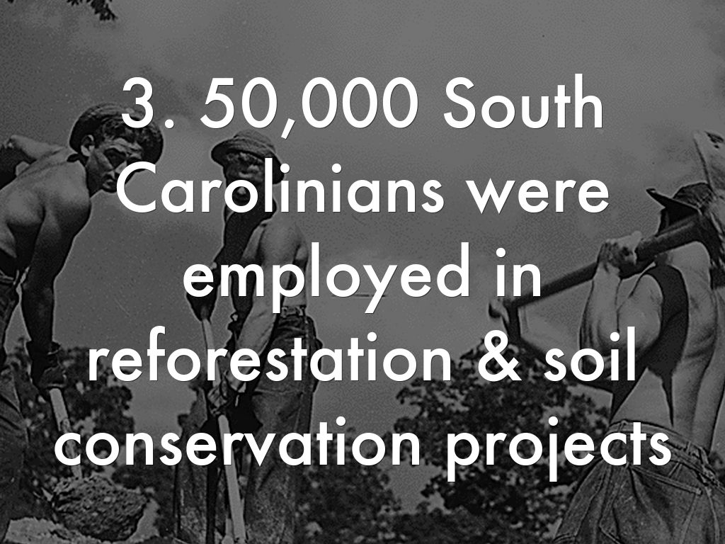

Slide 15
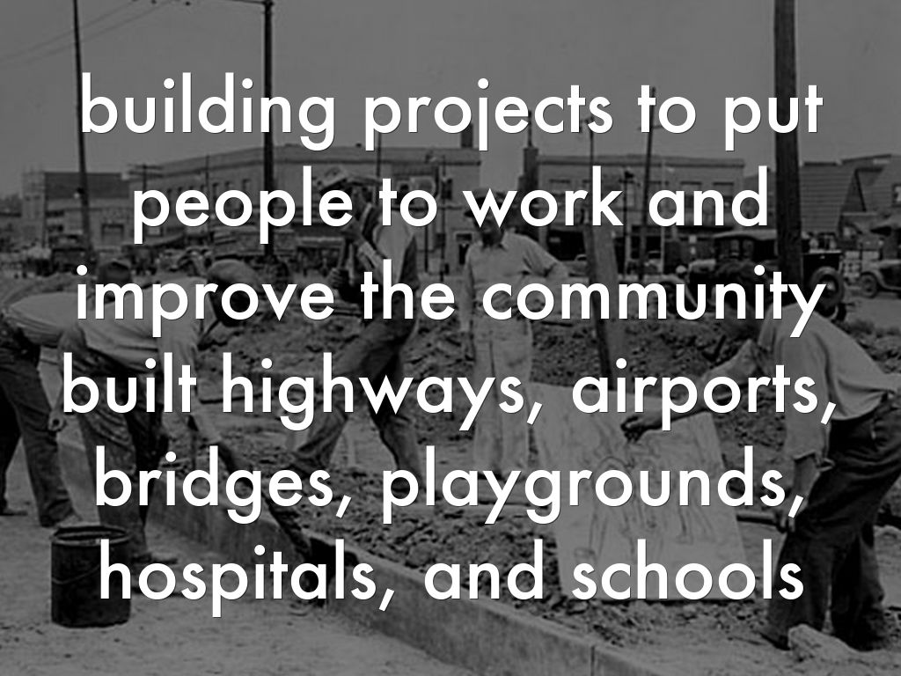

Slide 18
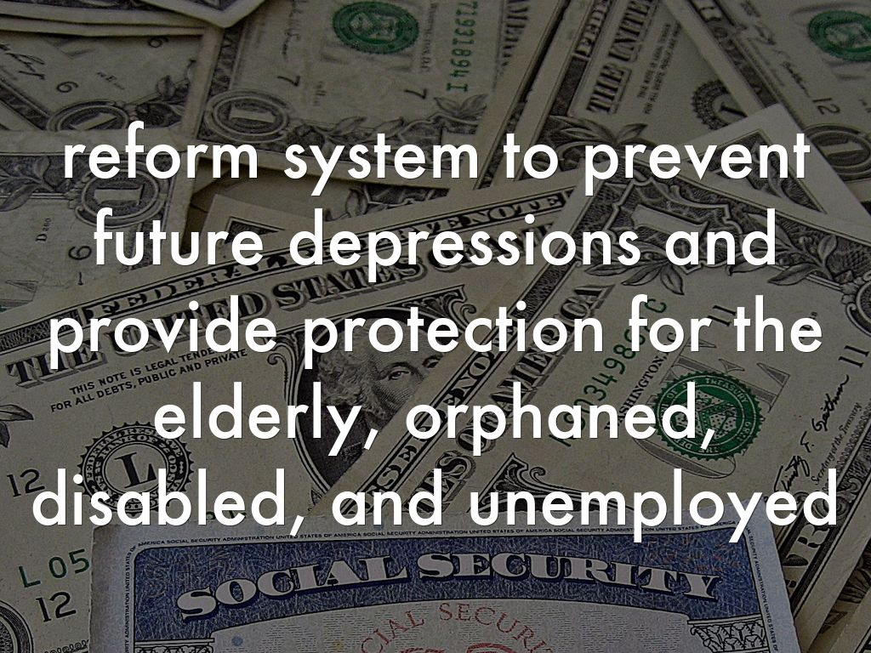
Photo by 401(K) 2013 - Creative Commons Attribution-ShareAlike License https://www.flickr.com/photos/68751915@N05
Created with Haiku Deck

Slide 19
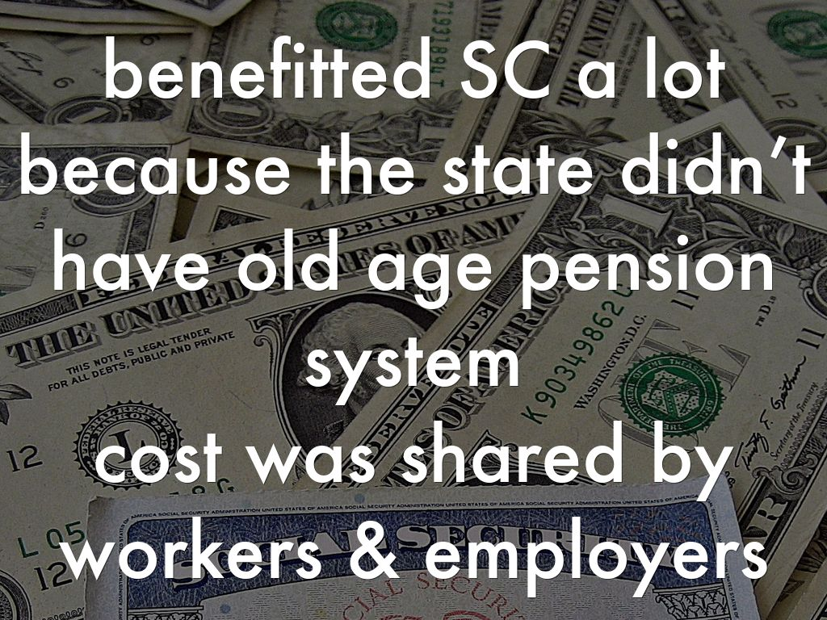
Photo by 401(K) 2013 - Creative Commons Attribution-ShareAlike License https://www.flickr.com/photos/68751915@N05
Created with Haiku Deck

Slide 20
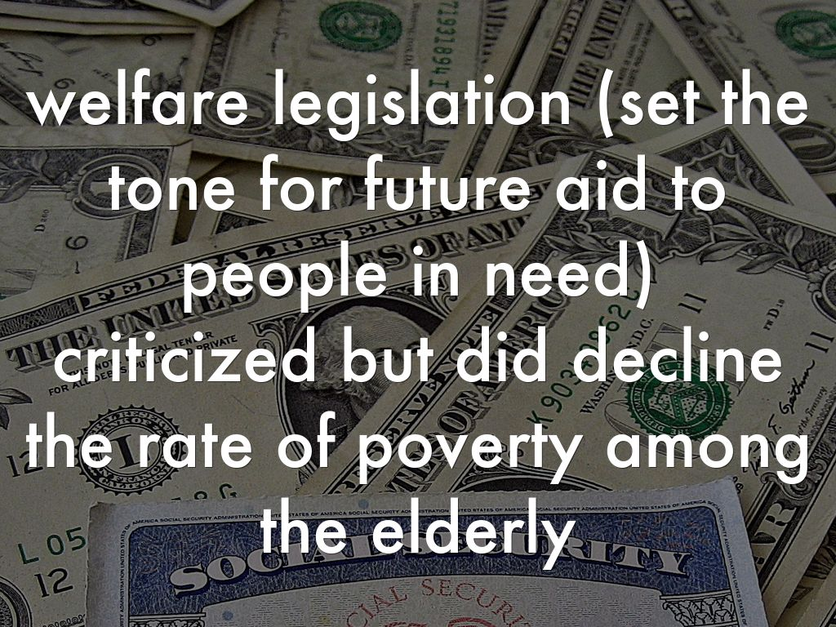
Photo by 401(K) 2013 - Creative Commons Attribution-ShareAlike License https://www.flickr.com/photos/68751915@N05
Created with Haiku Deck

Slide 21
Photo by AFGE - Creative Commons Attribution License https://www.flickr.com/photos/79684288@N00
Created with Haiku Deck

Slide 22
Photo by Thad Roan - Bridgepix - Creative Commons Attribution License https://www.flickr.com/photos/80651083@N00
Created with Haiku Deck

Slide 23
Photo by Thad Roan - Bridgepix - Creative Commons Attribution License https://www.flickr.com/photos/80651083@N00
Created with Haiku Deck

Slide 26
Photo by John Collier Jr. - Creative Commons Attribution-NonCommercial License https://www.flickr.com/photos/70882784@N00
Created with Haiku Deck

Slide 28
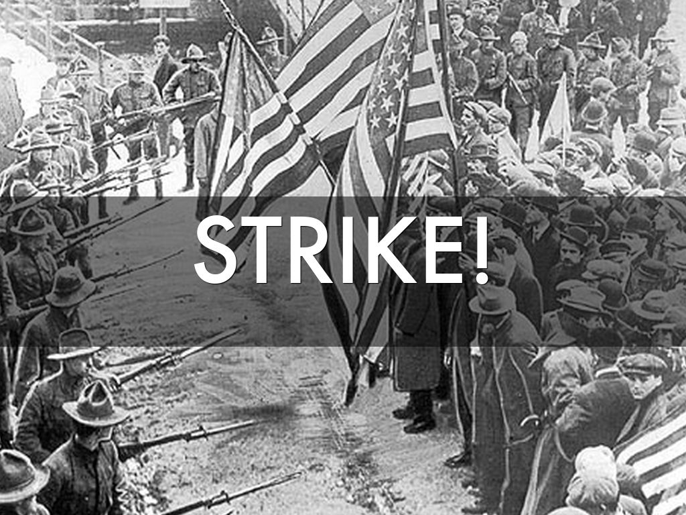

Slide 29
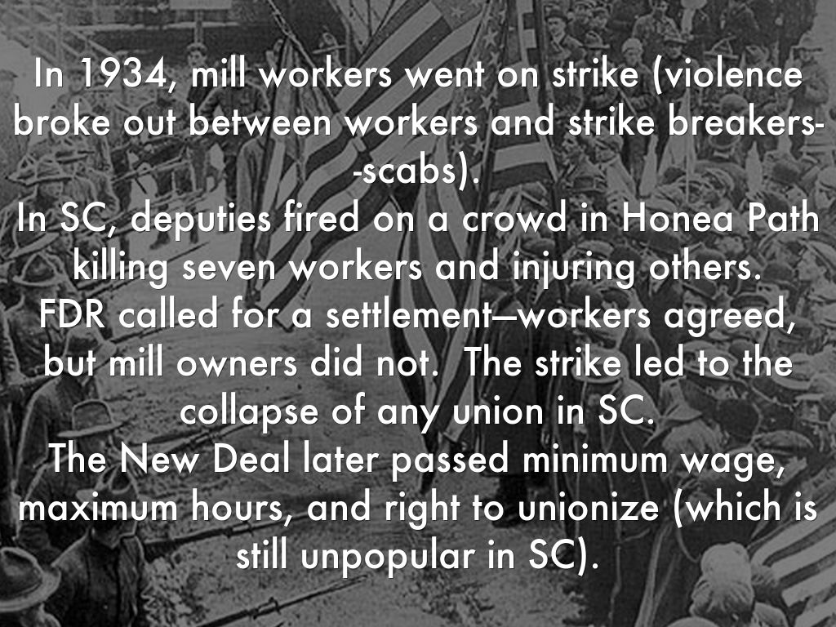

Slide 30
Photo by Black History Album - Creative Commons Attribution-NonCommercial-ShareAlike License https://www.flickr.com/photos/11047904@N08
Created with Haiku Deck

Slide 31
Photo by daystar297 - Creative Commons Attribution License https://www.flickr.com/photos/20587522@N00
Created with Haiku Deck

Slide 33
Photo by FDR Presidential Library & Museum - Creative Commons Attribution License https://www.flickr.com/photos/54078784@N08
Created with Haiku Deck

Slide 36
Photo by Don Hankins - Creative Commons Attribution License https://www.flickr.com/photos/23905174@N00
Created with Haiku Deck

Slide 37
Photo by Don Hankins - Creative Commons Attribution License https://www.flickr.com/photos/23905174@N00
Created with Haiku Deck

